Slide 1
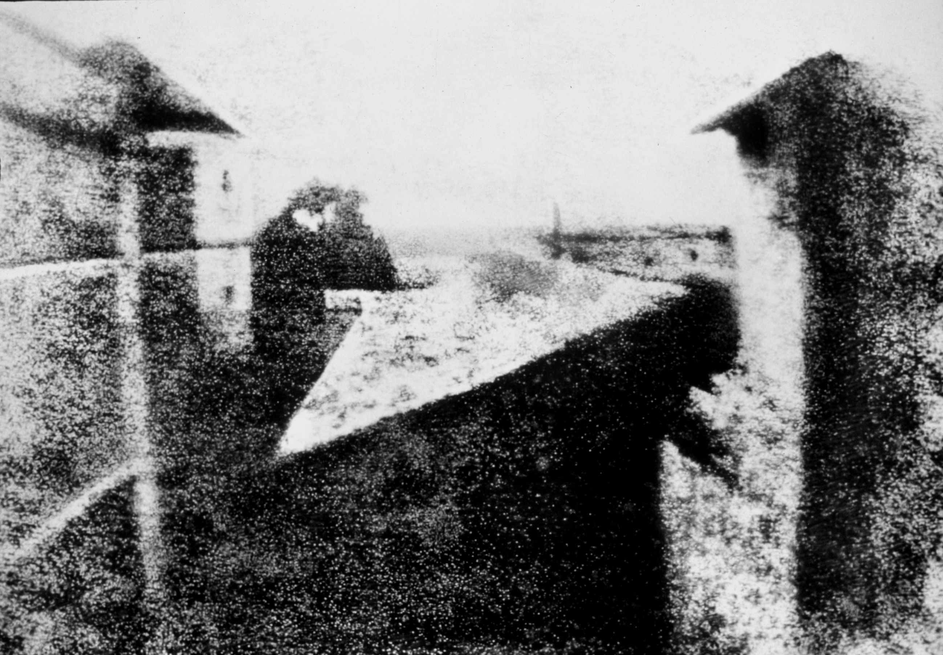
ORIGINS OF PHOTOGRAPHY
Joseph Nicéphore Niépce View from a Window at Le Gras, 1827

Slide 2
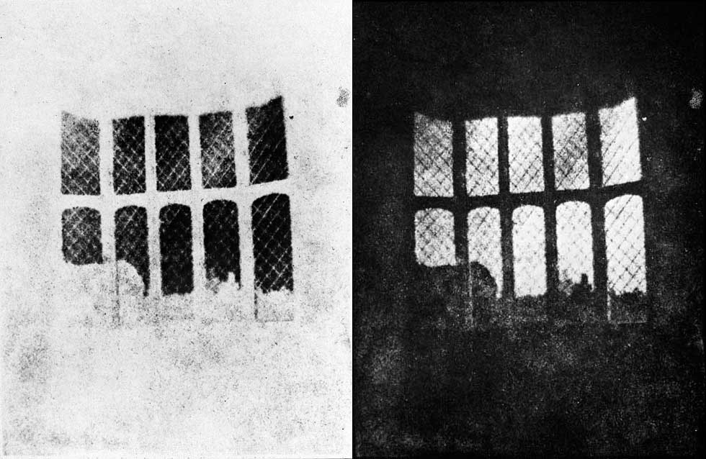
William Henry Fox Talbot Latticed Window, 1835

Slide 3
What did the invention of photography do for artists?

Slide 4
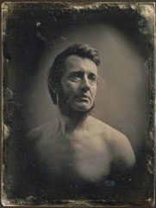
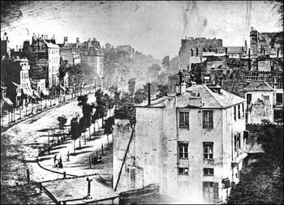
It liberated them from having to depict reality.
What could they consider instead?

Slide 5
mood & atmosphere
emotions
abstract interpretations of light, movement…
abstract concepts of the internal psyche
distortions of space
the changing qualities of light
…to name a few

Slide 6
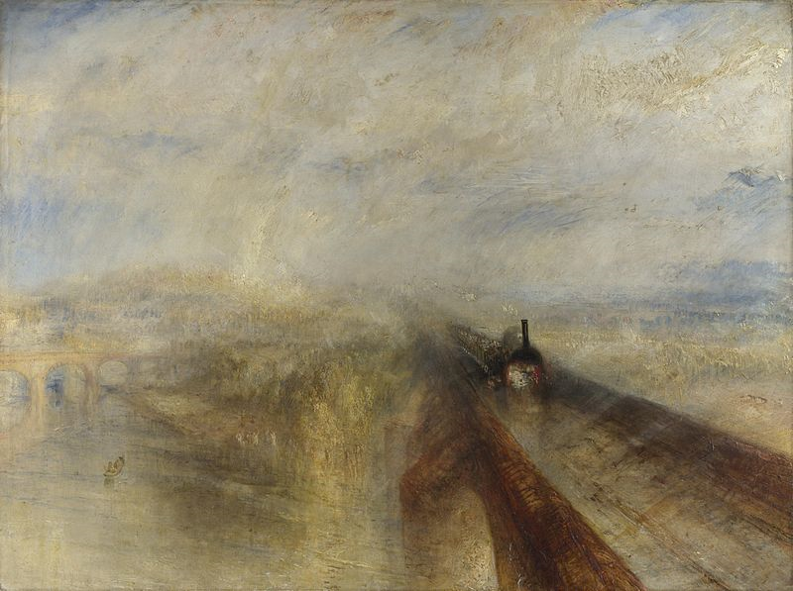
This is what Turner was doing when Photography was beginning to take off.
JMW Turner, Rain, Steam and Speed – The Great Western Railway 1844, oil on canvas.

Slide 7
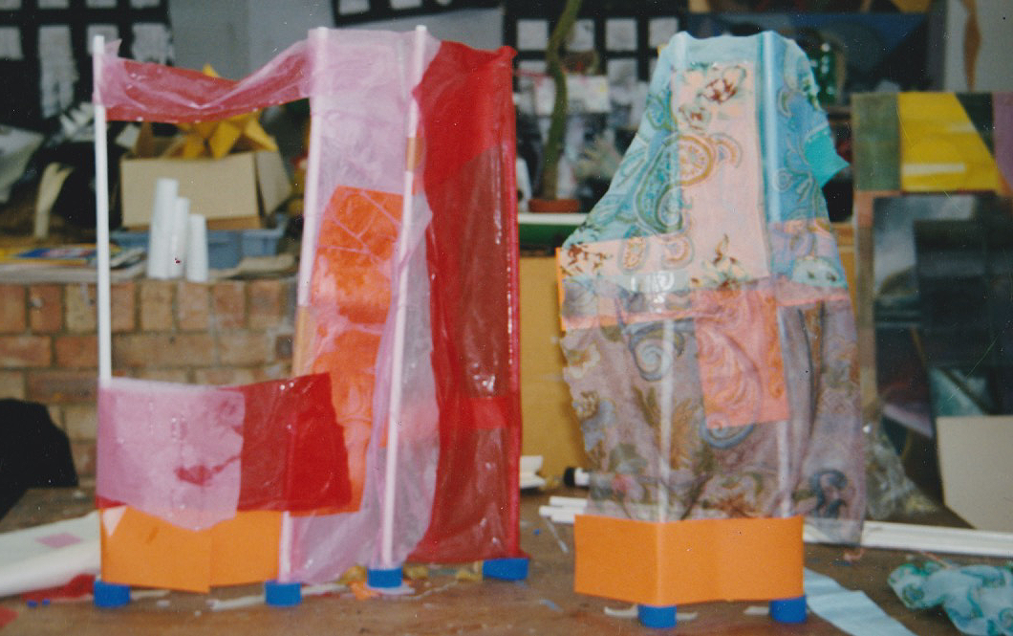
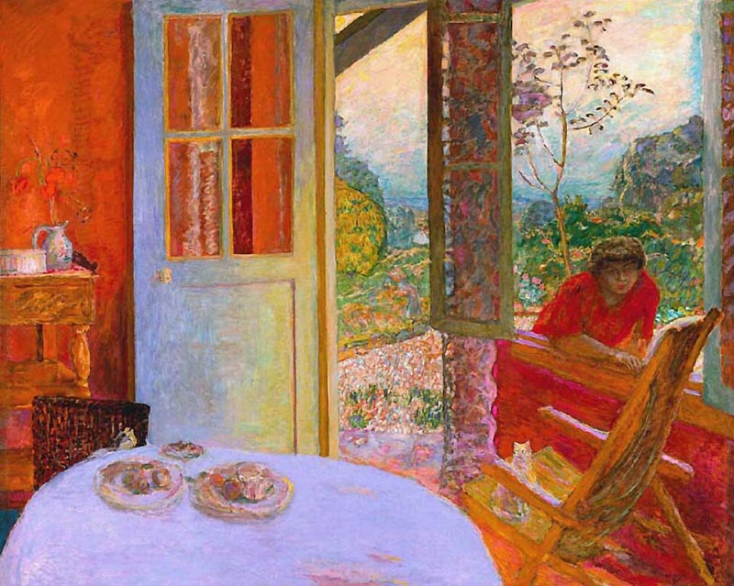
Task: Recreate a section of a Turner painting using the materials available.
This example recreates a section from the Pierre Bonnard painting below
Consider:
translucency of layers
transitions between colours
shape and form
structure
mark making
Do not be literal, be interpretative
Pierre Bonnard, The Dining Room in the Country, 1913

Slide 8
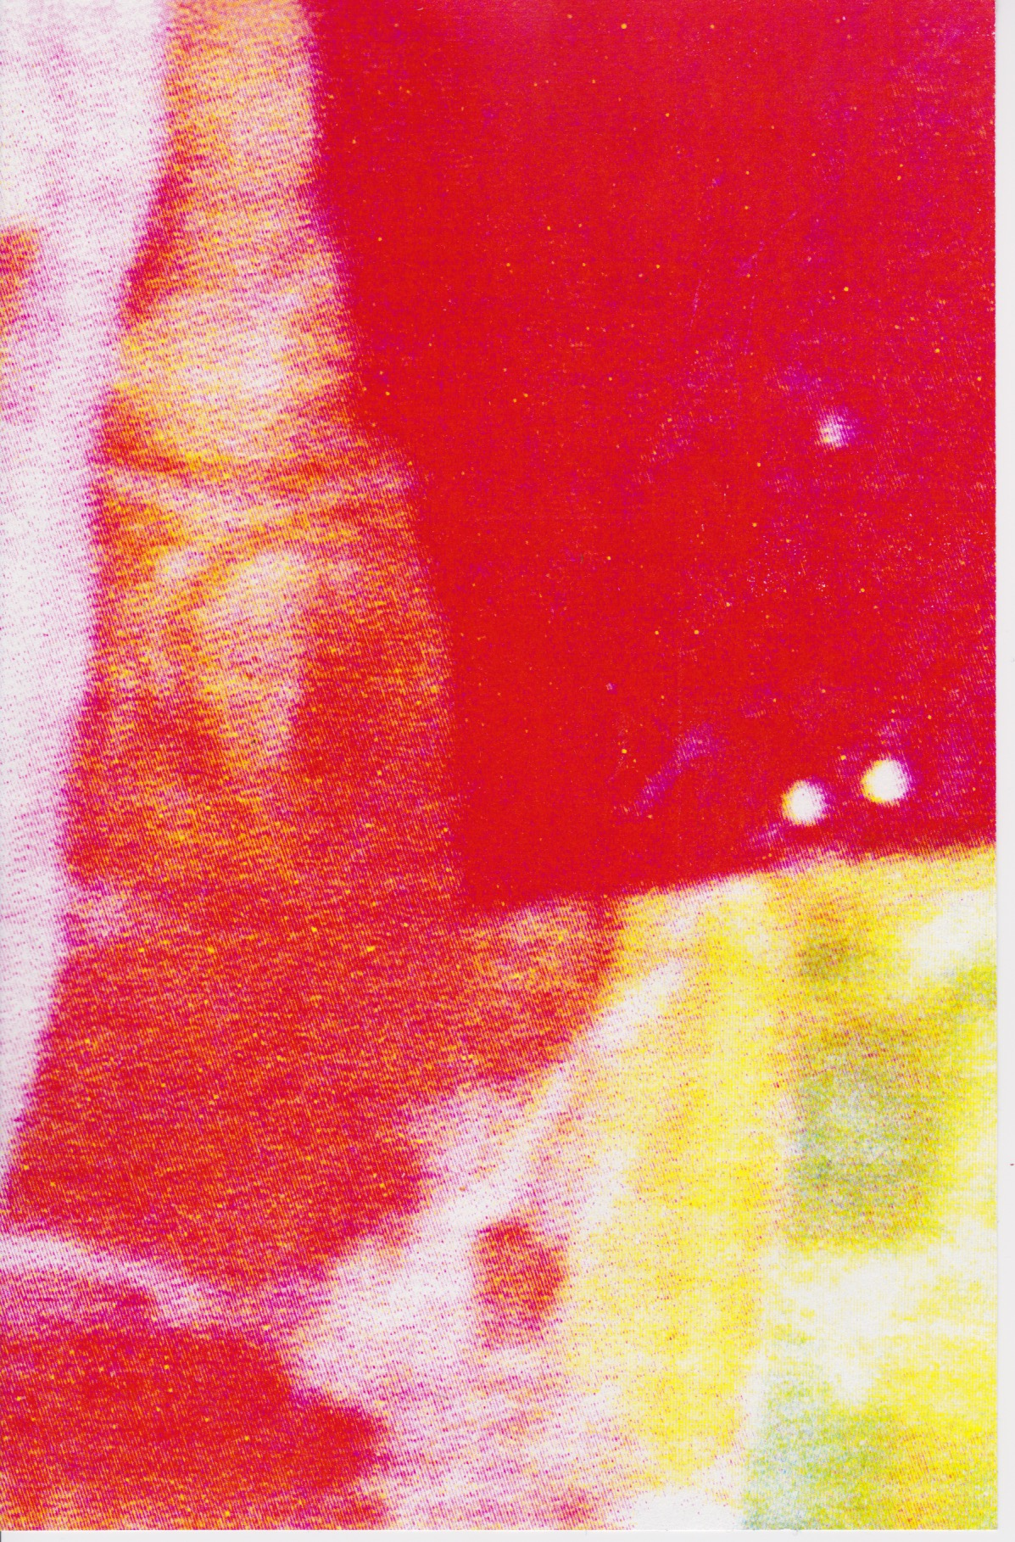
Photograph sections of the piece on your mobile phone.
Enlarge and crop the image.
Use a range of filters and editing effects to alter the image.
Save several versions and print.

Slide 9
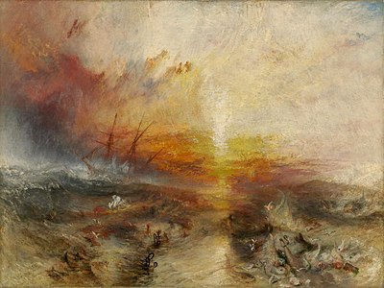
JMW Turner, The Slave Ship, 1840

Slide 10
JMW Turner, Rain, Steam and Speed – The Great Western Railway, 1844

Slide 11
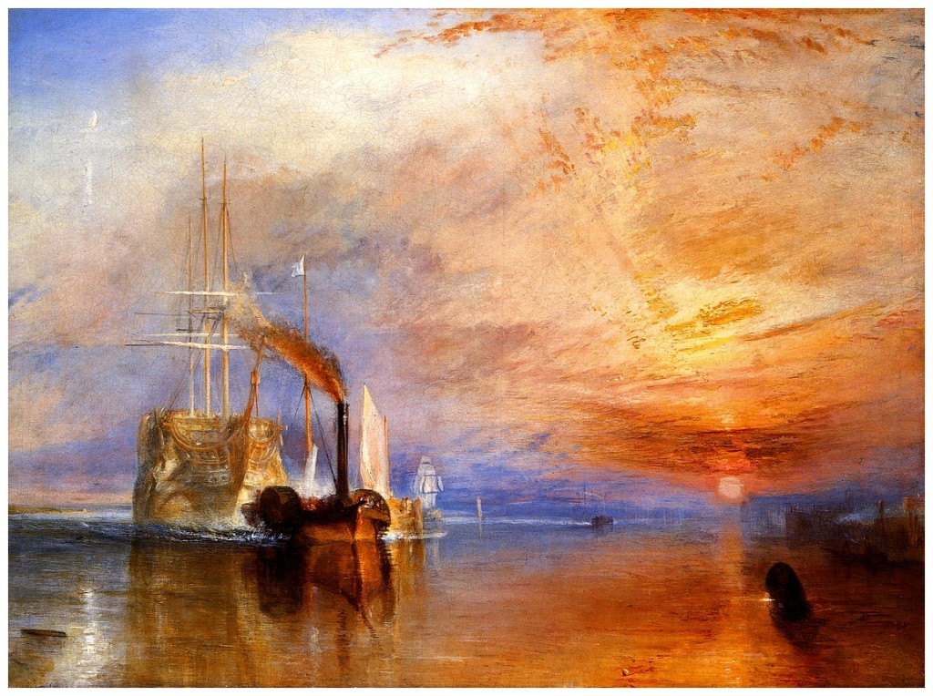
JMW Turner, The Fighting Temeraine, 1839

