Slide 1
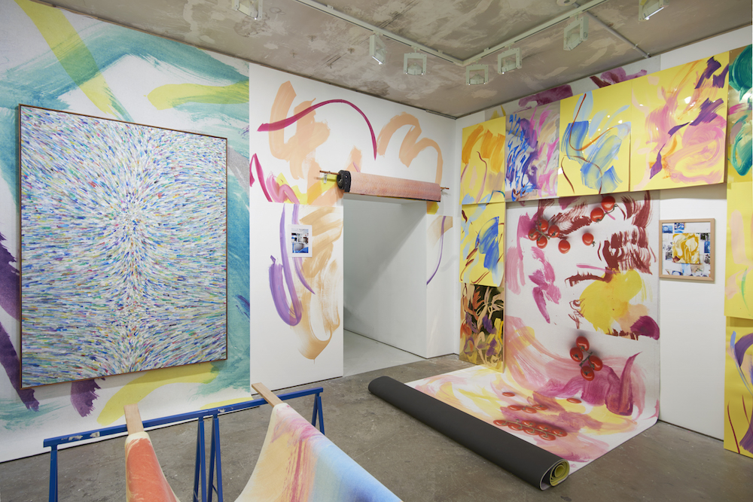
Task 3: Expressive Mark Making

Slide 2
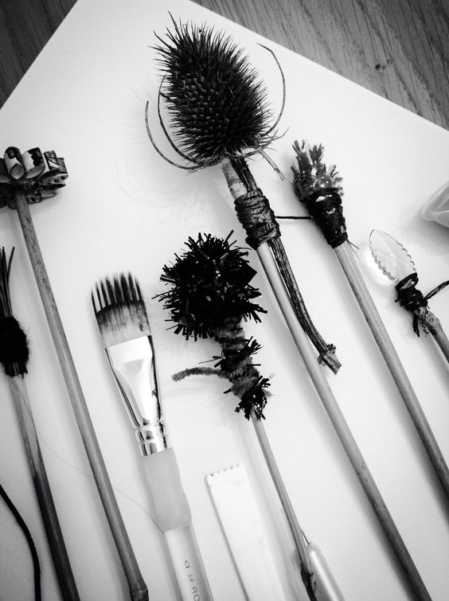
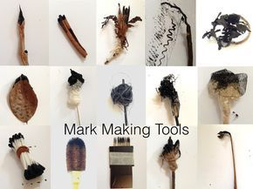
Make your own tools
Unorthodox brushes can create exciting marks in a drawing. These marks can, in turn, give a drawing an added depth or texture that couldn’t be achieved with a conventional brush.
Use the materials provided to create your own drawing tools.

Slide 3
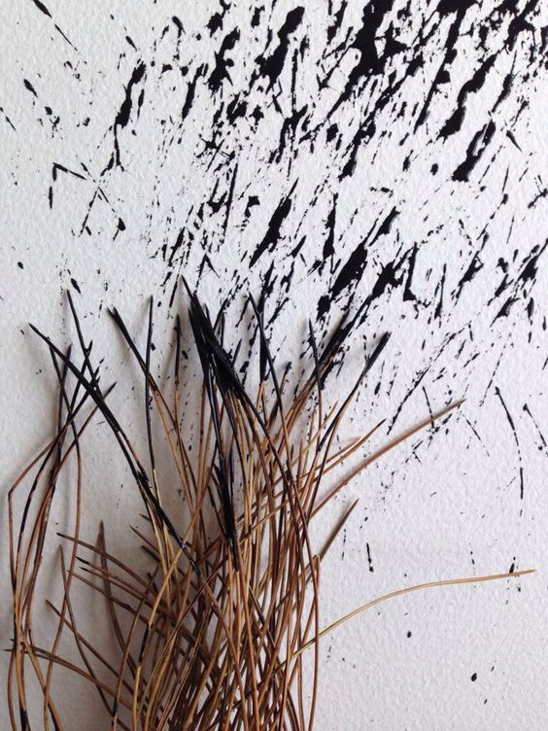
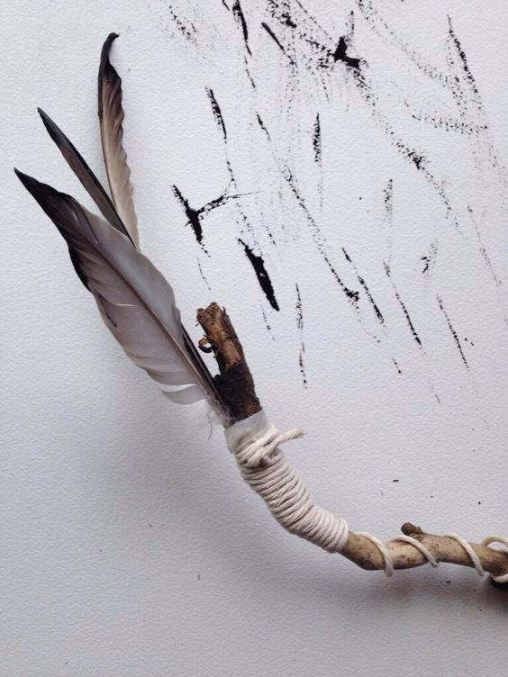
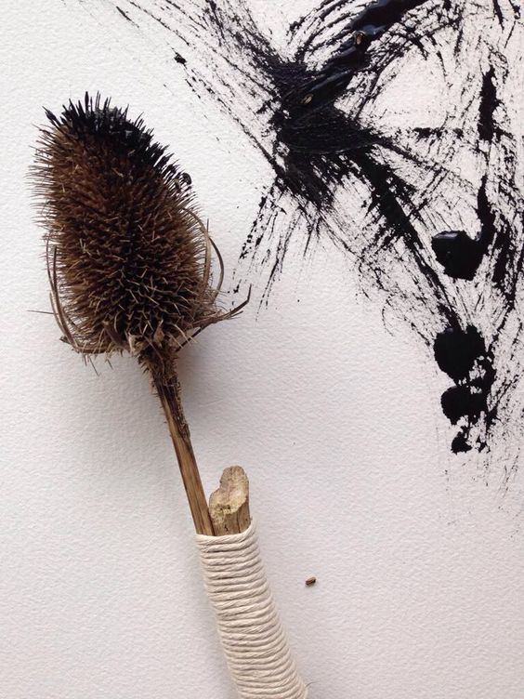
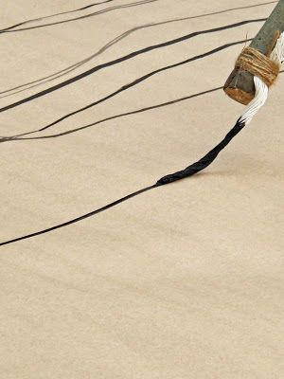
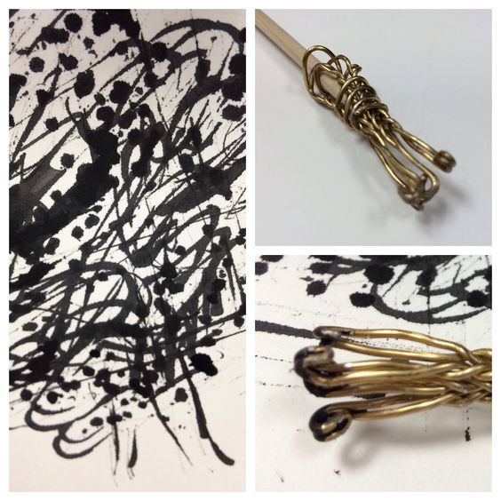
Explore mark making
Use the inks & paint provided to explore the types of marks your DIY tools can create.
Also explore using different concentration of ink / paint.
In your sketchbook

Slide 4
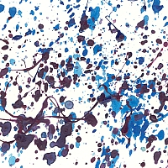
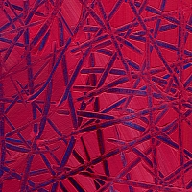
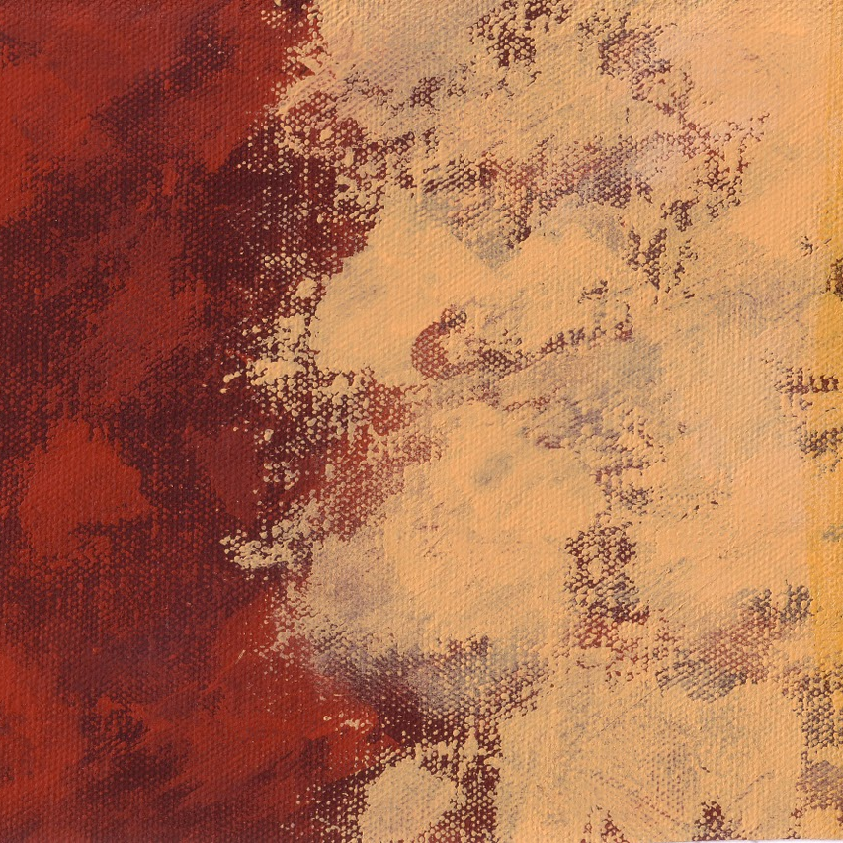
Explore these different painting techniques.
Experiment with different colour combinations and paints
Spattering is a technique where the paint is being sprayed or flicked onto the surface of a painting using either a paint brush, toothbrush or a spray diffuser.
Sgraffito (from Italian "graffiare") means to scratch into the paint to reveal areas of the surface underneath.
Scumbling is a painting technique for dry brushing a layer of broken colour over another colour.
Stippling is a technique when the brush is used end on.
Don’t forget to label your experiments and explain the process….

Slide 5
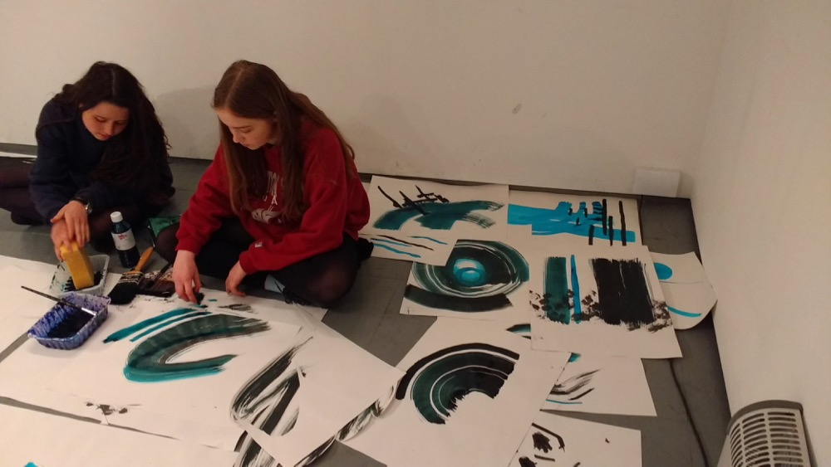
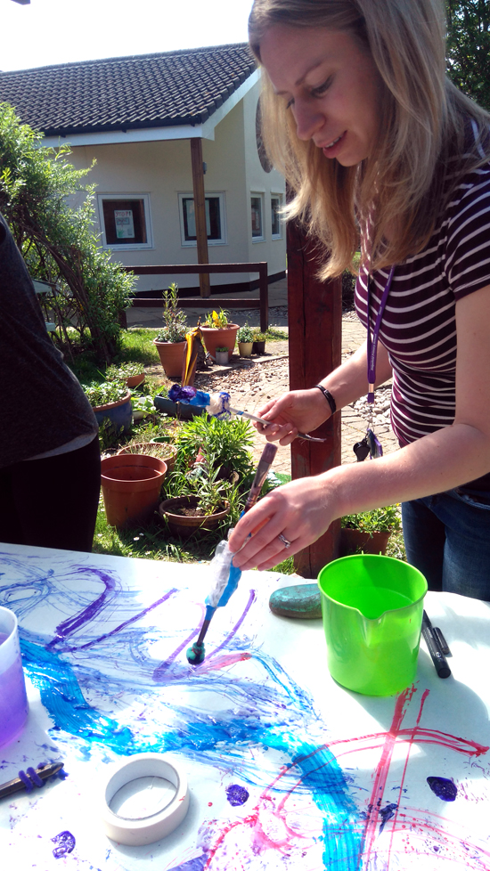
COLLABORATE
Step 1:
Select shapes and/or sections from any work you have completed in this project so far.
Use your unorthodox tools and the materials available to paint these selections on the large paper provided.
You can paint more than one and overlap shapes if you wish.

Slide 6
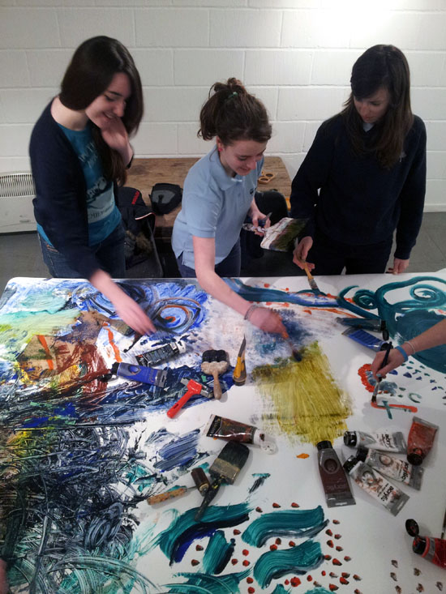
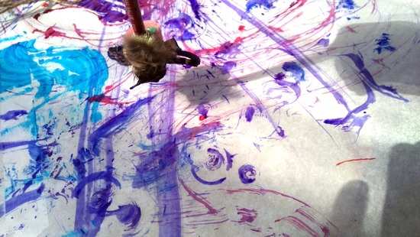
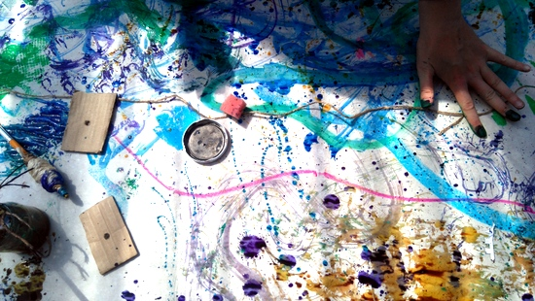
Step 2:
Enjoy a conversation with marks instead of words. Explore expressive mark making in response to the shapes created by each other.
Move around the piece.
Yes, we want you to work over and around each others paintings.

Slide 7
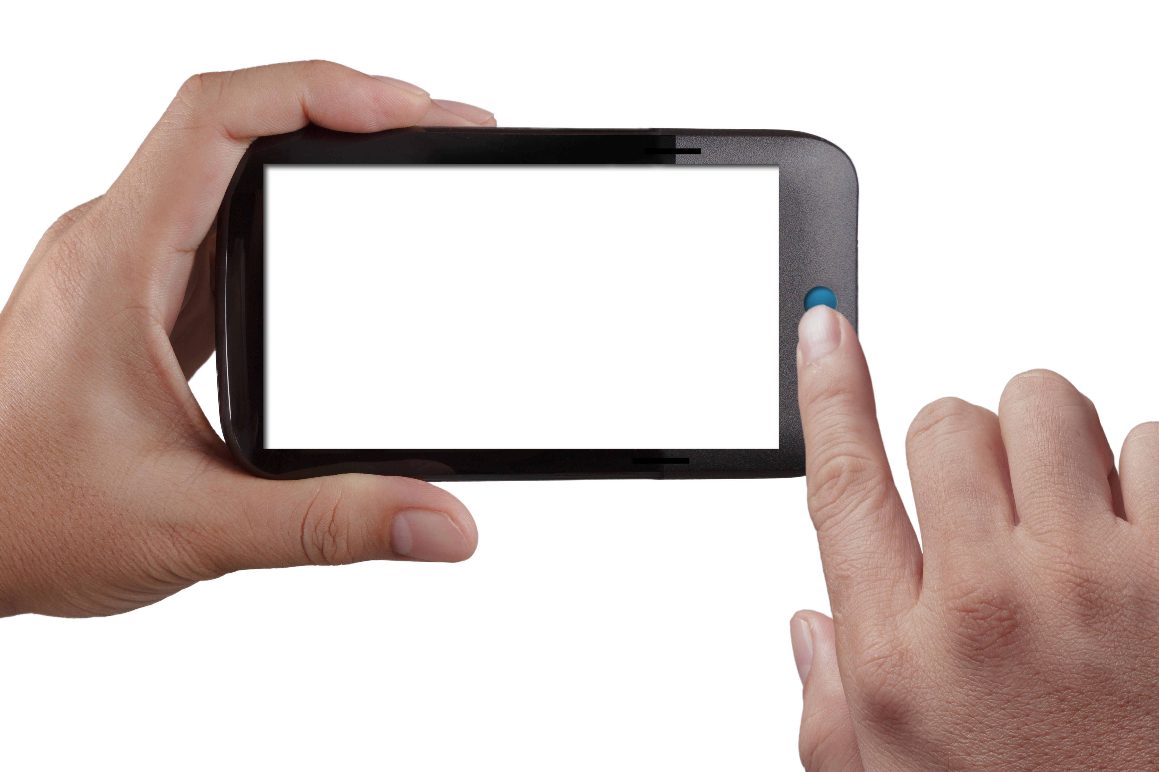
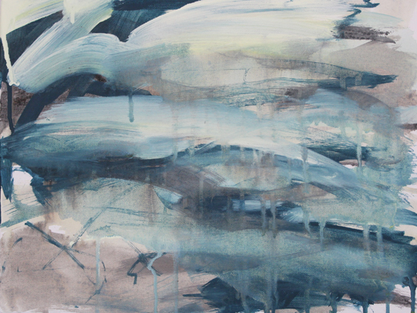
Use your phone to photograph successful sections…
What determines success?
How do you know?
What is your criteria? Write it down.

Slide 8
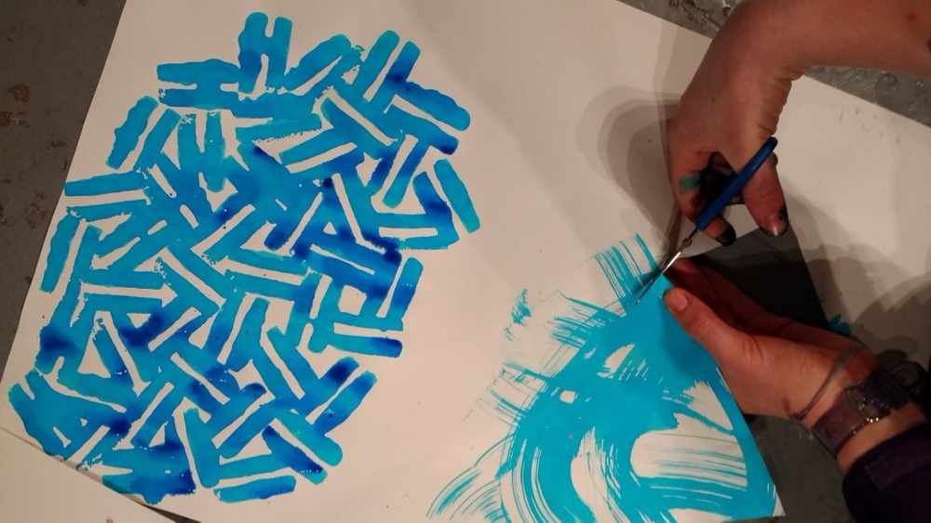
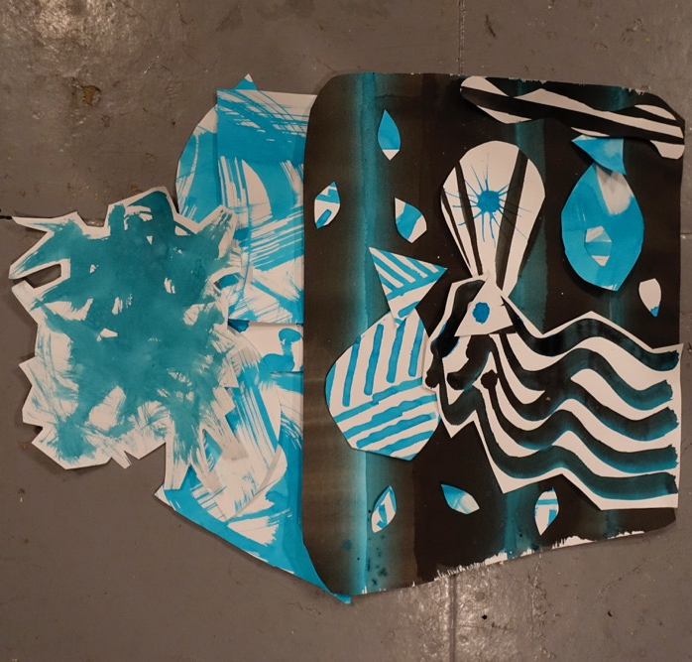
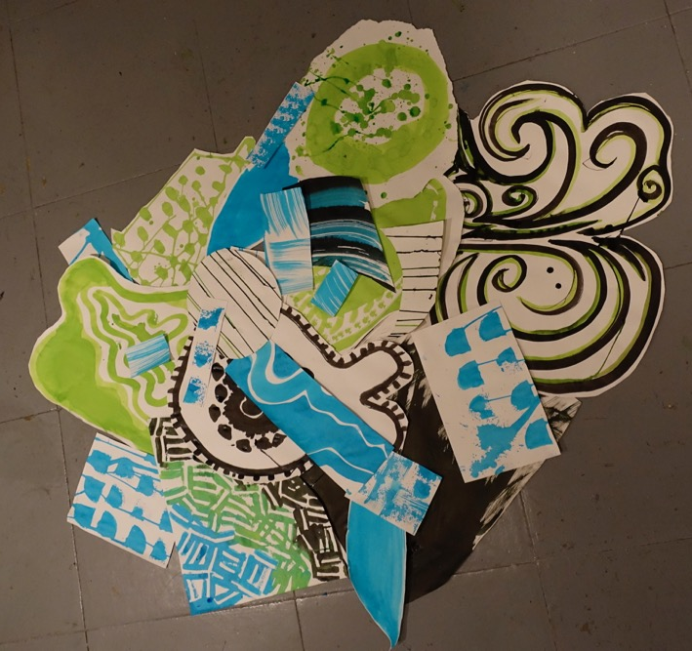
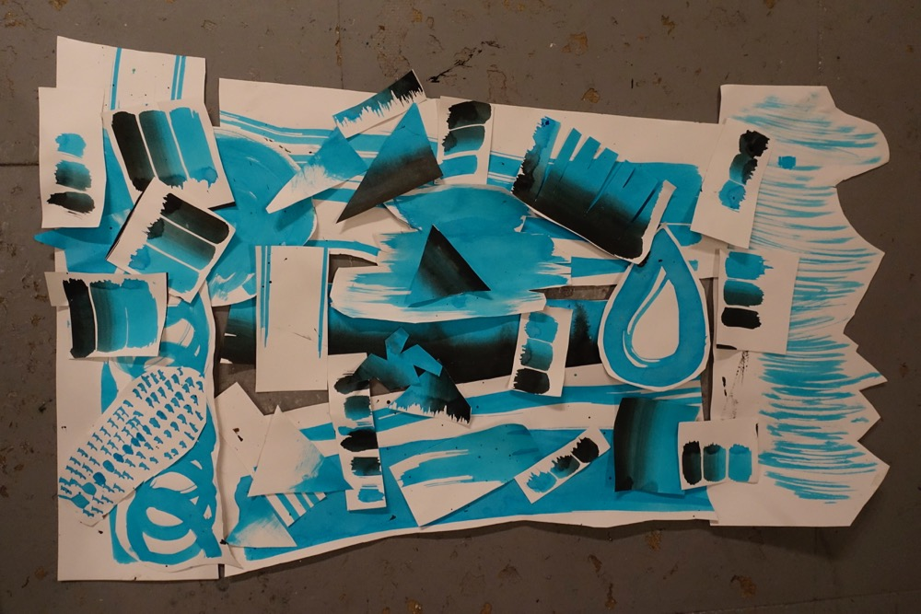
Step 3:
Cut out shapes and patterns and arrange them on paper or on the floor.
Work together to make decisions- question your selection and choices.
How will you document this dialogue / process?
PHOTOGRAPH

Slide 9
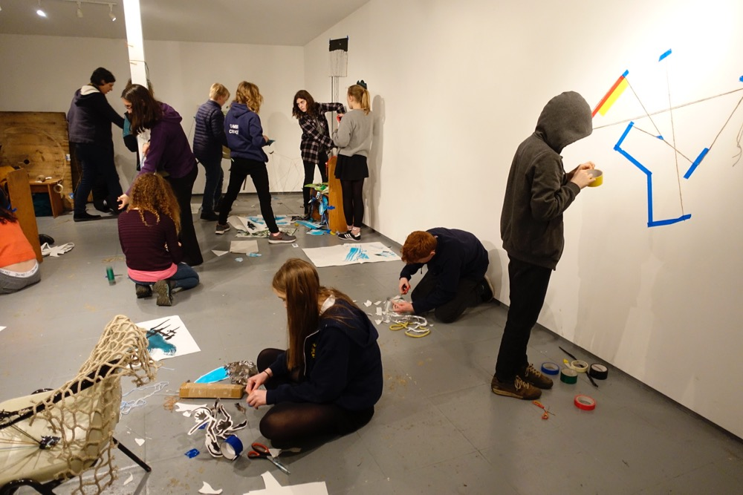
Step 4: Drawing into Space
Respond to the painting experiments using the entire room as your canvas. Create three-dimensional drawings from tape, string and paper. Include parts of the collaborative painting as appropriate.

Slide 10
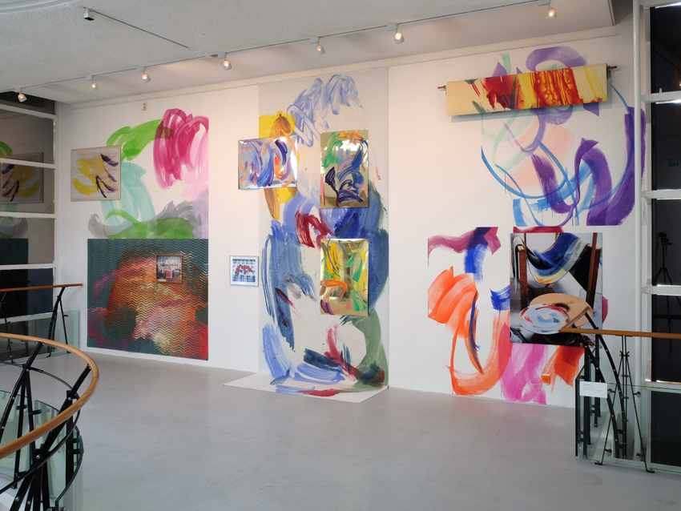
Look at work by Peggy Franck

Slide 11
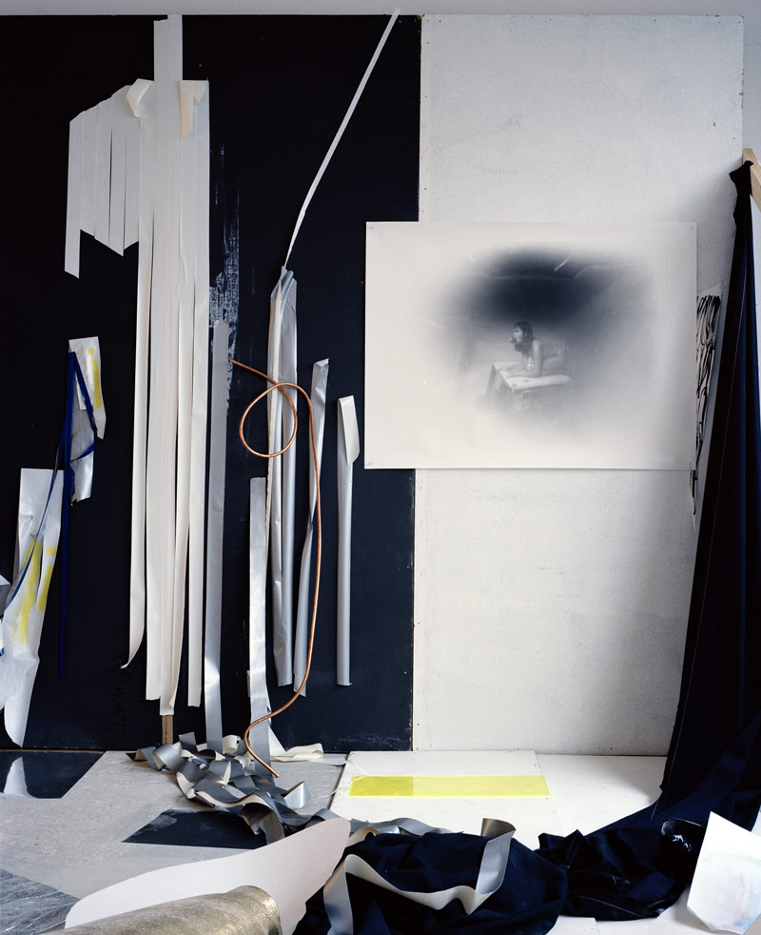
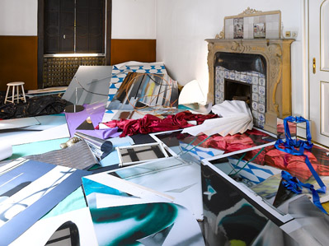
Peggy Franck (born 1978) is a young Dutch artist working with different media, photography, paintings, installations. Her work is based on her practice in the studio mixing everyday objects with materials such as Plexiglas, mirror, tape etc. She knows how to skillfully mix references for the viewers, is it a painting, a photograph, an abstract installation, her studio, or another place?

Slide 12
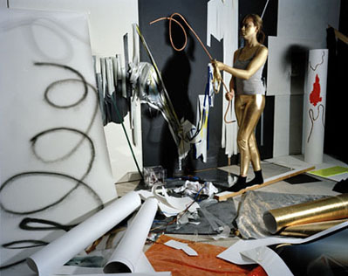
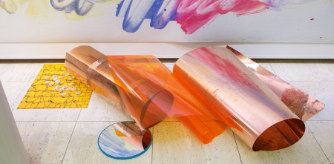
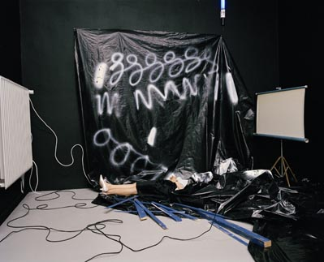
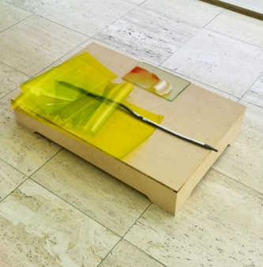

Slide 13
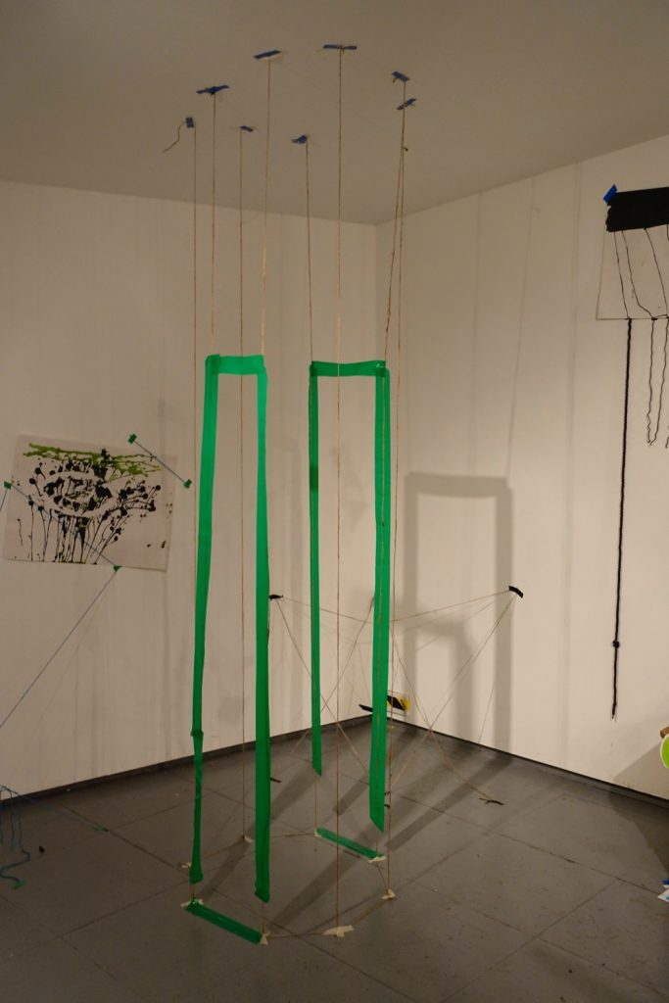
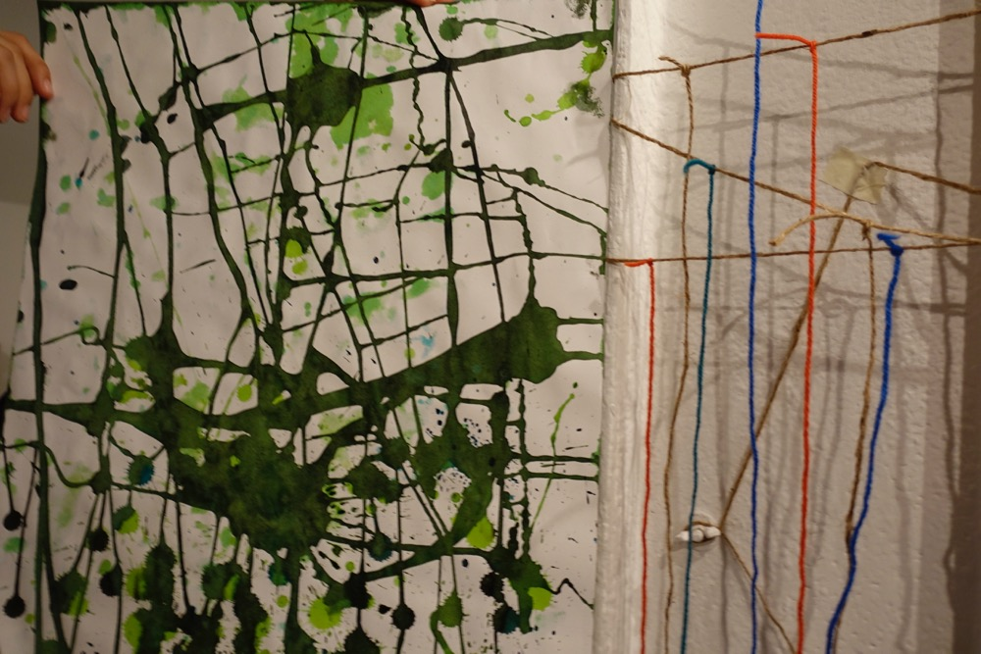
Maintain an awareness of what others are making. Develop a sense that you are creating this work together.
For example, you might like to work with someone else, to create pathways or negative spaces between the pieces, or visually relate your work to something happening next to it or on the other side of the room.

Slide 14
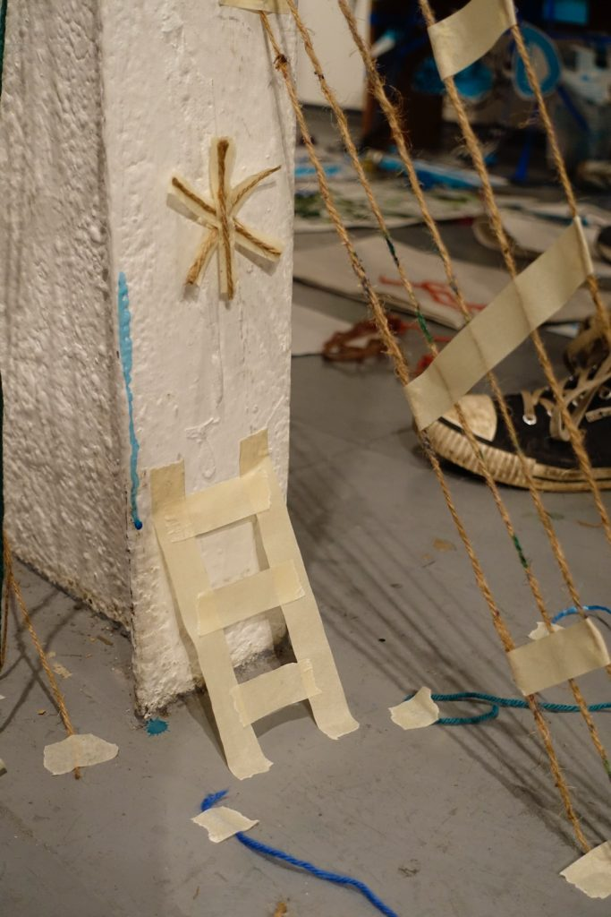
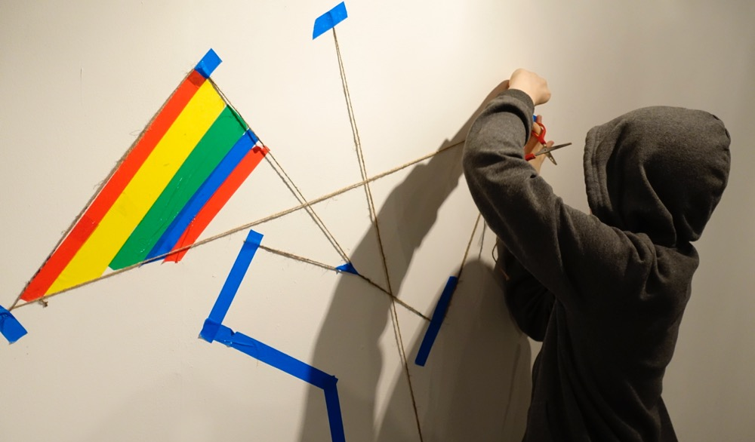
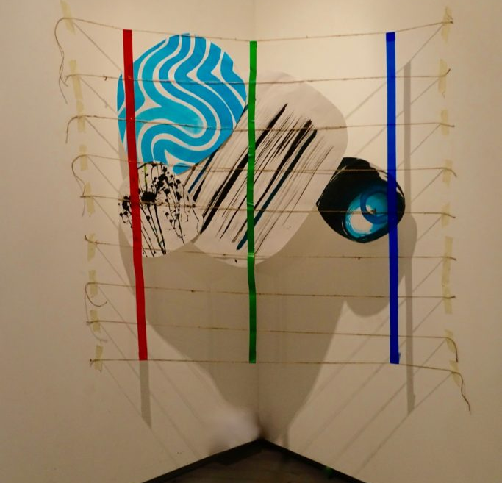

Slide 15
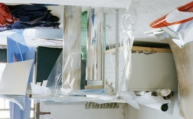
Use your phone to photograph successful sections…
What determines success?
How do you know?
What is your criteria? Write it down.

