Slide 1
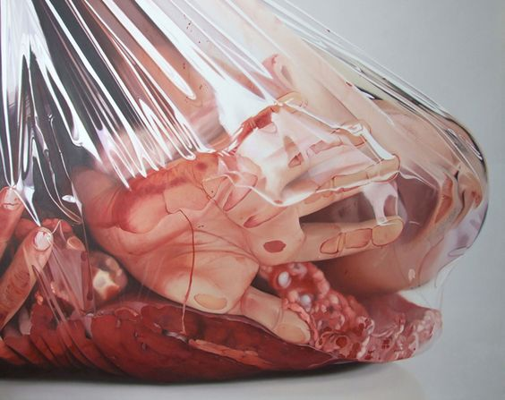
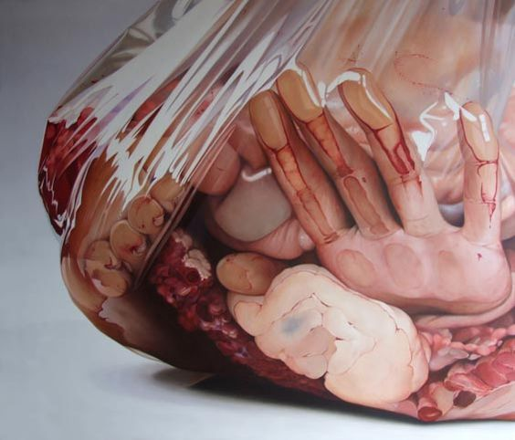
Task 2: Contained
Fábio Magalhães is exploring important themes such as animal cruelty through this photo-realist painting method.

Slide 2
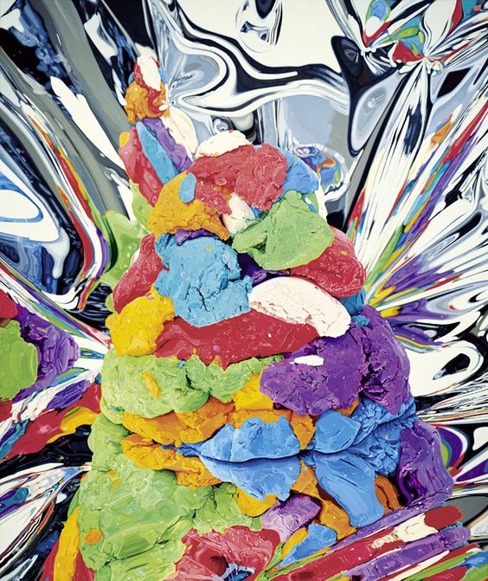
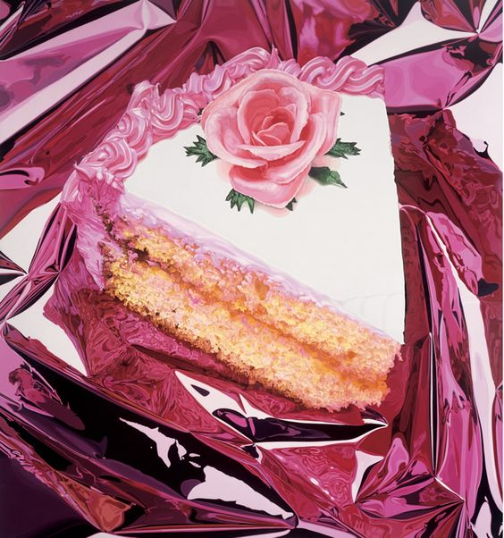
Jeff Koons is known for working with popular culture subjects and reproductions of banal objects. All works in ‘celebration’ reference memories of childhood, family, and holiday: balloon animals, hanging ornaments, play-doh, an easter egg, and birthday cake.

Slide 3
Use the food to construct a ‘still life’.
Your objects should be crushed, squeezed and pressed into the bag or within the foil. Ready to paint?

