Slide 1
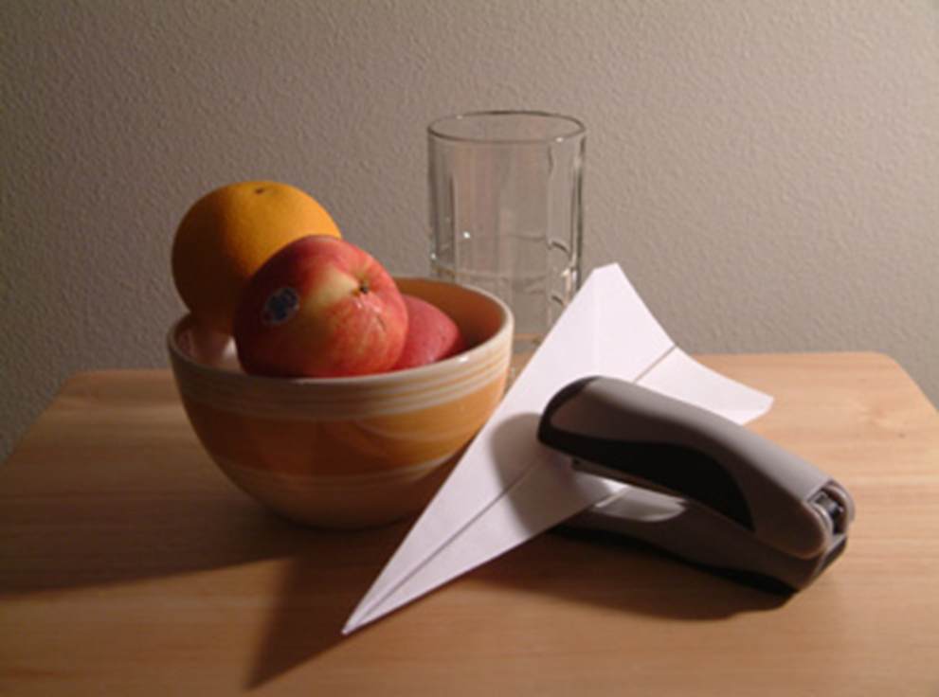
Lesson 1: Still Life

Slide 2
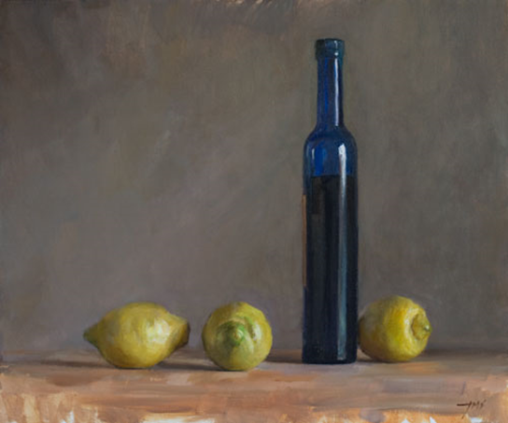
What can you say about these images?

Slide 3
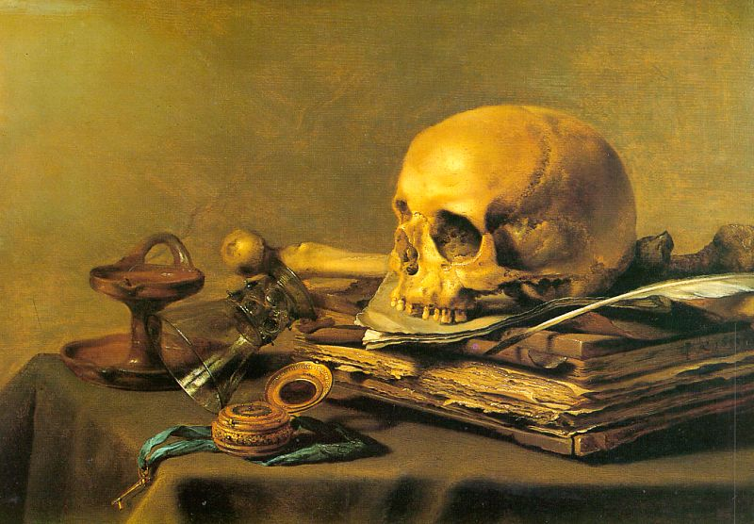
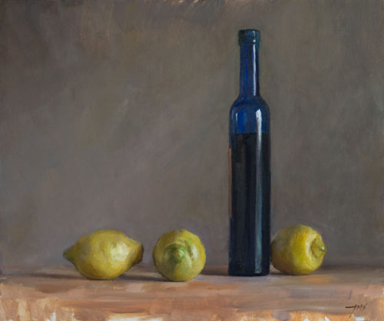
NOW:
ON THE PAPER IN FRONT OF YOU:
Write down the following questions
GROUP QUIZ (6 groups)
Q1. What is a still life?
Q2. What then, is NOT still life?
Q3. Why have artists used still life?
Q4. How might we create our own still life in our lesson?

Slide 4
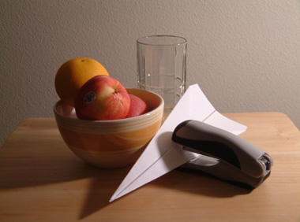
Still Life
A1.
Inanimate objects, not living, arranged in a particular way used by artists to improve drawing or painting skills. These objects could be natural or man made.
A2.
Moving living things, the human body.
A3.
As a way of practicing drawing and painting to improving skills and create artwork.
A4.
By arranging objects and recording them from a specific viewpoint

Slide 5
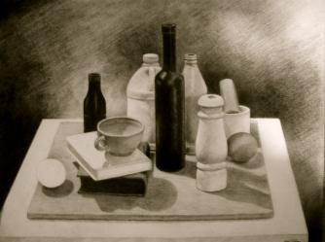
Still Life
Portrayal of something inanimate: a representation of inanimate objects such as fruit, flowers, or food, often in a domestic setting, in paintings, pictures, or photographs.

Slide 6
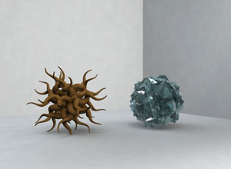
1. With your neighbours (2s or 3s)…
STARTER ACTIVITY
Use the materials to make small abstract sculptures
Bend, squeeze, tie, fold, roll
Organise your sculptures in a still life arrangement which you’ll draw
YOU HAVE 5 MINUTES

Slide 7
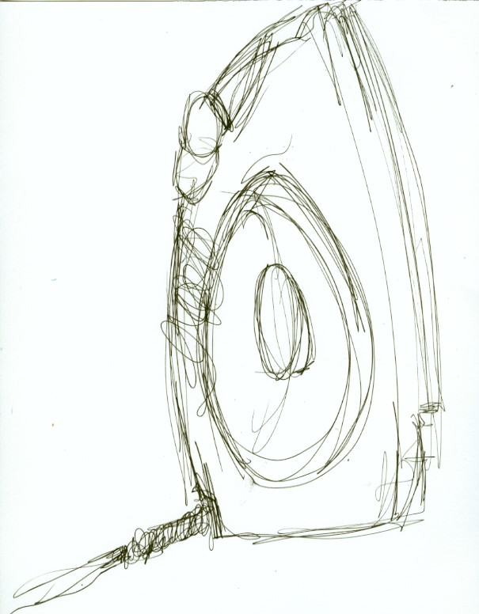
2. Gestural drawings
Make a small drawing of the objects from the angle you are sitting at. You have 60 SECONDS to include ALL of it

Slide 8
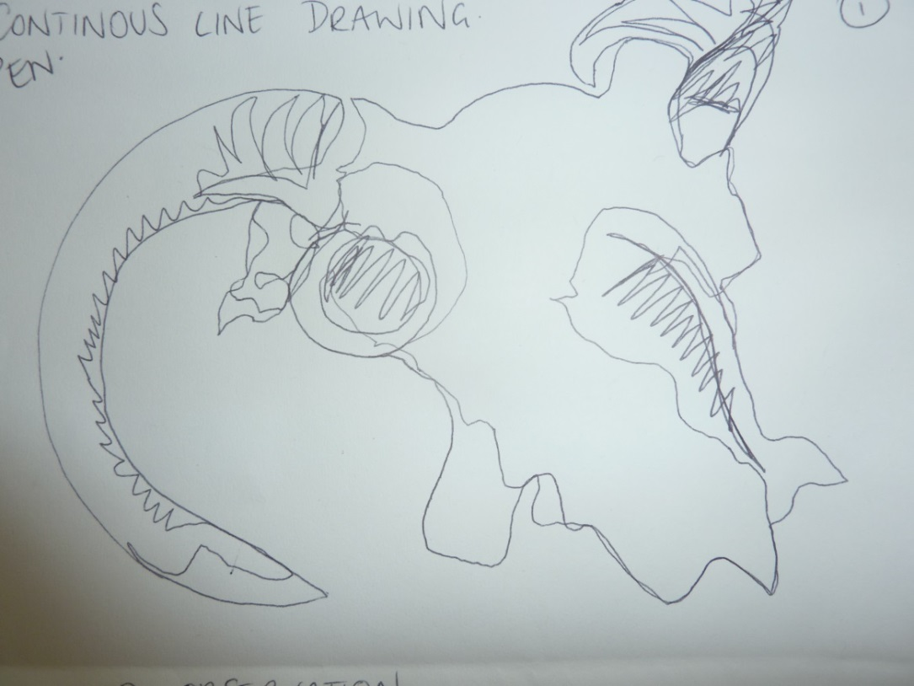
3. Continuous line
Now repeat the drawing using one continuous line- you must NOT take your pencil off the page until the drawing is complete

Slide 9
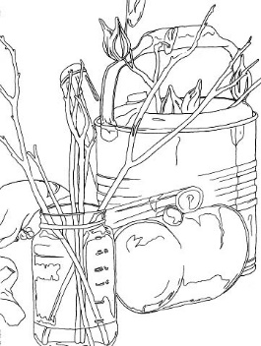
4. Contour Drawing
Use the remaining time up until the last 10 minutes of the lesson to make a detailed outline drawing

Slide 10
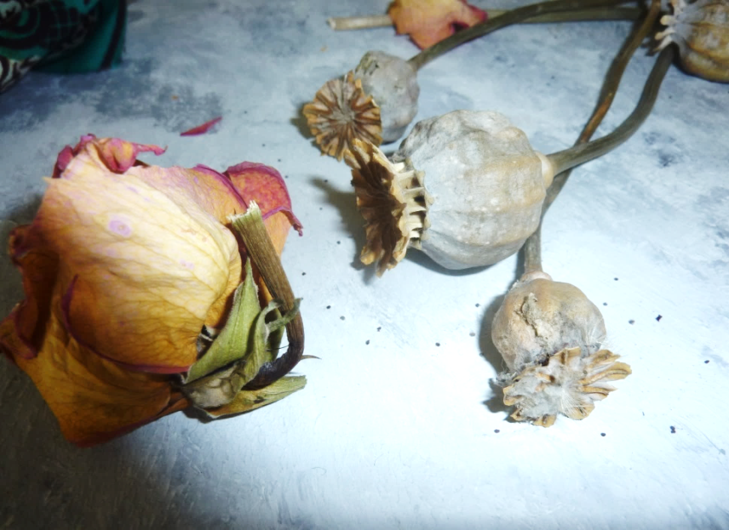
MAIN ACTIVITY
Preparation: Now that you can see how much information you can record in a short amount of time, you are going to create a REALISTIC version of your piece.
Using all the techniques you have already tried, create an OBSEVATIONAL drawing of your chosen objects.
ALWAYS LOOK AT YOUR OBJECTS.

Slide 11
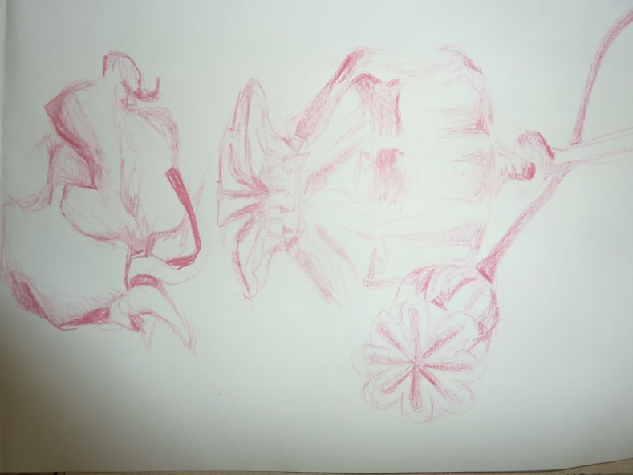
Using a green pen… WWW, EBI Which is your best technique? why? how could you improve your work?

