Slide 1
Task 1: Limitations
“I can never read all the books I want; I can never be all the people I want and live all the lives I want. I can never train myself in all the skills I want. And why do I want? I want to live and feel all the shades, tones and variations of mental and physical experience possible in my life. And I am horribly limited.”
― Sylvia Plath, The Unabridged Journals of Sylvia Plath
What do you want? What limits you? Answers on a post it.
money
confidence
social
pressure
media
pressure
Expectations
of others
opportunity

Slide 2
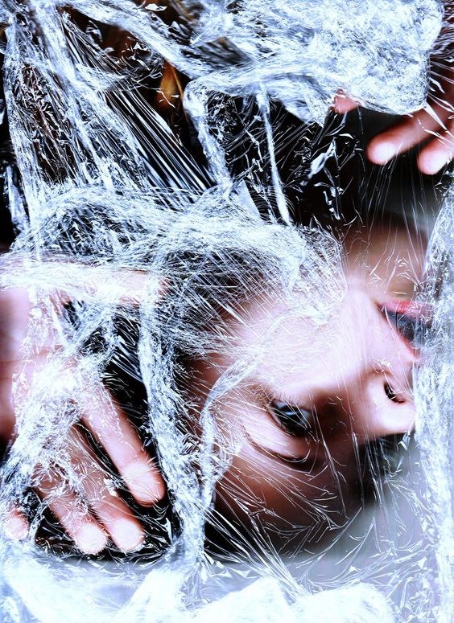
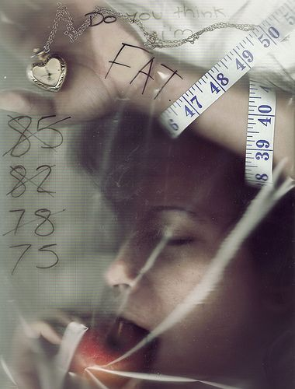
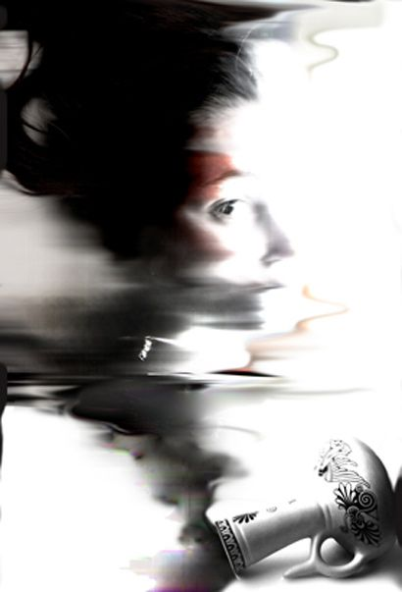
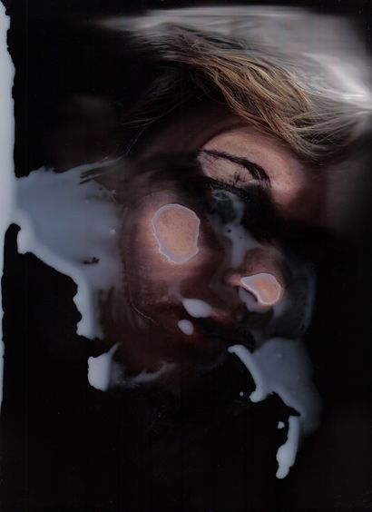
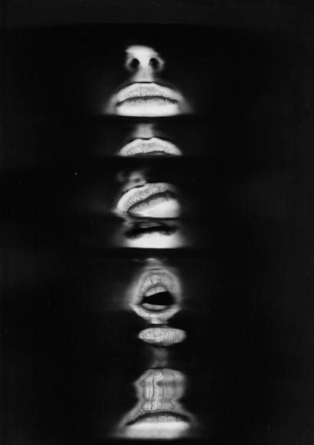
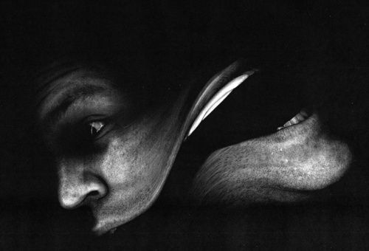
Cling film + paint
Objects + writing
Hands+ writing
Movement and objects
Use the text, materials and objects to construct a context for a scanned self portrait.
Consider how your face/body will appear within the context you have created.
Distortion + negative space
Movement + abstract

Slide 3
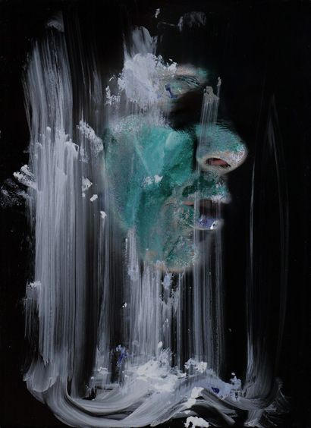
PHOTOCOPY YOUR SELF PORTRAIT

Slide 4
WARNING
Keep your eyes closed
Do not let any art materials touch the ‘bed’ of the photocopier
Clean up anything left behind on the glass

Slide 5
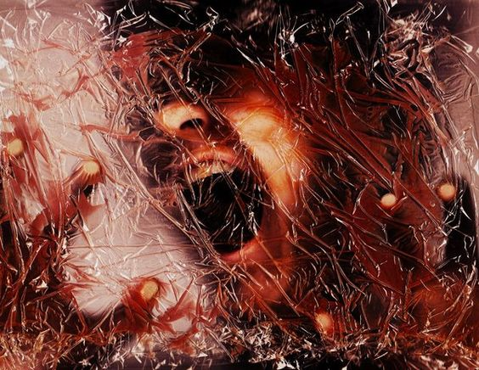
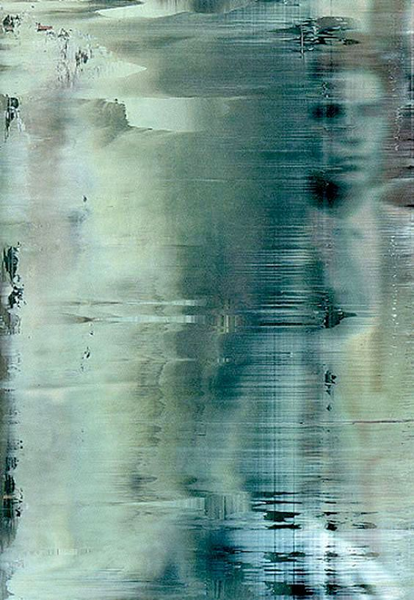
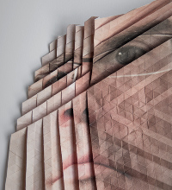
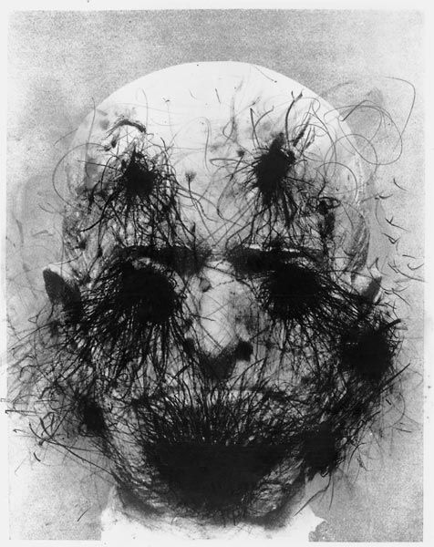
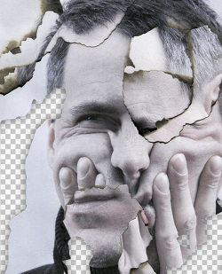
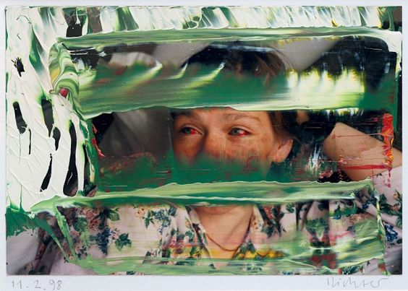
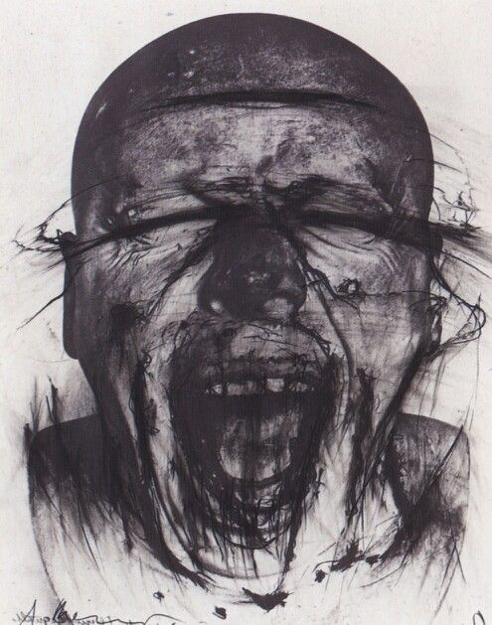
Is your intention clear? Develop your work.
Fold, tear, crease images like the examples below by Aldo Tolino
Ink and charcoal exaggerates expressions / emotion like these images by Arnulf Rainer
Add colour
Drag paint or use other media to ‘edit’ the image. The examples above are by Gerhard Richter.
Monoprint another p/copy
or put an image back through the photocopier to layer 2 or more images.

