Slide 2
REFLECTIONS
Ron Gilad - Fine Art / Design / Models / Products
Lee Borthwick - Fine Art / Photography / Installation / Product / Sculpture
Lee Borthwick creates custom-made and site specific natural artworks for residential, commercial and exterior spaces. It is Lee’s distinctive approach of combining pieces of tree and mirror that led to the creation of her signature “Mirror Tapestries”.
Each piece of wood I collect has a narrative and a past, each piece of work is therefore rendered unique. Wood is ethically sourced and collected through an array of sustainable and local sourcing techniques
“Ron Gilad’s hybrid objects combine material wit with aesthetic play; they sit on the fat, delicious line between the abstract and the functional” so says New York based artist Ron Gilad’s biography

Slide 3
REFLECTIONS
Mark Quinn - photographer / sculpture / installation / Painting / products
Quinn explores 'what it is to be human in the world today' through subjects including the body, genetics, identity, environment and the media. His work has used materials that vary widely, from blood, bread and flowers, to marble and stainless steel.
DULK - Fine Art / Illustration / Street Art / Sculpture / Urban Art / Painting / Drawing
As a child, Antonio Segura Donat (Dulk) helped his father to feed the birds they reared at their home. He copied illustrations of exotic animals that he found in his parents’ collection of old encyclopedias. At the age of eighteen, a close friend persuaded him to tackle the walls of the city and suggested he take the pseudonym of Dulk. His world is a surrealistic landscape full of imaginary details, rising up in factions against humans. Maybe they are wanting to warn us of Earth’s bleak future following an environmental catastrophe.

Slide 4
REFLECTIONS
Daniel Rozin - Interactive digital art / installation / Sculpture
Daniel Rozin is an artist, educator, and developer working in the area of interactive digital art. As an interactive artist Rozin creates installations and sculptures that have the unique ability to change and respond to the presence and point of view of the viewer. He has created these interactive mirrors out of wide variety of materials ranging from plastic pieces, wood, and even trash. But one of our favorites used this kinetic quality out of actual mirrors, which adds a level of humor and irony to the piece.
Jason Martin - Painting / Relief / Sculpture / Products
Drawing on the heritage of abstract expressionism and minimalism, Martin’s work centres on the physical properties of oil paint, and the subtleties of the painter’s manipulation of his medium.
In his latest works, the paint, heavy and viscous, reflects light at sharp angles as it rises into meringue like peaks.
Aside from painting Martin casts in copper, silver and nickel placing haphazard globules of paint against perfect flat and reflective surfaces/

Slide 5
REFLECTIONS
Led by Donkeys - urban art / street art / conceptual / Billboard art / social media art / political art / poster campaign / guerrilla art
Led By Donkeys' Poster Campaign Is Humiliating Politicians With Their Own Words Across London
Robbie Conal - illustration / graphic art / political art / street art guerilla art
Conal is an American guerrilla poster artist noted for his gnarled, grotesque depictions of U.S. political figures of note. A former hippie, he is noted for distributing his poster art throughout a city overnight using his "volunteer guerrilla postering army"

Slide 6
REFLECTIONS
Victoria Reynolds - fine art / painting / drawing
Though she thinks "meat tastes kind of funny", Reynolds spends hours at the supermarket to find just the right cut.
"It's hard these days to find large expanses of fat, but I love the texture and the glistening highlights. The butcher always looks at me strangely, because when I see fatty meat, I have to buy it straight away," she says.
Admiration, curiosity and sometimes disgust are standard responses to Reynolds's intricate canvases. "Artists have been painting flesh for years. I'm just doing it in a diﬀerent way. To me, meat and muscles are an incredible inner landscape
Jordan Kasey - painting / drawing
Kasey's scenes are burdened with inertia, weighed down by figures who seem trapped within their own corporeality. Overwhelming the canvas in their immense closeness, these thick forms slump and slouch into view. Kasey pours a sense of foreboding and listlessness in a series of portraits that capture the various realities — or sur-realities — of wasted time.
Kasey reflects real life as something uncomfortable and alien, painting people that are not either-or but both; slit-like eyes that are both open and closed, reflections and realities that are both here and there.

Slide 7
REFLECTIONS
Beth Campbell - installation / sculpture / conceptual / found art
Known for her drawings, sculpture, and architectural interventions, Beth Campbell creates works that challenge the notion of a physical world beyond our perception.
In Campbell’s installations and recent sculpture, what appears at first glance to be a facsimile of the everyday will reveal startling complexity:
Forms repeat and stutter.
Mirrors become portals.
Interiority is externalized.
The familiar becomes strange.
Graham Caldwell - sculpture / assemblage
Brooklyn based artist Graham Caldwell creates surfaces marked by crumpled and stretched distortions. Like seen in his latest works ‘Compound Eye’ and ‘Before After’ he mostly uses blown glass, steel, epoxy, mirrors, and other materials to create these otherworldly sculptures.
His practice is concerned with the elasticity of sight, and the way visual perception constructs and distorts the immediate external world.

Slide 8
REFLECTIONS
DAN GRAHAM
DAVID ALTMEJD
RYAN EVERSON
ALYSON SHOTZ
JEPPE HEIN
Based in concept, Dan Graham’s “pavilions” blur the line between sculpture and architecture. Toying with perception the pavilions employ two-way mirrors and glass to engage a viewer and disorient his sense of space.
David Altmejd employs mirrors in his works to help him, and a viewer, explore a fantasy world that puts reality into perspective. Depicting mythical creatures, Atmejd blurs distinctions between what is real and perceived.
Ryan Everson is a multimedia artist who reveals the sentimentality often associated with an idealized natural world. Sometimes camouflaged, Everson’s Fear creates a deeply rich symbolic metaphor for the feelings evoked by fear.
Alyson Shotz investigates issues of space by using reflective materials. Shotz says “I’m interested in making objects that change infinitely, depending on their surroundings.”
Danish artist Jeppe Hein is interested in illusion and turning passive visitors into participants. Hein uses mirrors and other reflective surfaces in his work. Hein often adds an element of humor to his pieces.

Slide 9
REFLECTIONS
Photography / Digital Manipulation
SLAVA SEMENIUTA
SATOKI NAGATA
SEBASTIAN MAGNANI
KANGHEE KIM

Slide 10
REFLECTIONS
Photography / Digital Manipulation
Kiripi Katembo, also known as Kiripi Katembo Siku, was a Congolese photographer, documentary filmmaker and painter. Katembo's short films, photography and other projects focused on the daily lives of the people of Kinshasa, as well as the economic and social challenges facing the Democratic Republic of the Congo

Slide 11
REFLECTIONS
Photography / Fashion
AIDA MULUNEH

Slide 12
REFLECTIONS
Typography
Lettering artist Jessica Hische has written and illustrated a children’s book, which encourages children to reflect on their day and set goals for the day ahead
– such as being “adventurous,” “strong,” “smart,” and “creative”.

Slide 13
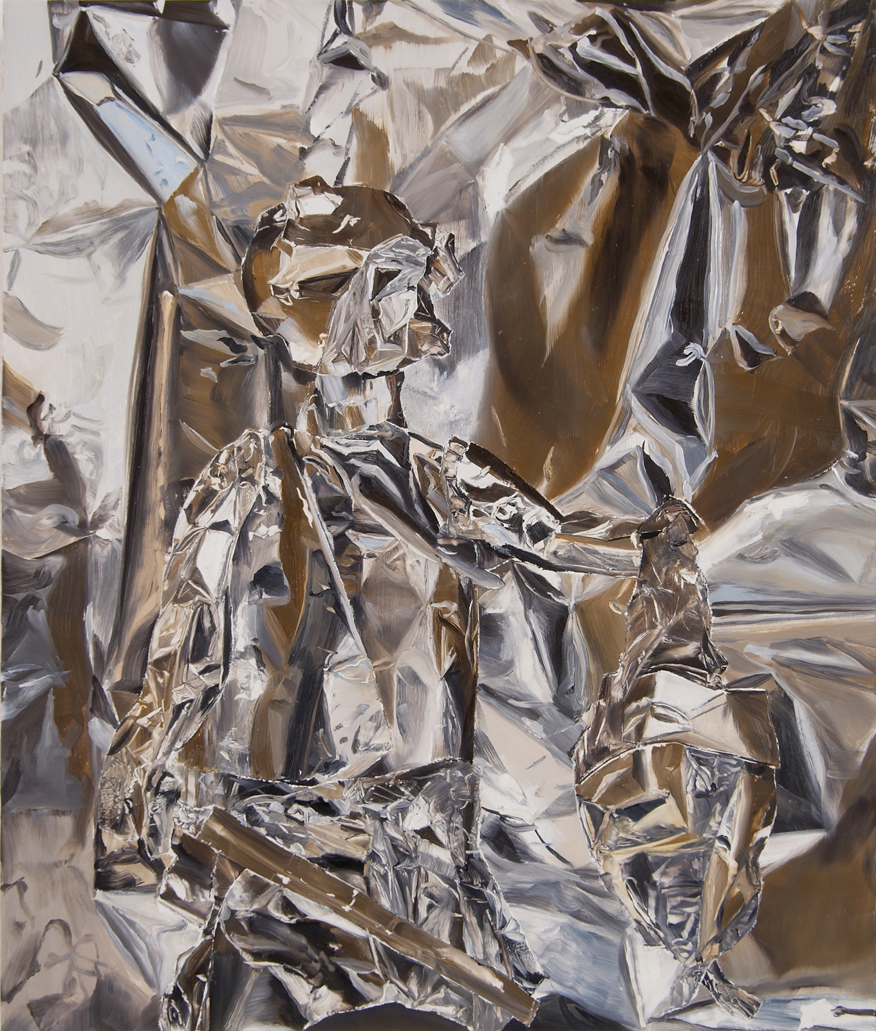
REFLECTIONS
Figurative
ANDREA KOWCH
EKUNDAYO
TWOONE
BART NIJSTAD
MELISSA BROWN
WILLIAM DANIELS
PANDELE

Slide 14
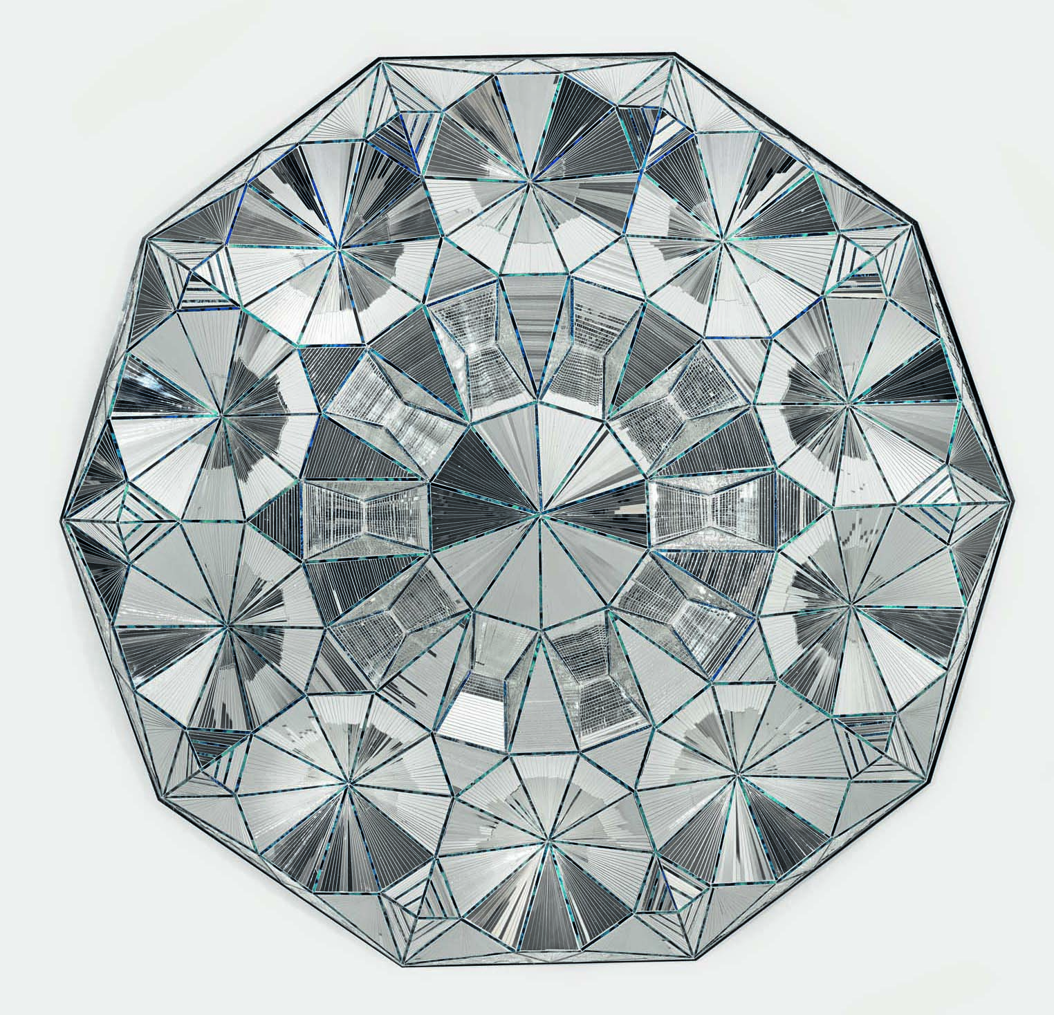
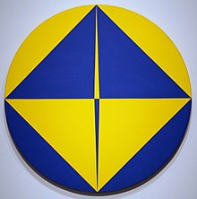
REFLECTIONS
Abstracted
CHRISTINA GRAHAM
MONIR SHAHROUDY FARMANFARMAIAN
HOWARDENA PINDALL
SARAH MORRIS
ELIZABETH NEEL
CARMEN HERRERA

Slide 15
REFLECTIONS
Collage / Print / Mixed Media
Wangechi Mutu
Gregory Euclide
Valerie Lueth
Yang Yongliang

Slide 16
REFLECTIONS
Sculpture / Installations
Jim Hodges Chromatically Mirrored Boulder Sculptures
Mobile Mirrors: Mannequins Covered in Mirror Shards
by Lilibeth Cuenca Rasmussen
Shimmering Chain-link Fence Installation by Soo Sunny Park
Mirror based work by Christopher Madden

Slide 17
REFLECTIONS
Design
RICHARD YASMINE
LUCAS EN LUCAS
MARCO ACERBIS
JOHN POMP
CAMILLA RICHTER

Slide 18
REFLECTIONS
Fashion

Slide 19
REFLECTIONS
Architecture / Interior Design
Ryan Wells
Santiago Calatrava
Frank Gehry

Slide 20
REFLECTIONS
Jewellery
DAVID YURMAN

