Slide 1
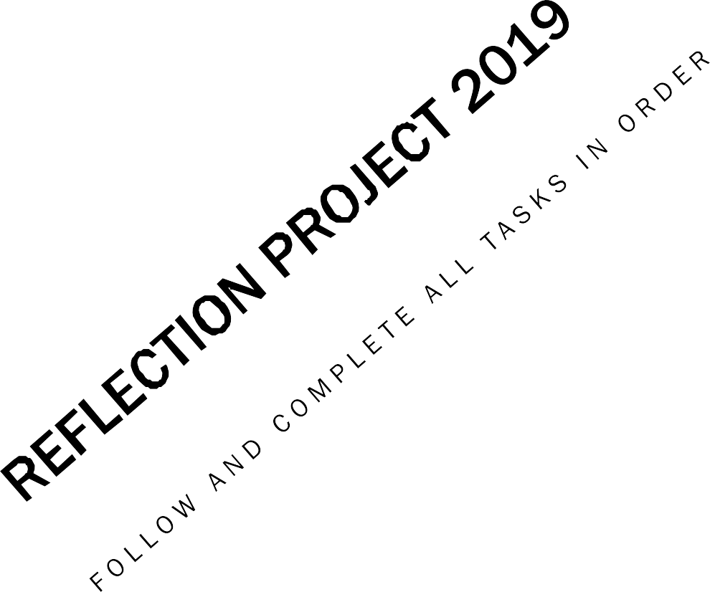

Slide 2
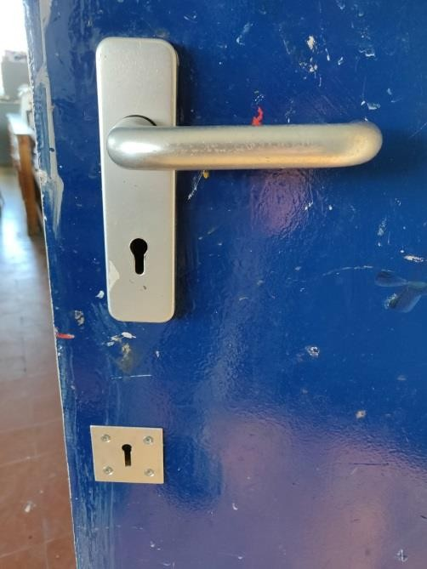
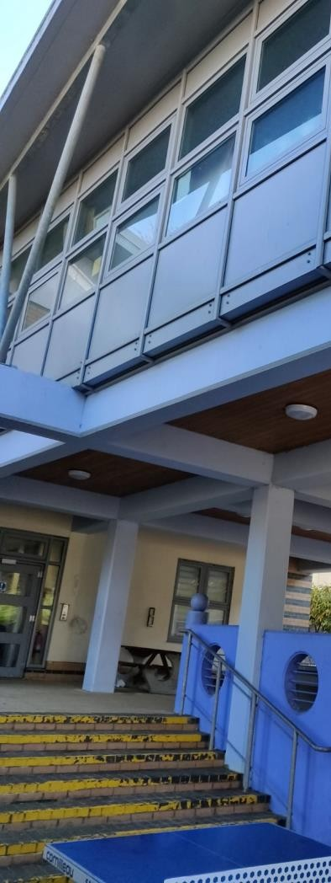
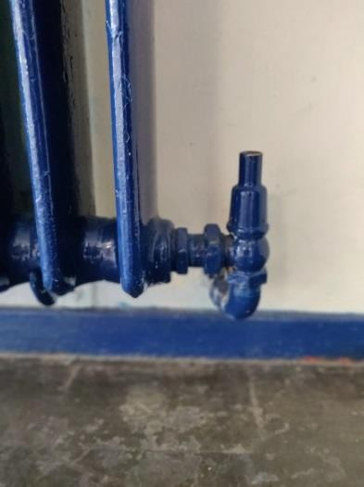
GO ON A JOURNEY AROUND SCHOOL
Take your sketchbook around school with some Art materials
Walk and then every minute stop at look either up , down , left or right. Draw the view that you see.
Make 3 drawings in different materials

Slide 3
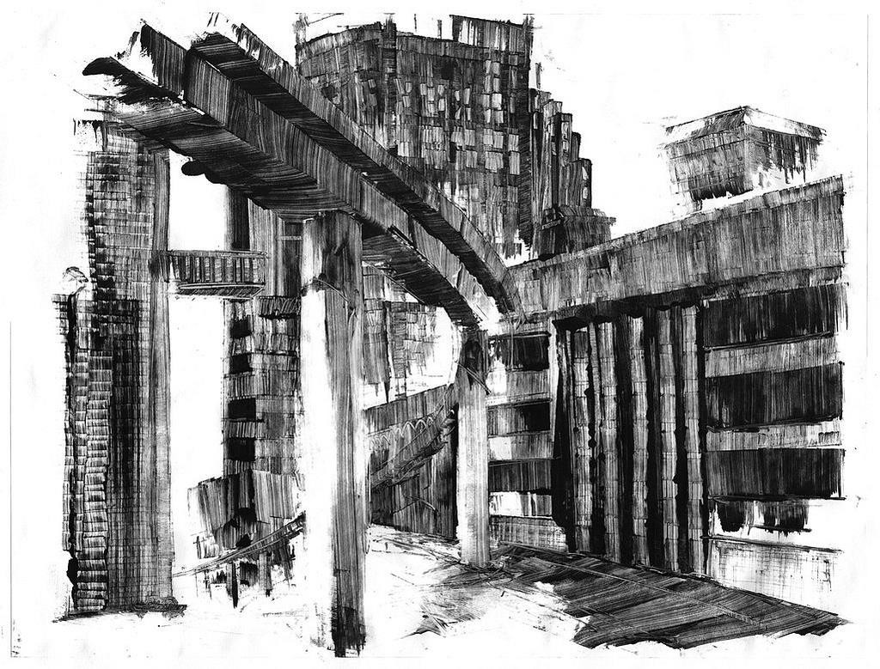
MONO-PRINTING
Create 2 detailed mono- prints from the resource photos around school

Slide 4
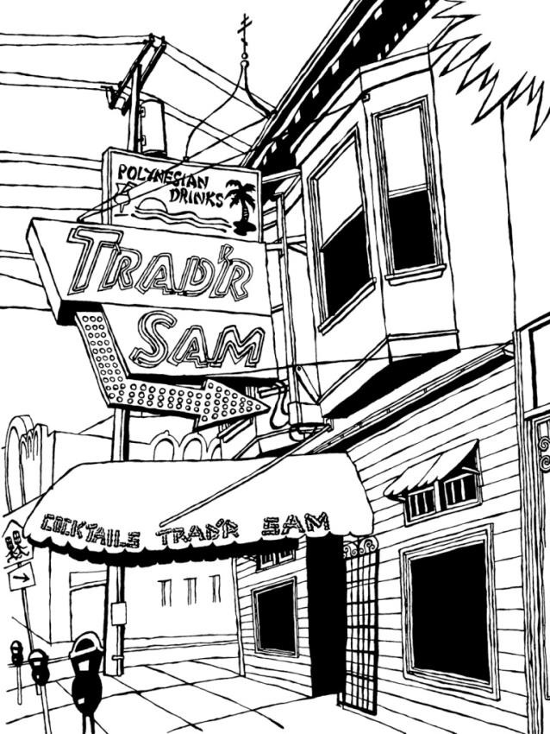
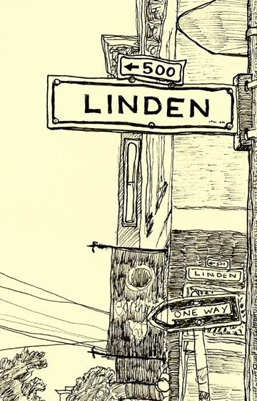
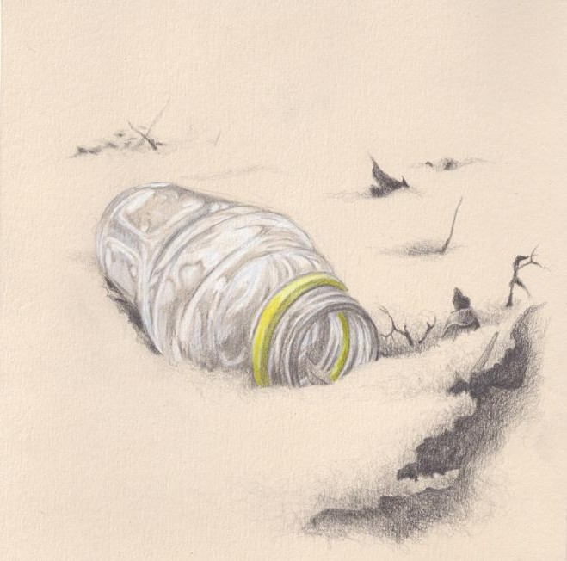
HOMEWORK
Record your journey home from school in the same way. Take 10 photos of close ups, streets, signs, anything you pass that interests you and bring in to school next lesson
Make a detailed drawing of one of the photos Bring in a map of the area of your journey

Slide 5
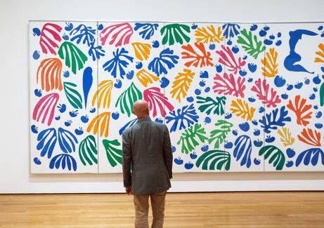
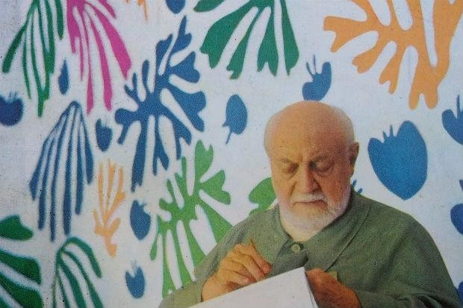
HENRI MATISSE
•
Henri Matisse was born on 31st December 1869, and died in 1954. He was 84.
He was a draughtsman, printmaker, and sculptor, but is best known as a painter.
Matisse also started to create large scale cut paper collages.
•
•

Slide 6
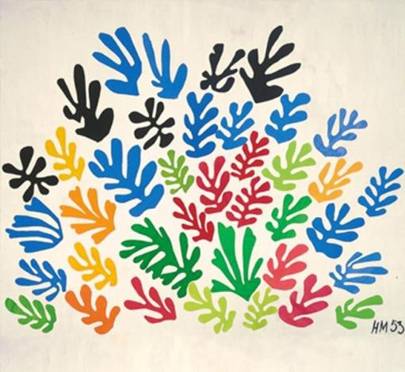
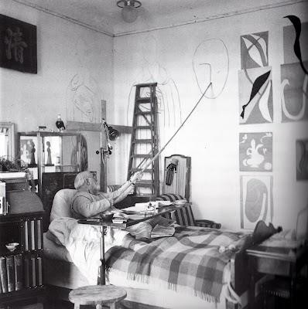
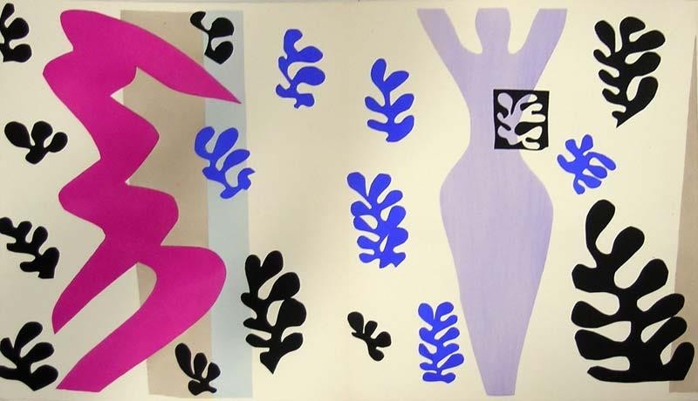
Matisse was in a wheel chair during his later years; which resulted in him creating some of his most well known cut-out pieces. After he could no longer stand for extended periods of time, Matisse began creating works using a pair of scissors and paper. He used a long stick to assemble them on his walls until he was happy with the
arrangement. He called this technique ‘painting with scissors
Complete 2 pages of research on Matisse’s cut-outs.

Slide 7
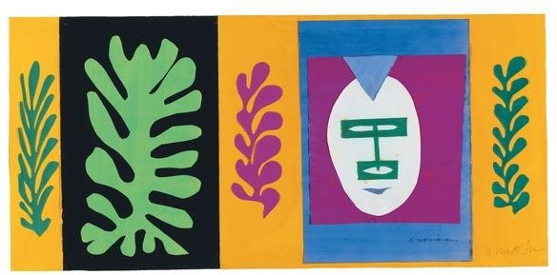
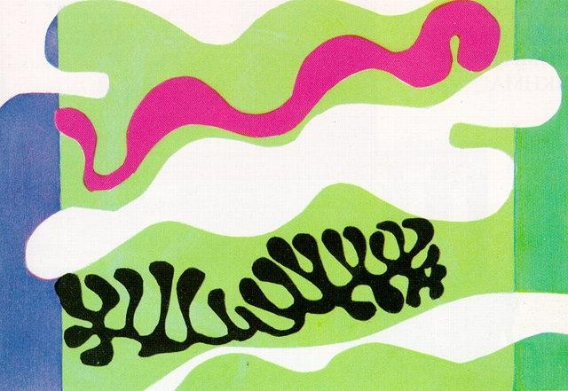
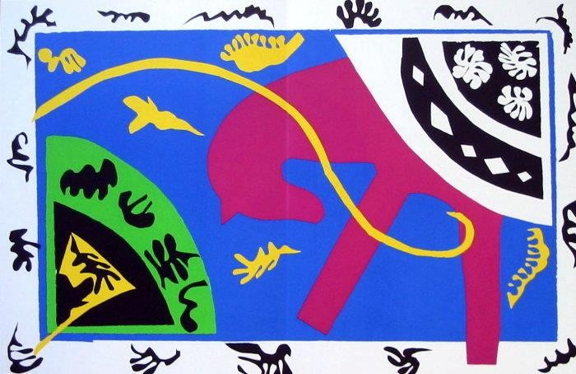
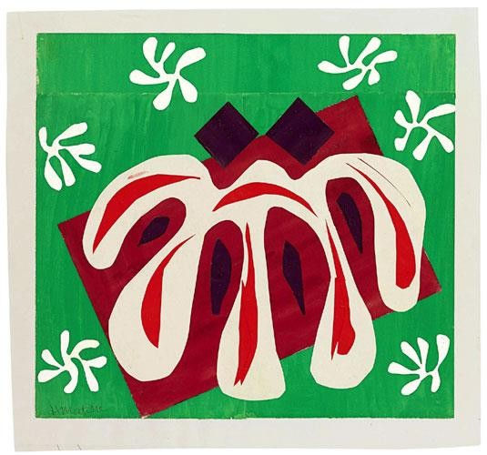

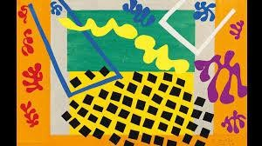
PAINTING WITH SCISSORS.

Slide 8
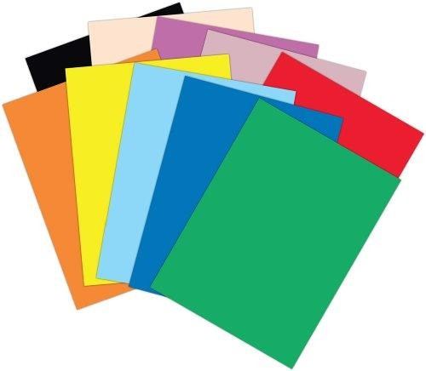
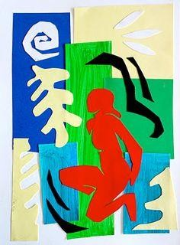
PAINTING WITH SCISSORS
You have be given a variety of different coloured papers.
Now try creating your own “Journey” in the cut out style of Matisse .Choose 3 photos to work from and try to recreate these in paper. Do not draw any outlines. Take a risk and just cut the shapes.
Stick these pieces in your sketchbook

Slide 9
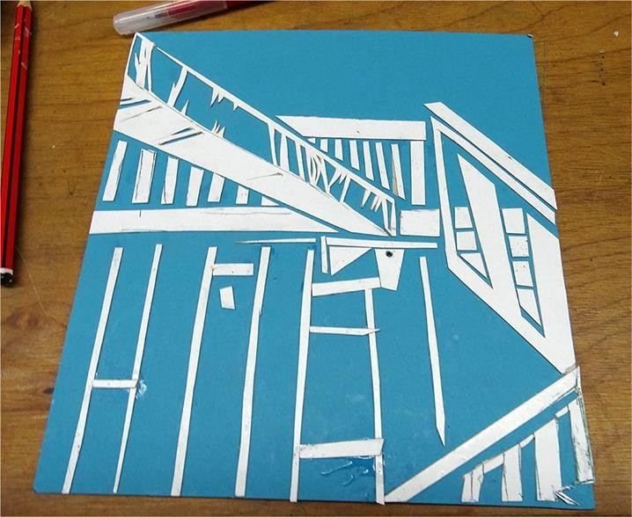
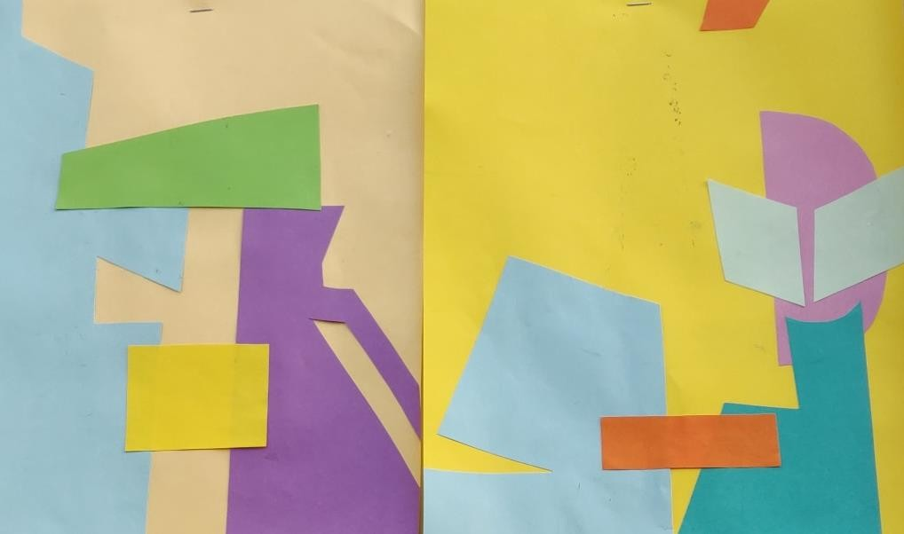

Slide 10
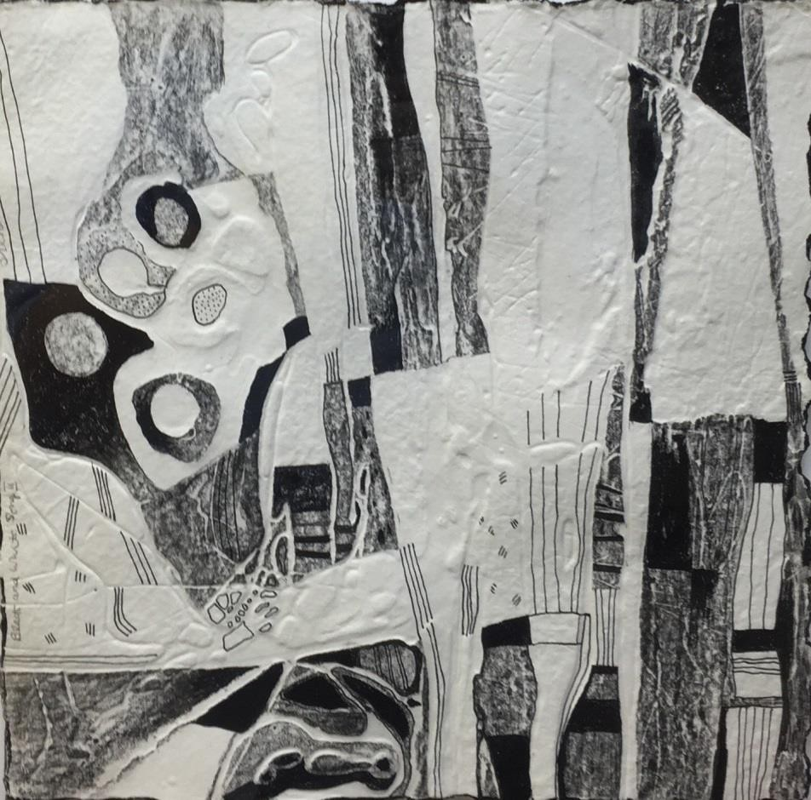
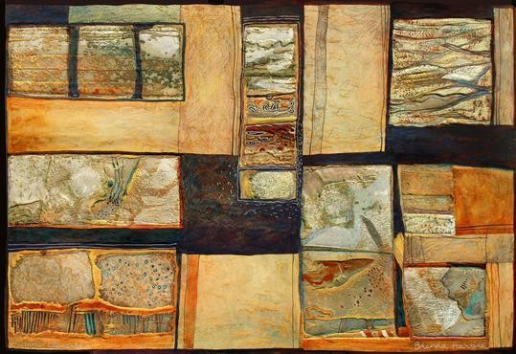
BRENDA HARTILL
Her work explores the texture, pattern and light of the landscape, and ranges from finely drawn figurative works to bold, heavily embossed abstract images. Far the past 10 years she has been most interested in drawing abstract imagery from the landscape.

Slide 11
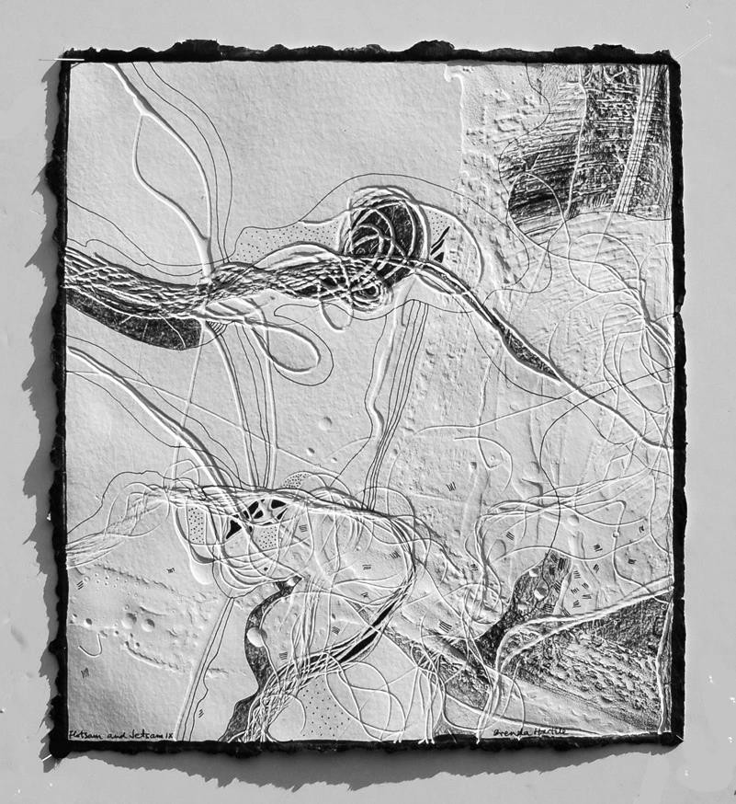
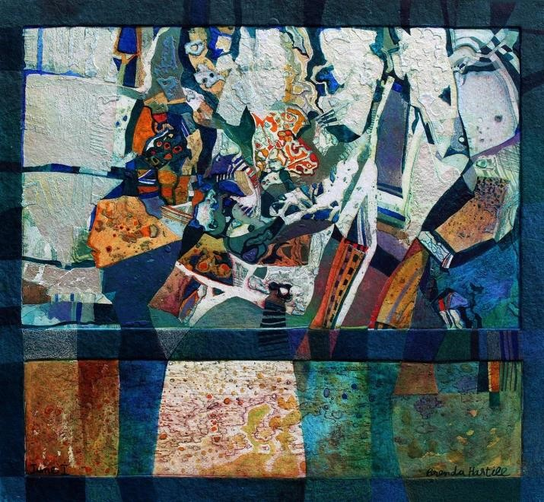

Slide 12
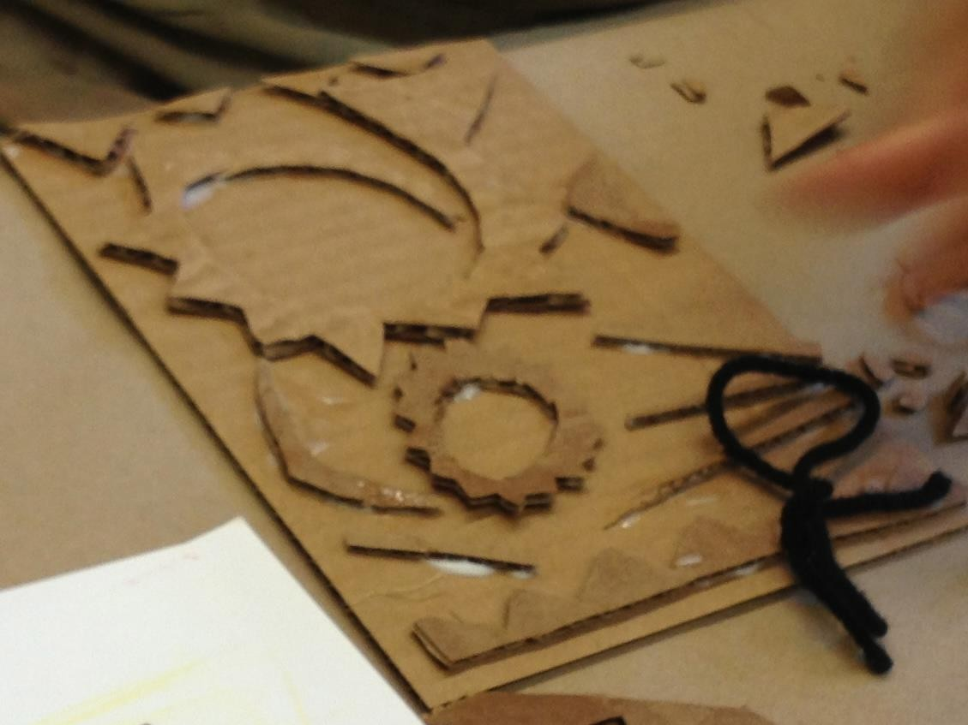
COLLAGRAPH PRINTING
Next take a section of one of your photos.
Recreate this out of just thick card like the image here so that the details and shapes in the image are raised
/relief.

Slide 13
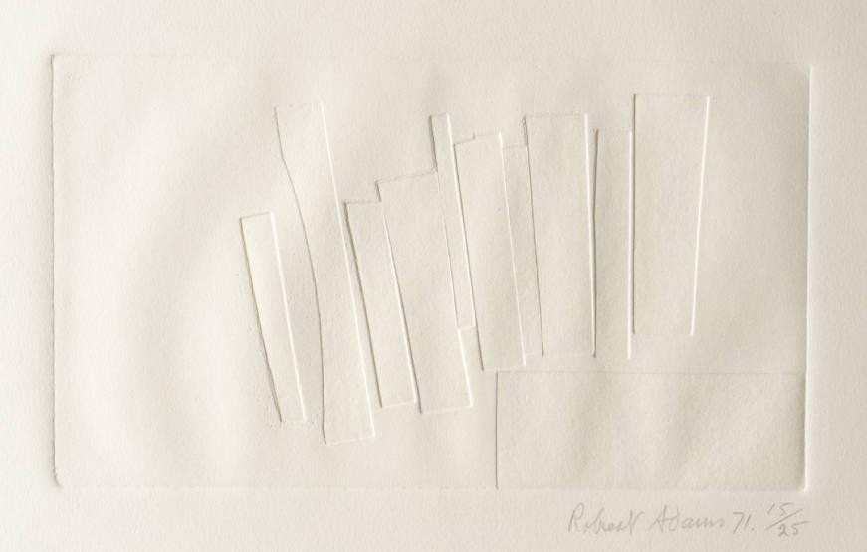
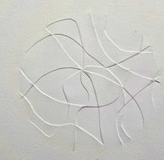
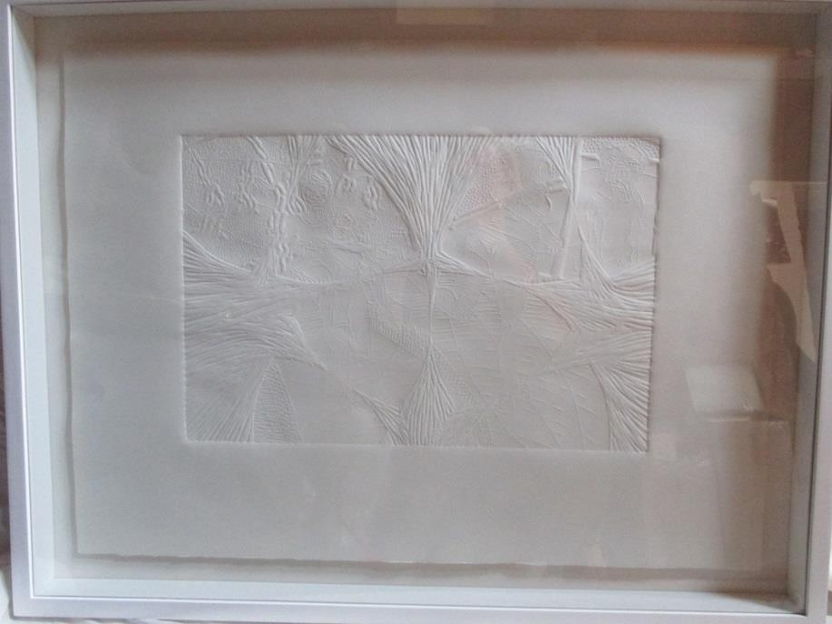
CREATE AN EMBOSSED PRINT
Using the printing press, create an embossed print of your card relief. Once complete stick this in your sketchbook. Stick in the images by Brenda Hartill and explain her work briefly.

Slide 14
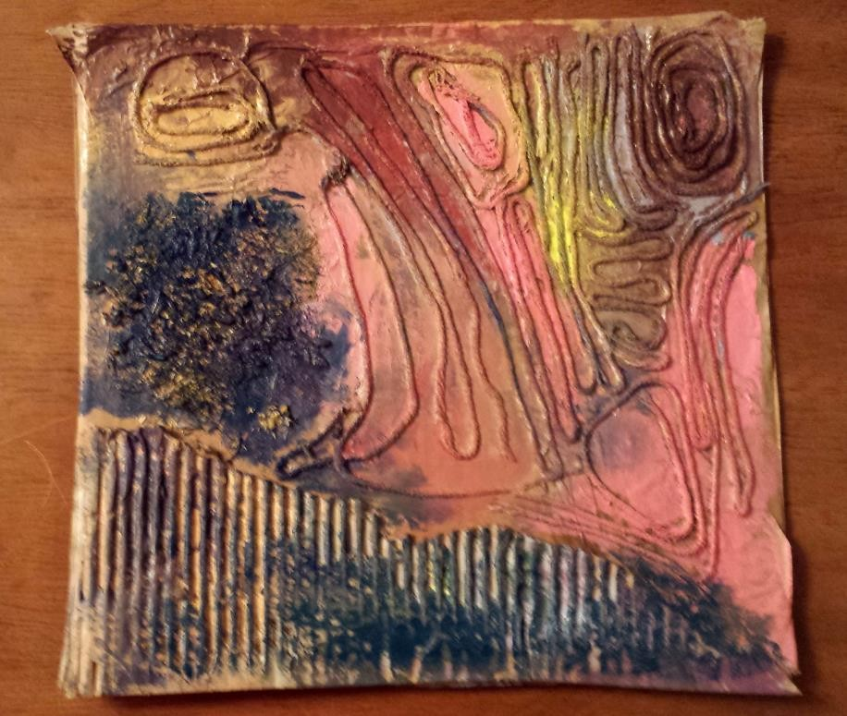
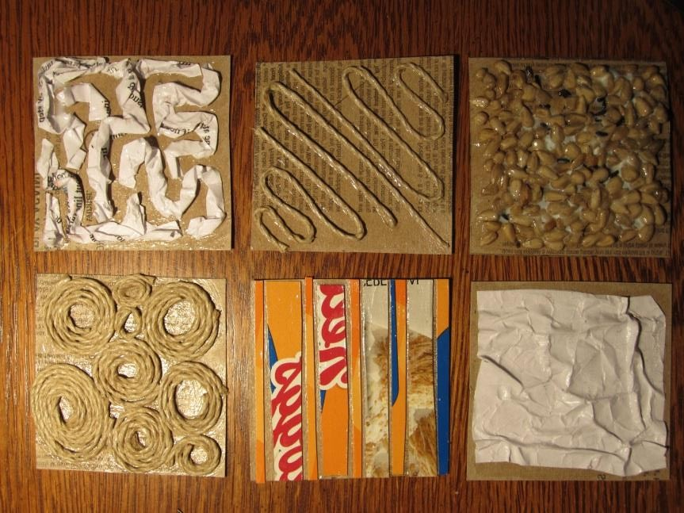
ADD MORE TO YOUR PLATE
https://www.youtube.com/watch?
v=SxbsSpk3wW0
Watch the clip above. Once you have created an embossed print, begin to add more materials like string, and cotton buds, and tin foil etc to your plate to create more texture. Once completed make a Collagraph print in different coloured inks. Also experiment with printing on different papers/colours…..

Slide 15
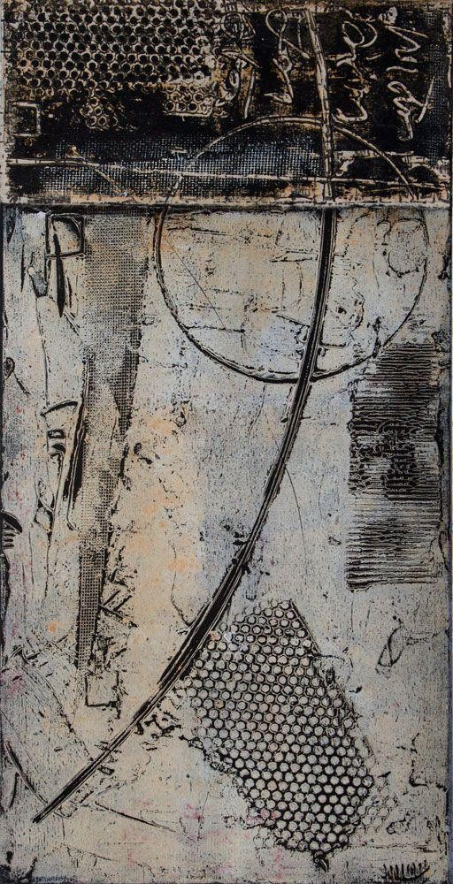
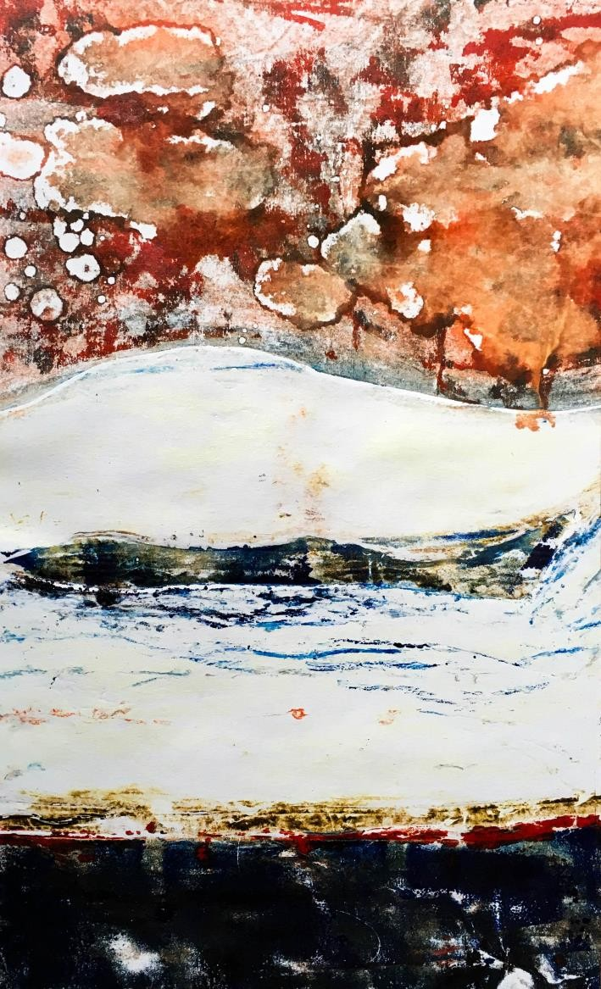
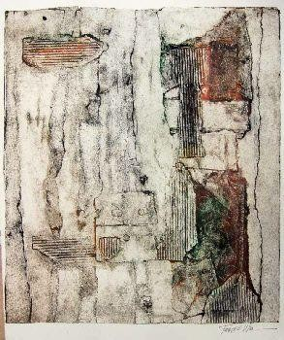

Slide 16
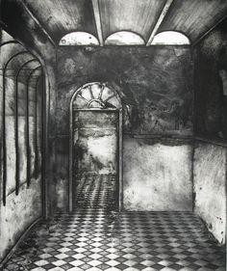
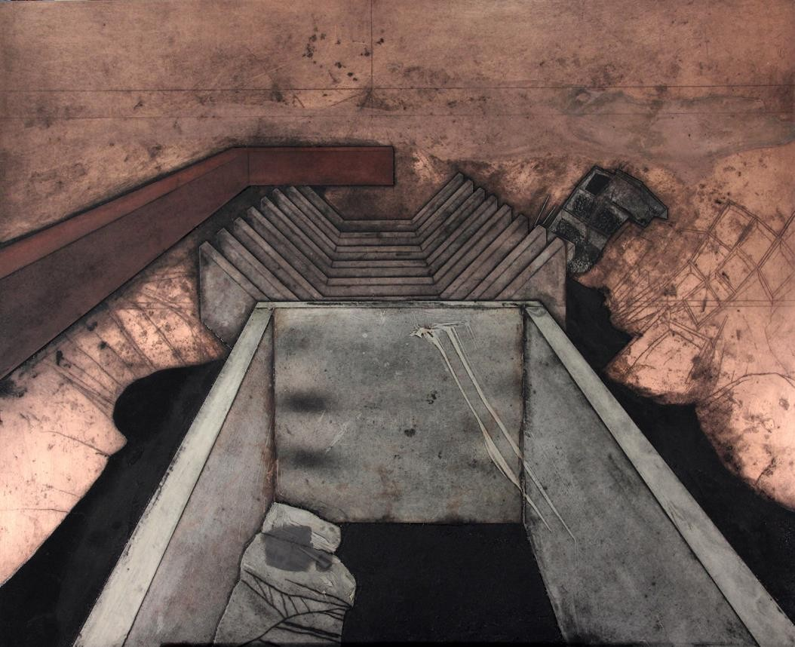

Slide 17
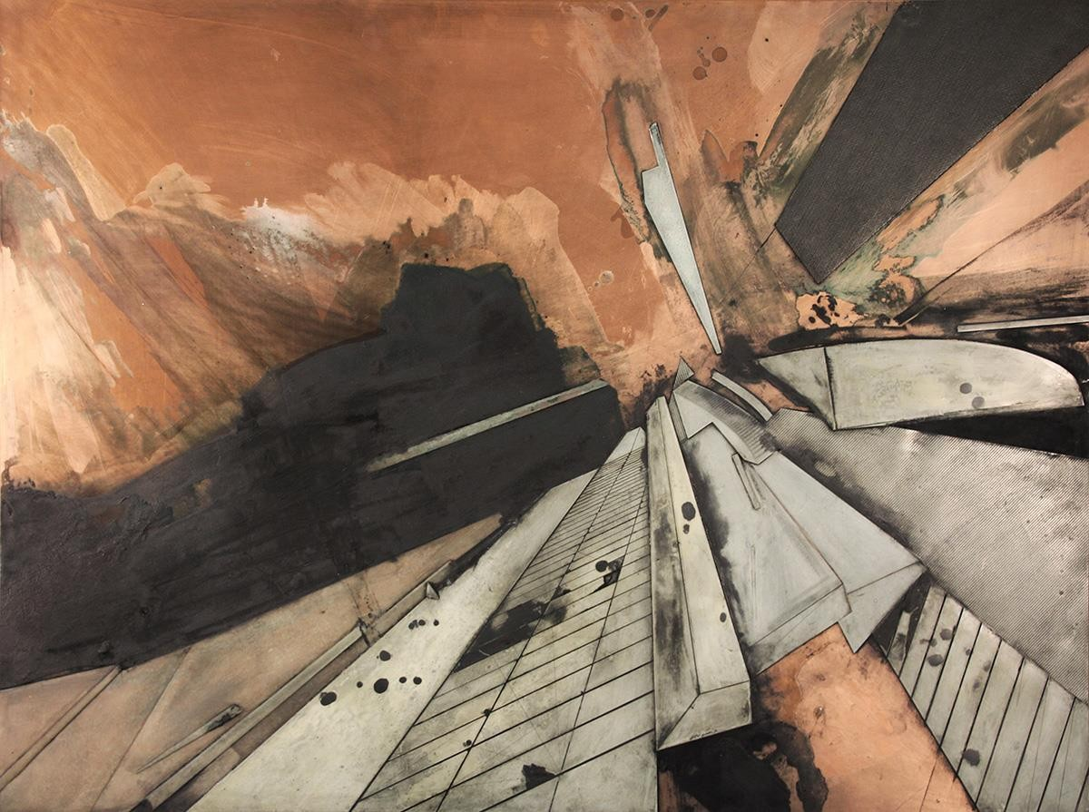

Slide 18
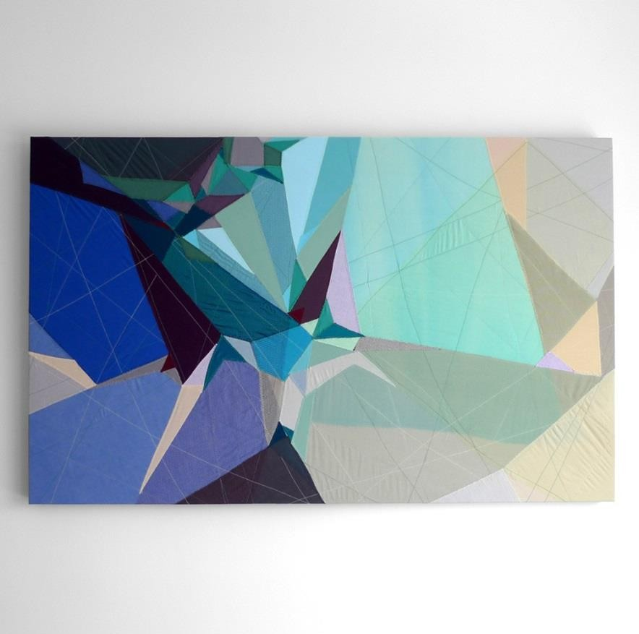
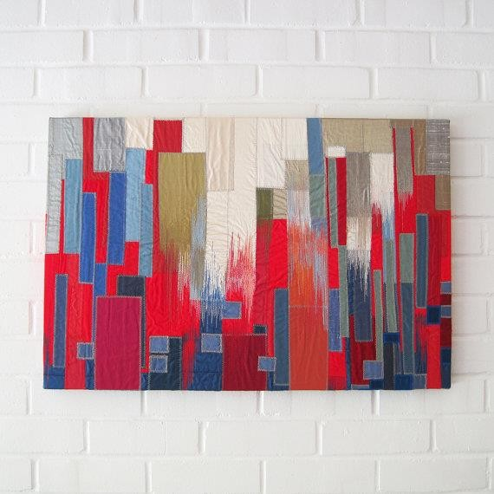
TEXTILES
Sarah Symes has a background in architecture and graphic design, which informs the way she works with textiles today. She has also been influenced by the many eclectic cities in which she’s lived; London, Los Angeles, San Francisco and Vancouver all play their own part in Sarah’s work. Through her art she seeks to reinterpret her memories of these places and the people she has encountered in them. Her process owes more to painting and collage than traditional embroidery techniques; she selects fabric, dyes it as necessary, cuts it into strips, squares or shapes and uses the sewing machine to stitch it together in a highly improvisational way.

Slide 19
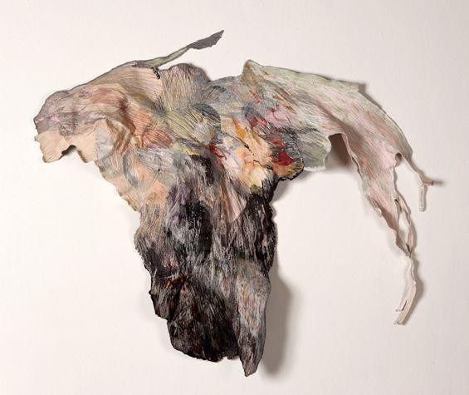
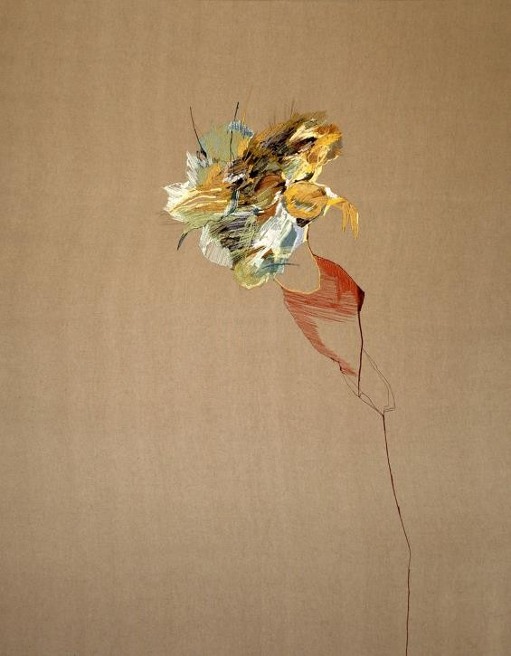
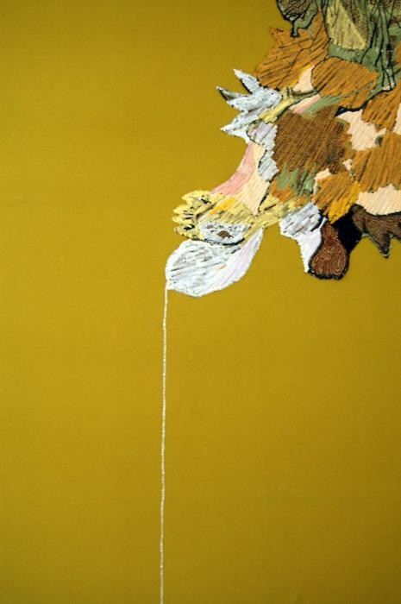
JOSEFINA CONCHA
Chilean artist Josefina Concha creates delicate stitched pieces using her sewing machine as a painter would use her brush. The thread is used as a means of abstract expression and the quality of the materials guides Josefina’s creative process.

Slide 20
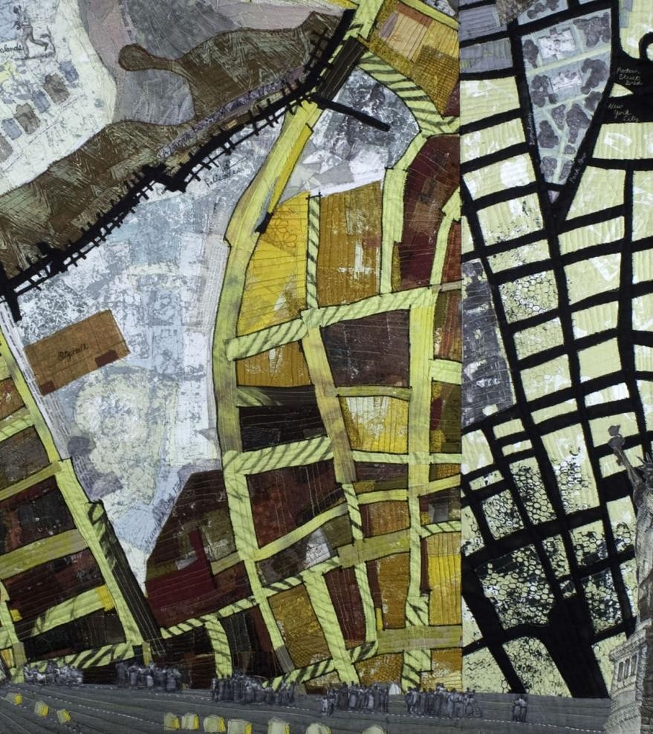
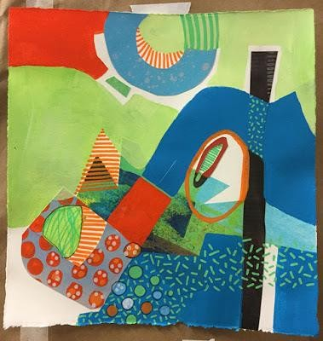
Using the varied fabric provided, recreate a section from one of your photos, by sewing (or use glue) pieces together.

Slide 21
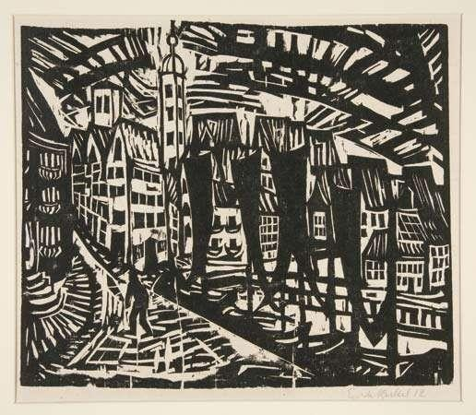
ERICH HECKEL
Erich Heckel, (born July 31, 1883, Döbeln, Germany—died January 27, 1970 German painter, printmaker, and sculptor who was one of the founding members of Die Brücke (“The Bridge”), an influential group of German Expressionist artists. He is best known for his paintings and bold woodcuts of nudes and landscapes. The Brücke artists helped to revive the woodcut tradition in Germany; they prized the medium’s ability to convey rough, spontaneous marks and bold, flat colour. Heckel was the artist most prolific in woodcut, often creating posters and invitations for Die Brücke exhibitions.

Slide 22
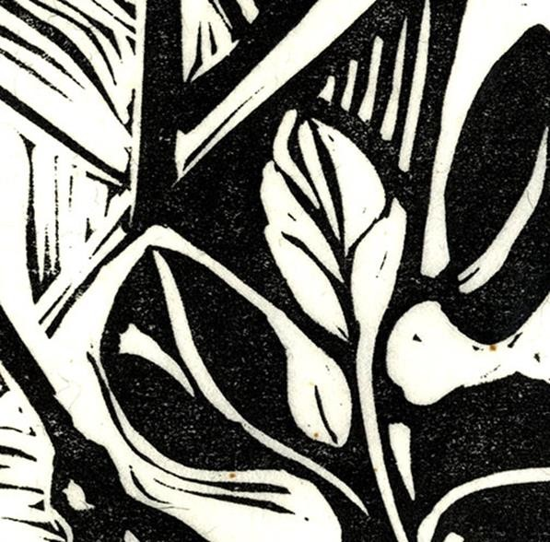
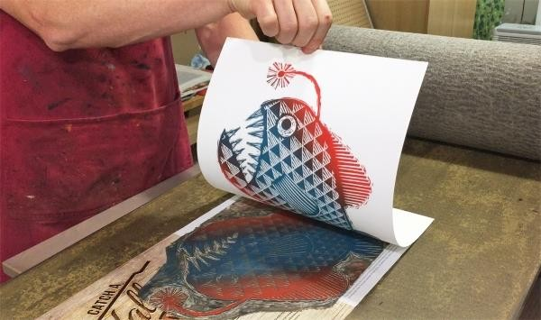
SINGLE-COLOUR LINO PRINTS
The easiest style of lino print is a single-colour print. You cut the design once, and print it using one colour only. Black is usually used because of its strong contrast to white paper.
Plan your linocut design on a sheet of paper, or on the lino itself, before
you start cutting. Remember, what you cut away will be white and what you leave will be black. Also, the printed version will be reversed, so if you've any lettering you must cut this out backwards.

Slide 23
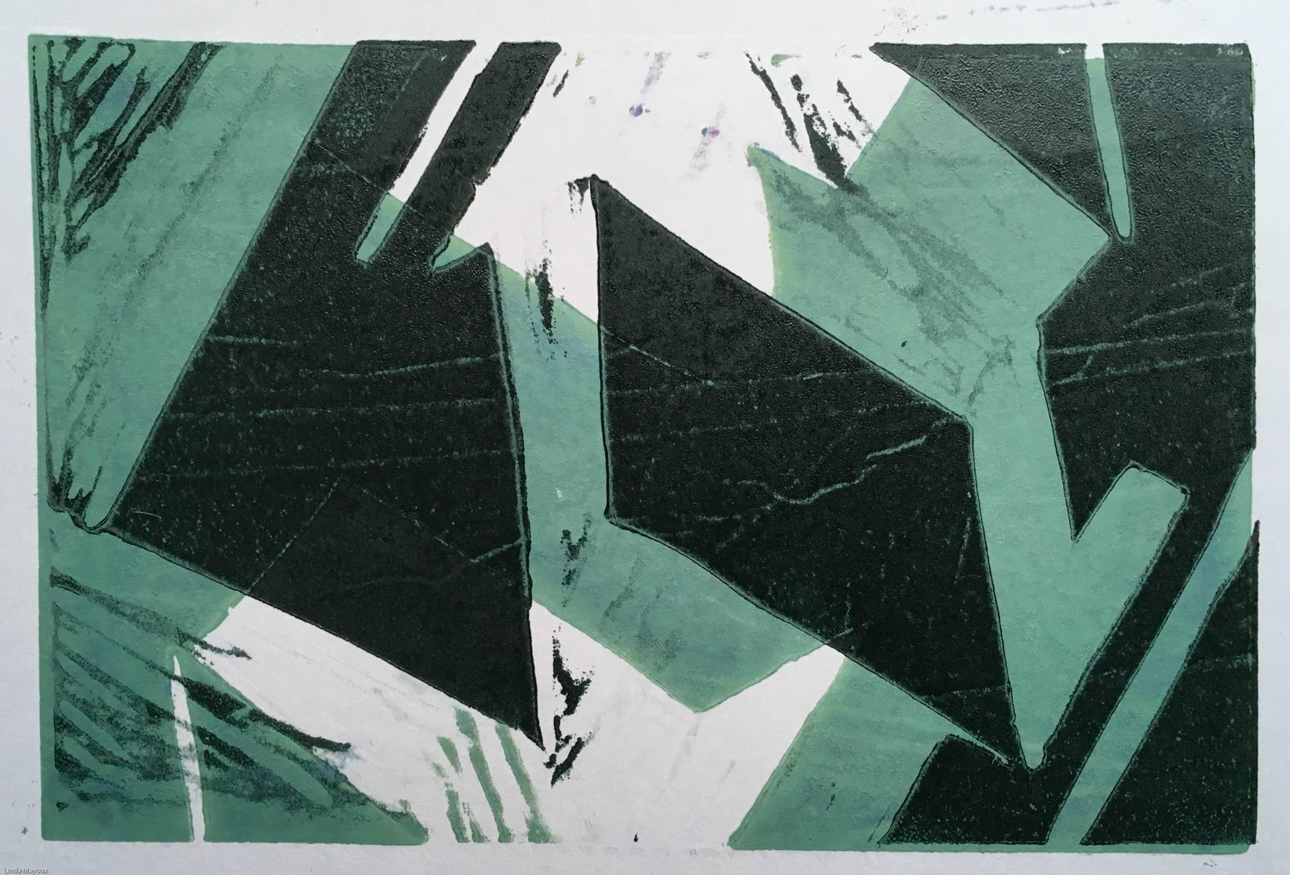

Slide 24
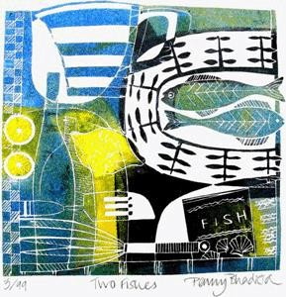

REDUCTION LINOCUTS
Reduction linocuts are printed from one piece of lino, cutting it again for each new colour in your design. The first cut is for any areas in the design to be left white (or the colour of the paper), and you print it with colour 1. The second cut takes away those areas in the design you want to be colour 1 in the final print. You then print colour 2 on top of colour 1. (Ensure the ink is dry before printing the next colour.) The result is a print with white and two colours.

Slide 25


CREATE A SERIES OF 3 COLOUR LINO PRINTS
Looking at your own “Journey” photos, select sections from 6 images. Draw these sections in your book.

Slide 26

TRACE YOUR ABSTRACT SECTIONS ONTO LINO
Next trace your favourite 3 sections and then transfer these on to 3 pieces of lino/adigraf.
Begin to make 3 different lino cuts.

Slide 27

EXPERIMENT WITH DIFFERENT MATERIALS
Next experiment printing each piece on to different papers using different colour combinations.
Think about colour combinations.

Slide 28


COLOUR THEORY
Colour Harmonies
- basic techniques for creating colour schemes
Below are shown the basic colour chords based on the colour wheel.
Complementary colour scheme
Colours that are opposite each other on the colour wheel are considered to be complementary colours (example: red and green).
The high contrast of complementary colours creates a vibrant look especially when used at full saturation. This colour scheme must be managed well so it is not jarring.
Complementary colour schemes are tricky to use in large doses, but work well when you want something to stand out.
Complementary colours are really bad for text.

Slide 29


PRINT ONTO MAPS
Print off maps of the general area of journey, from the internet
Experiment with lino-printing your designs directly on to maps

Slide 30



Slide 31


Slide 32

ROBERT RAUSCHENBERG
Robert" Rauschenberg (October 22, 1925
– May 12, 2008) was an American painter and graphic artist whose early works anticipated the pop art movement. Rauschenberg is well known for his "Combines" of the 1950s, in which non- traditional materials and objects were employed in innovative combinations. Rauschenberg was both a painter and a sculptor and the Combines are a combination of both, but he also worked with photography, printmaking, papermaking, and performance.
Complete 2 pages of research on this artist.

Slide 33



CREATE COLLAGES OF YOUR JOURNEY

Slide 34


LINO PRINT ONTO YOUR COLLAGE

Slide 35

FINAL PIECE
Create your final piece. To do this select your best 9 prints and put them together in a grid. These could be made up of :-
Lino prints Reduction prints Printing on to collage Textiles pieces
Mono-prints Collagraph.

Slide 36
RESOURCE PHOTOS

Slide 37

RESO
URCE IMAGES

Slide 38


Slide 39


Slide 40


Slide 41


Slide 42


Slide 43


Slide 44


Slide 45


Slide 46


Slide 47


Slide 48


Slide 49


Slide 50


Slide 51


Slide 52


Slide 53


