Slide 1







*

Slide 2









Edexcel GCSE Art and Design 2019 - Externally Set Assignment
Counts towards 40% of your final mark for your GCSE
AO1 (Develop) -
Find relevant artists to look at
Use this work to inspire mini pieces of work
Make personal comments (critical understanding) about this work
Visit museums, galleries, cities, spaces etc to inspire your work
AO2 (Experiment and Refine) -
Explore different media in your sketchbook Use different techniques and processes
Evaluate how successful your experiments have been
AO3 (Record)
Collect and present only relevant imagery
Produce high quality drawings/sketches/ paintings etc.
Take your own photos
Annotate your work
AO4 (Present)
Produce confident and high quality final piece/s
Work must be personal and creative
Ensure your work links to your prep work

Slide 3





*
The throwing back by a body or surface of light, heat, or sound without absorbing it. ‘the reflection of light’
An idea about something, especially one that is written down or expressed. ‘reflections on human destiny and art’
An amount of light, heat, or sound that is
reflected by a body or surface.
‘the reflections from the street lamps gave them just enough light’
Serious thought or consideration.
‘he doesn't get much time for reflection’
An image seen in a mirror or shiny surface. ‘Marianne surveyed her reflection in the mirror’
A thing bringing discredit to someone or something.
‘it was a sad reflection on society that
because of his affliction he was picked on’
A thing that is a consequence of or arises from something else.
‘a healthy skin is a reflection of good health in general’
What does Reflections mean to you?

Slide 4
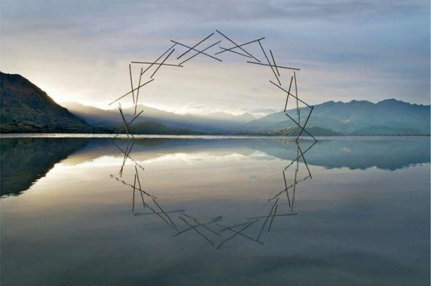






* The artists and images on
the next few slides are
suggestions to help you think about possible ideas. You
may already have ideas of
your own.
Martin Hill
* Keep an open mind at this
point…
*

Slide 5
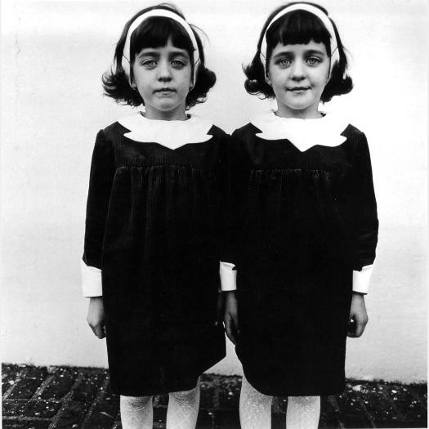
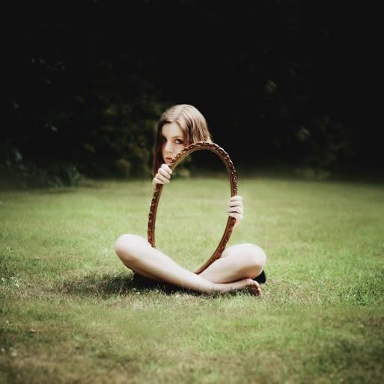
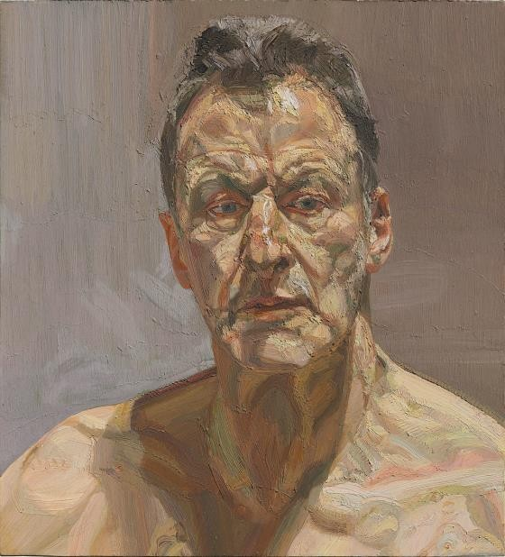




*Daydreamer
Diane Arbus
*Contemplative
*Pensive
*Meditative
*Impulsive
*Likeness
*Shimmer
*Exaggerated
*Twins
*Self
Laura Williams
Lucian Freud
*

Slide 6
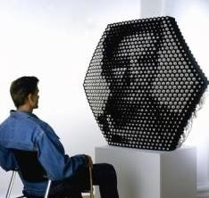
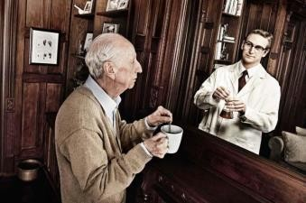
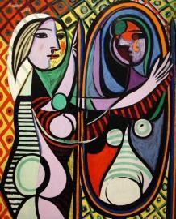
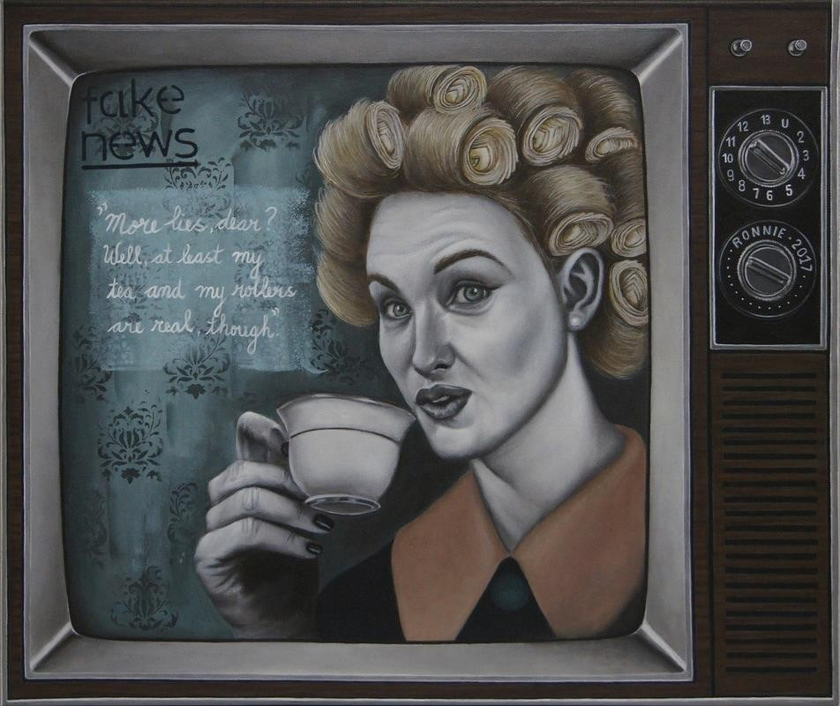
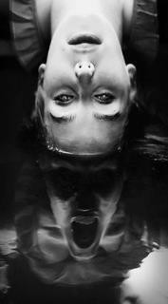
Tom Hussey
Daniel Rozin
Pablo Picasso
Ronnie Jiang

Slide 7
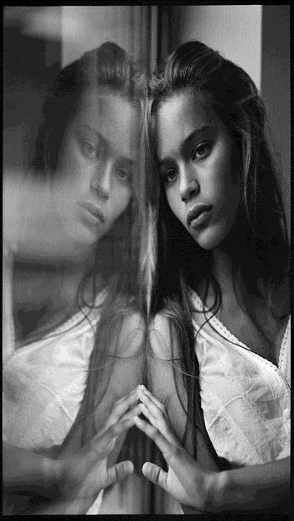
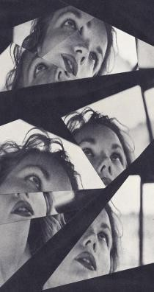
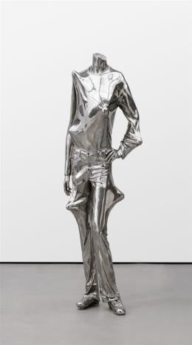
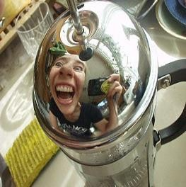
Kevin Willems
Envy bumps, 2007
Erwin Wurm

Slide 8
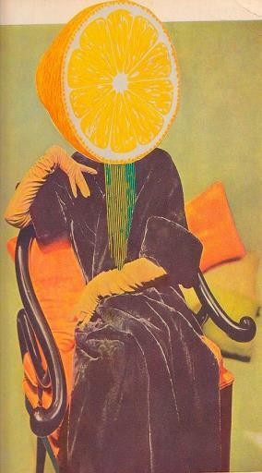
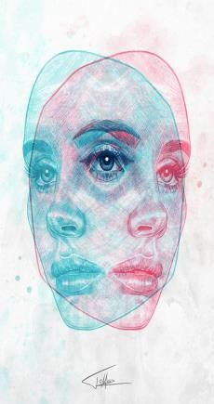
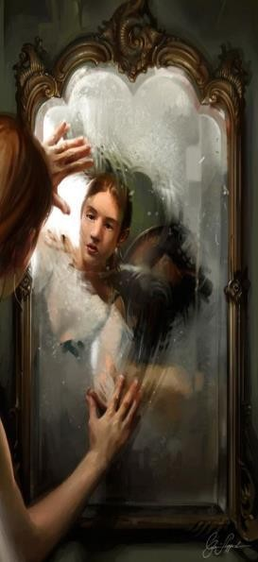
Destiny, 2017
Tomasz Mro
Sour Disposition
Geoff Kim
Cynthia Sheppard

Slide 9

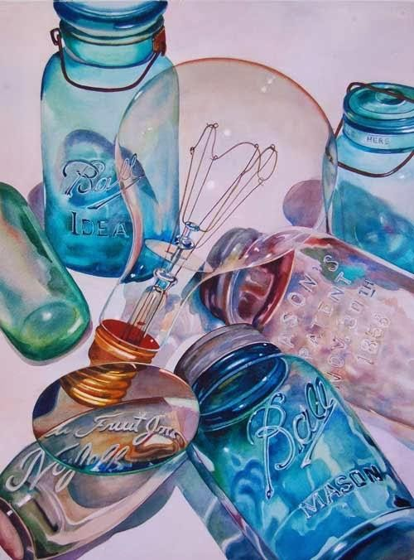
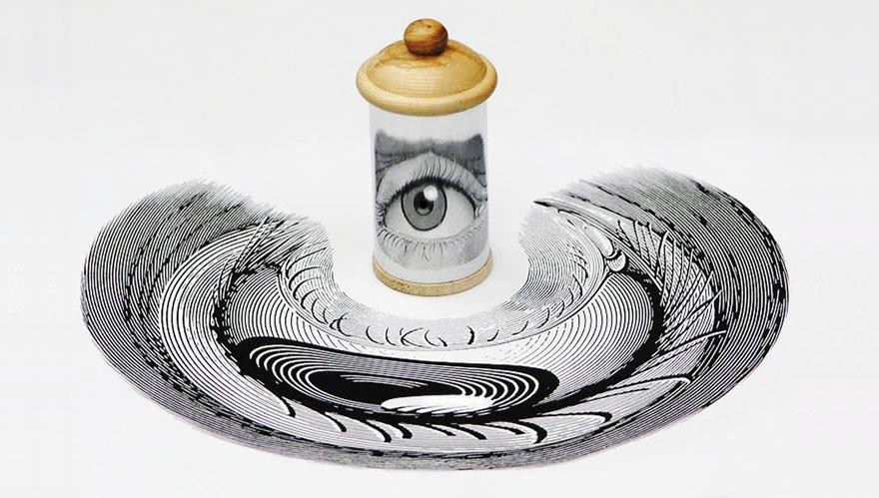






*Mass produced
Vonnie Whitworth
*Material qualities
*Evoke
*Narratives
*Replica
*Neglect
*Recycled
*Deflect
*Anamorphic
*Pattern
Istvan Orosz
Kate Bush/Peacock Design
*

Slide 10
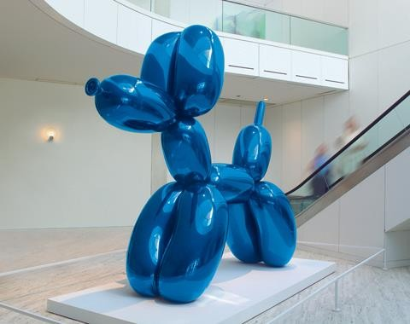
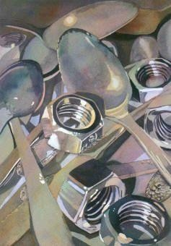
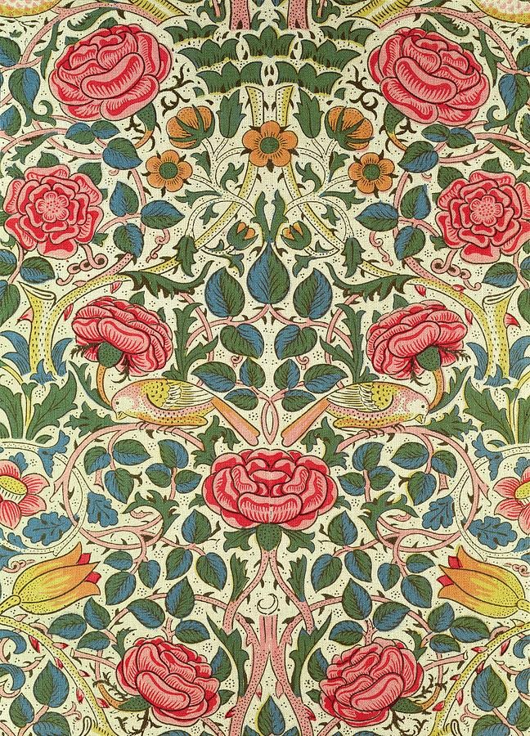
Jeff Koons
William Morris

Slide 11


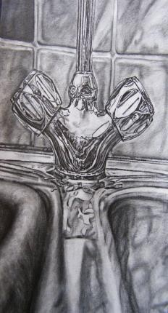
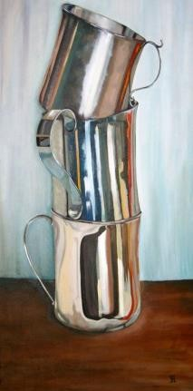

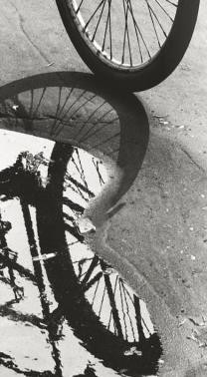
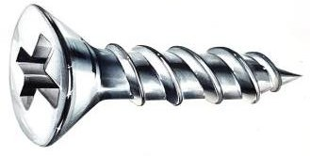
*
Dennis Hopper

Slide 12
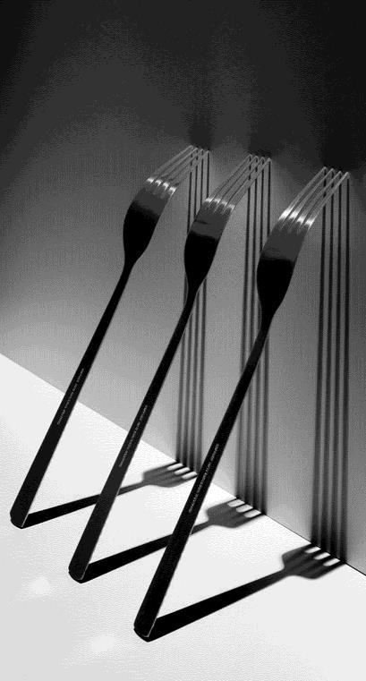
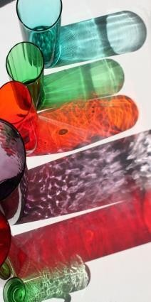
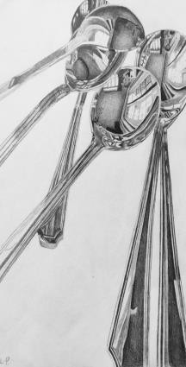
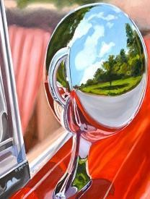
Darek Grabus
GCSE student

Slide 13
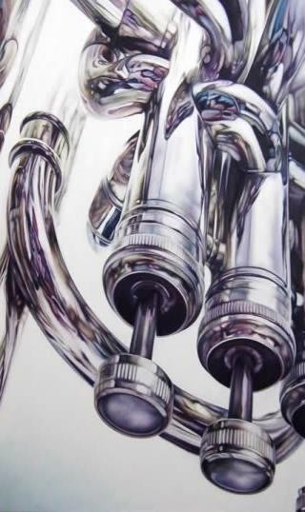
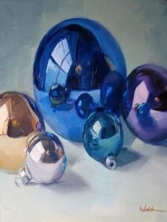
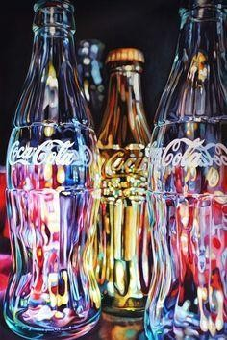
Sarah Sedwick
Kate Brinkworth
Todd Ford

Slide 14
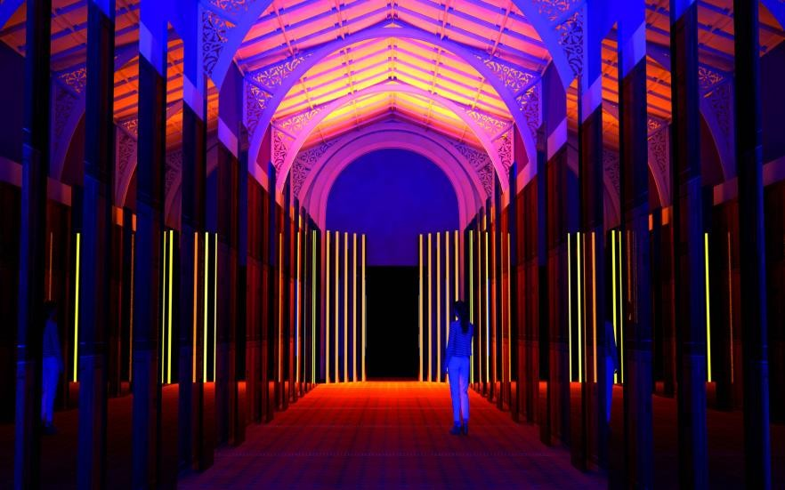
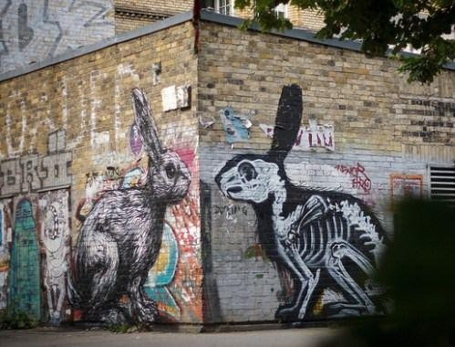



*Illumination/lighting
*Murals
*Architecture
*Façade
*Demonstration
*Polished
*Radiate
*Positive/negative
*City life
*Memories
Flynn Talbot
*
ROA

Slide 15
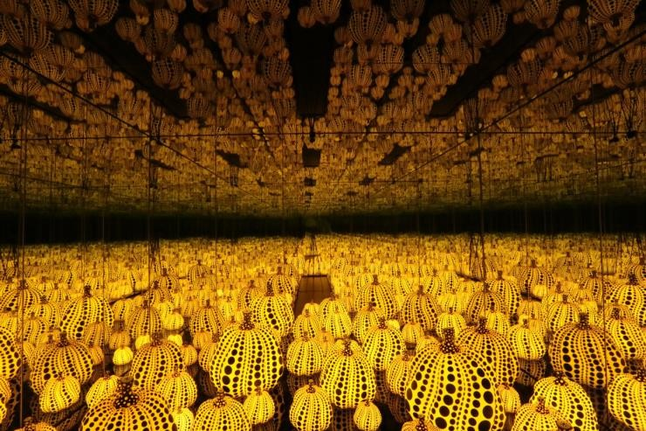
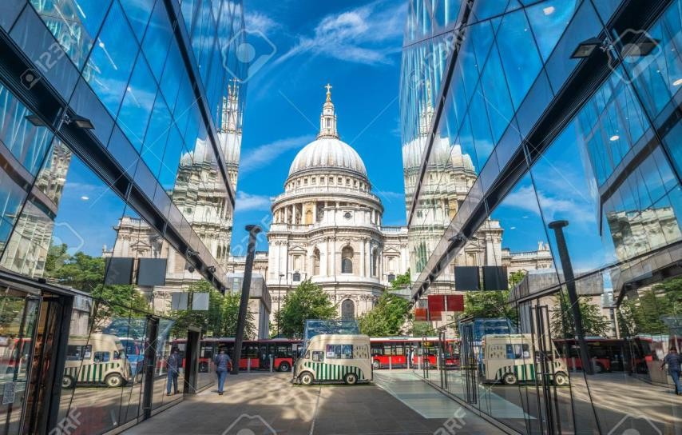
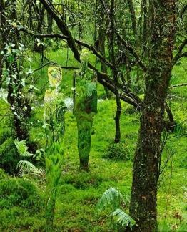
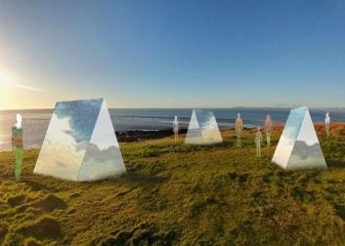
Yayoi Kusama
Rob Mulholland

Slide 16

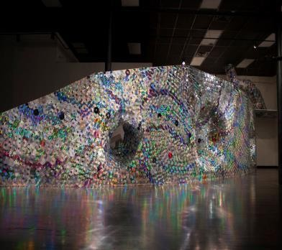


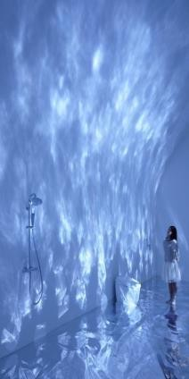
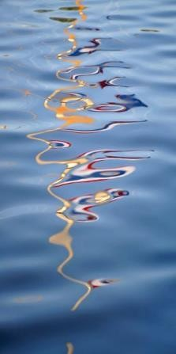
*
Leticia R. Bajuyo
Torafu
Architects

Slide 17
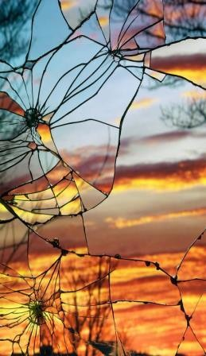
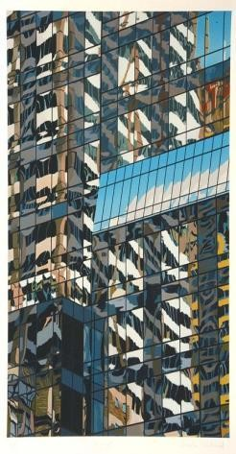
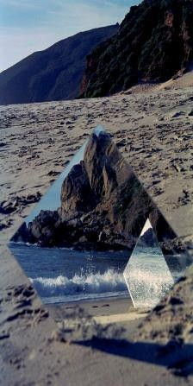
Bing Wright
Brendan Neiland
Amanda Charchian

Slide 18





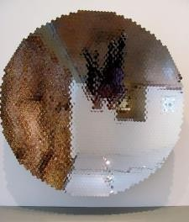
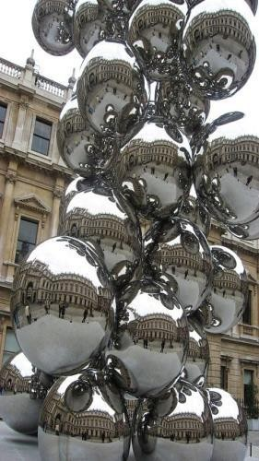
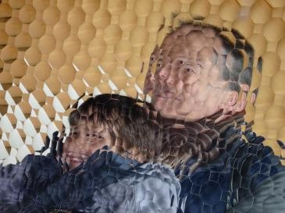
*

Slide 19
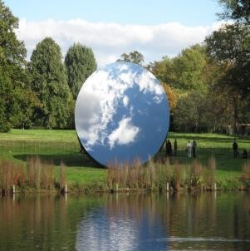
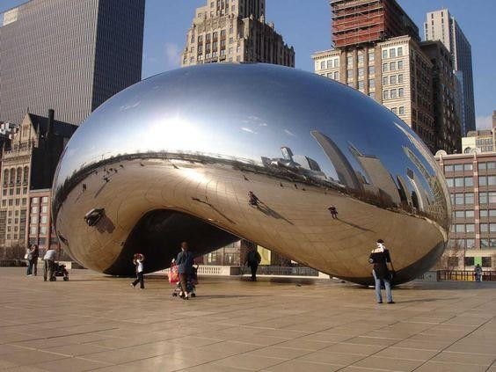
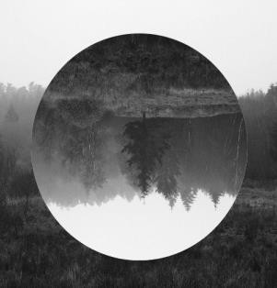

Slide 20







*

Slide 21










*
Michael Goro
Gavin Hammond
Grzegorz Wrbel
Scott Russell

Slide 22







*Water
*Moon and Sun
*Wildlife
*Symmetry
*Echoes
*Time of day
*Shadow
*Erosion
*Life cycle
*Camouflage
Rachel Cross
Nils Udo
Kiyochika Kobayashi
*

Slide 23




Damien Hirst
Rhian Symes
Abbott H. Thayer
Henri Rousseau

Slide 24




Emma Cammack
Cecilia Paredes
Nora Unda
Lee Borthwick

Slide 25




Slide 26





Andrew Macara
Ernst Haeckel
Georgia O’Keefe

