Slide 1
YEAR 11 GCSE EXAM 2019
REFLECTION: FIRST 6 LESSONS
COMPLETE ALL TASKS
MAKE SURE YOU PRESENT ALL TASKS IN YOUR BOOK
CONNECTING THEM TO THE RELEVANT ARTISTS IN THIS
PRESENTATION. YOU HAVE CLASSWORK AND HOMEWORK TIME TO
COMPLETE THESE OVER THE FIRST 2 WEEKS.

Slide 2
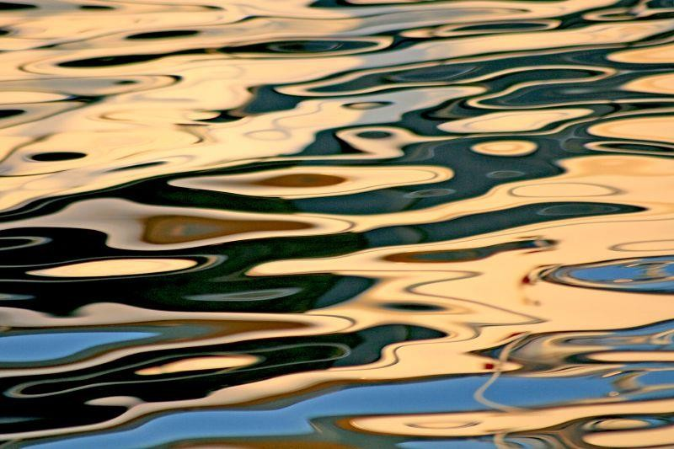
TASK 1: WATER REFLECTION

Slide 3
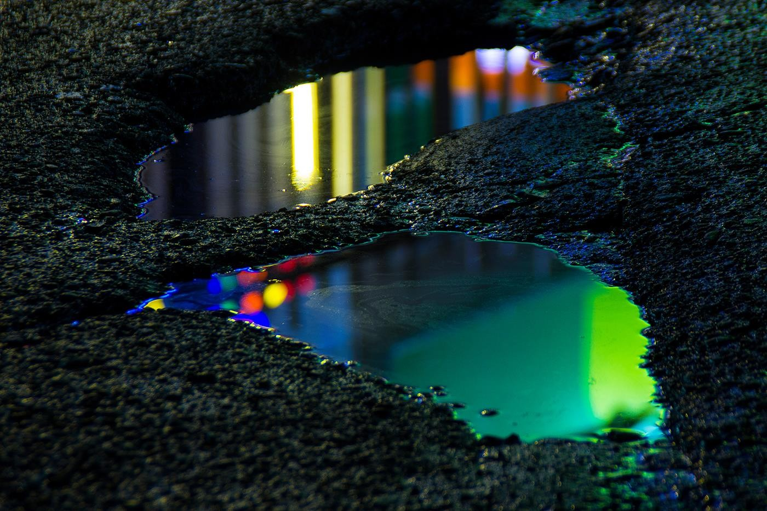
Photographer and artist Slava Semeniuta, who goes by the name Local Preacher, recently noticed the glimmering reflective beauty of the streets of Sochi after an evening rain. As the artist tells Colossal, he had his camera handy and was able to “show the hidden beauty under our feet.”

Slide 4
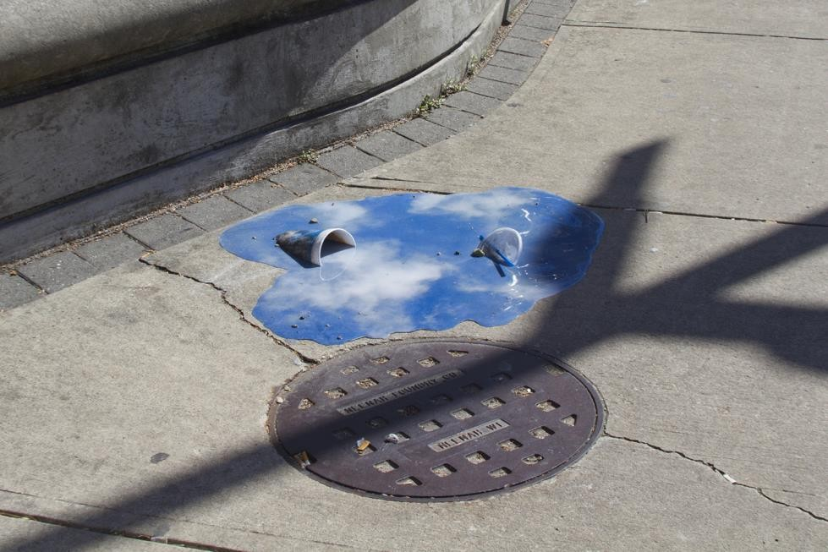
Chicago-based artist Jeffrey Michael Austin spends a lot of time photographing the puddles that collect on his city’s sidewalks and streets, observing the mirror-like quality that occurs when the sun hits the water at just the right angle.
Eager to remake these special moments of reflection, Austin began creating his own sculptural puddles that appear to reflect the sky above.

Slide 5
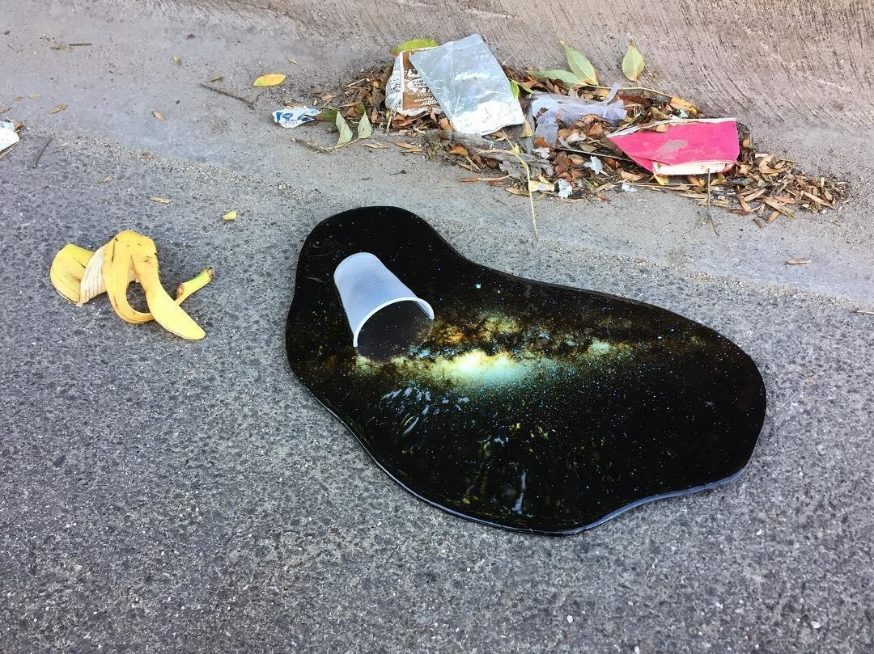

Slide 6
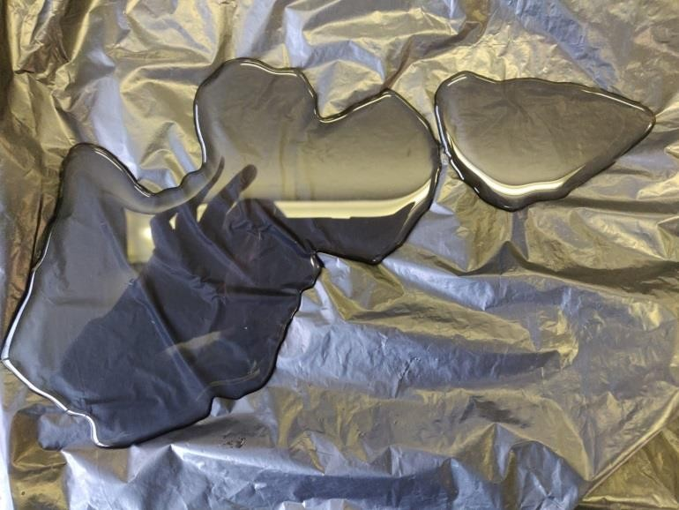
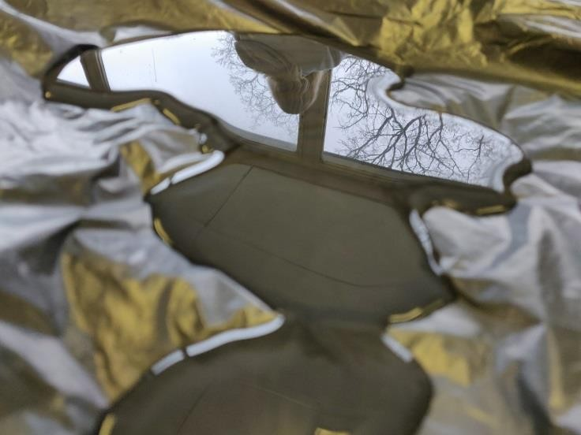
LESSON 1: TASK 1: PUDDLES
Pour water onto a black bin liner to create a puddle
Your teacher will photograph your puddle for you today
to print for next lesson.

Slide 7
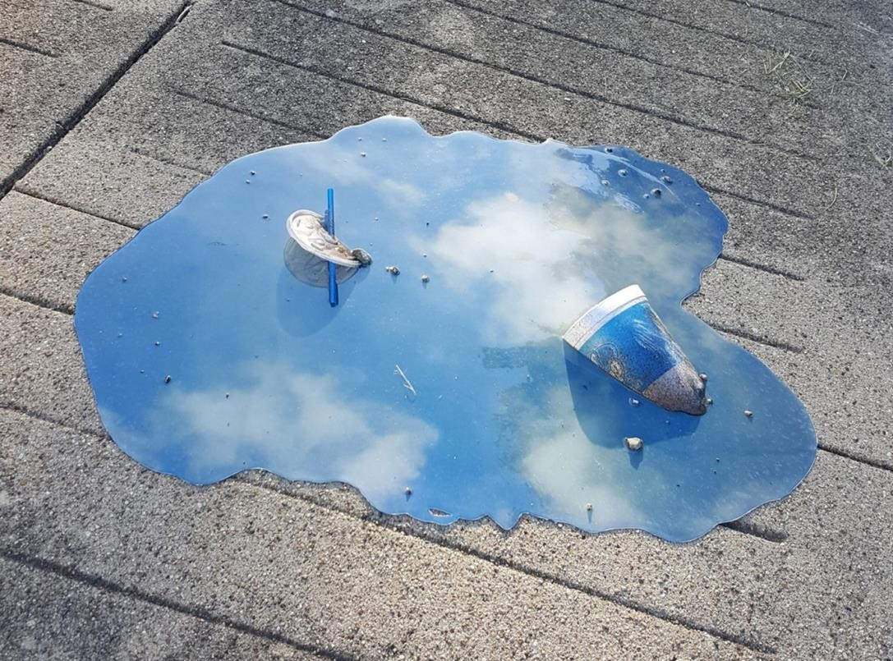
LESSON 1: TASK 2: CLAY PUDDLES
Looking at your water
puddle create a clay puddle.
First use a rolling pin to flatten a piece of clay before cutting out the puddle looking at the shapes in your photos.
Smooth out the edges to refine.
Leave to dry before firing. Glaze or paint the puddles.
Use the reference photos of
coloured lights or skies and paint on to the surface of your puddle.

Slide 8
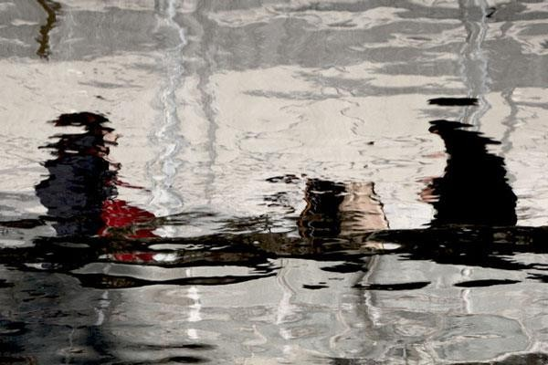
LESSON 2: TASK 2: DRAWING PUDDLES
You will be given a print out of your puddle. In pencil, draw the puddle and its reflection in detail on a full page in your book.
Alternatively use chalk pastel on black sugar paper!

Slide 9
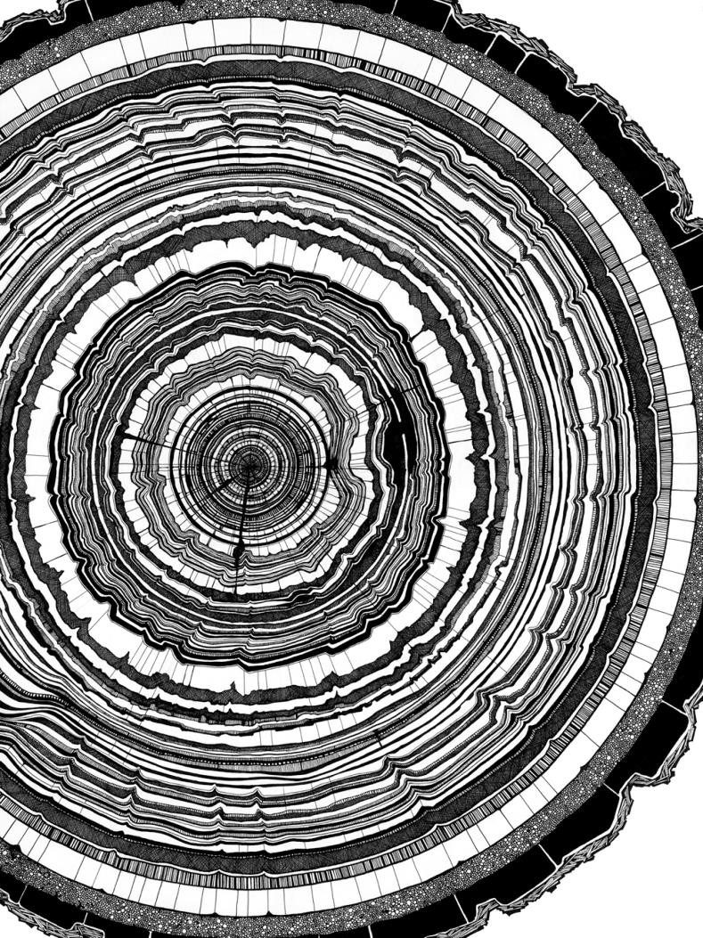
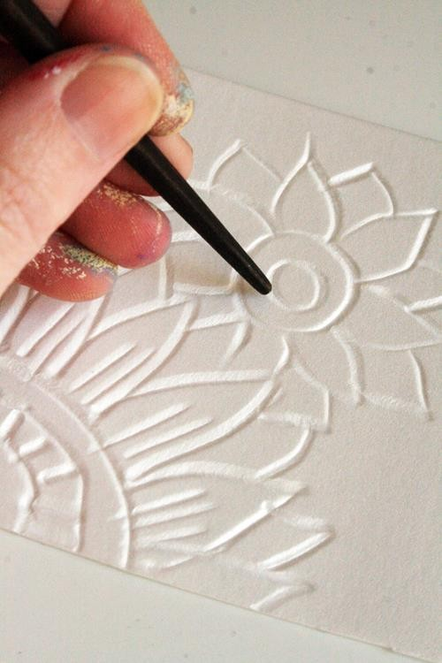
LESSONS 3/4: TASK 3 : TIME REFLECTION-PRINTMAKING
Copy an image of a cross section of a tree onto polystyrene.

Slide 10
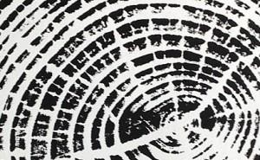
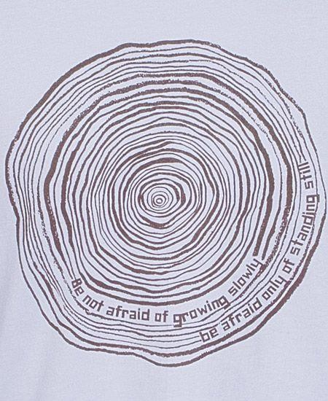
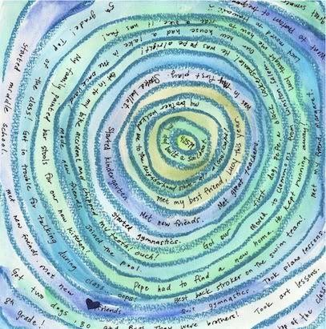
PRINT ONTO PAPER AND ADD STORIES FROM CHILDHOOD MEMORIES
Try to keep early memories in the centre and your most recent on the outer rings

Slide 11
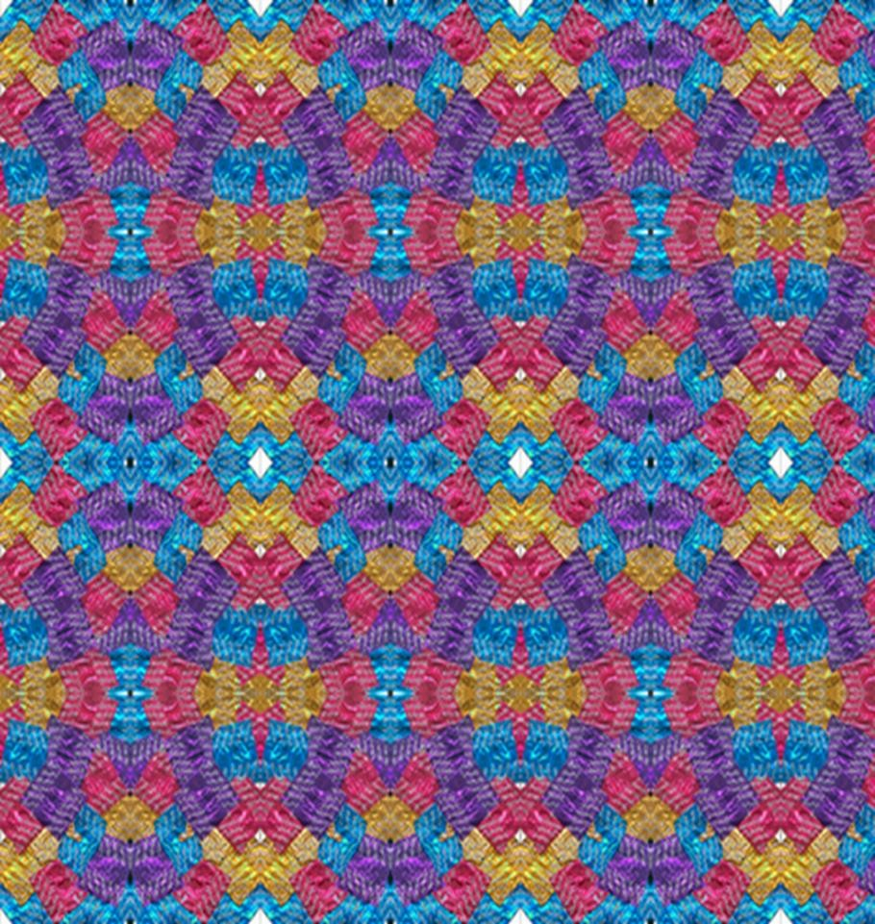
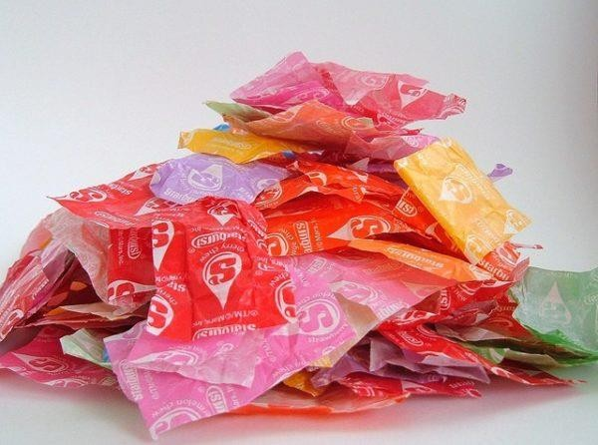
HOMEWORK
Buy your favourite sweets this week-make sure you buy
ones with wrappers!
Keep all your sweet wrappers!
In your sketch-book, create a repeated pattern with your
wrappers to make a kaleidoscopic effect.

Slide 12
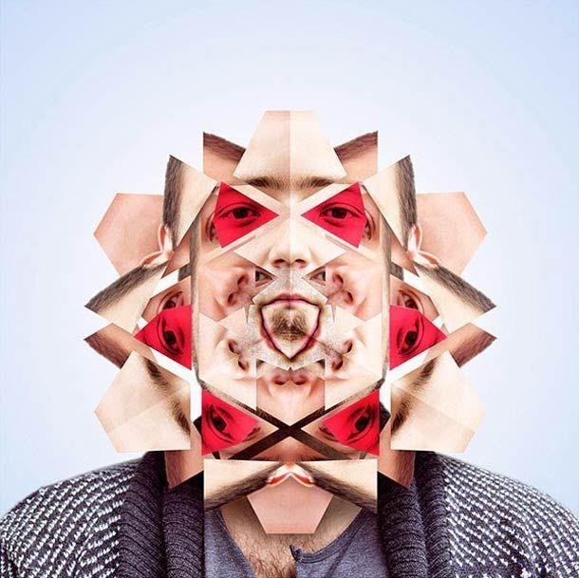
ALTERNATIVE HOMEWORK
Alternatively find 2 different photos of yourself at different ages. Print these off a number of times and create a repeat pattern/ tesselation with the pieces. Do this in your sketchbook!

Slide 13
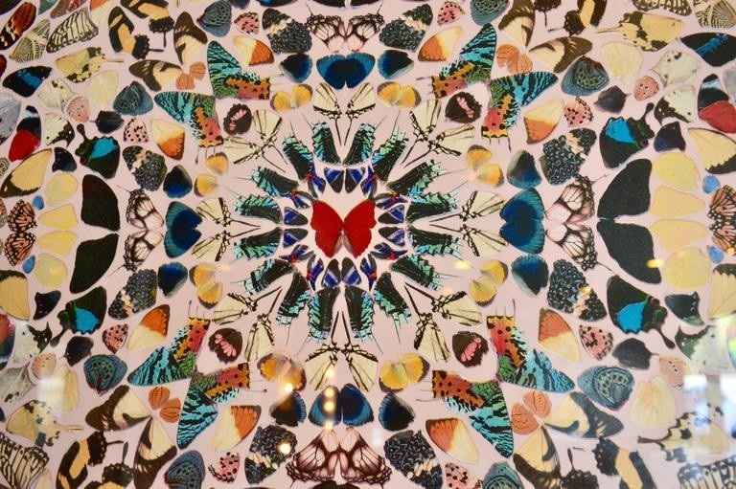
DAMIEN HIRST

Slide 14
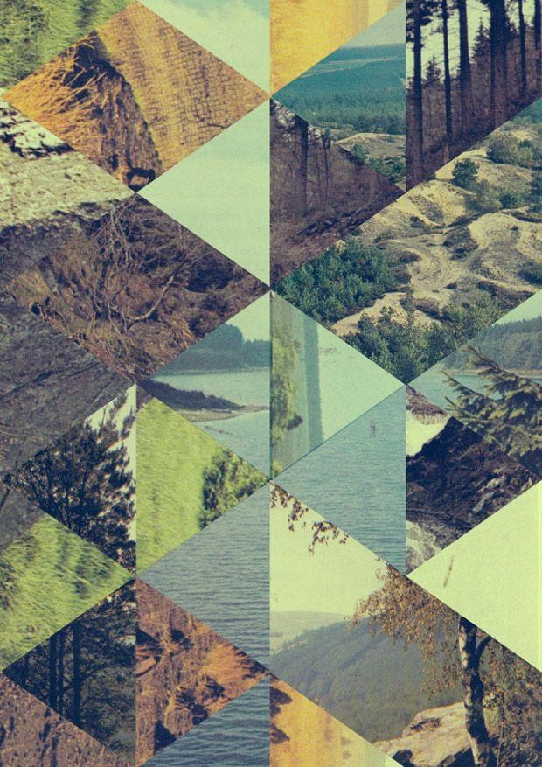
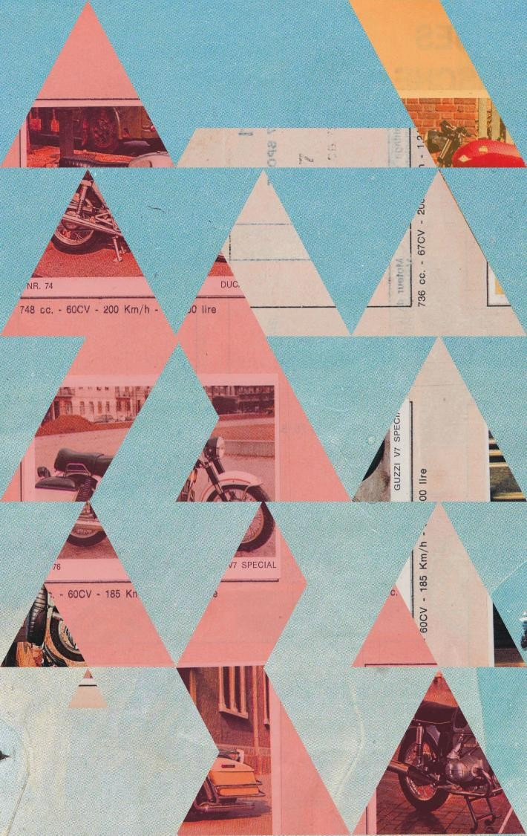
JELLE MARTENS
Jelle Martens’s eye catching work combines strong graphic blocks of colour woven together with saturated grainy photography to create dynamic visual images.

Slide 15
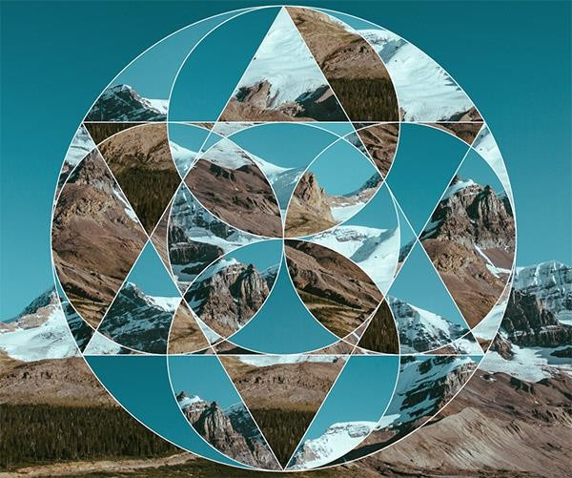
LESSON 5/6: TASK 4: GEOMETRIC COLLAGE
Using the Muswell Hill old and new photos, create a patterned symmetrical collage. You can cut the photos into similar geometric shapes to create your own pattern and layout like Damien Hirst’s Butterflies or Jelle Marten’s digital collages

Slide 16
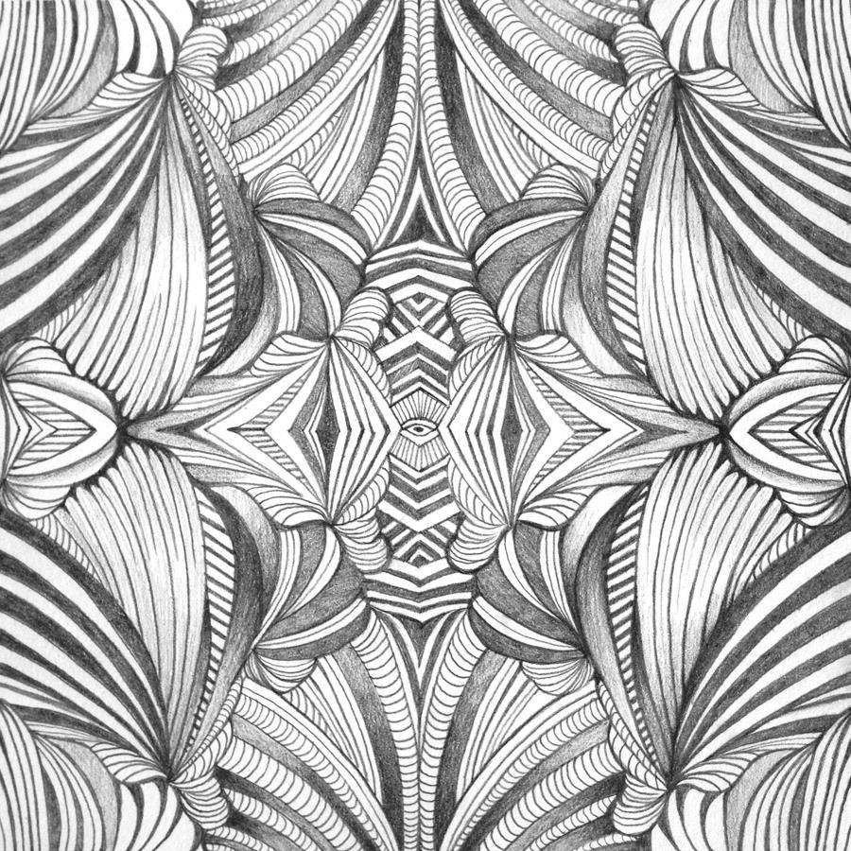
TASK 5: DRAWING
Make a full page drawing of your Muswell Hill Tesselation/Collage

Slide 17
LESSON 6: TASK 6: GLAZE/PAINT YOUR CLAY PUDDLE
Glaze your fired clay puddle looking at the resource
images of skies, or your own puddle photo.
Finish off any of the outstanding tasks! Present these
carefully in your sketchbook.

Slide 18
HOMEWORK
Complete 3 strands on “Reflection.”
-1 page per strand.
-Each page should contain a drawing and collected images and research on your sub-theme.
-Use your mind map from your half term task for ideas.
-Look at the exam paper for ideas
-See the accompanying power-point presentations for ideas

Slide 19
IMAGE RESOURCES FOR TASKS

Slide 20
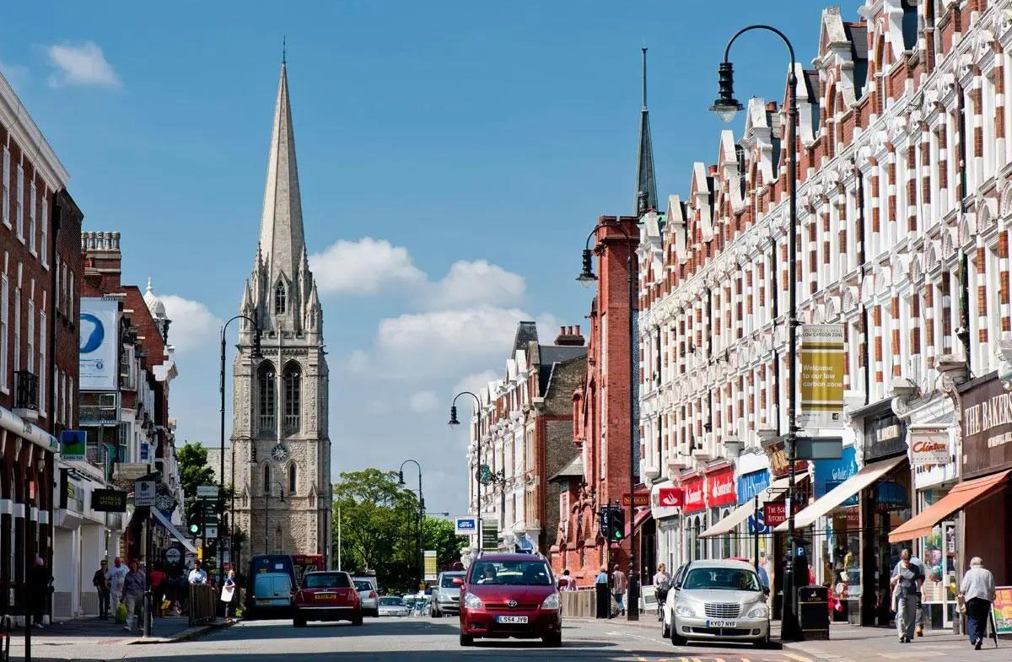

Slide 21
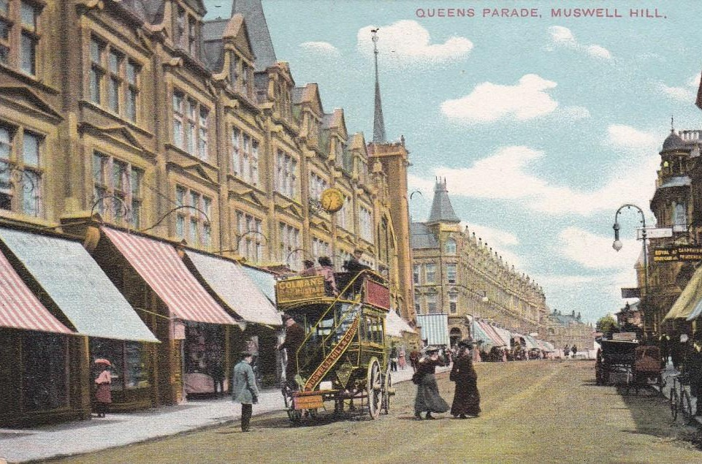

Slide 22
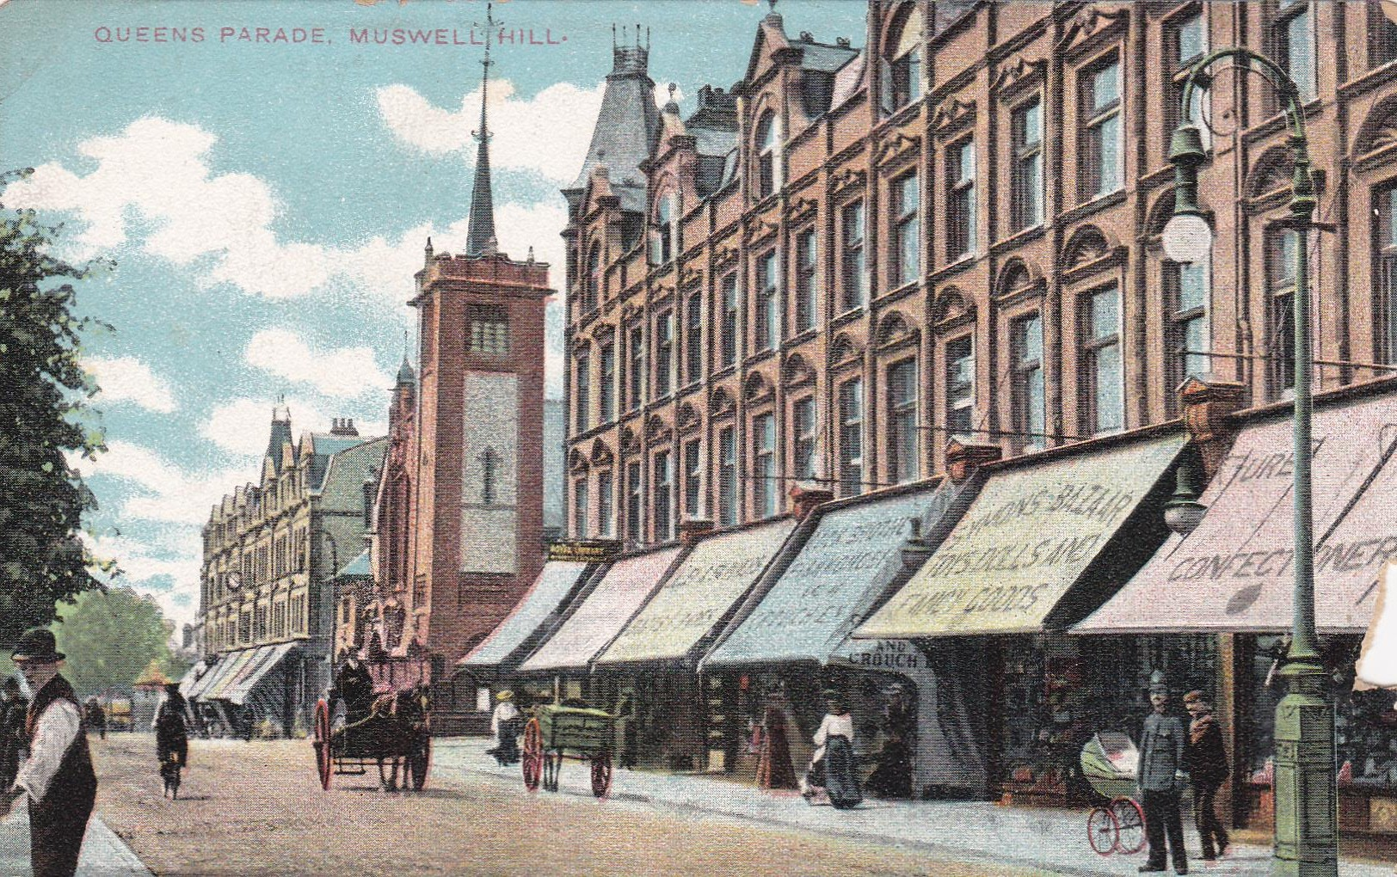

Slide 23
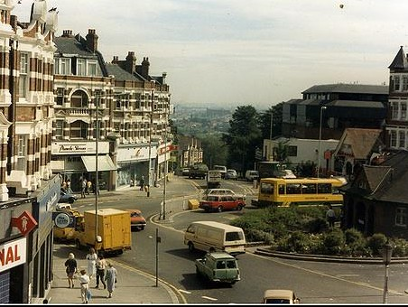

Slide 24
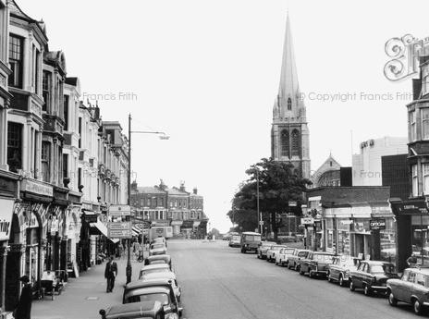

Slide 25
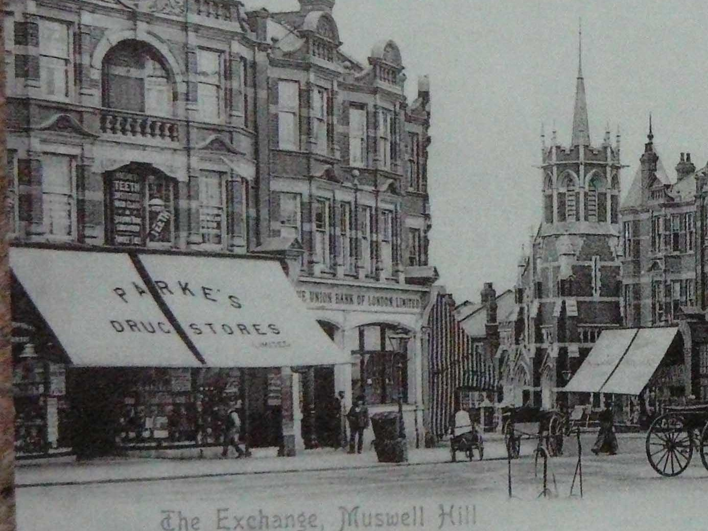

Slide 26
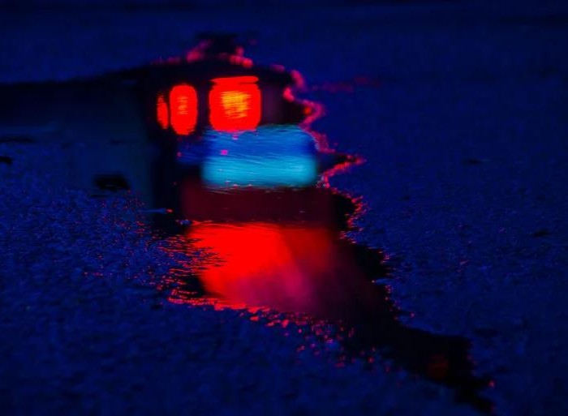

Slide 27
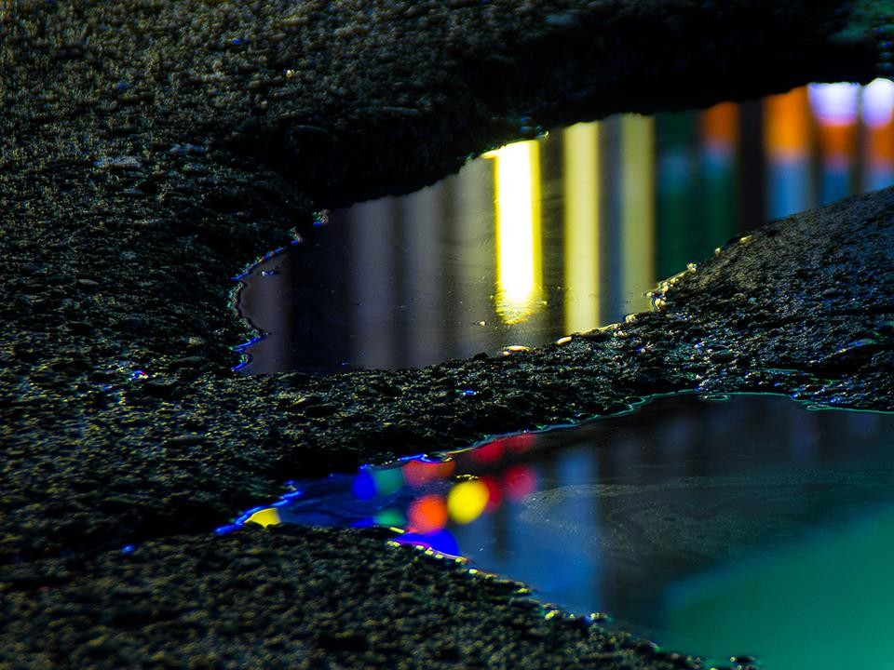

Slide 28
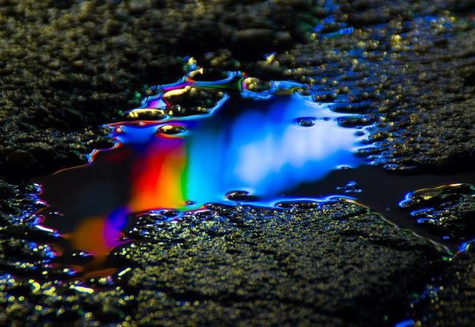

Slide 29
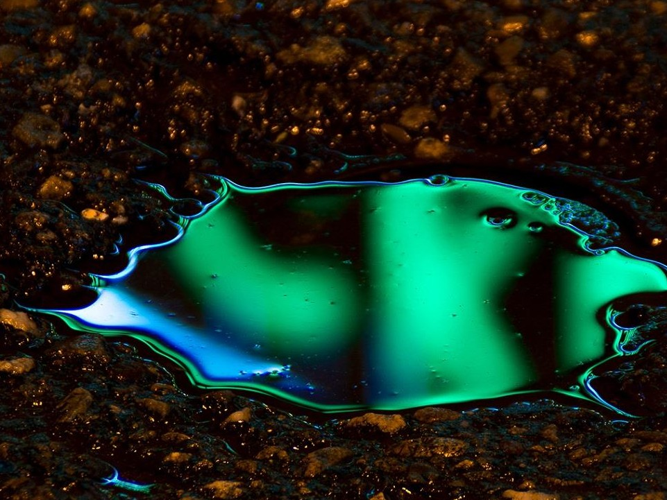

Slide 30
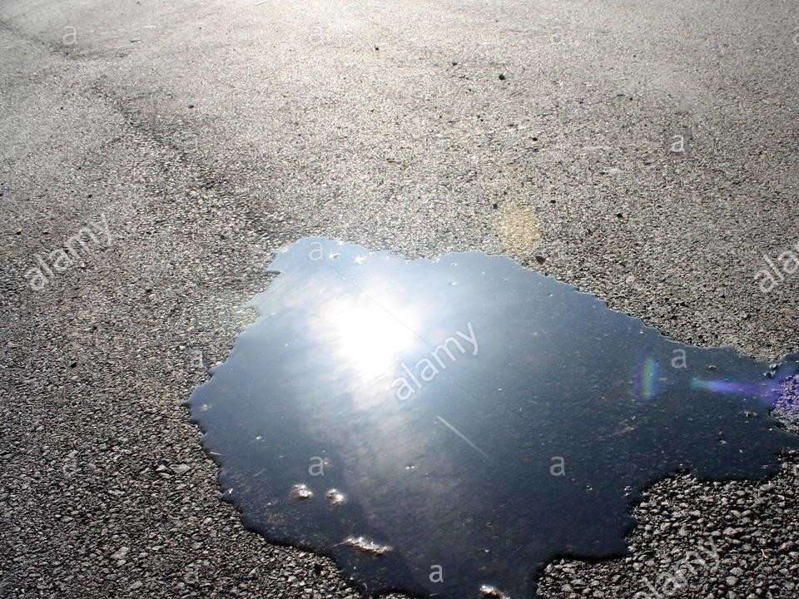

Slide 31
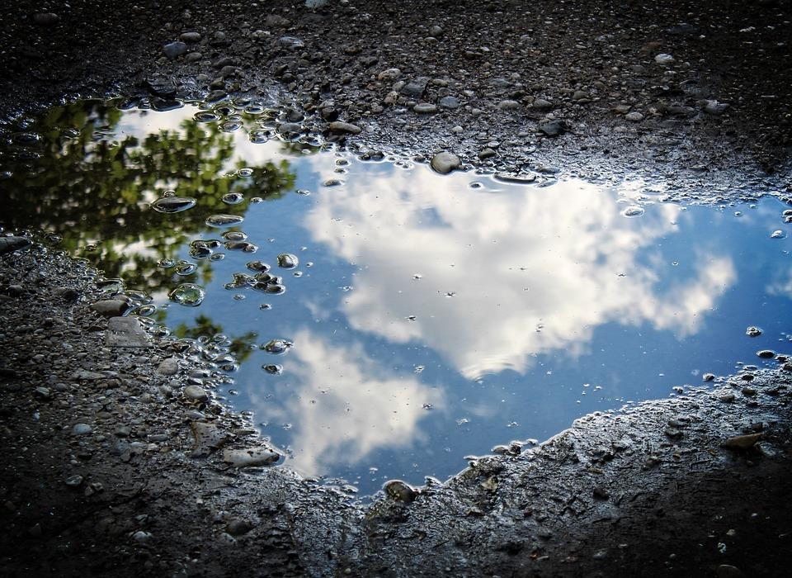

Slide 32
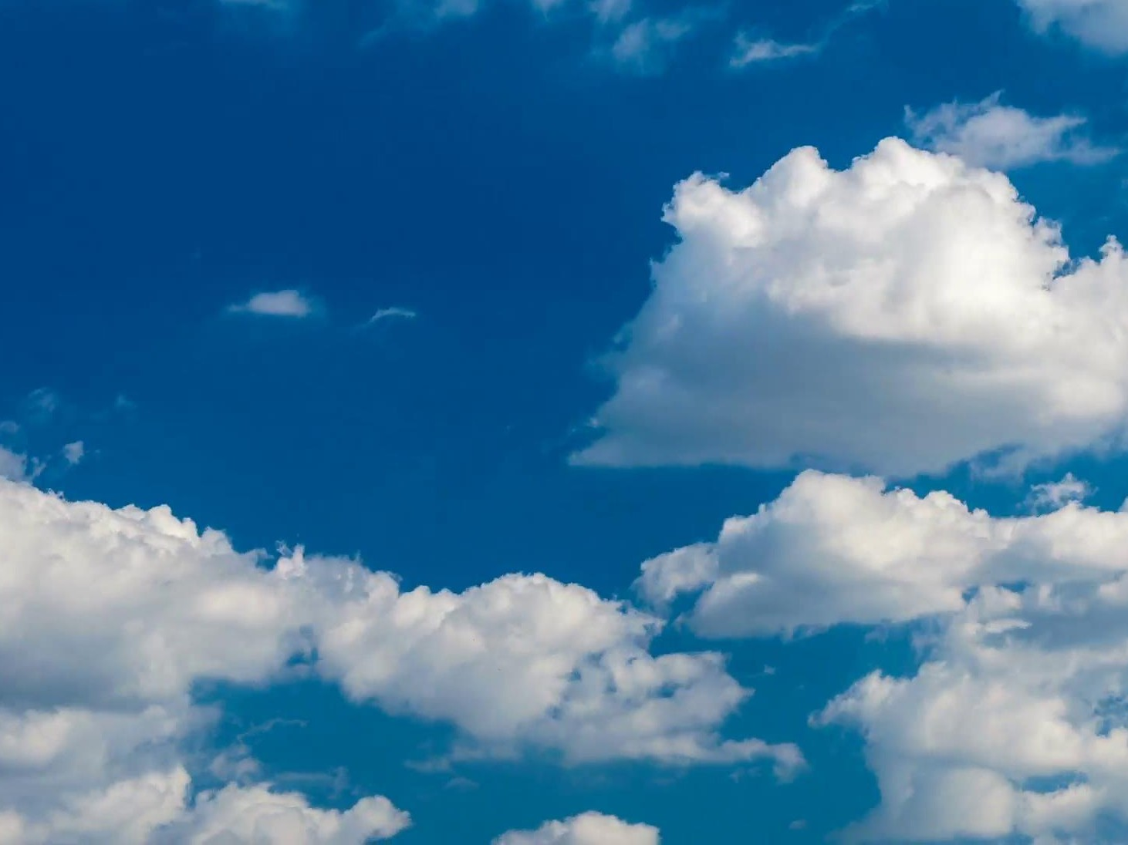

Slide 33
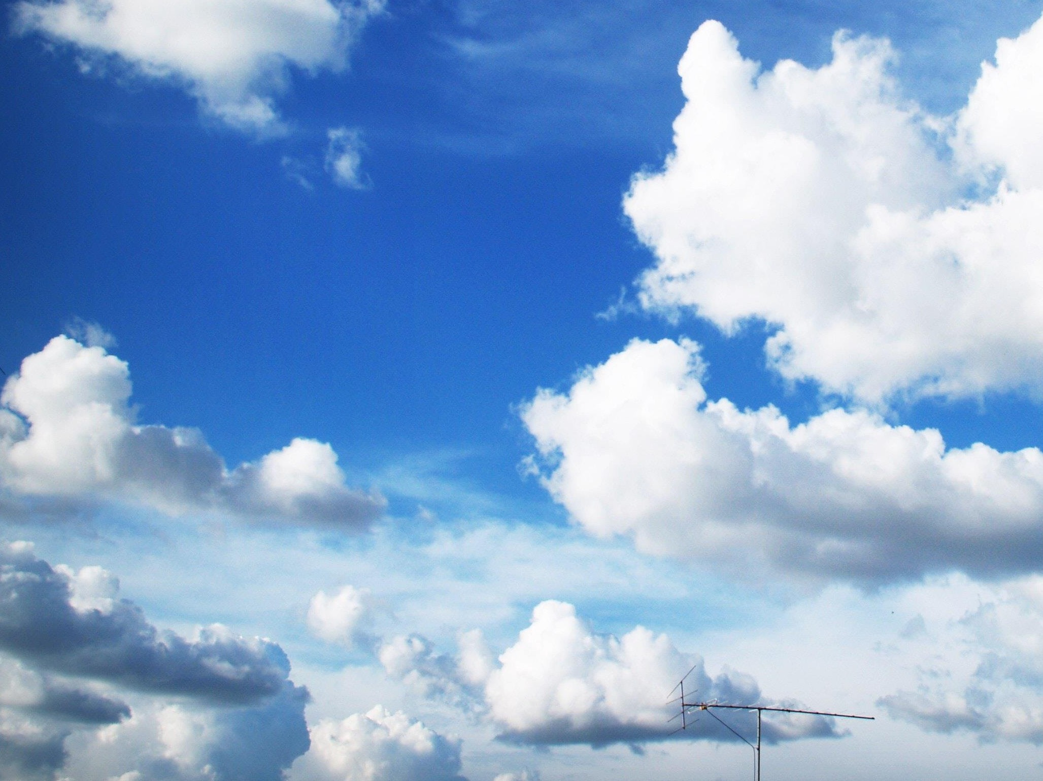

Slide 34
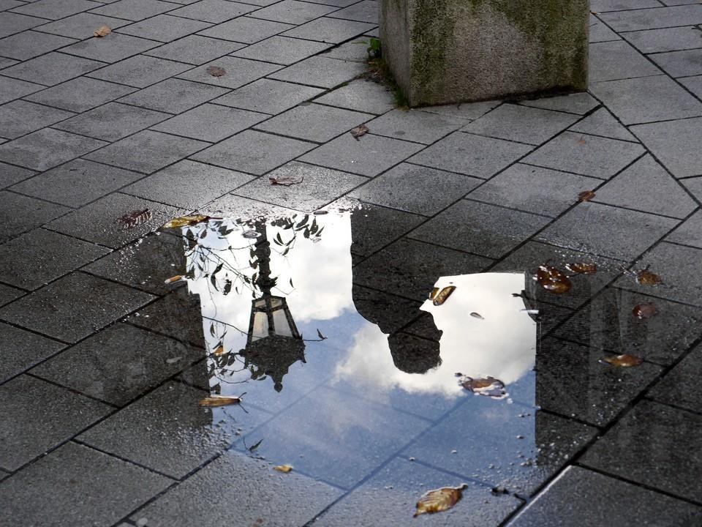

Slide 35
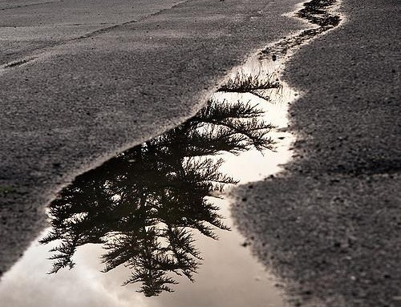

Slide 36
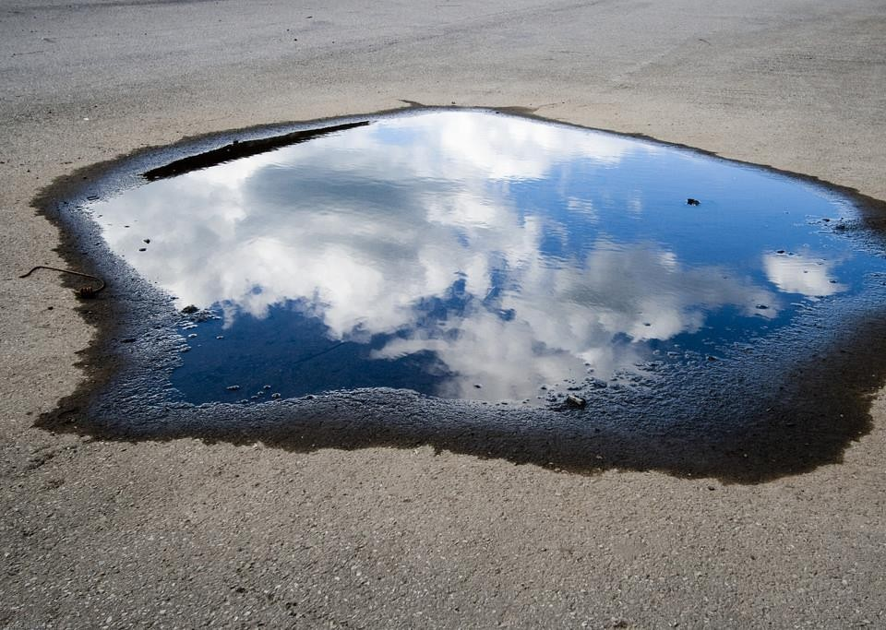

Slide 37
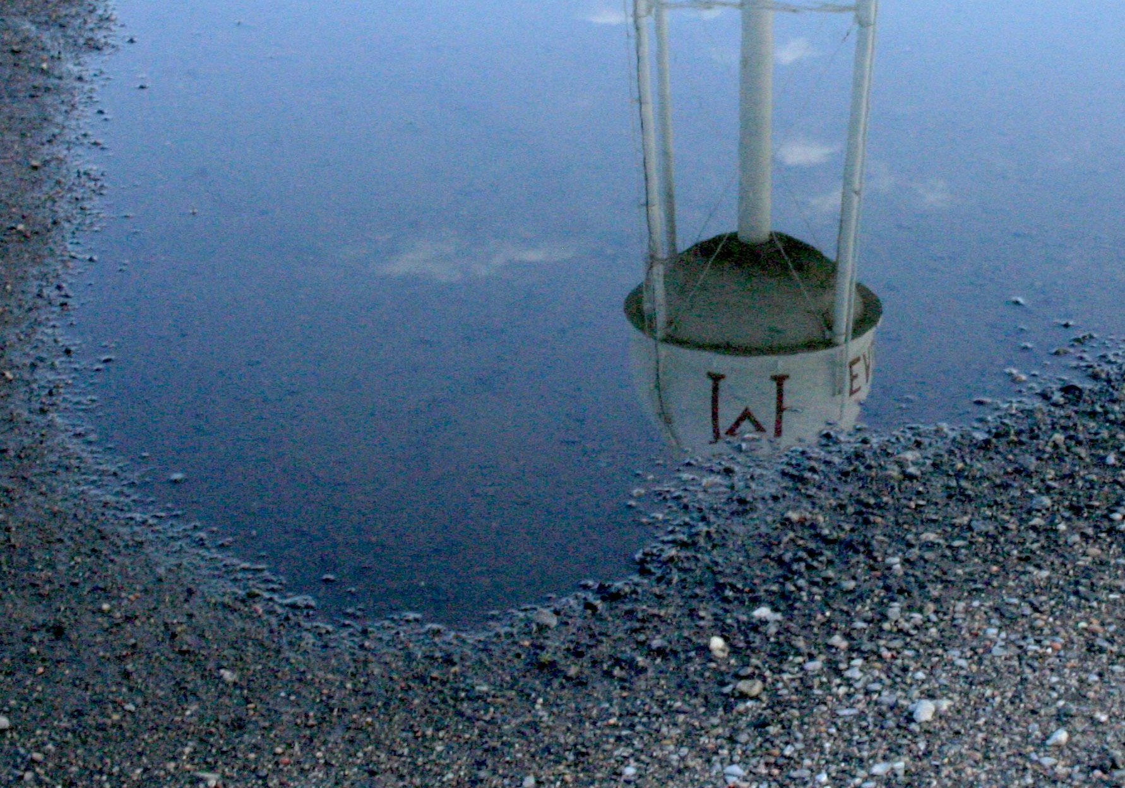

Slide 38
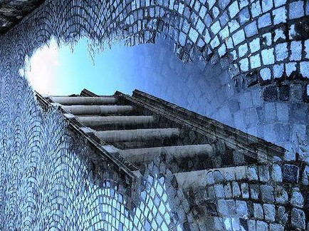

Slide 39
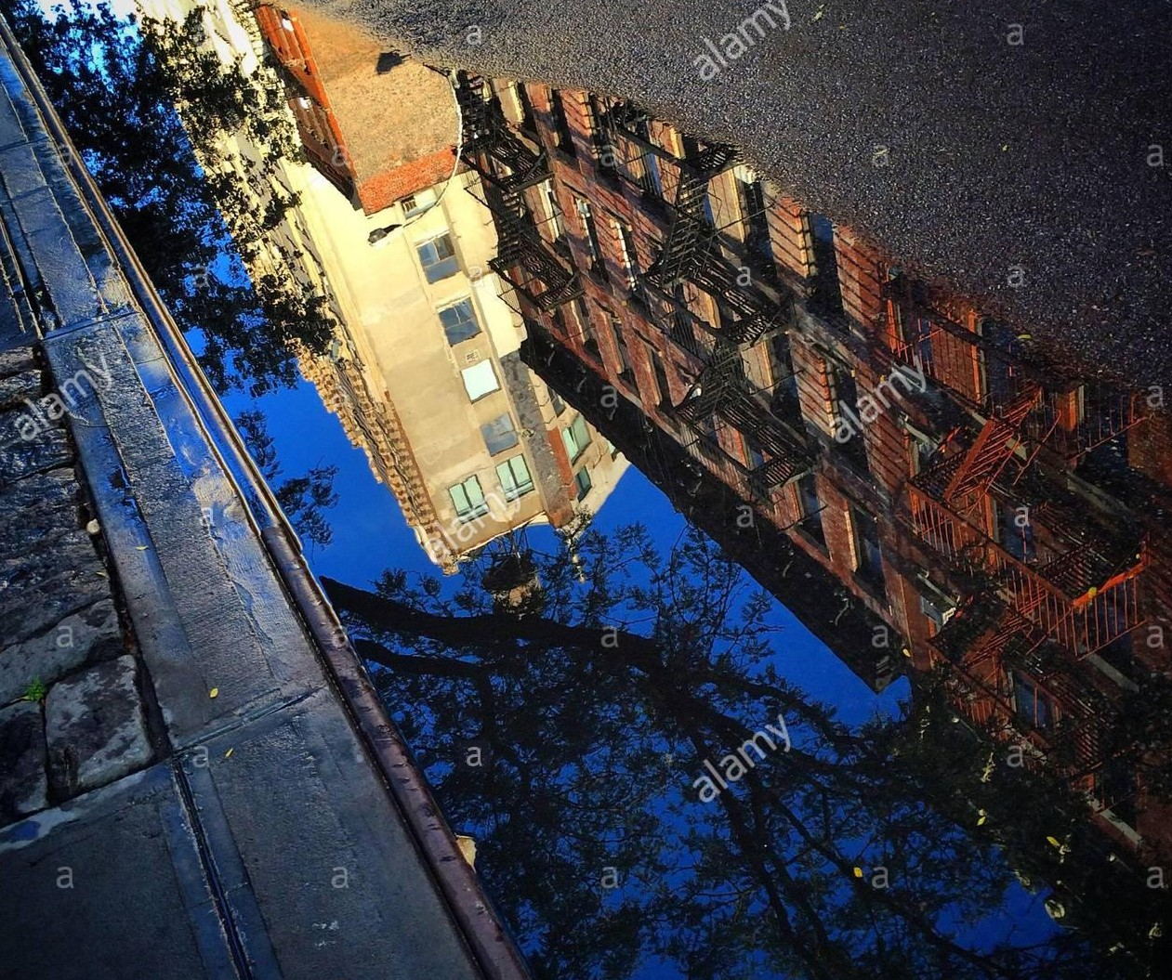

Slide 40
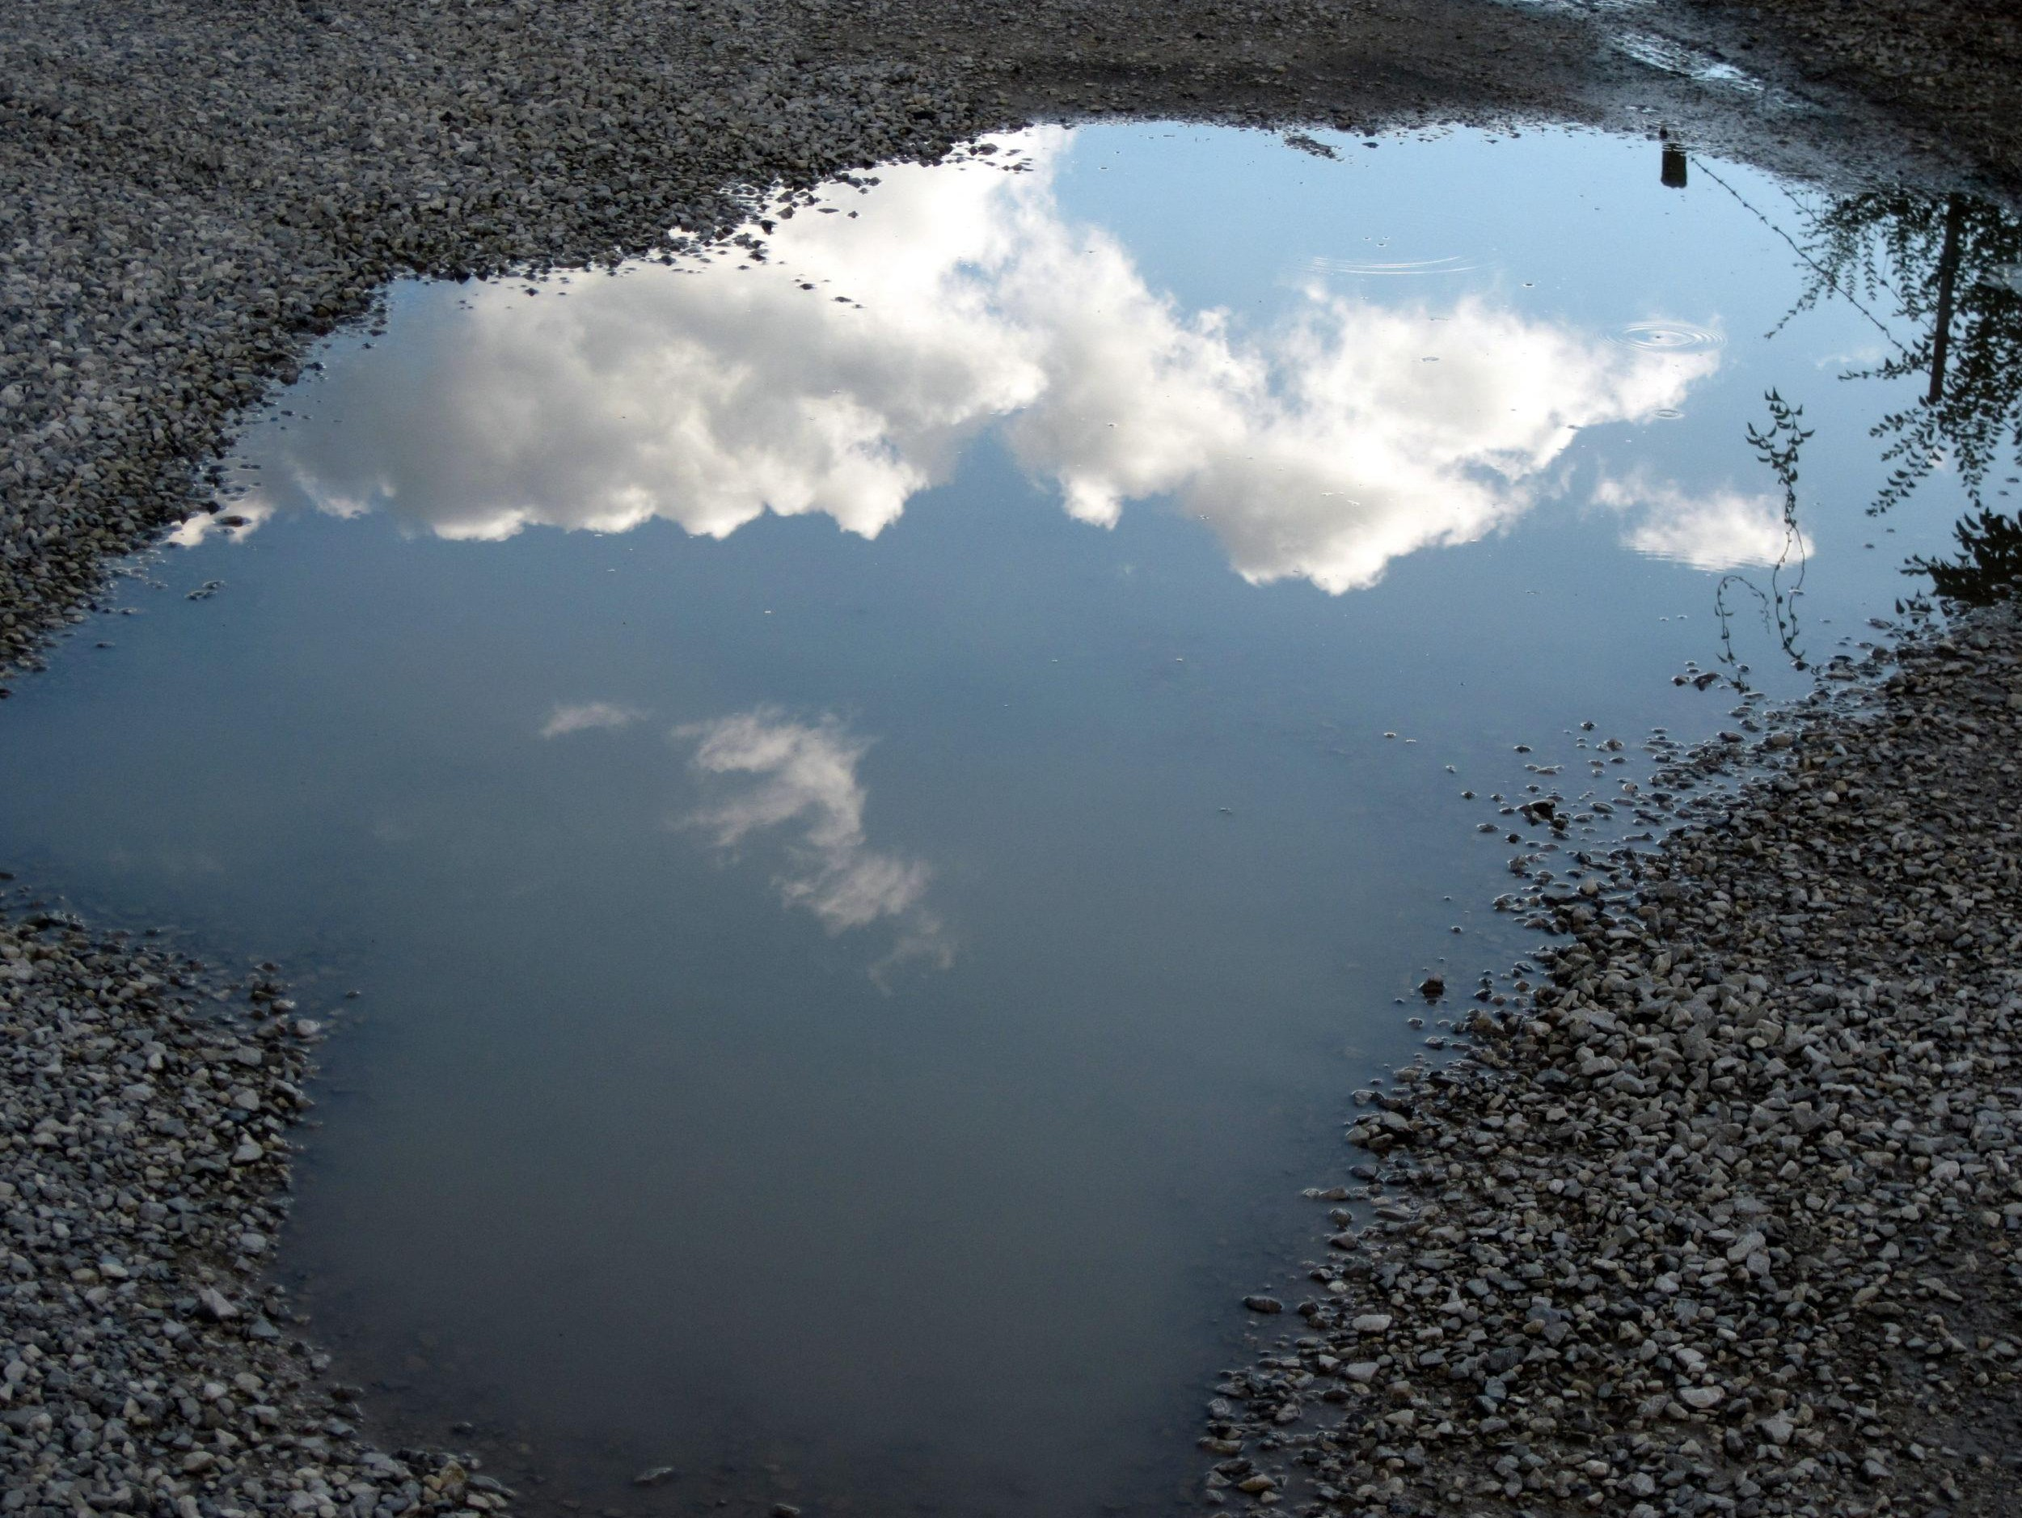

Slide 41
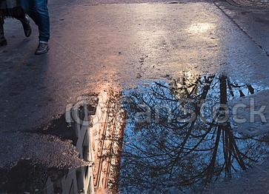

Slide 42
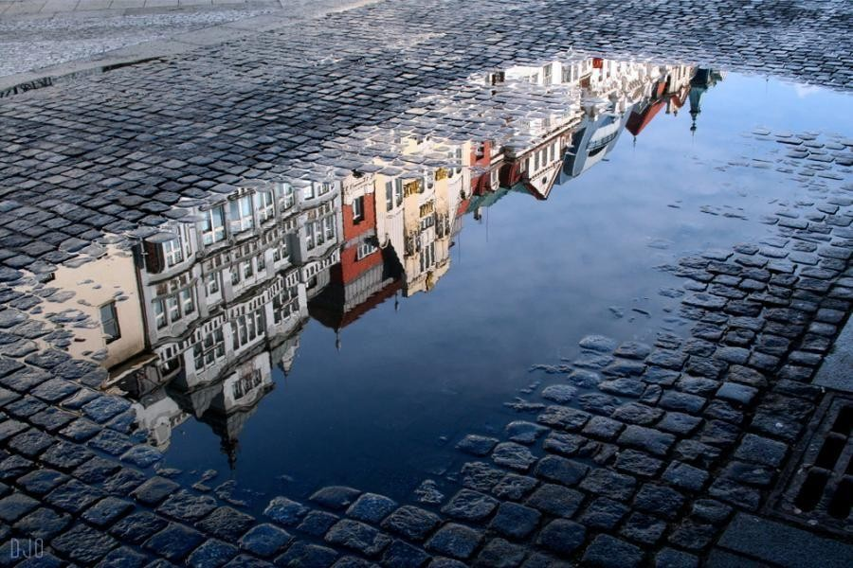

Slide 43
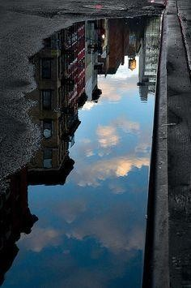
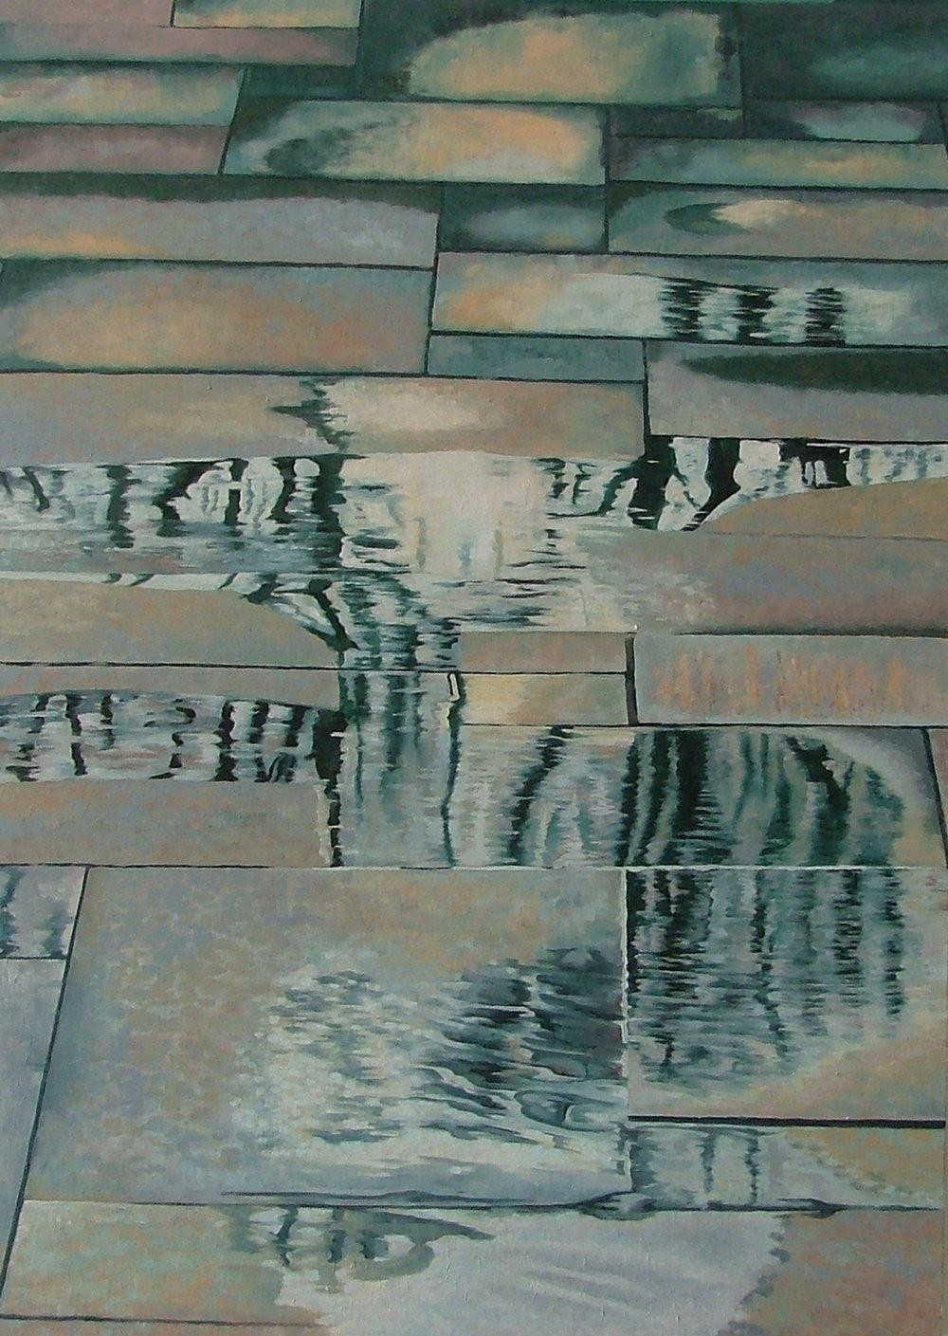

Slide 44
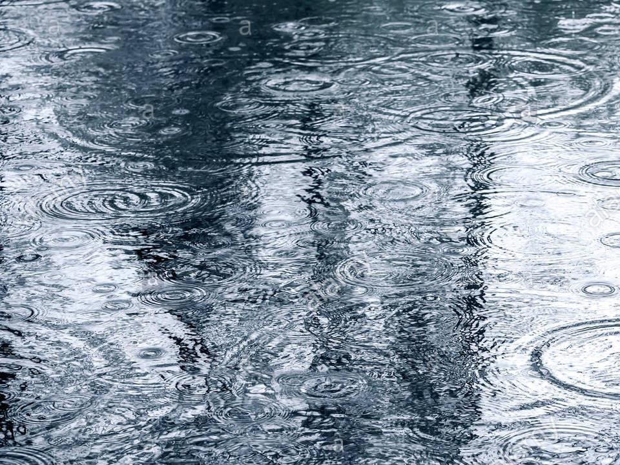

Slide 45
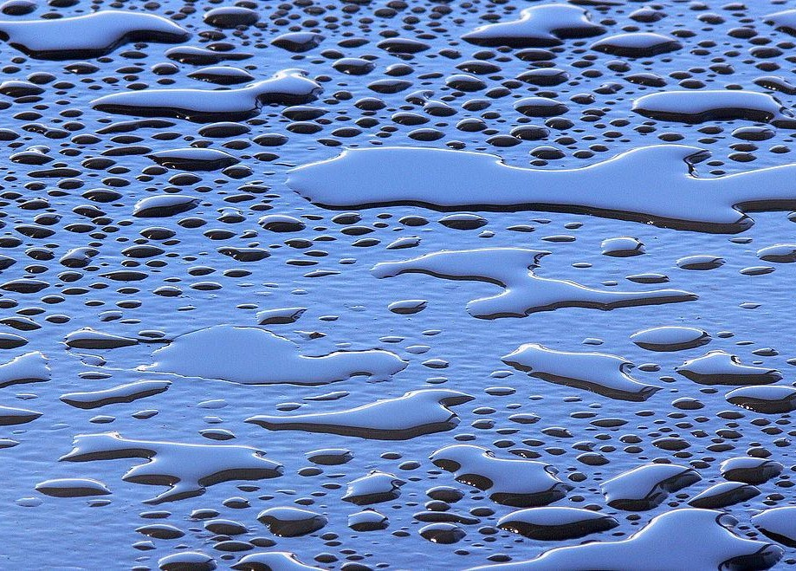

Slide 46
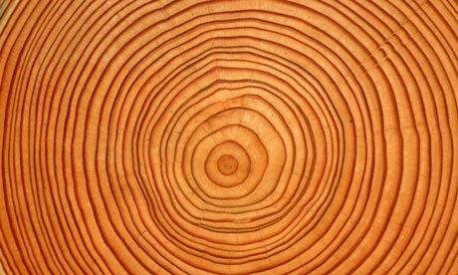

Slide 47
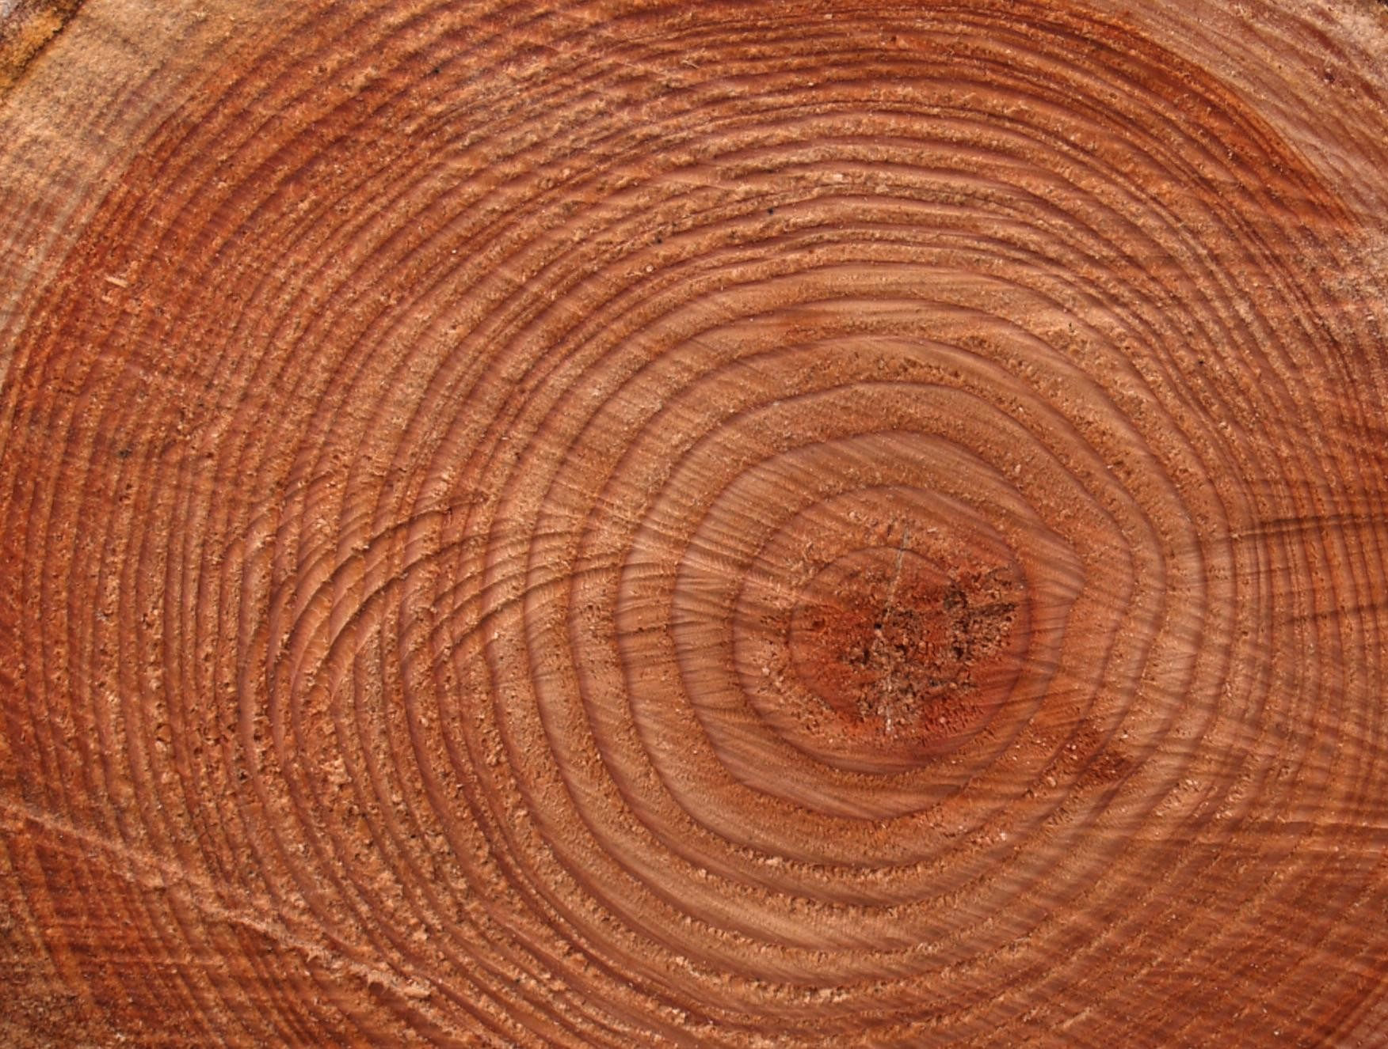

Slide 48


