Slide 1
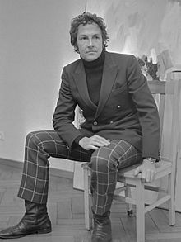
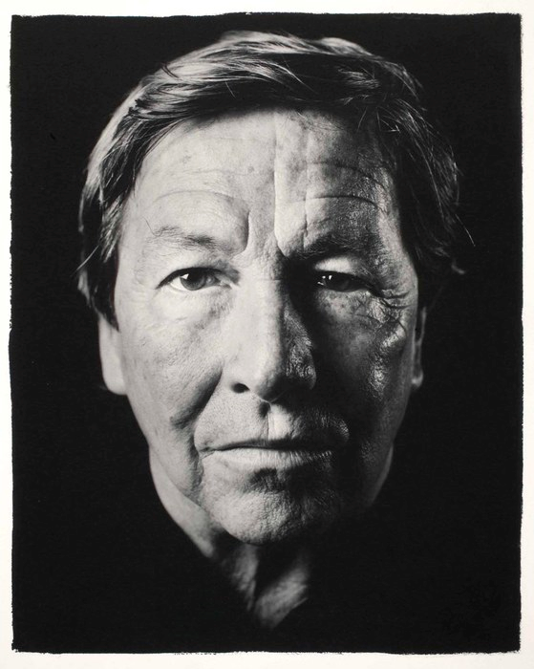
“Stop remembering something that you are sure of everyday and make space for new mistakes”. Robert Rauschenberg
Rules for Making Art
1 Learn everything and anything
2 Collaborate, share and be generous
3 Use your body. See where things take you
4 Use what inspires you
5 Break the boundaries. If it doesn’t exist, invent it
6 Make a difference in your world
7 Break the rules
Look at the work first before you begin to complete the work task.
Look closely.
Try to make connection: literal, visual. Have you seen work like this before? Where? What is Rauschenberg trying to communication to his audience?
Take photos of your experience of seeing this exhibition and use them in a Rauschenberg way to tell the story of your visit. What impact did the work have on you? Etc etc…

Slide 2
Task 1
Josef Albers = Combinations.
Robert Rauschenberg = Combines.
Explain the difference.
------------------------------------------------------------------------------------------------------------------------------------------------------------------------------------------------------------------------------------------------------------------------------------------------------------------------------------------
Find examples of work where Rauschenberg has used found objects. (OBJECTS not images) Document your finding in a detailed drawing. Your drawing should take no less than 40 minutes.

Slide 3
Task 2
For inspiration and materials to work with Rauschenberg would walk around the block of his studio. This is how he would begin his working day.
Using Rauschenberg’s idea of walking and allowing unexpected things to draw his attention, you are to walk through the exhibition and select different aspects of the work that draw your attention. Name 6 different elements
You are to make drawings of the different things you find interesting the works. Look at the way Rauschenberg composes his paintings and combine your chosen bits to resemble a Rauschenberg composition.
"I actually had a kind of house rule, if I walked completely around the block and didn't find enough to work with, I could take one other block and walk around it in any direction—but that was it. The works had to look at least as interesting as anything that was going on outside the window.“
Robert Rauschenberg
Read
this
quote

