Slide 1
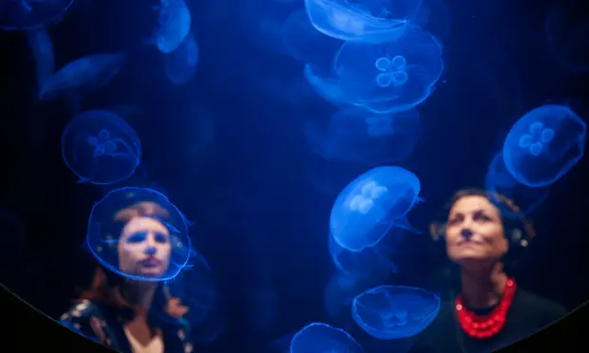
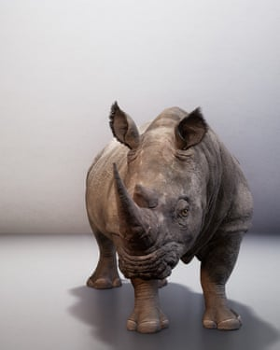
Royal Academy Eco-Visionaries: Confronting a planet in a state of emergency
Discover how architects, artists and designers are responding today to some of the most urgent ecological issues of our times. From climate change to species extinction and resource depletion, the damaging effects of modern life are more tangible than ever. Eco-Visionaries examines humankind’s impact on the planet and presents innovative approaches that reframe our relationship with nature. Through film, installation, architectural models and photography, the works in this exhibition interrogate how architecture, art and design are reacting to a rapidly changing world, beyond mainstream notions of sustainability.
This fits well into one of our exam themes-”Broken” but you may also be able to link the work to “Personal Space” and “Extreme Contrast”
Task 1
Find the Jellyfish installation by Rimini Protokoll. Make a drawing of a section of this on a full page. Underneath explain why the work was created and how it makes you feel.
Task 2
Find the sculpture on the left by Daisy Ginsberg and make a full page detailed colour drawing of the work. Explain how and why the work was made. How could it link to your theme? Look at the questions below to help you.
Task 3
Find a work of art that fits the theme that you have chosen-(Broken/Personal Space/Extreme Contrast)and draw this or a section of it in detail on a full page. Explain how it links to your theme.
Questions to help you annotate your pages:
What’s the title and date of the work?
What is (or appears to be) the content or subject of this work?
What materials/media were used?
How has the artist used colour?
What feelings or thoughts does this piece evoke?
What is your opinion of the work? Give reasons
In what ways (if any) does the work relate to the theme you are studying?
‘They are winning’ by Rimini Protokoll
The Substitute by Alexandra Daisy Ginsberg

