Slide 1
Look at this work by Jim Dine.
He has spent as much time working on the background as the object he is drawing.
Use any pencil, biro or pen in your pencil case apart from highlighter or felt tip and sharpie.

Slide 2
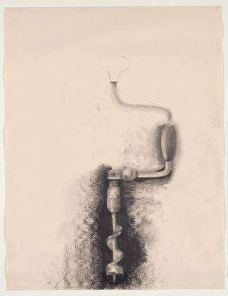
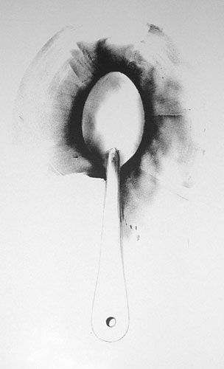
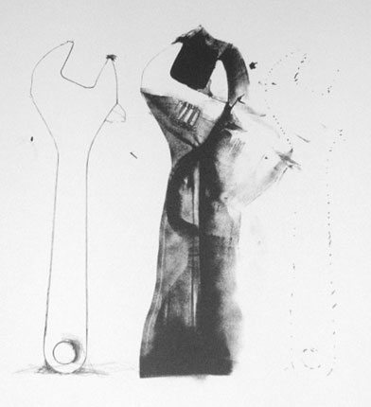
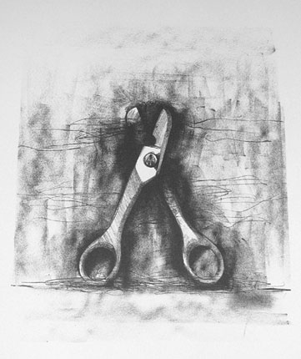
Step 1: Shade around the object drawn on the sheet provided (the shape has already been drawn for you.
Make the shading as dark as you can near the object then gradually have lighter tones as you move away.
Step 2: Use the photocopies to add detail to the actual object. Try to use 10 tones.

