Slide 1
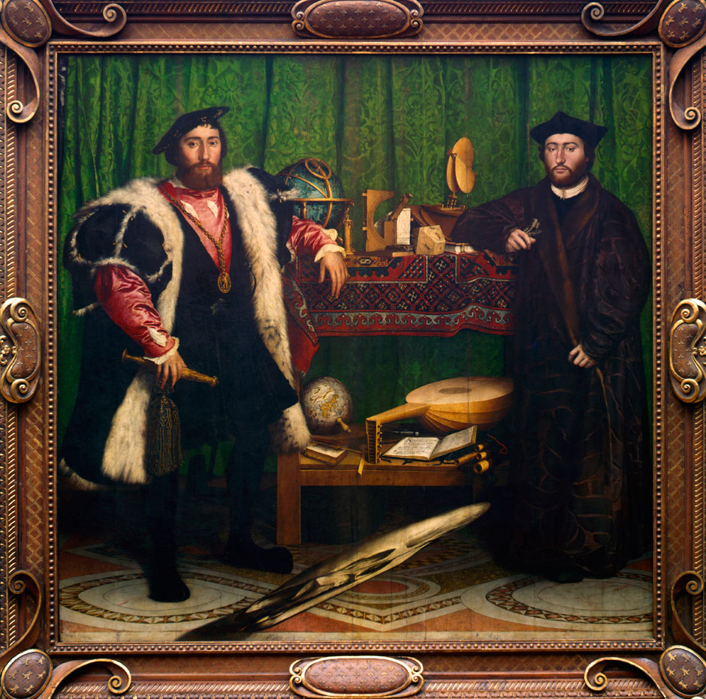
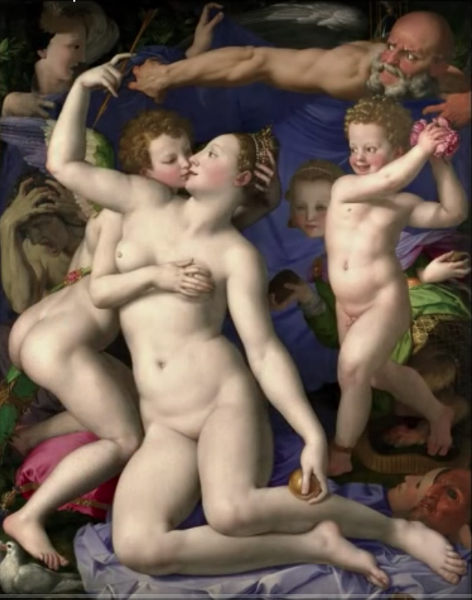
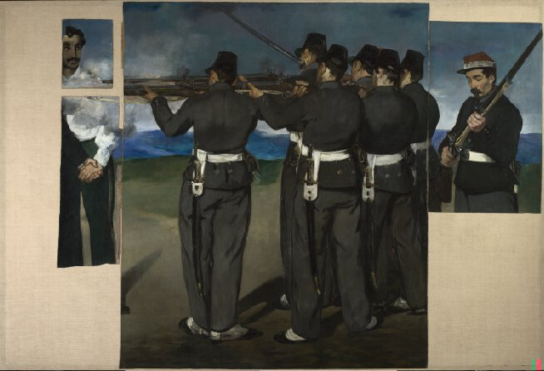
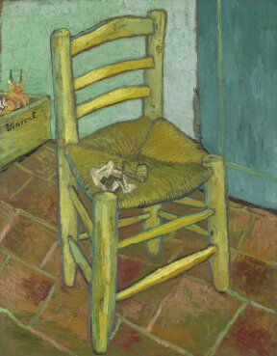
Art Trip: 8th February 2018
Document the trip to the independent galleries and the National Gallery.
Part 1:
Use the questions in your pack to help direct your analysis of the smaller galleries.
Include drawings, further information from the internet, pres releases and anything else you picked up in the galleries. Consider any links you made between the work and the exam theme.
Part 2:
Annotate the four pieces that were discussed in he National Gallery. Use the questions as prompts. Decipher the codes, symbols and secrets in the work.

Slide 2
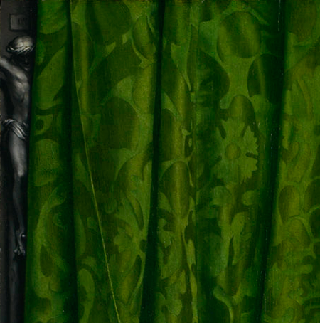
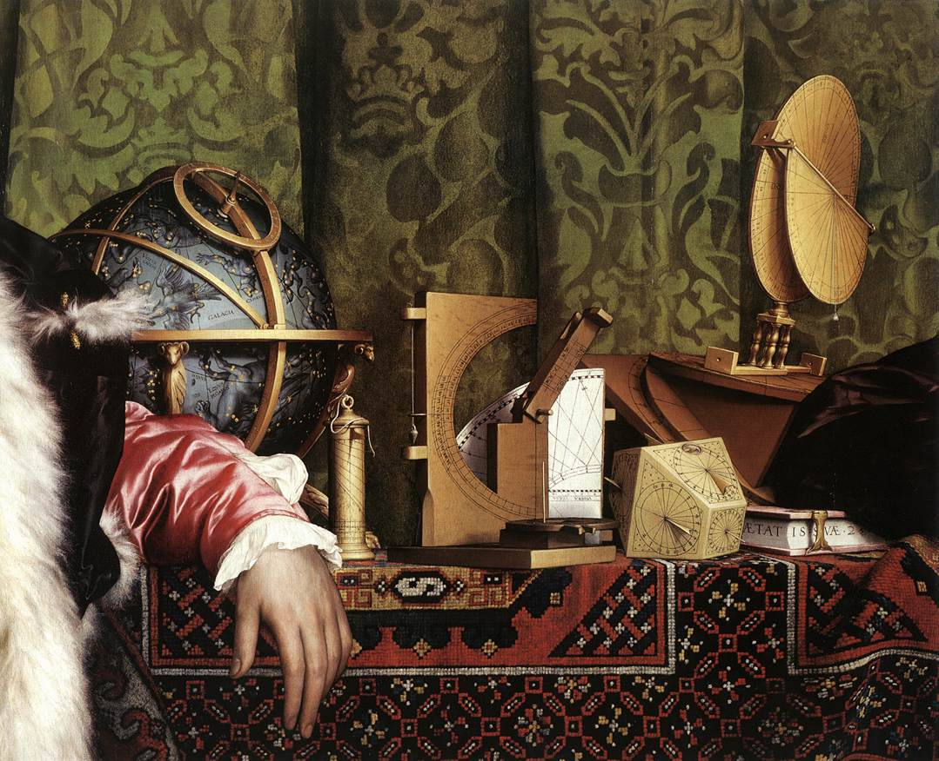
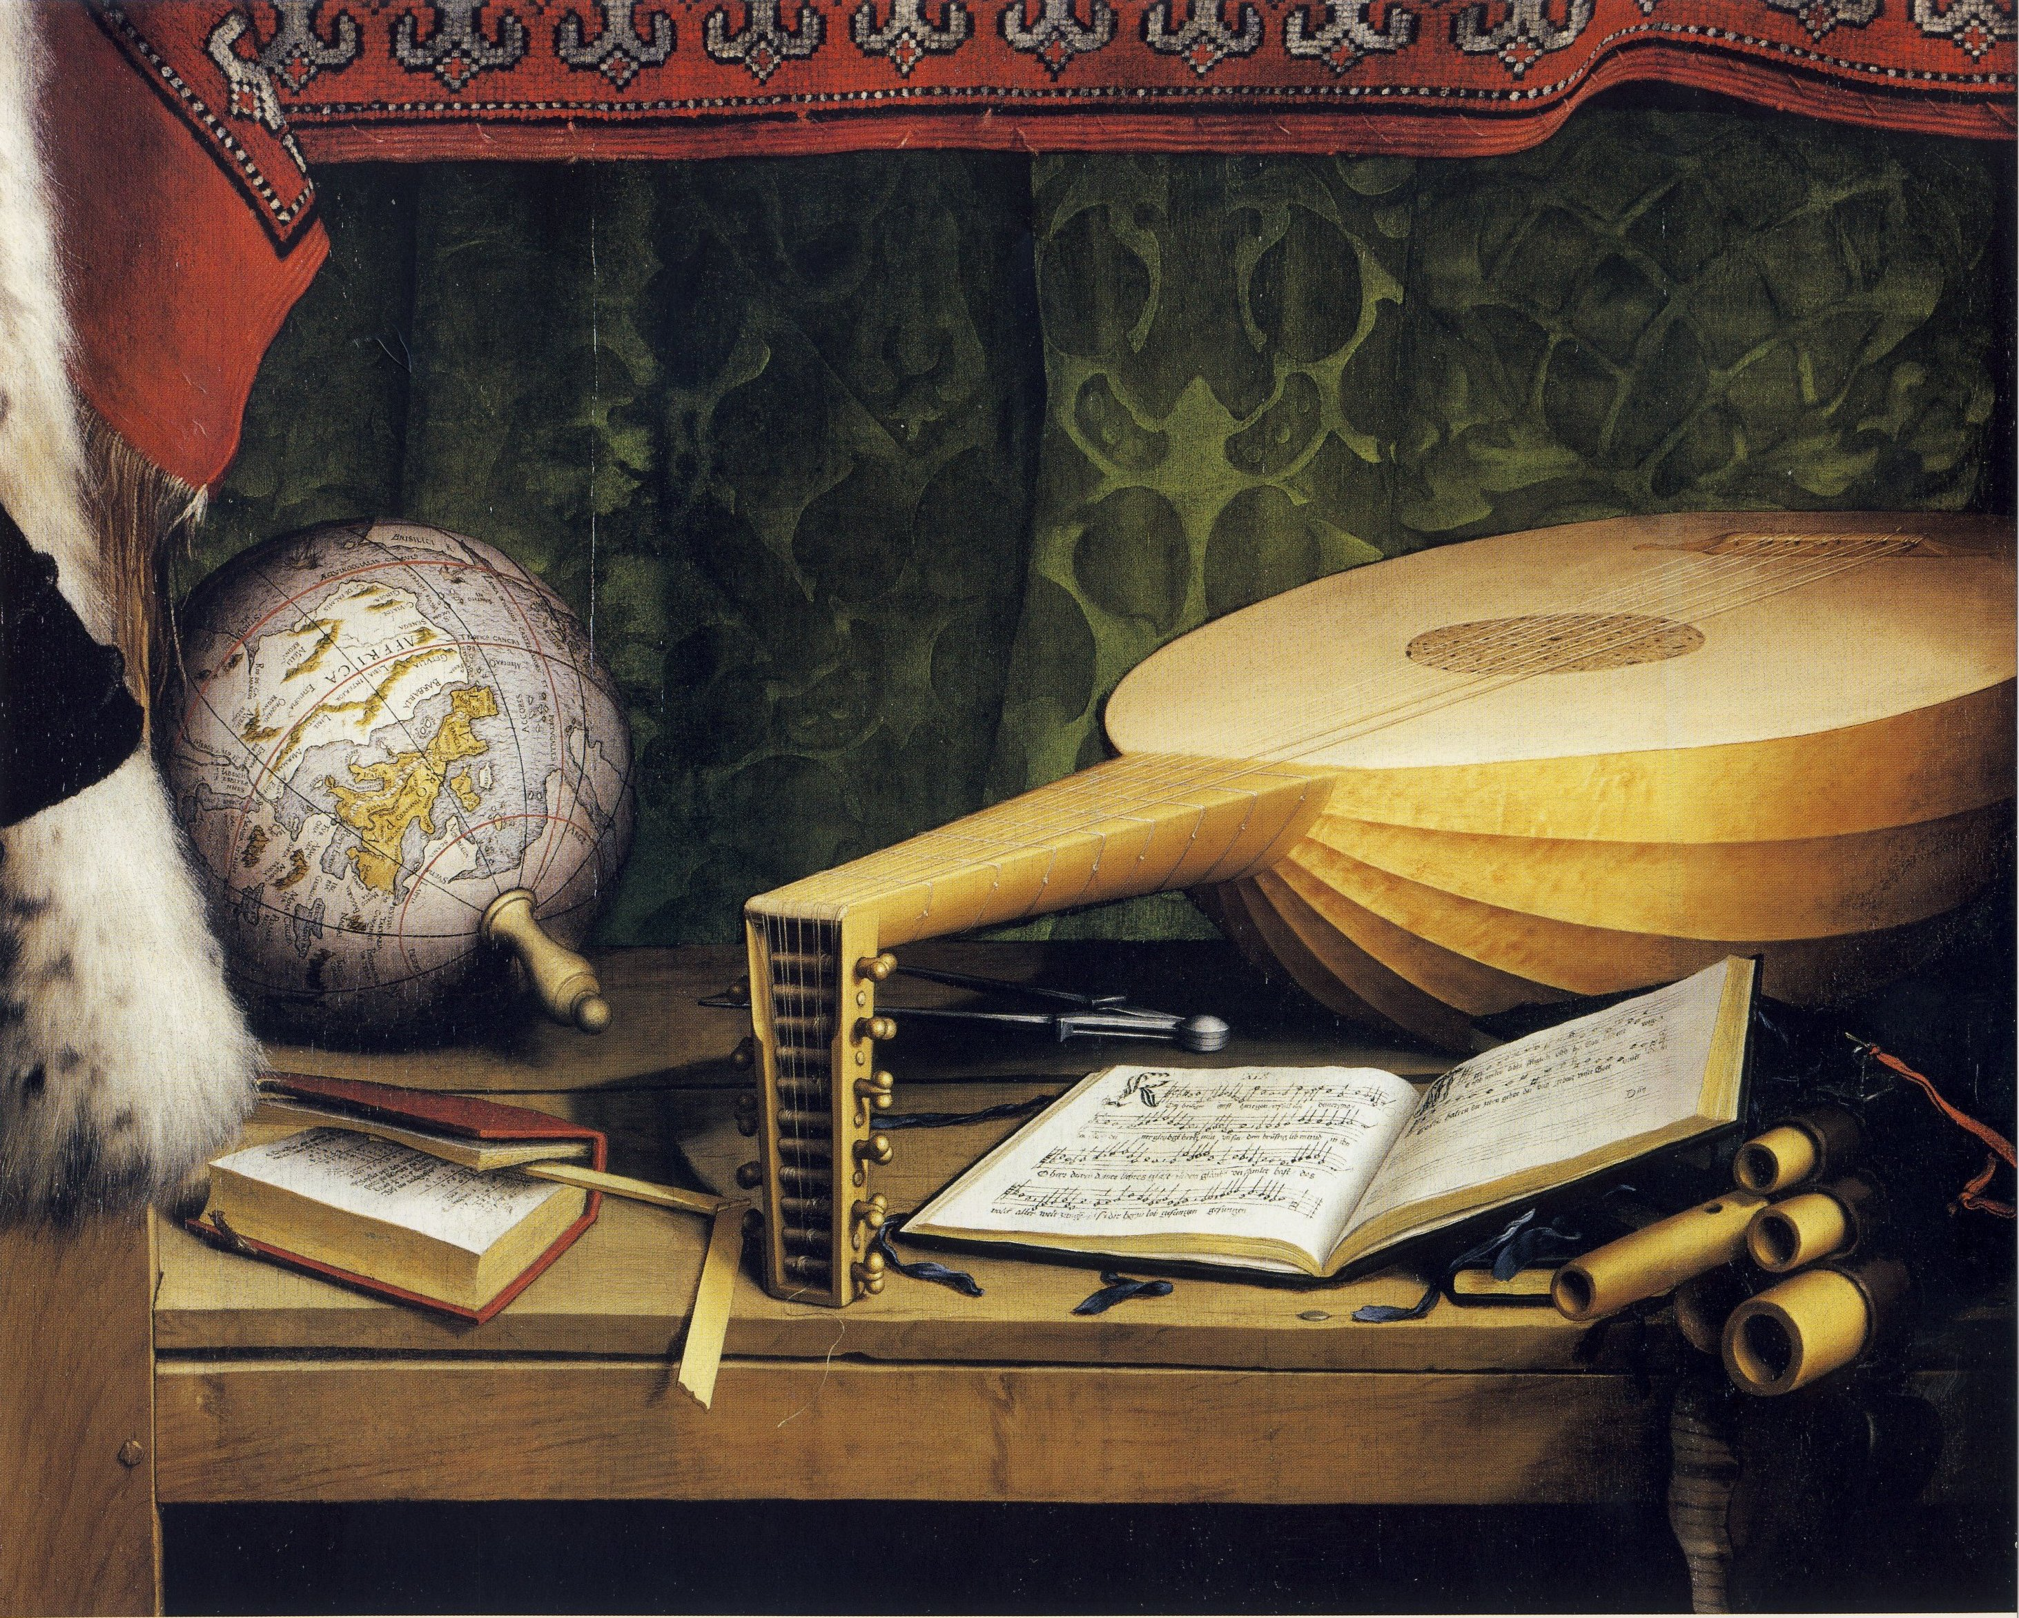
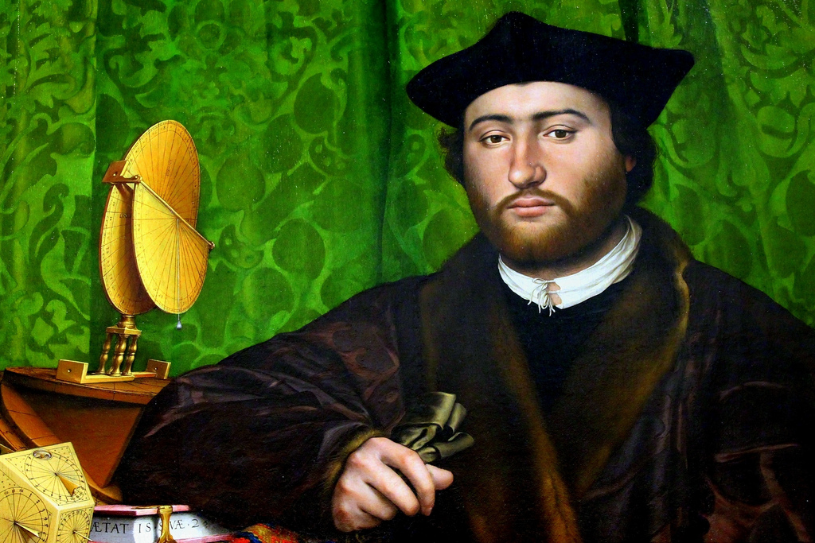
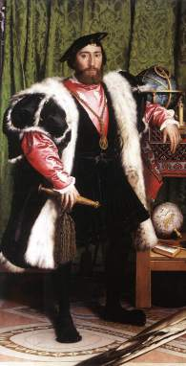
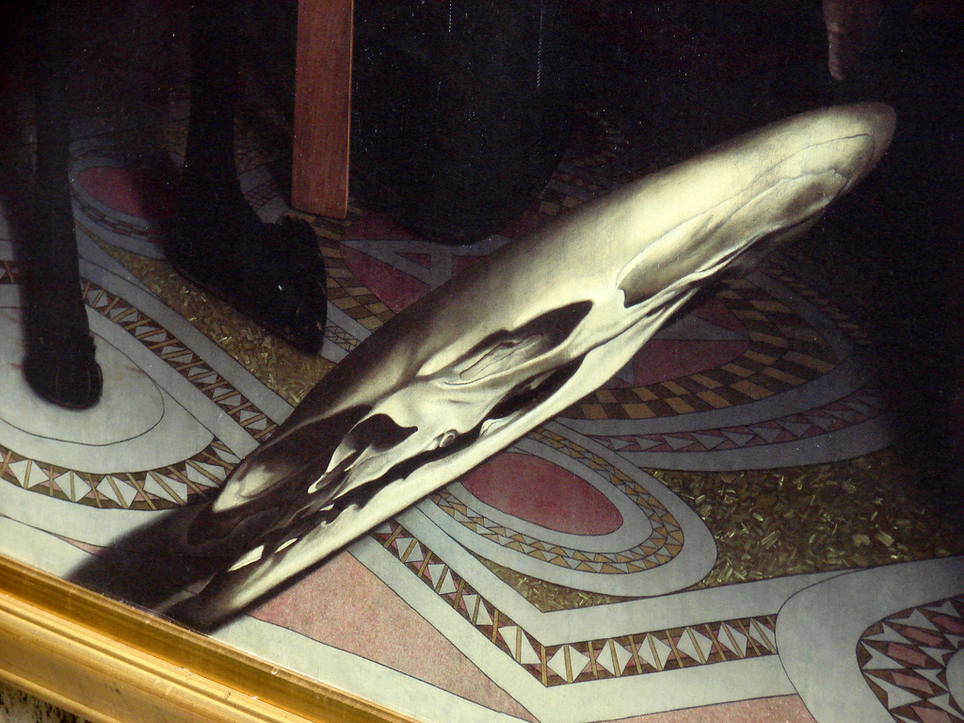
Why would the crucifix be hidden behind the curtain?
(Clue- Catholics adored icons, the Church of England did not.)
What was going on at the time? (In Europe, in England, between Henry VIII and the Pope..?)
Who are the Ambassadors?
Where are they from?
What jobs/roles did they have?
Who commissioned the painting?
Who planned the composition?
What objects are on the upper shelf? What are they concerned with?
What scientific developments are implied here?
What objects are on the lower shelf? What are they concerned with?
Are they broken? Why would there be broken objects?
‘The Ambassadors’, Hans Holbein the Younger. 1533
What does the Ambassadors clothing say about his wealth and status?
What is the significance of the gloves?
Why has Holbein included a skull?
Why is it distorted?
Why is there an empty lute case underneath the lower shelf?

Slide 3
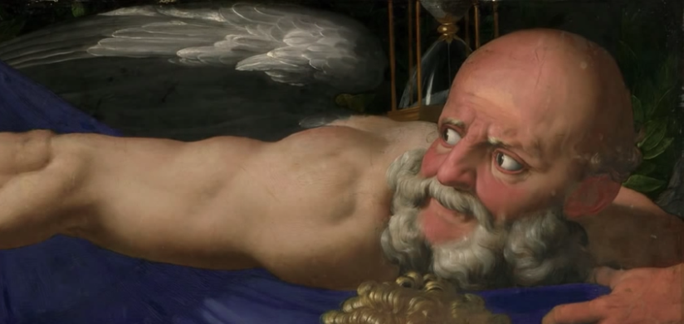
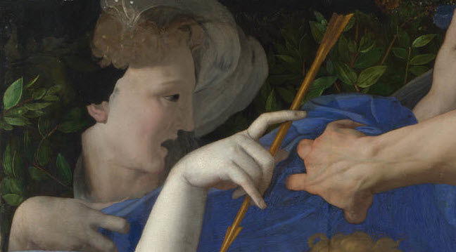
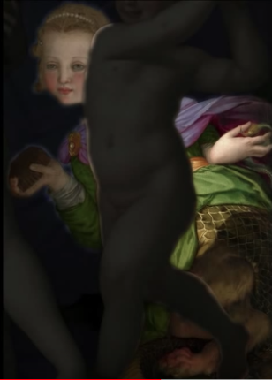
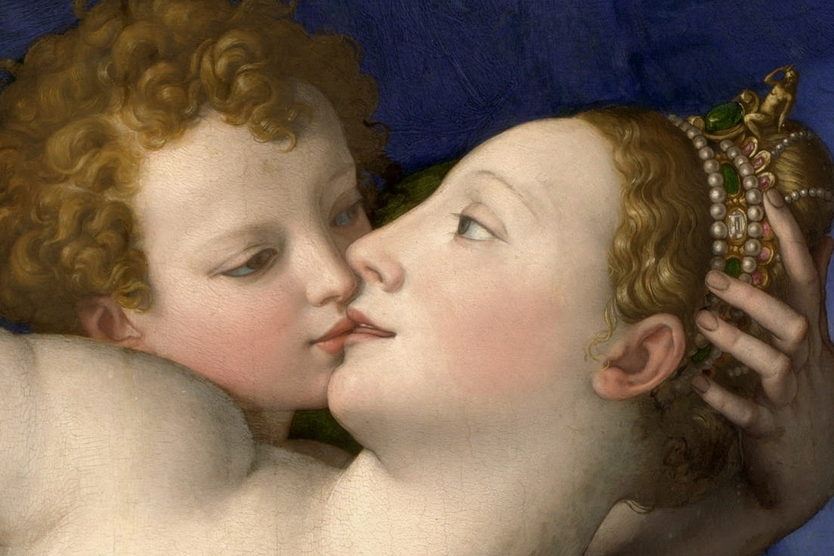
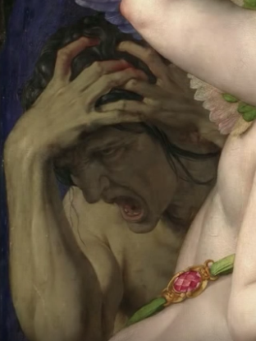
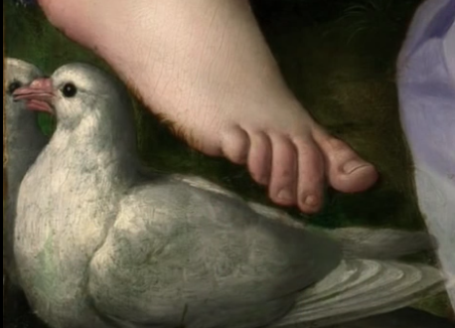
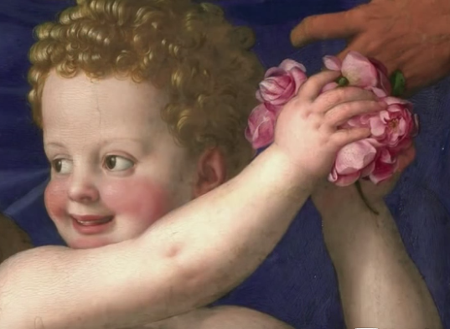
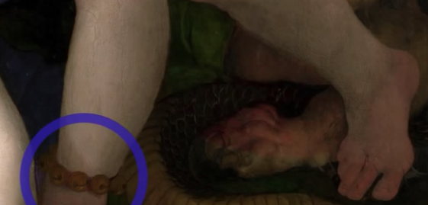
https://www.khanacademy.org/humanities/renaissance-reformation/high-ren-florence-rome/pontormo/v/bronzino-an-allegory-with-venus-and-cupid
Who commissioned this painting?
Who was it for?
What is the theme?
Who is this? How do you know?
Who is this?
Who are these figures?
What is their relationship?
What does this figure represent?
Who is this?
What kind of creature is she?
What is she holding?
What do the objects represent?
‘An Allegory with Venus and Cupid’, Agnolo Bronzino. 1540-1546
What is interesting about Folly’s feet?
What birds are these?
What is the significance of the birds?
What is the significance of the golden apple?
What do the masks represent?
Who is this?
What is he about to do?

Slide 4
The Execution of Maximilian, Edouard Manet. About 1867-8
The Austrian Archduke Ferdinand Maximilian (1832 - 1867) was installed in Mexico as a puppet emperor by Napoleon III in 1863. He was dependent on the support of the occupying French army and when Napoleon withdrew his troops Maximilian was captured by Mexican forces loyal to their legitimate republican government. He was executed alongside two of his generals, Mejía and Miramón, on 19 June 1867.
The left-hand section of the canvas showing General Mejía was probably cut off by Manet himself. After the artist's death the canvas was cut up into smaller fragments, some of which were sold separately. Edgar Degas eventually purchased all the surviving fragments and reassembled them on a single canvas. A sketch for a group of soldiers, formerly in the Gallery and now in the British Museum, was once thought to have been made in preparation for this work, but its attribution to Manet is no longer certain.
https://www.nationalgallery.org.uk/paintings/learn-about-art/paintings-in-depth/in-the-line-of-fire-manets-the-execution-of-maximilian
Van Gogh’s Chair, Vincent Van Gogh. 1888
This work was painted while Van Gogh was working in the company of Gauguin at Arles. It was retouched early in 1889. Van Gogh painted a companion picture of Gauguin's armchair, shown by night, now in the Van Gogh Museum, Amsterdam. The two paintings may have been intended to represent the contrasting temperaments and interests of the two artists.
What could you say about Van Gogh’s interest / affinity with the colour yellow?
What is in the box in the background?
https://www.nationalgallery.org.uk/paintings/vincent-van-gogh-van-goghs-chair

