Slide 1
Lino step by Step

Slide 2
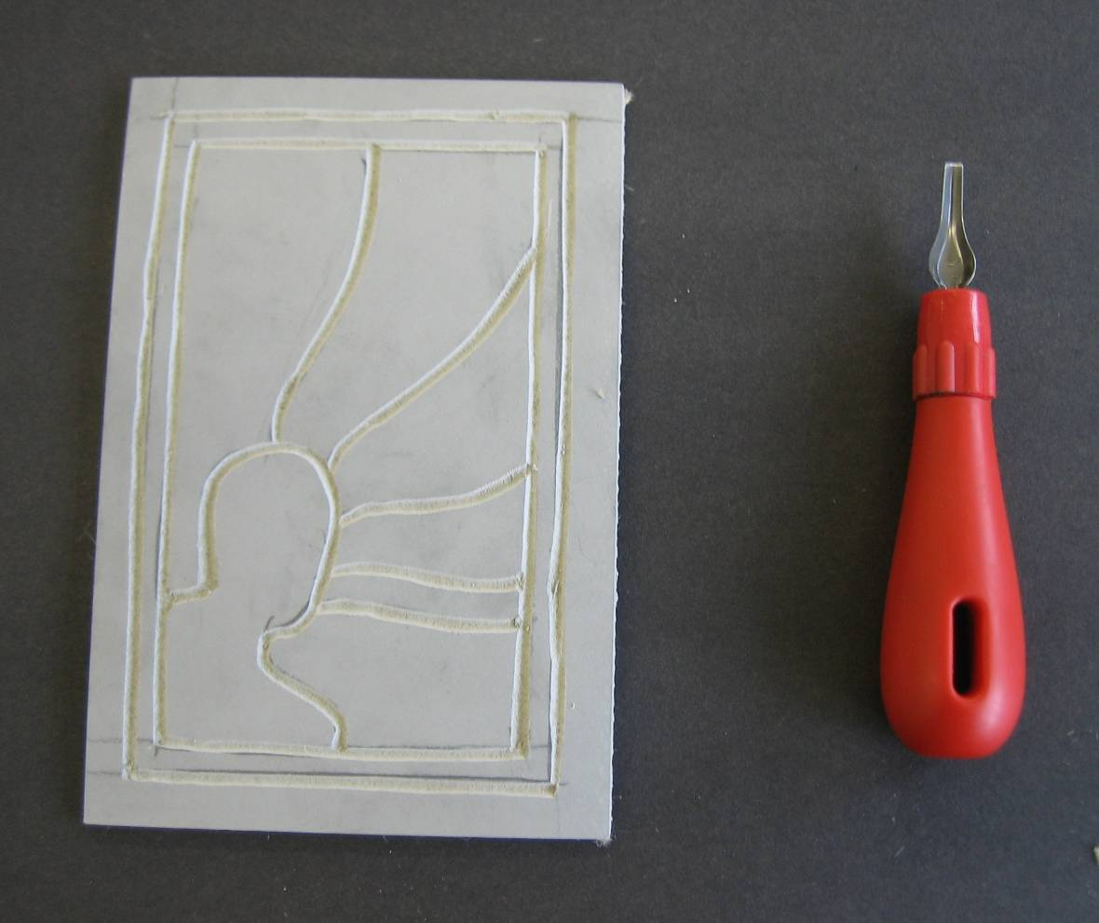
The First Cutting
This is your first cut
Remember the Health and Safety Instructions!
Cut out the OUTLINES ONLY
Notes:
Speech here…

Slide 3
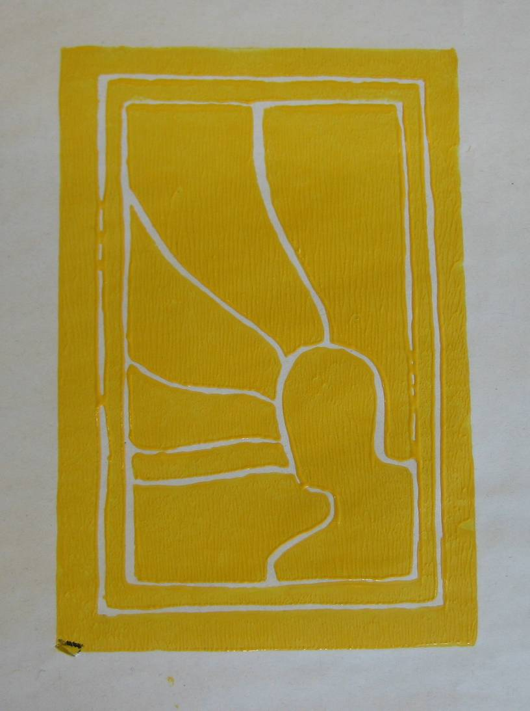
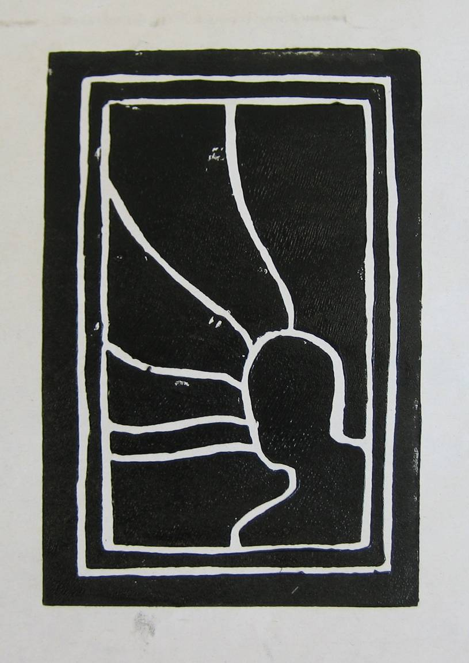
Your First Print (LIGHTEST COLOUR)
Ink up your roller with ink
Transfer the ink onto your plate
Try to get an even layer of ink

Slide 4
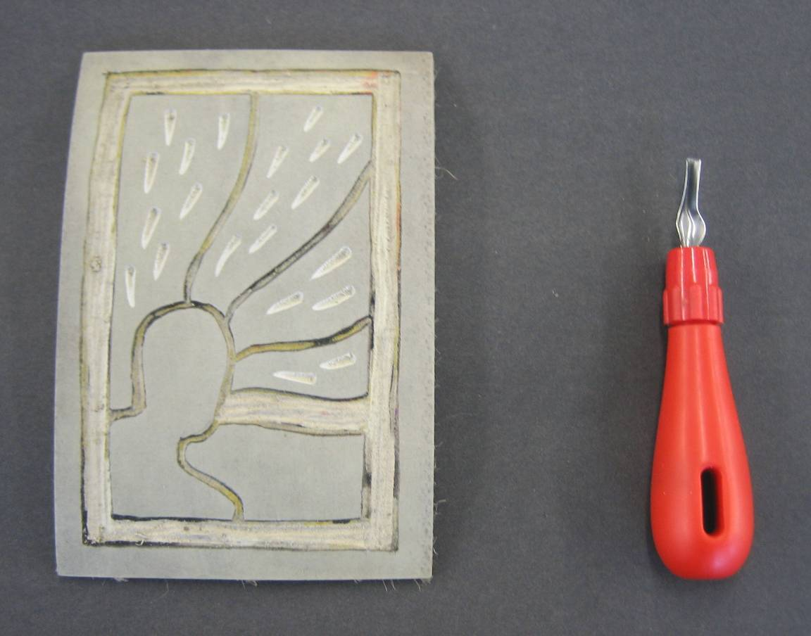
The Second Cutting
After washing and drying your plate you are ready to cut away (or reduce) more of your plate
Remember Health and Safety!
This time any thing you cut away will stay the same colour as the first ink layer

Slide 5
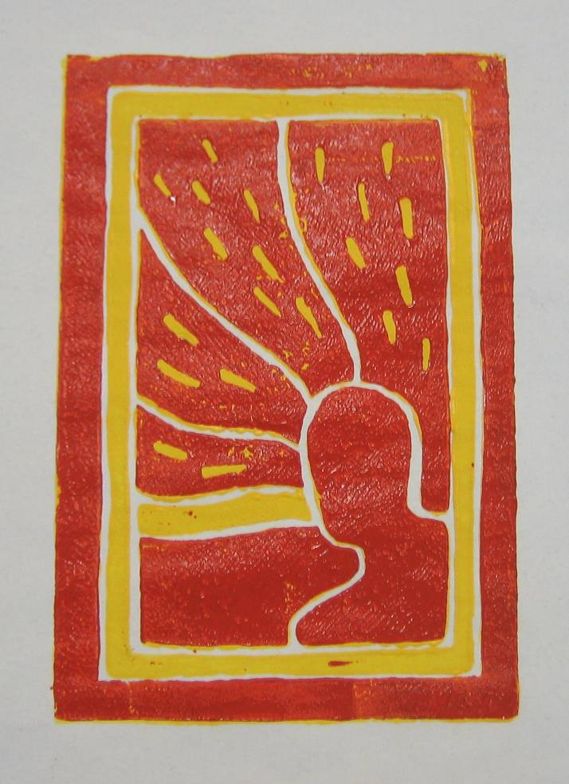
The Second Print (MIDDLE COLOUR)
Print this colour once on separate paper
Print twice more, this time aligning it perfectly on top of 2 of your other colour prints.

Slide 6
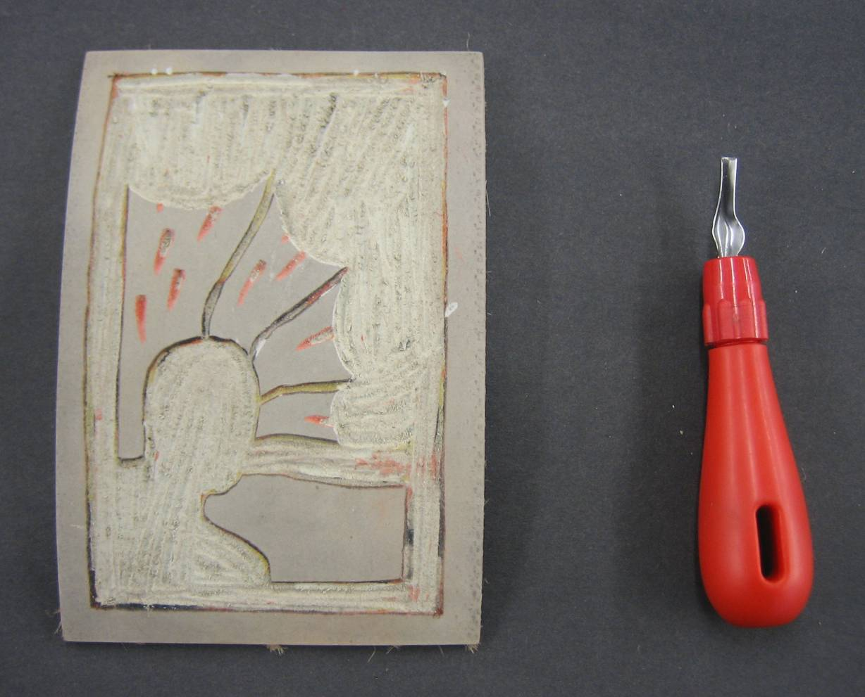
The Third Cutting
Time to reduce your plate again
Remember Health and Safety!
See how much of the plate has been removed

Slide 7
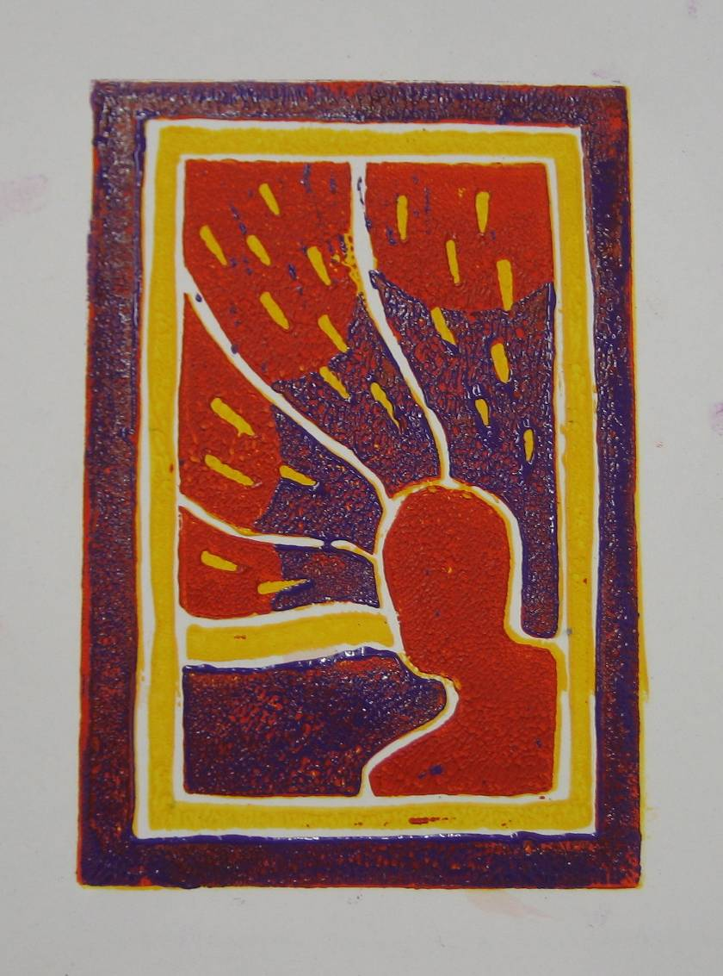
The Final Print (DARKEST COLOUR)
Place the plate back over the first and second print
See how the colours from the other layers show through
Do this to four of your prints
Stick the best one in your book

