Slide 1
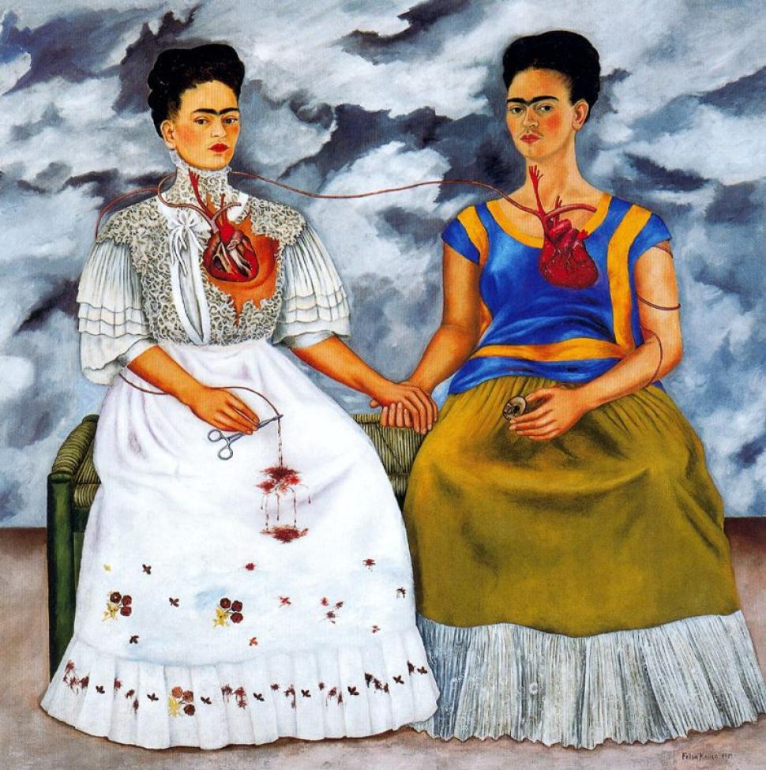
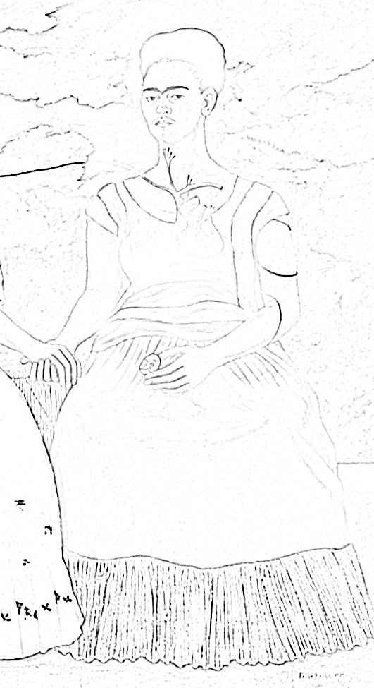
‘Las Dos Fridas’ (The Two Fridas)
by Frida Kahlo
The two Fridas are holding hands. They both have visible hearts and the heart of the traditional Frida is cut and torn open.
The main artery, which comes from the torn heart down to the right hand of the traditional Frida, is cut off by the surgical pincers held in the lap of the traditional Frida.
The blood keeps dripping on her white dress and she is in danger of bleeding to death. The stormy sky filled with agitated clouds may reflect Frida's inner turmoil.
Task 1: Complete the drawing. Use the image below to help you.
Task 2: Create a list of objects that could symbolise your character, emotions, interests or relationships with others.

