Slide 1
REFLECTION
GCSE Unit 2 Externally Set Assignment 2019

Slide 2
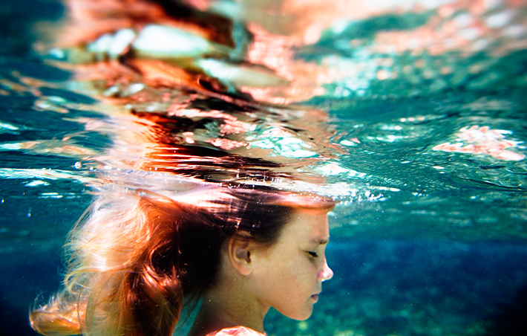
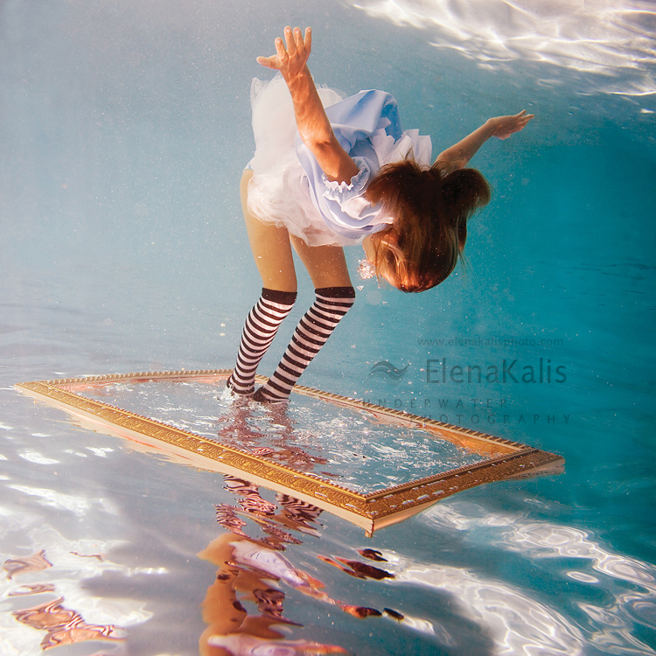
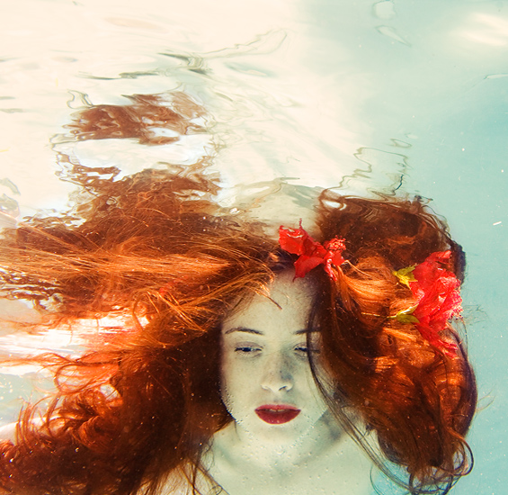
Reflections in water
Elena Kallis
Lydia Francis
AS Exam Piece 2012

Slide 3
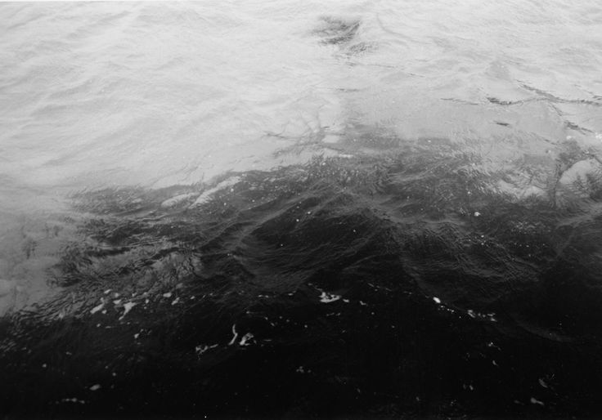
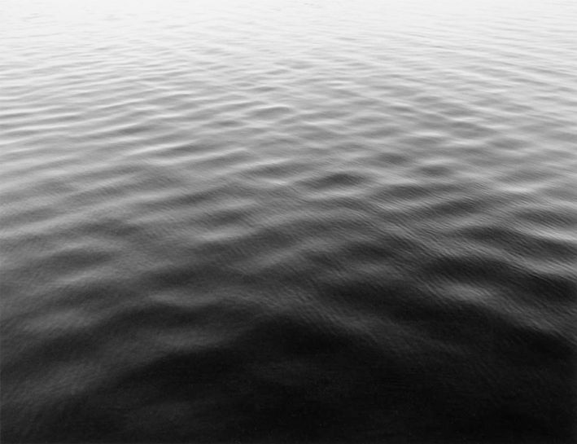
Koo Bohnchang ‘Oceans and Rivers’
Your choice of
paper to print on can give the illusion of ripples.

Slide 4
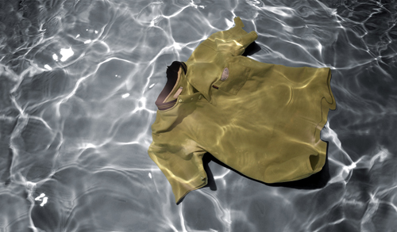
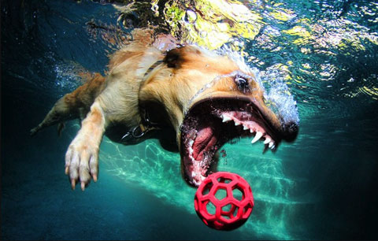
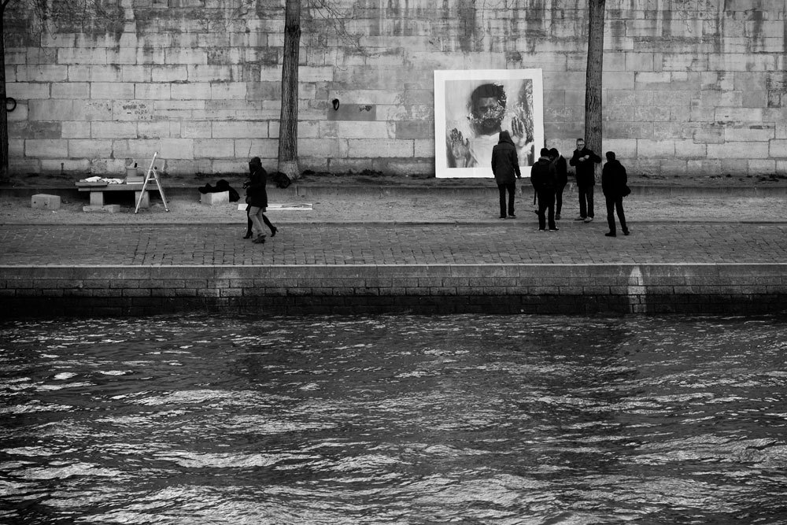
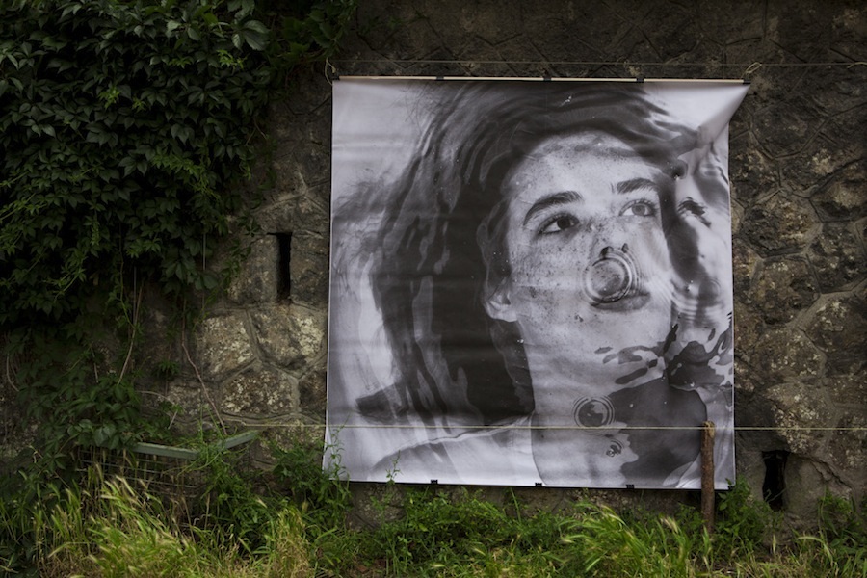
Erika Diettes
Seth Casteel
Alban Grosdidier

Slide 5
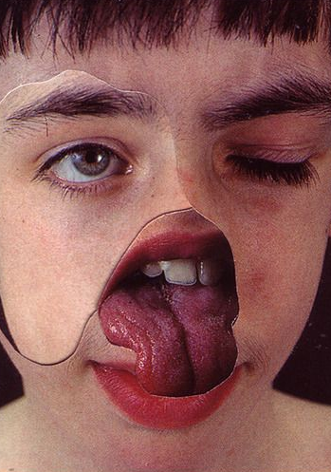
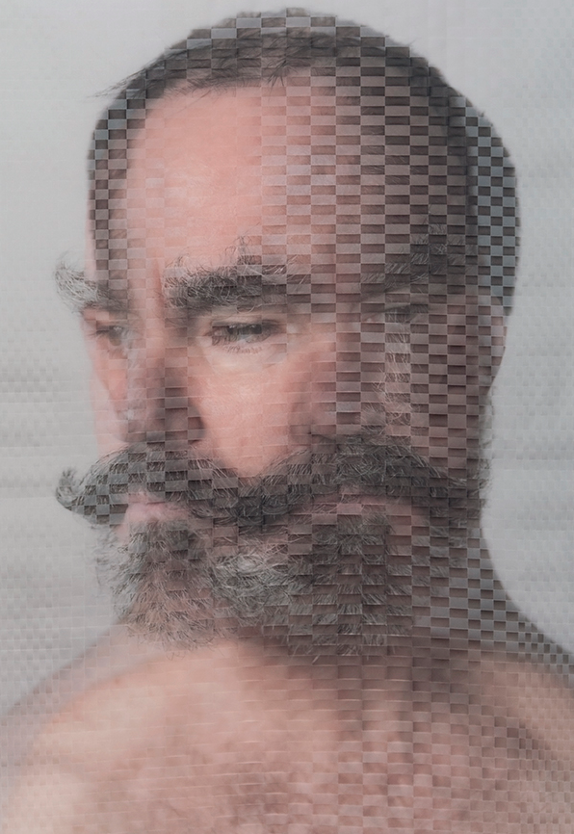
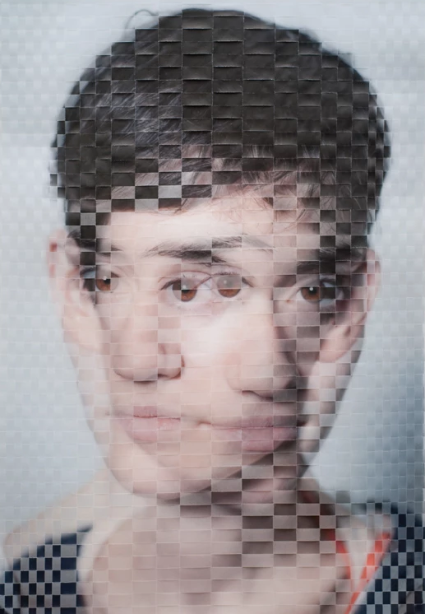
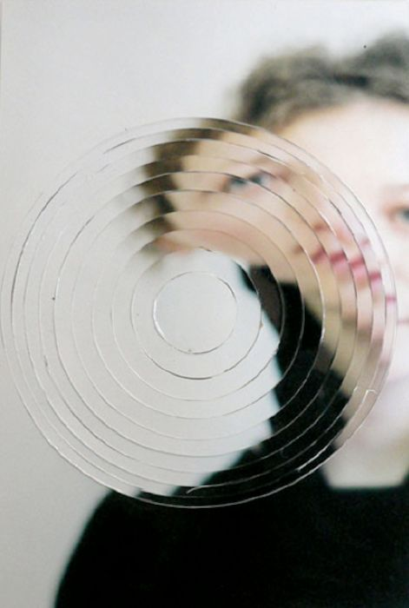
Distorted portraits-stylised ripples from reflections
Anonymous
David Samuel Stern
Jean Faucheur

Slide 6
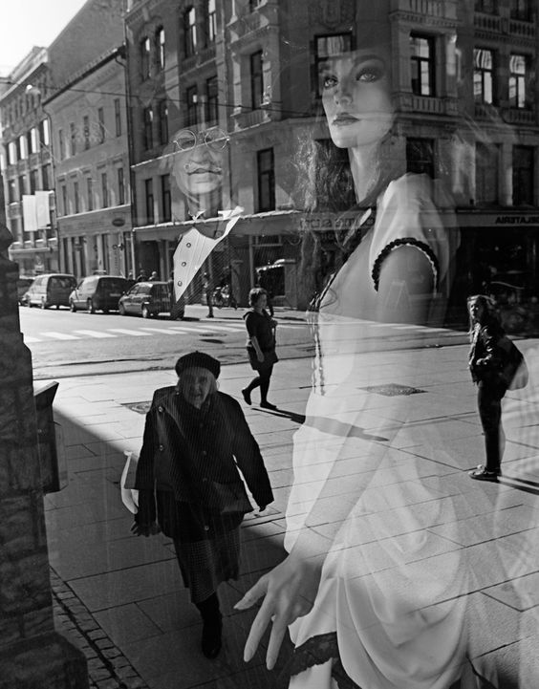
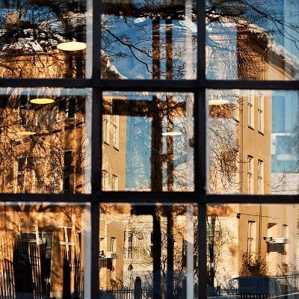
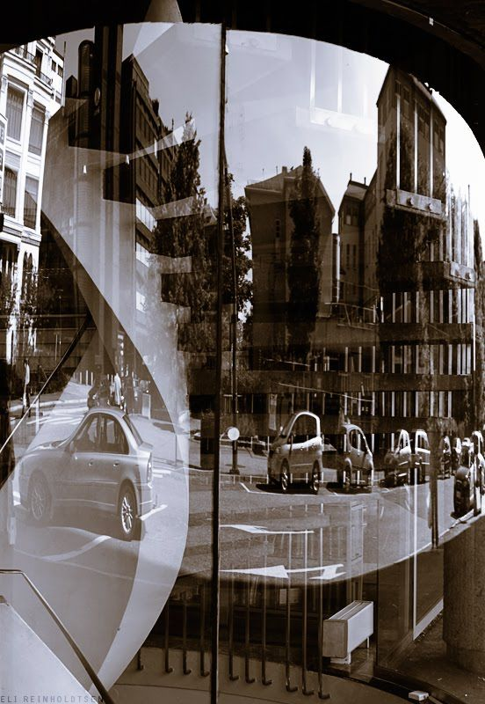
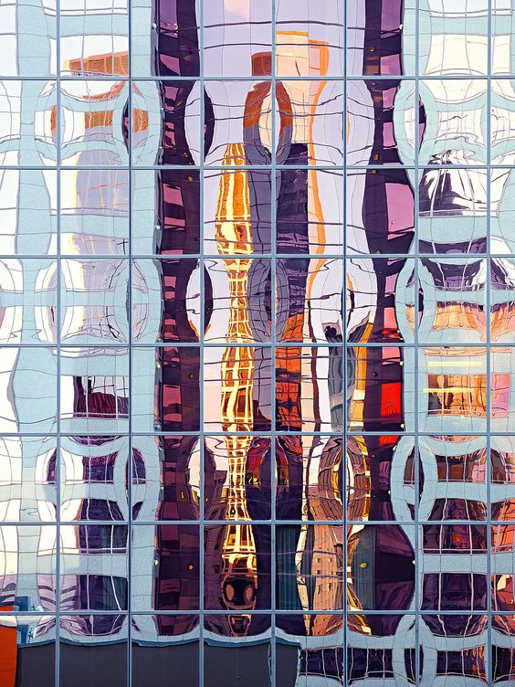
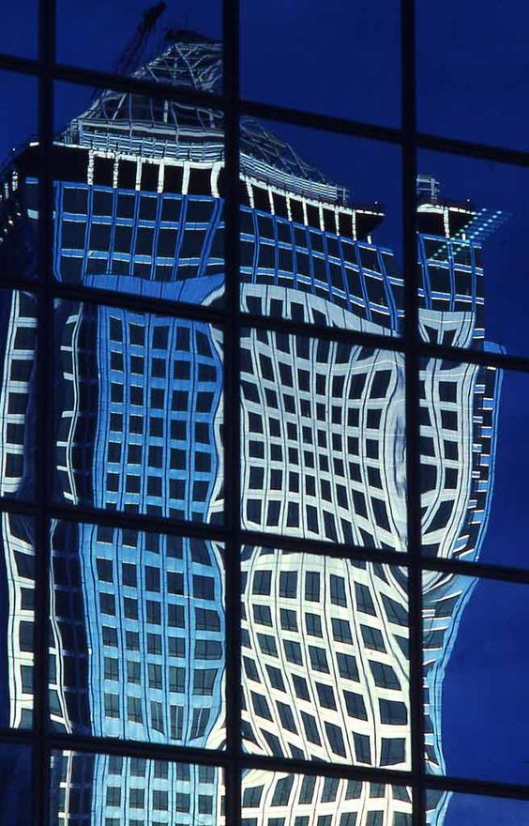
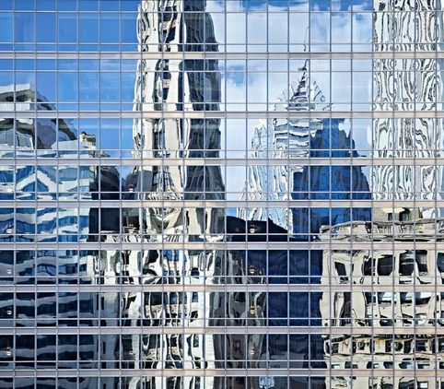
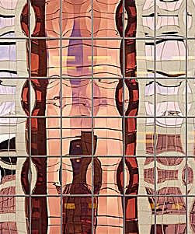
Reflections in windows
Eli Reinholdtsen
Andrea B. Stone

Slide 7
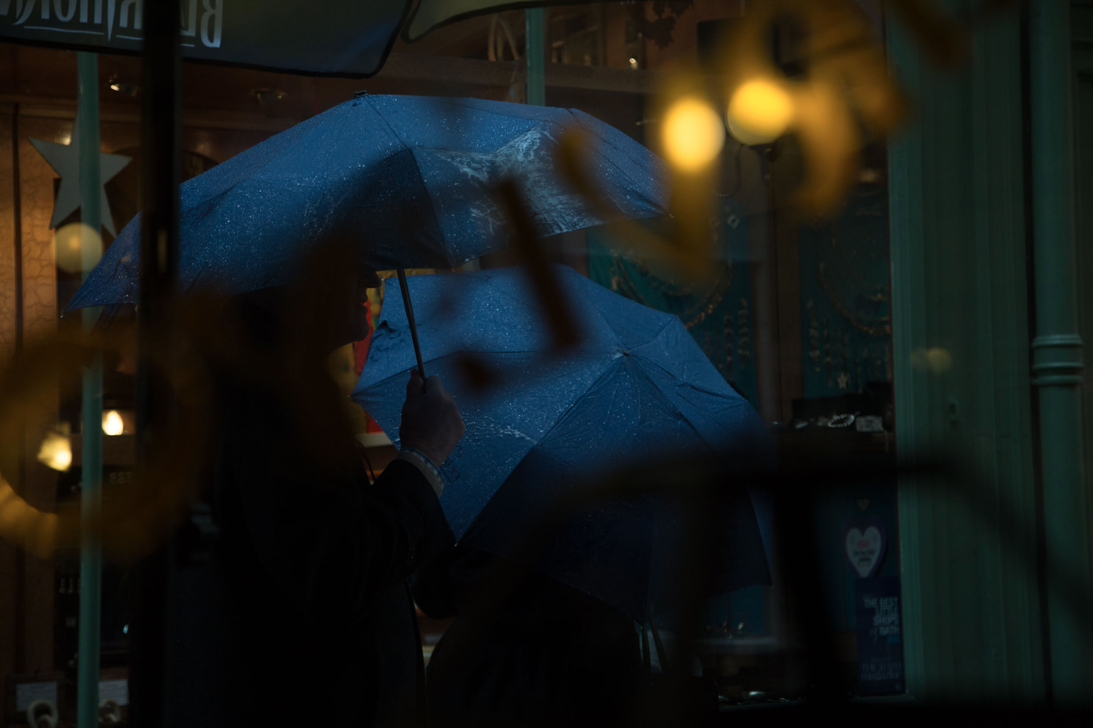
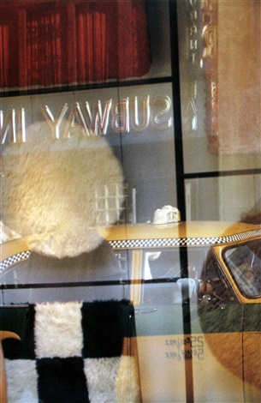
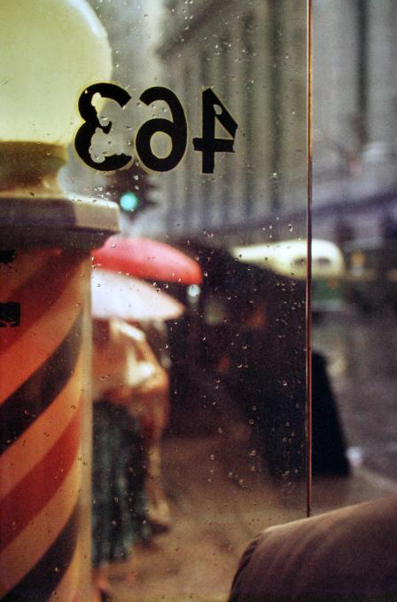
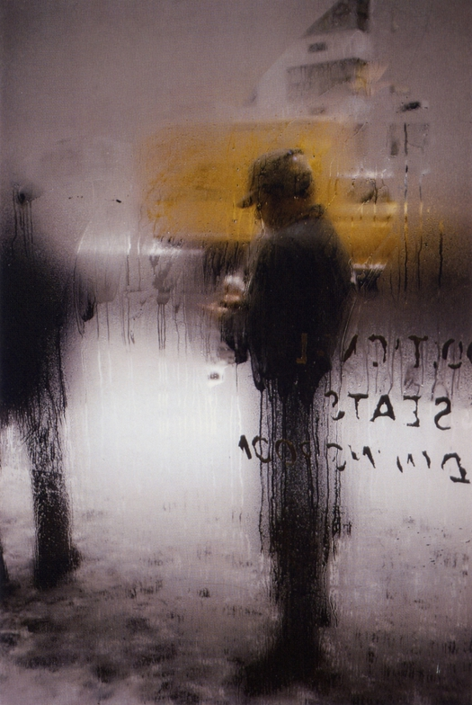
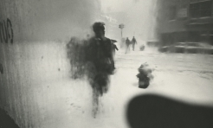
Saul Leiter (Photopedagogy Jon Nicholls, Thomas Tallis School)
Leiter was foremost a painter who discovered the possibilities of colour photography. His images explore colour harmonies and often exploit unusual framing devices - shop signs, umbrellas, curtains, car doors, windows dripping with condensation - to create abstracted compositions of everyday street life in the city.
Leiter was fond of using long lenses, partly so that he could remain unobserved, but also so that he could compress space, juxtaposing objects and people in unusual ways. Many of his images use negative space, with large out of focus areas, drawing our eye to a particular detail or splash of colour.

Slide 8
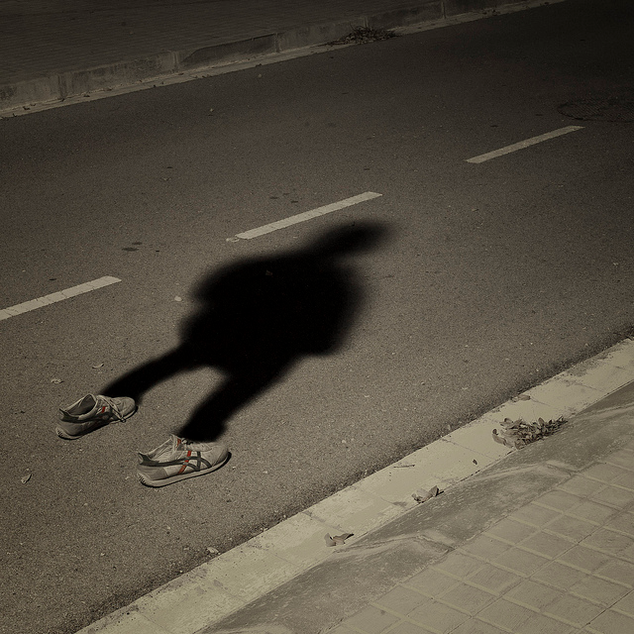
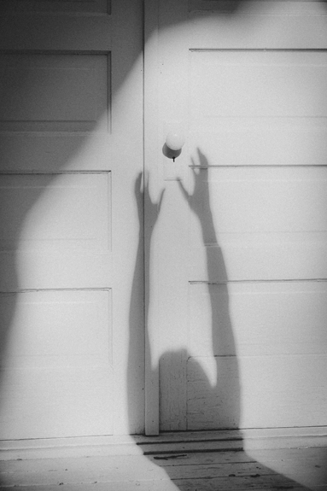
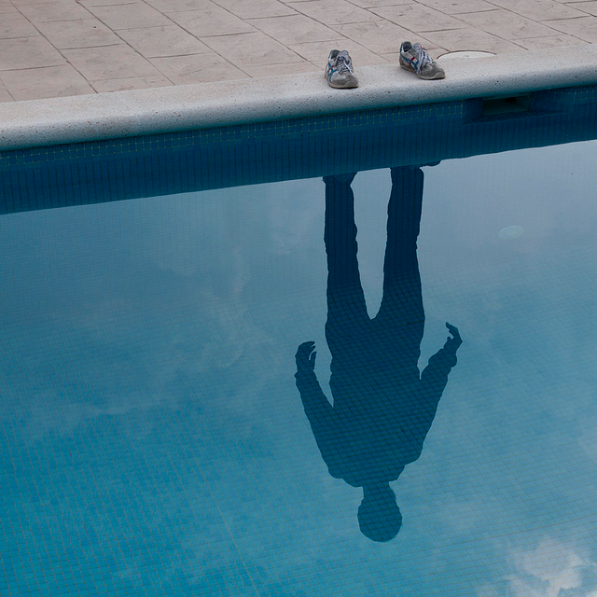
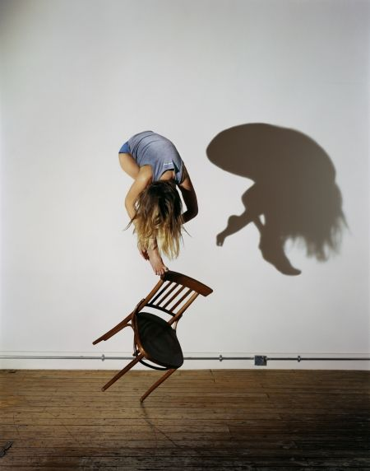
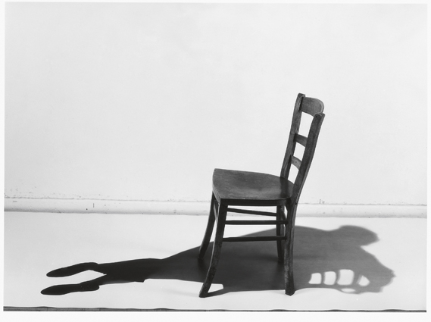
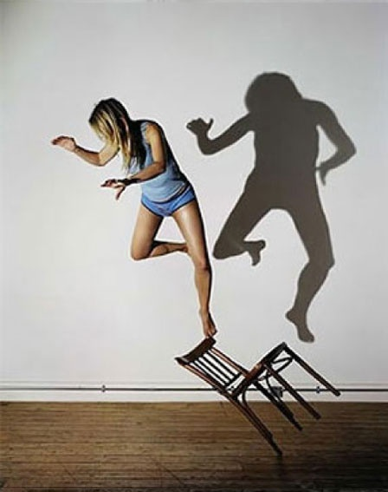
Shadows
PoL Úbeda Hervàs
Floris Neusüss
Sam Taylor Wood

Slide 9
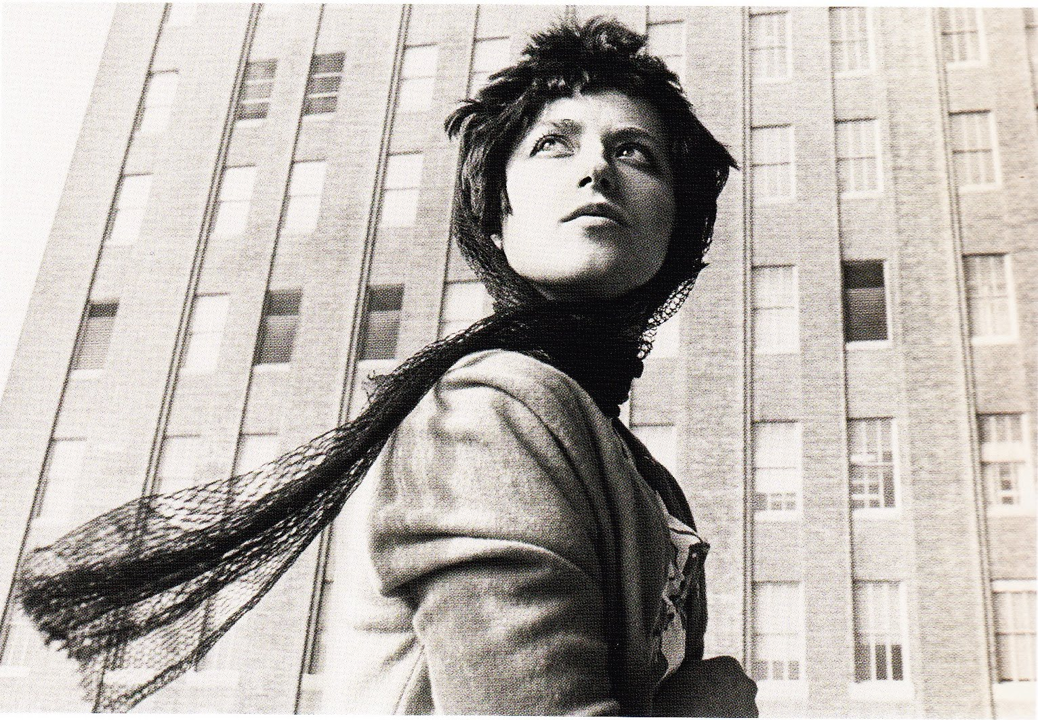
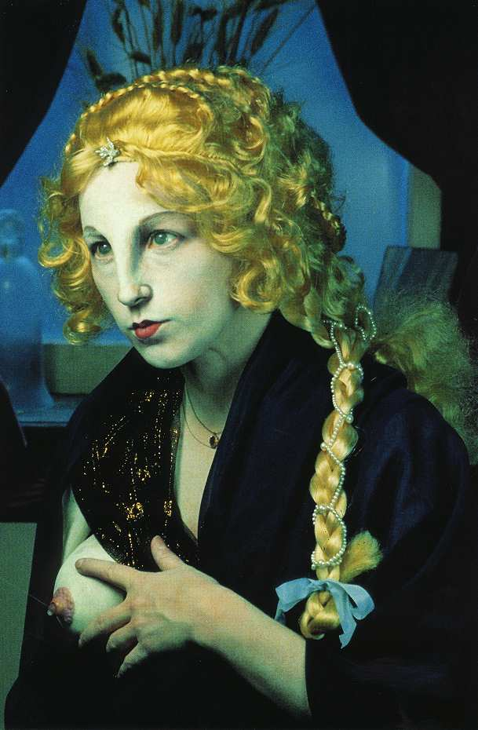
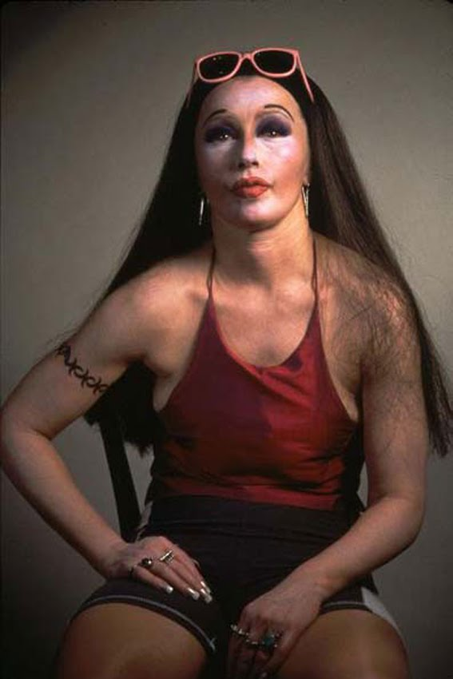
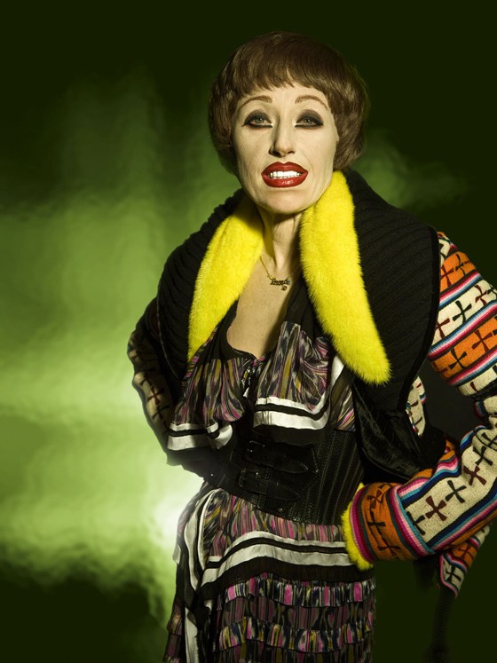
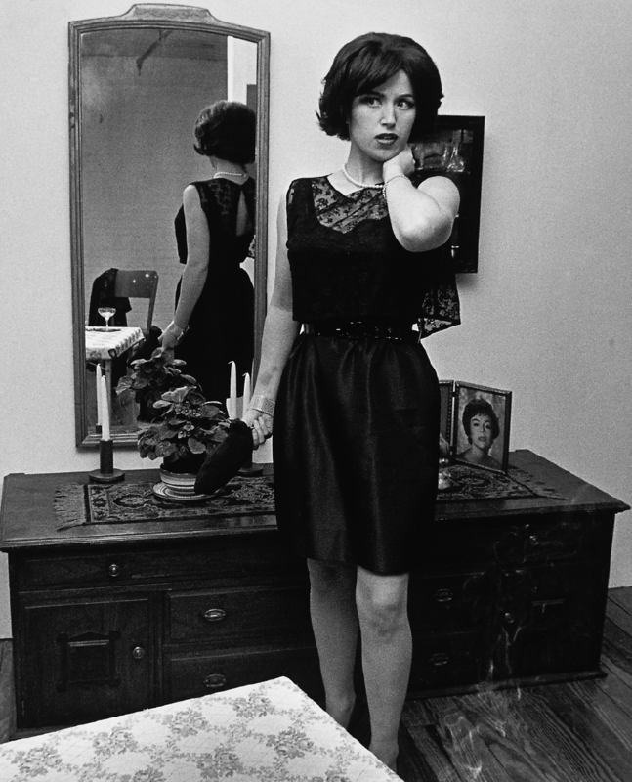
Reflect different aspects of an identity: Cindy Sherman
Sherman works in series, typically photographing herself in a range of costumes. For example, in her landmark 69 photograph series, the Complete Untitled Film Stills, (1977-1980) Sherman appeared as B-movie, foreign film and film noir style actresses. Although Sherman does not consider her work feminist, many of her photo-series, like the 1981 "Centerfolds," call attention to the stereotyping of women in films, television and magazines.

Slide 10
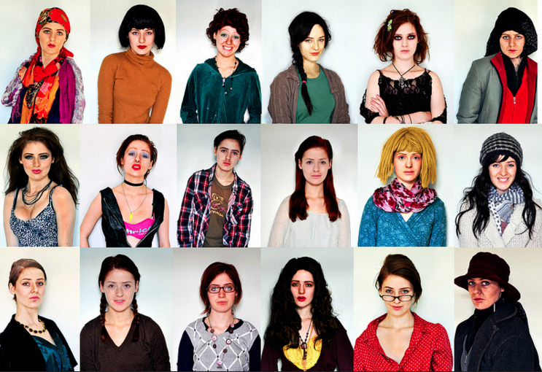
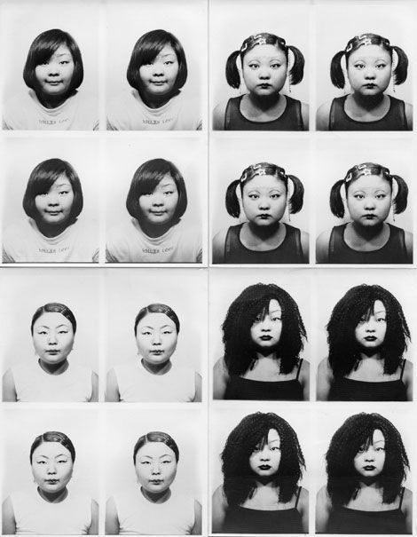
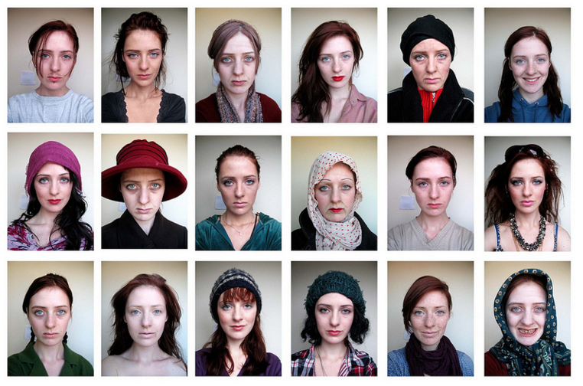
Cindy Sherman responses by ex-student, Lydia Francis
Tomoko Sawanda

Slide 11
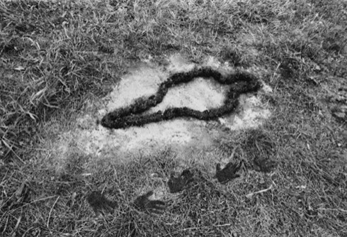
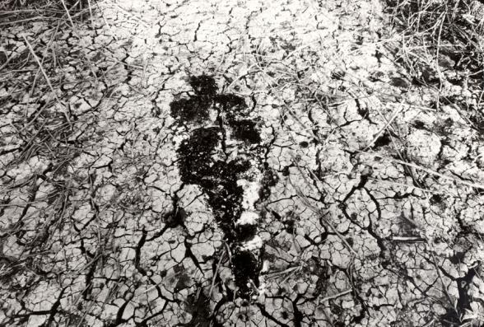
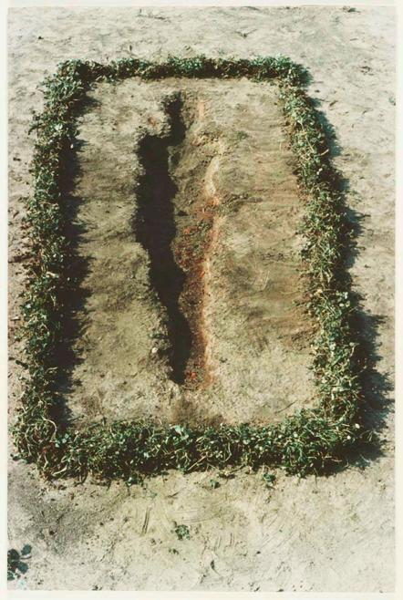
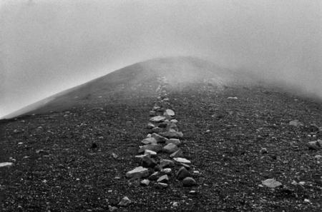
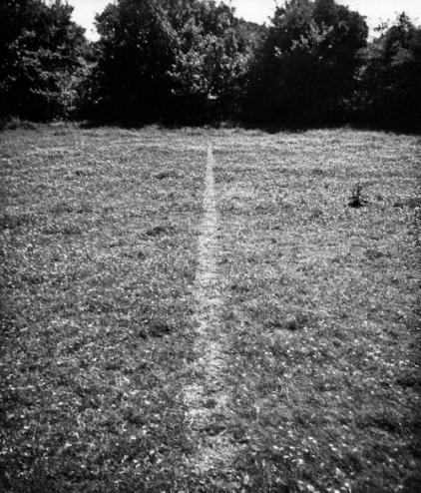
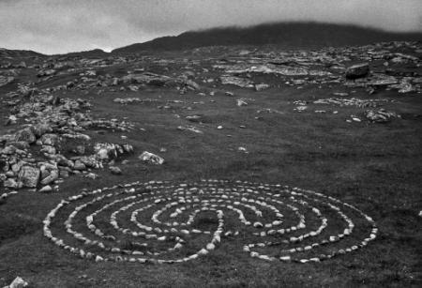
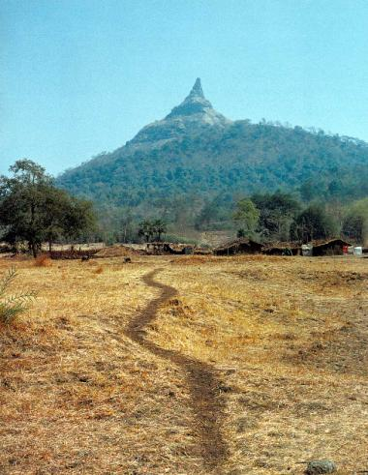
Reflections of a journey
Ana Mendieta, Silueta, 1976
The silueta (silhouette) was a series of artwoks made by Ana Mendieta in which she left an ‘imprint’ of her body in snow, mud, sand, grass etc. These were transient ephemeral artworks, at their creation a performance piece, then recorded photographically.
Artist Richard Long is known for his Land-Art, often photographing tracks made by repeated use, or arranging natural materials within the landscape and then photographing them.

Slide 12
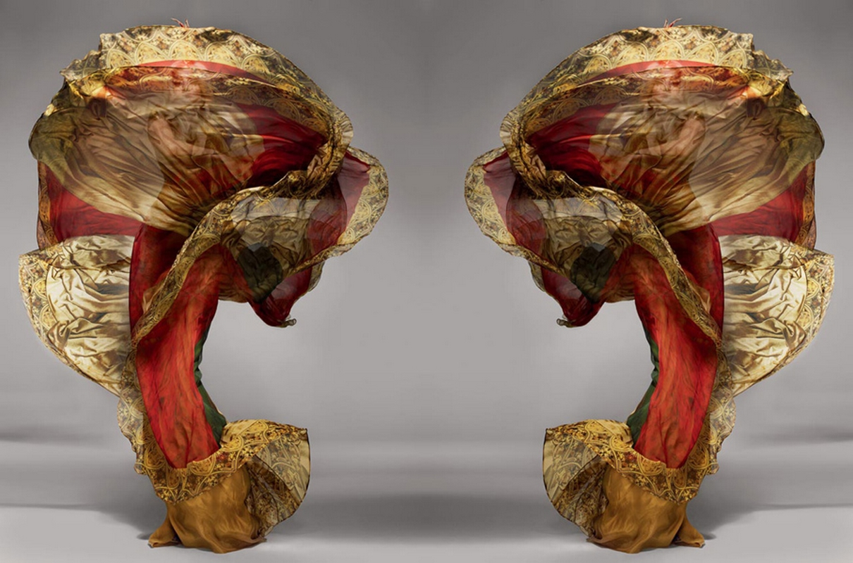
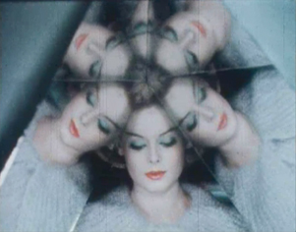
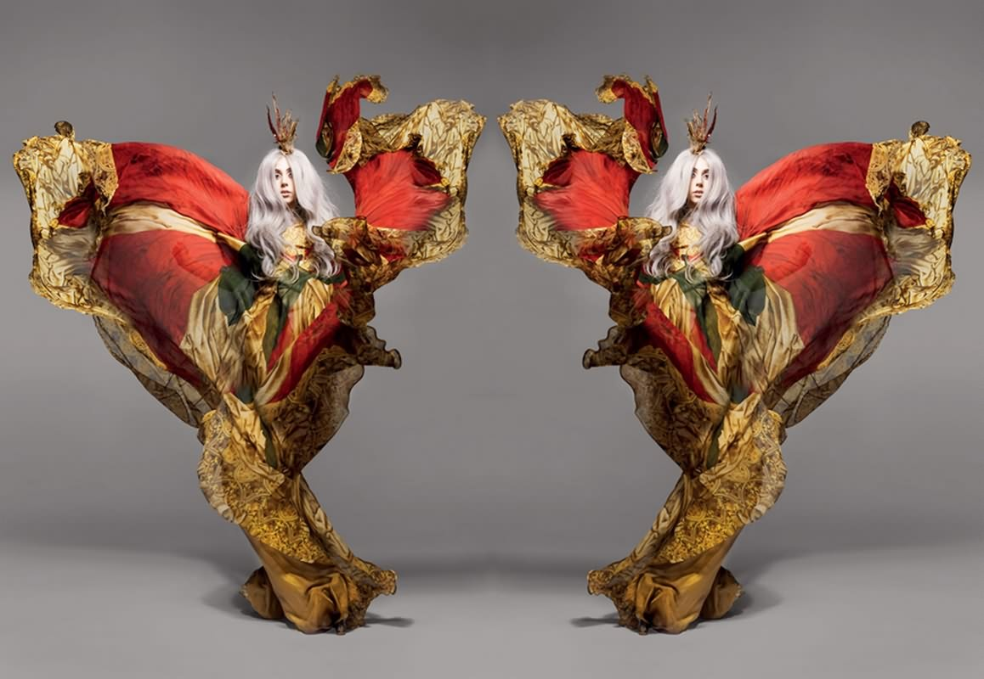
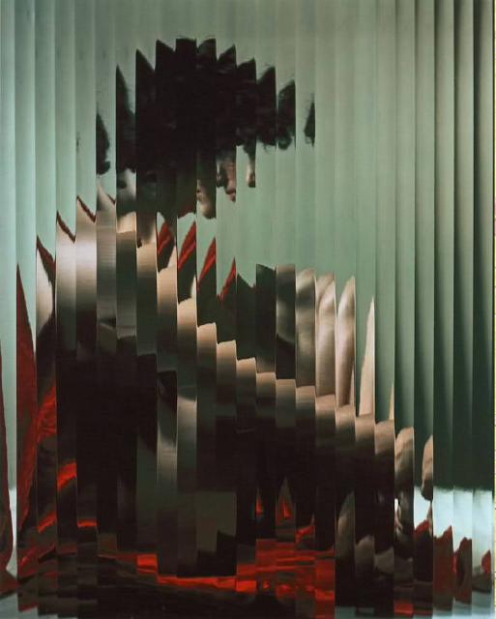
Fashion: Stylised Reflection
Nick Knight
Erwin Blumenfeld https://www.youtube.com/watch?v=tPtwcbEL74c

Slide 13
Reflect on the past in the present
Ugne Henriko
Carra Sykes
Irina Werning
Clarisse D'Arcimoles
Bobby Neel Adams

Slide 14
Laura Gertsone
Little Miss Stitch
Lisa Kokin

Slide 15
Reflection of light
Andrew Curtis
BANKSY: Mobile Phone Lovers
Dan Witz: portrait paintings

Slide 16
Phillip Toledano
Gamers

Slide 17
Anthony Cassell

Slide 18
Multiple Reflections
Alvin Langdon Coburn
A broken mirror, edges jagged, would be a fitting metaphor for the photographs by Alvin Langdon Coburn, taken early last century. He was smashing convention, refracting reality, elevating partial reflections over traditional images. It's not just a metaphor, though: the pictures he took in this period – vortographs, as they became known – were shot through the prism of three pieces of glass, splitting the image into segments, creating weird and wonderful distortions.

Slide 19
Craig Cramer
Cramer scans flowers then manipulates them in Photoshop to create reflected patterns whereas Horst P Horst would create his mirrored images in the darkroom.
Horst P Horst

Slide 20
Reflecting the inner self
Meggie Royer
Anonymous
Gillian Wearing
Signs that say what you want them to say and not Signs that say what someone else wants you to say

