Slide 1
How do we ‘read’ a photograph?
What do we mean by ‘read’?
Notes:
Describe what we can see. Try to decipher codes, clues and other photographic devices to understand if the photographer is presenting us with something more than a photographic record.

Slide 2
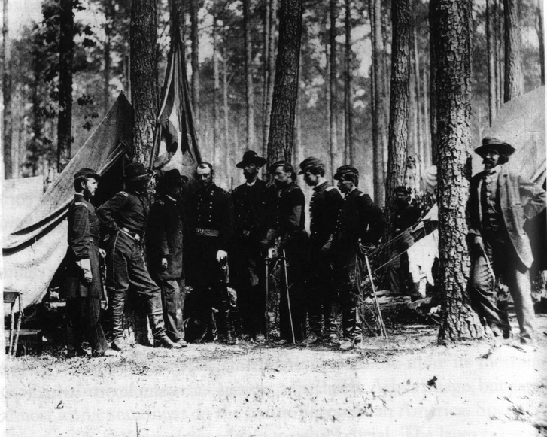
What factors make it difficult to read an image?
Matthew Brady General Robert Potter and Staff. Matthew Brady Standing by Tree, 1865
Notes:
A characteristic portrait from the American Civil War. The central aspect of this photograph is the presence of the photographer, Matthew Brady, to the right of the official military group. Brady's presence not only questions the terms of photographic meaning, but the values of the system and the subjects photographed. Compare, for example, Brady's stance to that of General Potter. Note also the insistence on the vertical as part of a larger symbolic military and male code.
this is a conventional portrait and confirms the values of a military world and the significance of distinguished individuals as they confirm their place in history. But what happens when we include the figure of Brady in the image? Allow Brady's presence on the right to be the object of our attention and immediately Potter is de-centred. The compositional balance of the 'first' photograph is completely broken. What emerges is a double structure: an official group portrait which advertises and celebrates a white military world, and a second which, through the simple presence of the photographer, questions the terms of reference of the first. Brady has established a critical distance between himself, the group, and the way the group has been photographed; an aspect further underlined by the way his own pose, nonchalant and casual, is in direct contrast to the others. In terms of Barthes's reading of photographs Brady's presence creates a punctum which begins a process of questioning.

Slide 3
What factors make it difficult to read an image?
Matthew Brady General Robert Potter and Staff. Matthew Brady Standing by Tree, 1865
Notes:
Viewer: has expectations and makes assumptions, there will be problematic, ambiguous and contradictory meanings between the viewer and the image.
Image reflects our codes, conventions, values, beliefs, hierarchies and other frames of reference back at us.
Photographer is presenting a specific aesthetic, critique, political or ideological stance.
Wider context of the image- social, cultural, aesthetic

Slide 4
When we look at photographs, we don't just look at them passively; we search for meaning and message, even if we are not consciously aware of doing so. In this way, you could argue that we read images as we would a piece of writing, trying to discover the meaning and the message behind it.
At its simplest, the message could be that the photographer decided the scene was worth recording. At its most complex, an image can provoke problematic and ambiguous relationships between the reader and the image.
Isabel Lee
Notes:
An image always contains a message that reflects the codes, values, and beliefs of the photographer. The eyes of the viewer and the eyes of the photographer influence how it is read. In this way, the photograph is never a true representation of a scene, but a representation of how we see the world.

Slide 5
Denotative vs Connotative
What’s the difference?

Slide 6
Denotative vs Connotative
Literal explanation
Implied overtones
For example, a black cat is just an example of a four-legged animal which happens to be a certain colour. Here, the difference between denotation and connotation is decided by what society has told us that certain symbols, colours, expressions and such mean. In this way, the connotations of a black cat in western society might suggest unluckiness, or evoke ideas of ‘slyness’ or an association with witchcraft (amongst many other things).

Slide 7
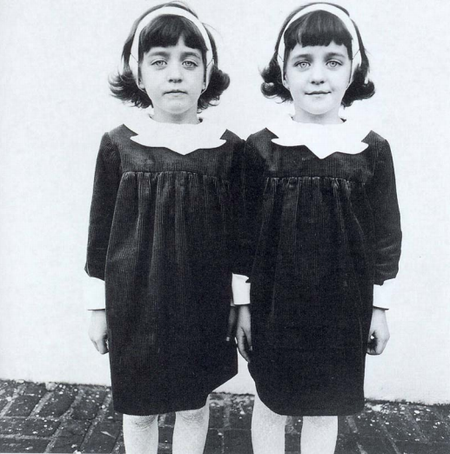
Diane Arbus Identical Twins, 1967
Notes:
Arbus's image is deceptively simple and belies its implicit complexity. On one level it is an exemplary Arbus photograph and reflects her concern with identity. But it is also about difference, and the act of looking (and judgement). In many ways it can be viewed as a visual essay on the nature of photographic meaning.

Slide 8
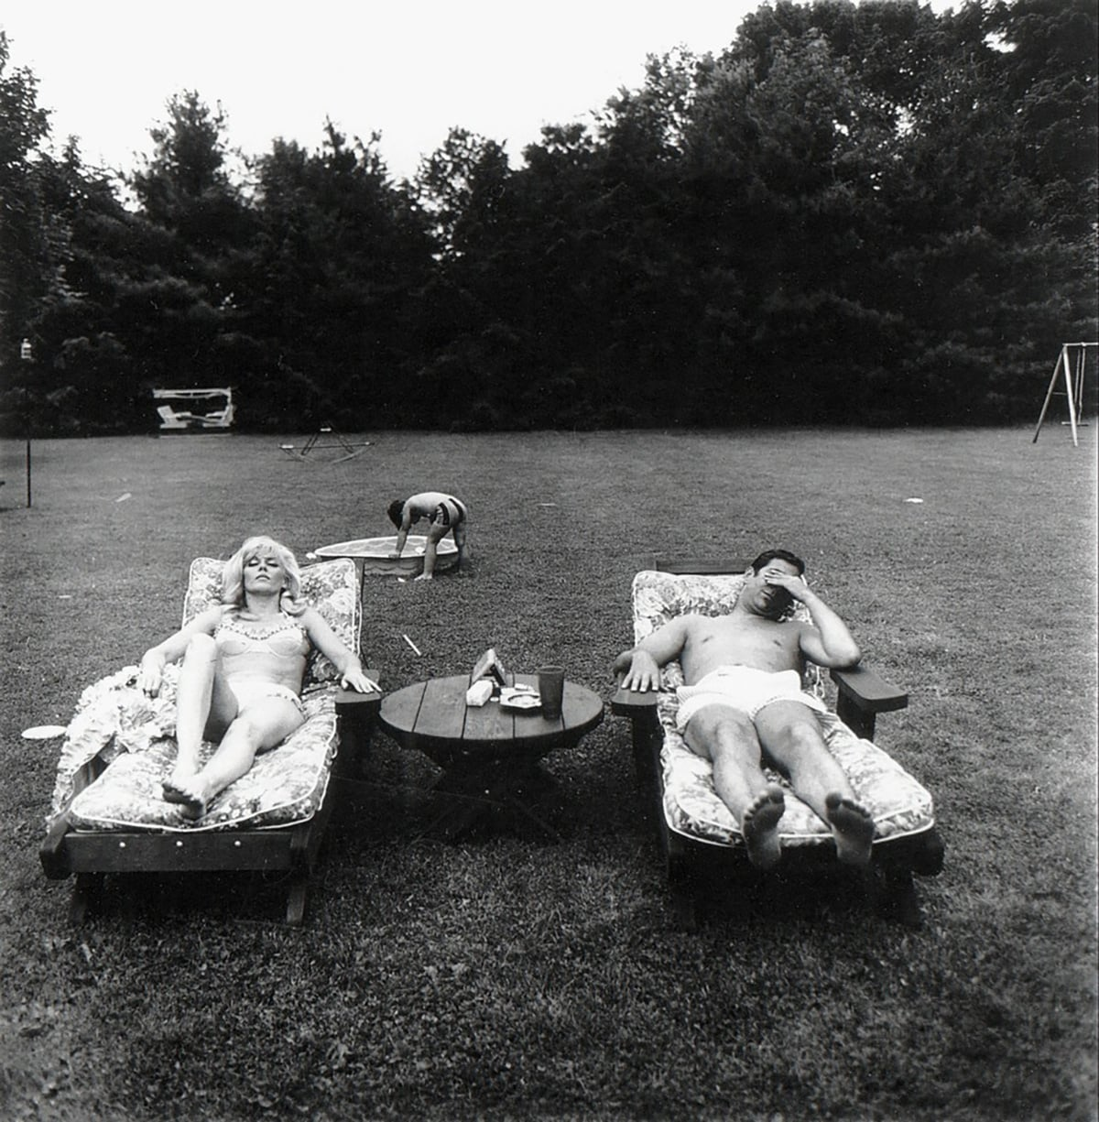
Diane Arbus A Family on Their Lawn One Sunday in Westchester, New York, 1969
Notes:
An archetypal Arbus Image which, highly symbolic In Its language, presents what might be seen as a general Image of American culture. It remains an example of the way a single photograph can represent a larger condition, at once cultural, social, and, In this Instance, psychological.

Slide 9
Homework:
Read chapter 2 from Graham Clarke's book, 'The Photograph' (link attached).
Create a page on your e-portfolio (weebly) called Critical & Contextual Studies.
Add a title: 'How do we read a photograph?'
Explain the difference between Denotative and Connotative.
Discuss the Denotative and Connotative attributes of the two Arbus images. You can present your thoughts in a table or as a paragraph of text. See the link (Study notes) for tips regarding comparative essays.

