Slide 1
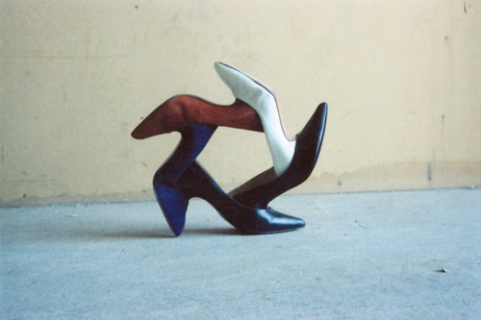
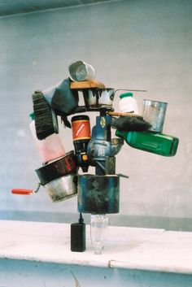
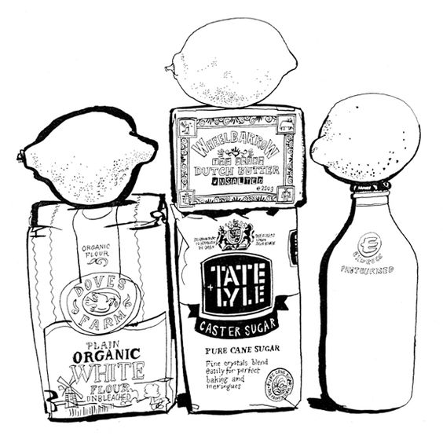
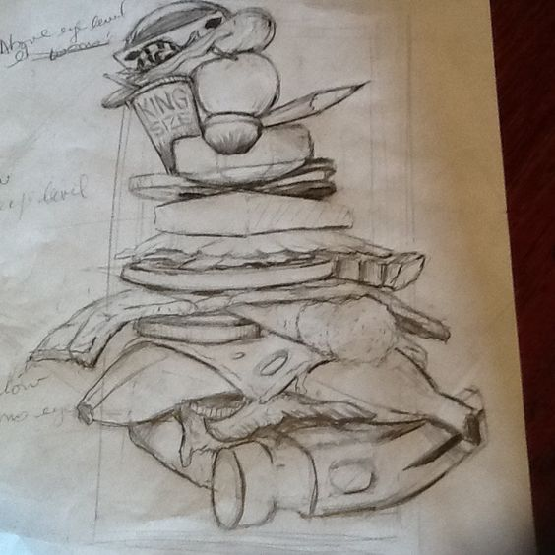
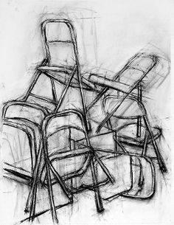
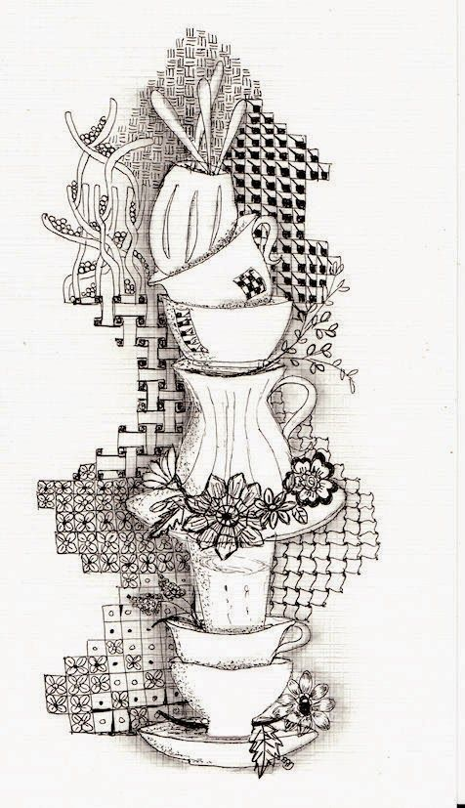
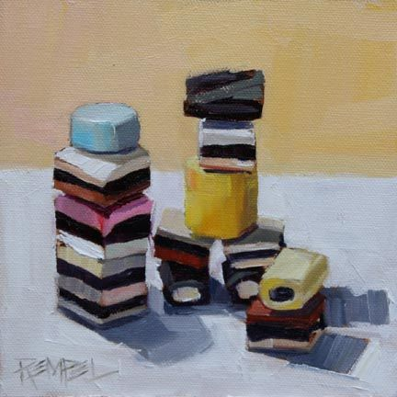
Homework 3: Stacked Drawing
Arrange a series of object to form a temporary still life. Look at these examples by Fischli and Weiss and Roeli van Vliet:
Draw this using tonal pencil or charcoal from an interesting viewpoint.
Grade 2 / 3 | Grade 4 | Grade 5
The objects can be simple and arrange so that there is not much foreshortening. Use at least three different tones. | The composition should include some foreshortening and perspective (eg ellipses). Use at least five different tones. | Include foreshortened objects, perspective, eight different tones and use mark making to suggest the texture of the objects in the composition.

