Slide 1
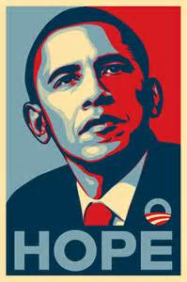
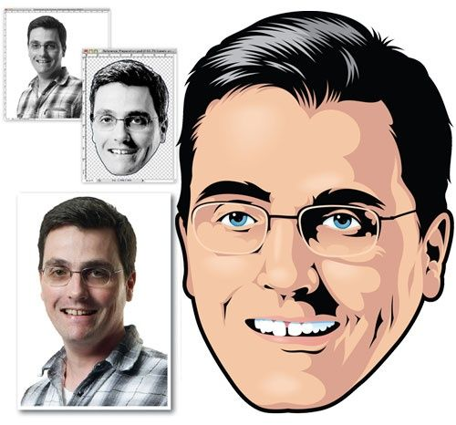
Homework: Simplify an image
Choose one of the images provided by your teacher. Simplify the image down to three colours and a stencil effect. Draw or paint in colour.
(If you have the means and expertise to create this in Photoshop you must screen grab the steps you take and include these in your sketchbook along with a print out of the final image.)
Grade 3 & 4 | Grade 5 | Grade 6
A simplified, colour drawing that includes detail and crisp lines. | A three colour image that shows a good likeness o the original. Detail and crisp lines. | A well executed drawing (flat colour, sharp lines etc) that includes a background & message.
‘Hope’, by Shepard Fairey, 2008- This poster by the American artist immediately went viral after its release. It captured the country’s need for optimism and hopefulness after eight dismal years of George Bush II.

