Slide 1
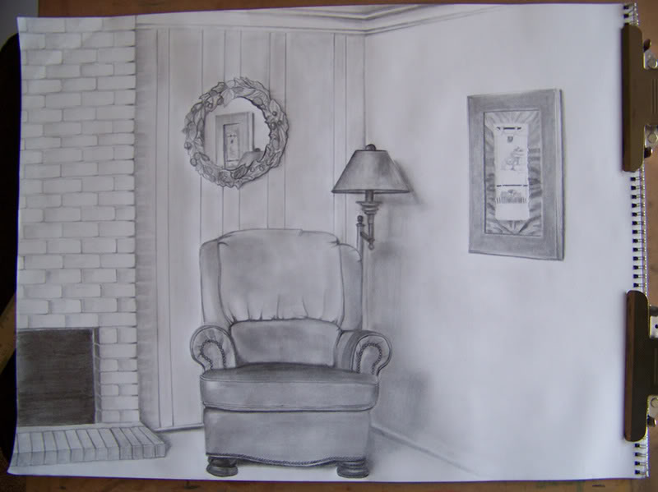
Corner of a room
Draw the corner of your bedroom as illustrated in the example below. You should use tonal pencil or charcoal for this homework.
Success criteria:
Draw at least 5 objects in situ
Use tone.
Make sure to add lots of detail
Fill the whole a4 page
Corner of a room
Draw the corner of your bedroom as illustrated in the example below. You should use tonal pencil or charcoal for this homework.
Success criteria:
Draw at least 5 objects in situ
Use tone.
Make sure to add lots of detail
Fill the whole a4 page
Grade 2/ 3 | Grade 4 | Grade 5
The objects can be simple and arrange so that foreshortening is reduced. Use at least three different tones. | The composition should include some foreshortening and perspective. Use at least five different tones. | Include foreshortened objects, perspective, eight different tones and use mark making to suggest the texture of the objects in he composition.
Grade 2/ 3 | Grade 4 | Grade 5
The objects can be simple and arrange so that foreshortening is reduced. Use at least three different tones. | The composition should include some foreshortening and perspective. Use at least five different tones. | Include foreshortened objects, perspective, eight different tones and use mark making to suggest the texture of the objects in he composition.

