Slide 1
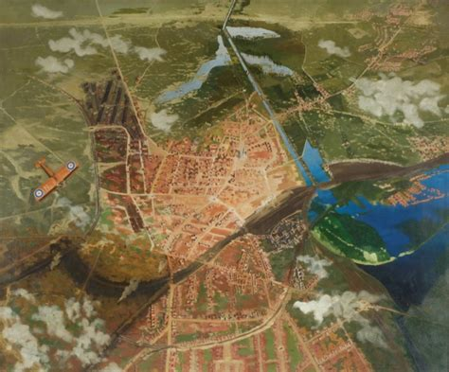
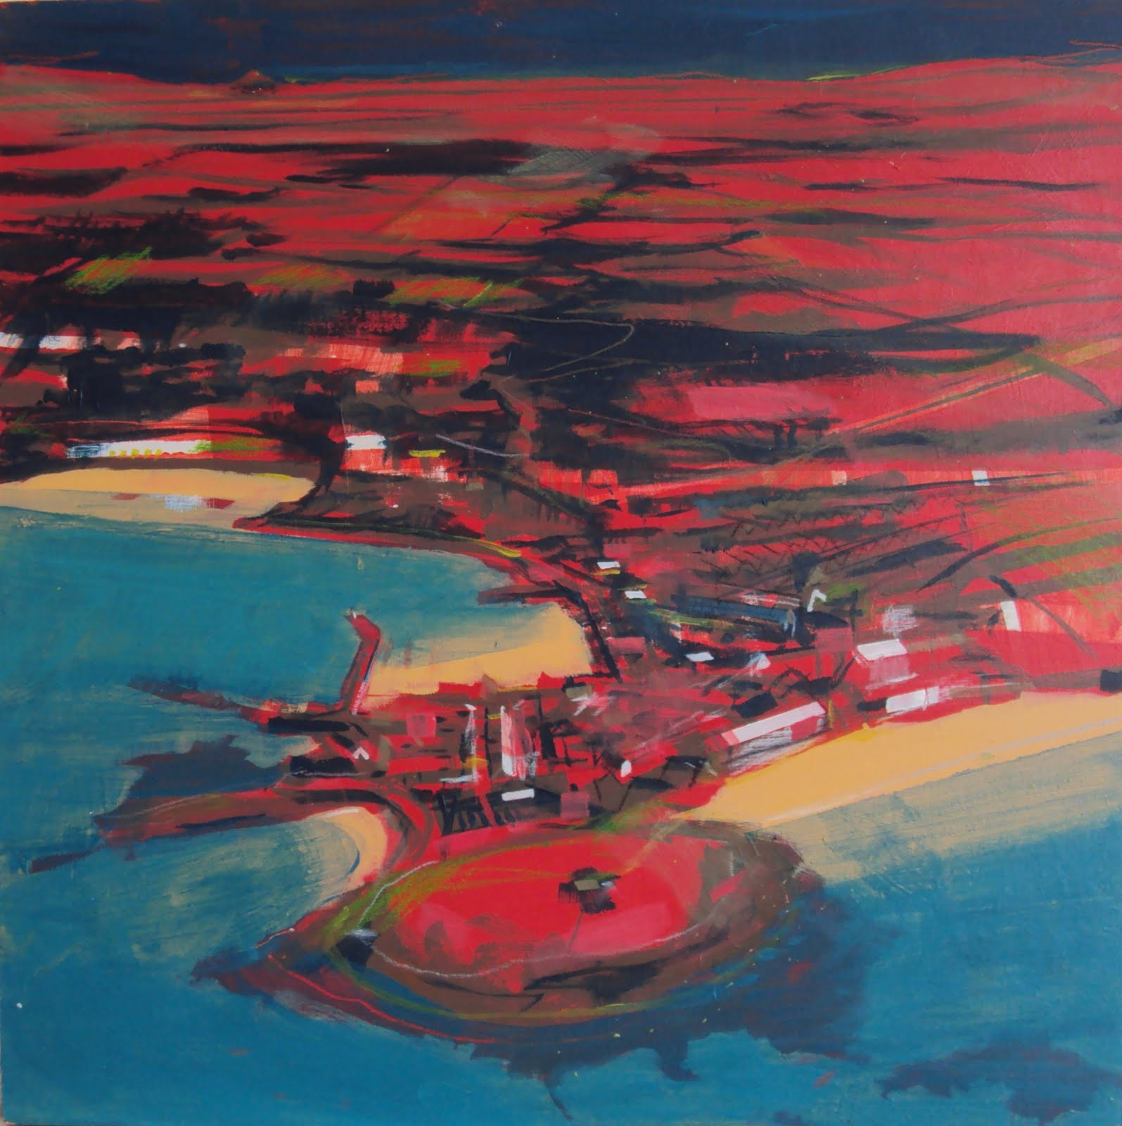
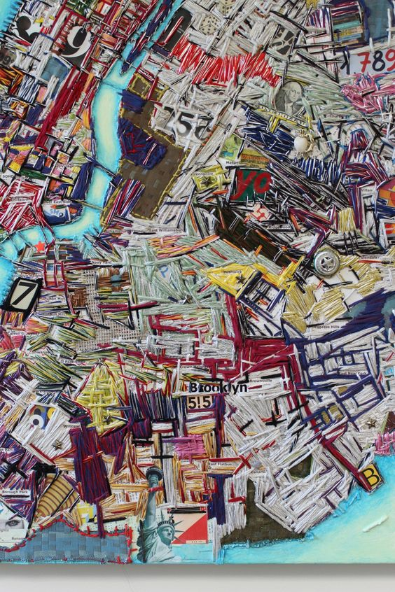
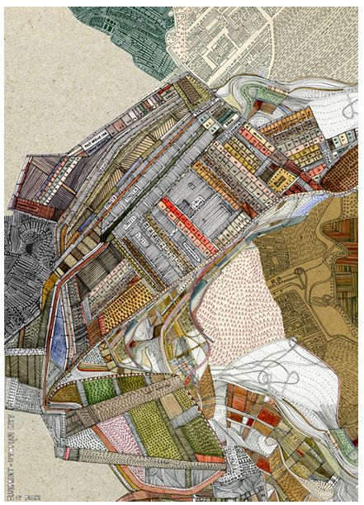
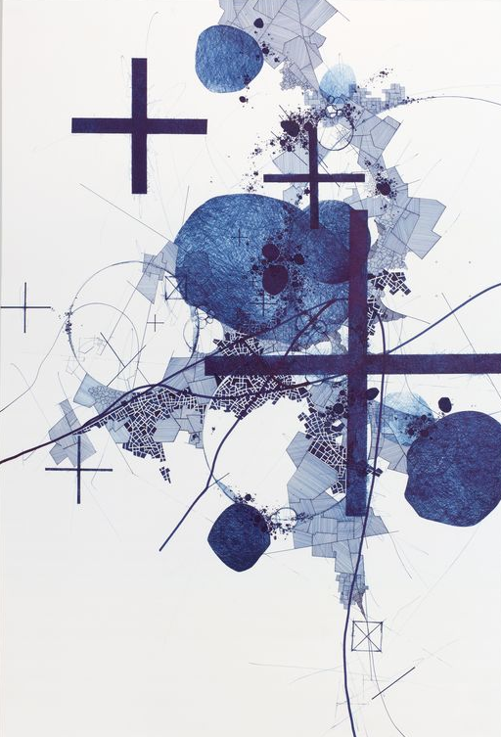
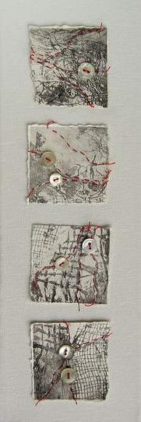
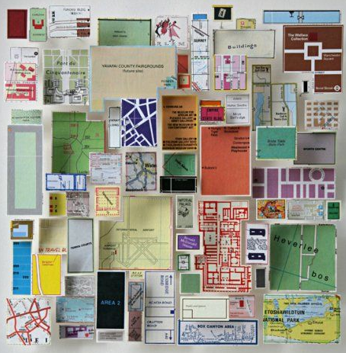
Wander
a : to move about without a fixed course, aim, or goal
b : to go idly about
The freedom to move and to travel has inspired many artists. Sydney Carline and Peter Lanyon explored the soaring freedom of flight creating these aerial images of the landscape beneath them.
Sydney Carline
Peter Lanyon
Complete a 30 minute wander and document your route on a map.
Repeat your route and complete the following tasks:
Collect objects to photograph and draw from when you are back home
Write a stream of consciousness for all or part of your route
Photograph the horizon at different points
Use a range of media to draw parts of your route: you must do this in situe NOT from photographs
This should take roughly 4 sketchbook pages
Create a piece out of your sketchbook using your map as a base and the other work you did as inspiration.
Ruben Marroquin
Nigel Peake
Derek Lerner
Helen Smith
Chris Kenny

Slide 2
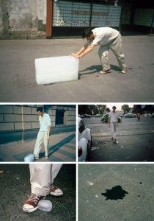
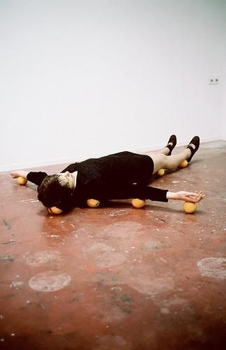
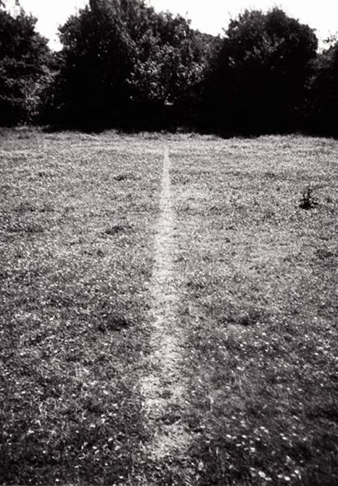
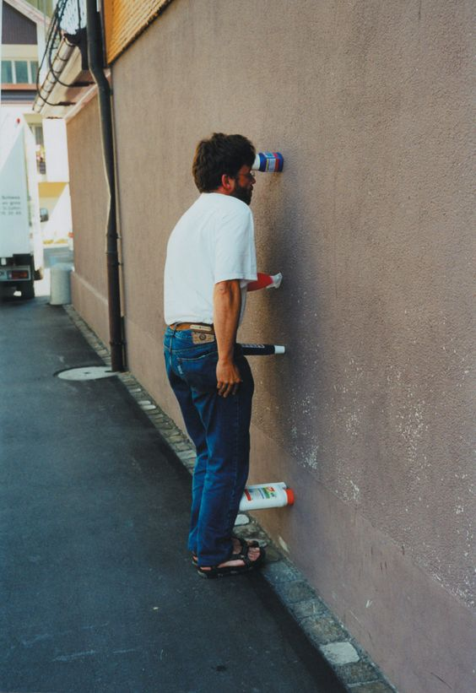
Intervention
Success Criteria:
Visit several locations and photograph them, create drawings and plan.
Look at these artists…. Discuss their work (Intentions, wider issues, technique)
Create an artwork that:
Challenges generally accepted behaviour in your local area
Makes an impression on your environment, leaves a (legal) mark
Uses public spaces as a performance space
Francis Alys
Erwin Wurm
Richard Long

Slide 3
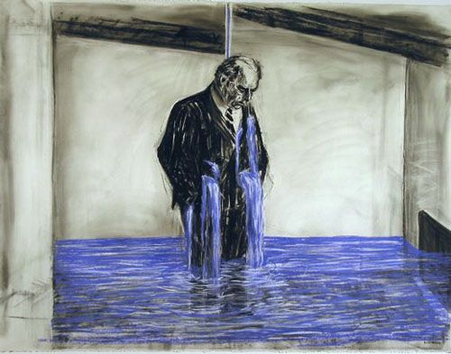
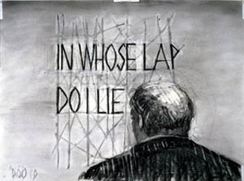
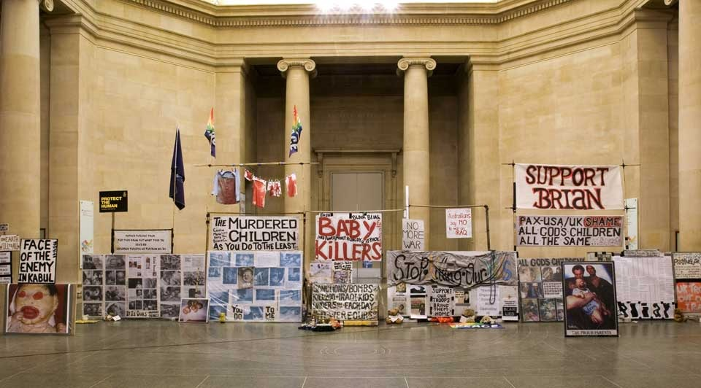
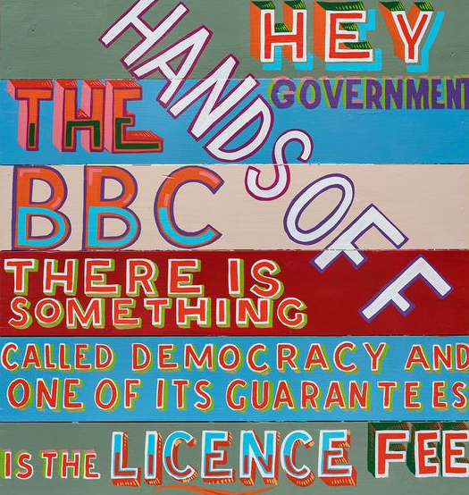
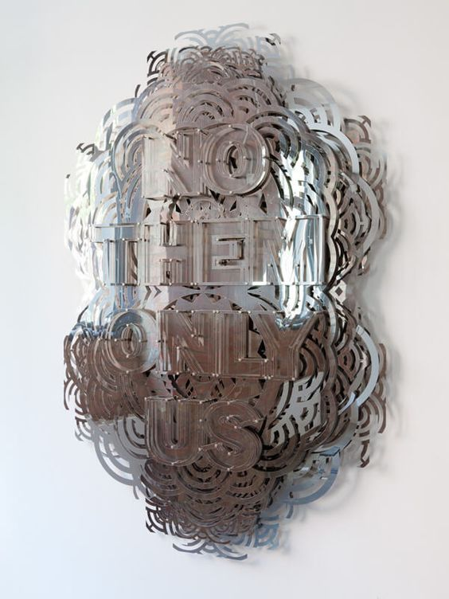
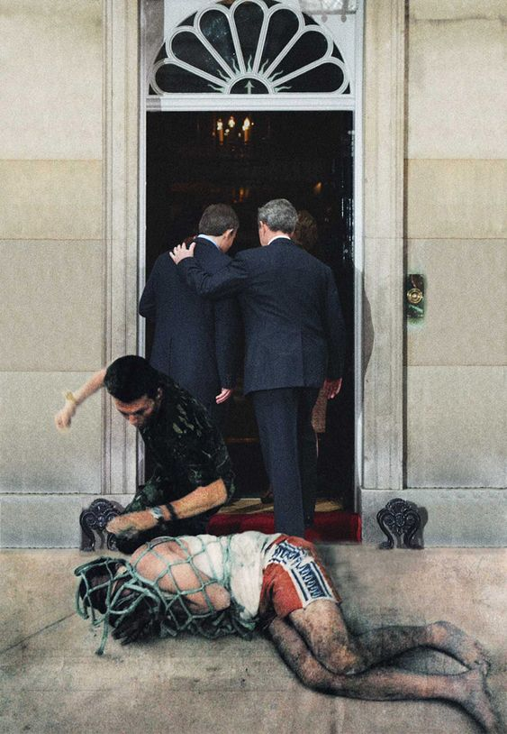
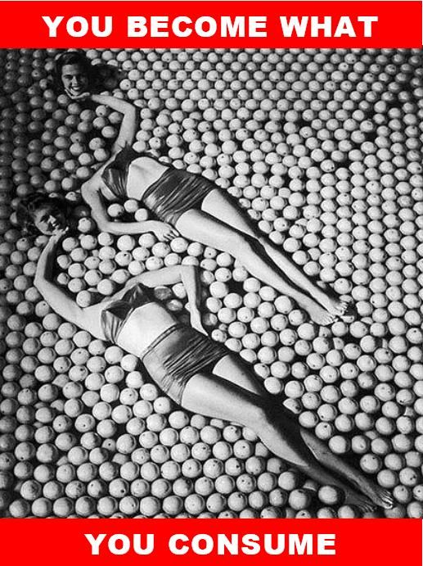
William Kentridge’s drawings and animations engage with the recent political history of south Africa, forming an individual and often ambiguous commentary on the struggle for liberation and it’s consequences. Mark Wallinger’s State Britain was a reconstruction of Brian Haw’s protest against the war in Iraq. Create a piece that questions and challenges social and political orders.
Challenge:
Research an issue and develop an out of sketchbook piece. Consider the approach and techniques used by the artists in this slide and demonstrate all your planning in your sketchbook.
Signs
Bob & Roberta Smith Mark Titchner
Collage
Kennard & Phillips Barbara Krugar

Slide 4
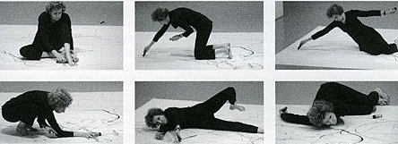
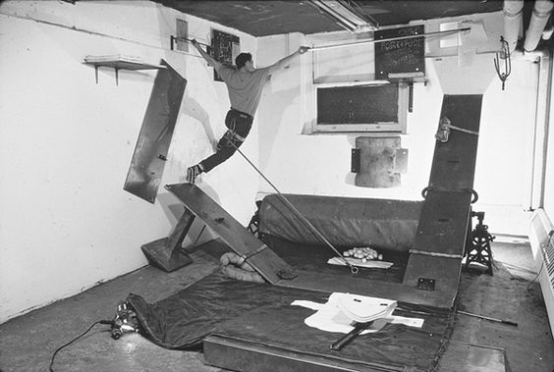
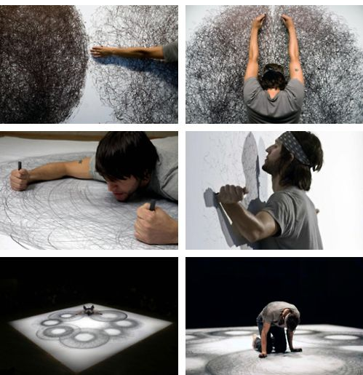
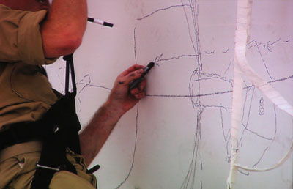
Restricted
Trisha Brown
Create drawings whilst being inhibited in some way or only draw as far as you can reach.
Consider the intentions behind Matthew Barney’s Restrained Drawings and explore mark making as a means of presenting an experience.
Tony Orrico

Slide 5
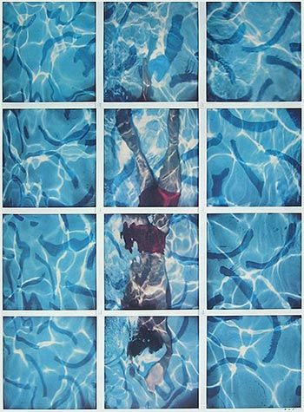
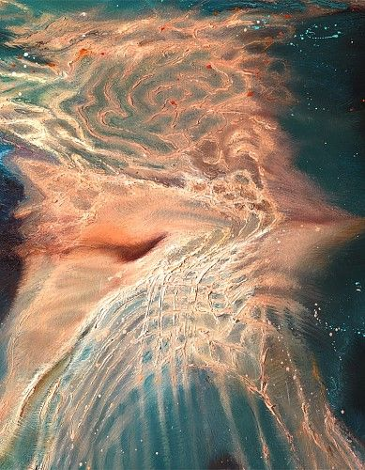
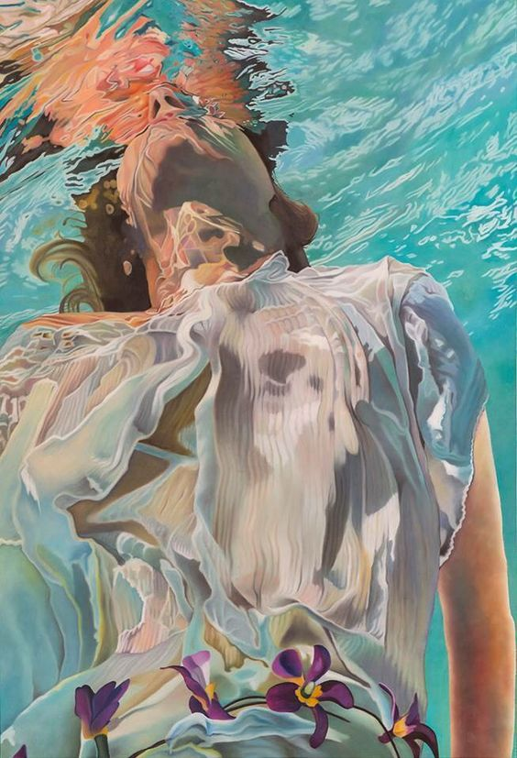
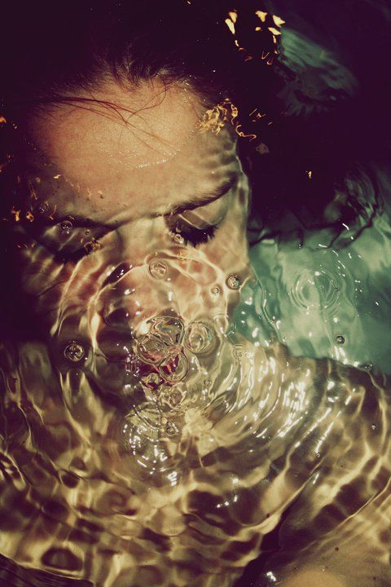
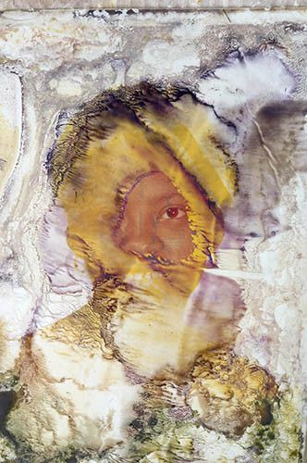
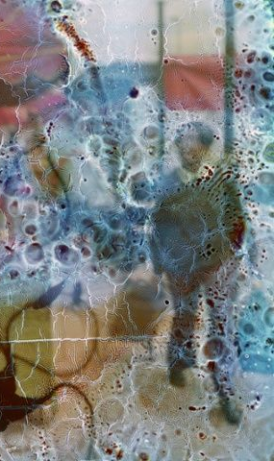
Weightless
The only place we can truly feel weightless is in water. The buoyancy allows us to drift both physically and mentally.
Observe the body in water. Draw and paint your observations paying particular attention to the distortion. Explore the effect of liquids on images like Strembicki and Gill below.
Lorraine Shemesh
Joseph Moncada
David Hockney
Alban Grosdidier
Stan Strembicki
Stephen GIll

