Slide 1
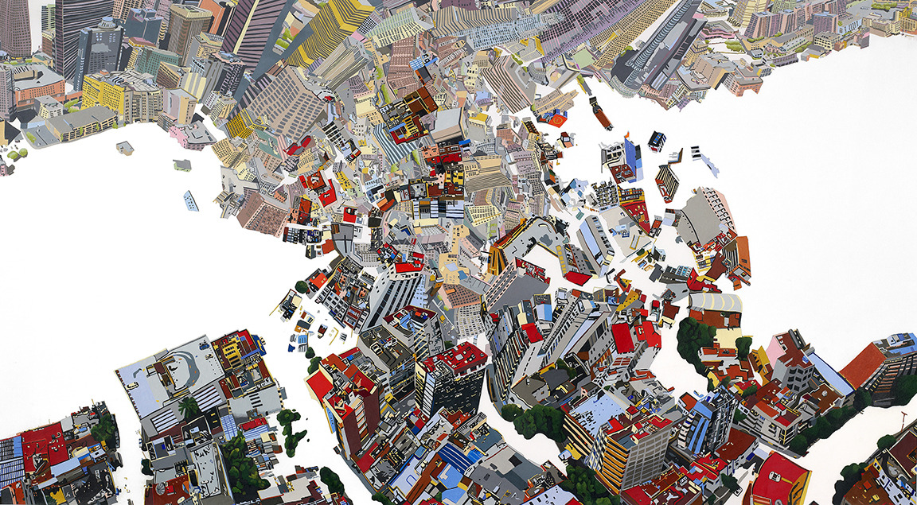
GCSE Exam Project:Fragments (Landscape)

Slide 2
.
This project will help you to achieve marks across all assessment objectives. It is a project based on landscapes.
Print off the following images of London and Muswell Hill…..

Slide 6
Muswell Hill from above

Slide 7
Practical 1: Drawing/Tracing
Print your aerial landscape A4 or A3 and with some tracing paper, trace 10 buildings. Try to make these spread out over the image. Leave the rest as it is.

Slide 8
Susan Logoreci
Logoreci’s perspective is directly informed by aerial views, since she charters helicopters for day and night flights to survey the city from a place that is hardly ever experienced. Drawings are then rendered from photographs taken from above, which doesn’t always transfer over smoothly. It is in this transference that the white abstract spaces heighten and frame pockets of unseen places.
Complete one page research on Susan Logoreci’s work.

Slide 9
Photocopy your tracing onto cartridge paper and use watercolour to paint the buildings. Leave the white space as it is or use a flat colour acrylic to paint. Ask your teacher to help you decide on a background colour.
Practical 2: Watercolour/Flat Colour painting

Slide 10
Sunga Park
Bangkok-based illustrator and graphic designer Sunga Park embraces the unpredictable nature of watercolors in her drippy depictions of architectural landmarks. In her extensive travels throughout Europe, Park stops to consider the finest details of Gothic cathedrals or the antennae-laden rooftops of residential streets in Croatia, but allows entire paintings to fade away into a wash of ghostly color.

Slide 11
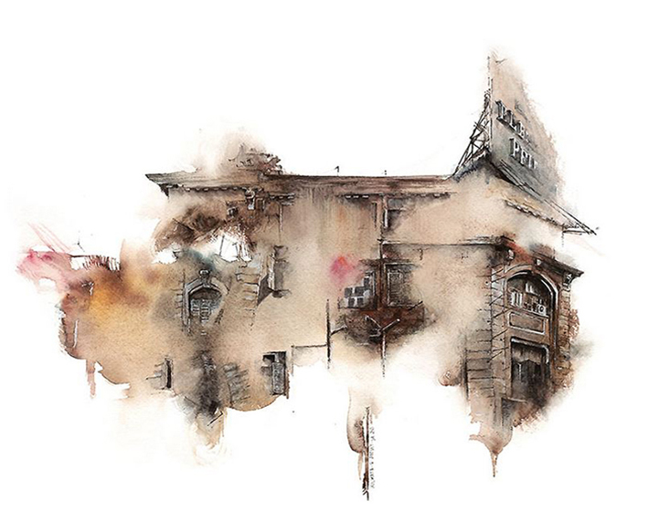
Practical 3: Fine Liner
Take more photos of London buildings (different styles)and then stick these in your book.
Make fine liner enlargements of sections of these buildings and then hold upright. Drip water down the image and see if you can recreate Park’s style!
Research/present Park’s work in your sketchbook

Slide 12
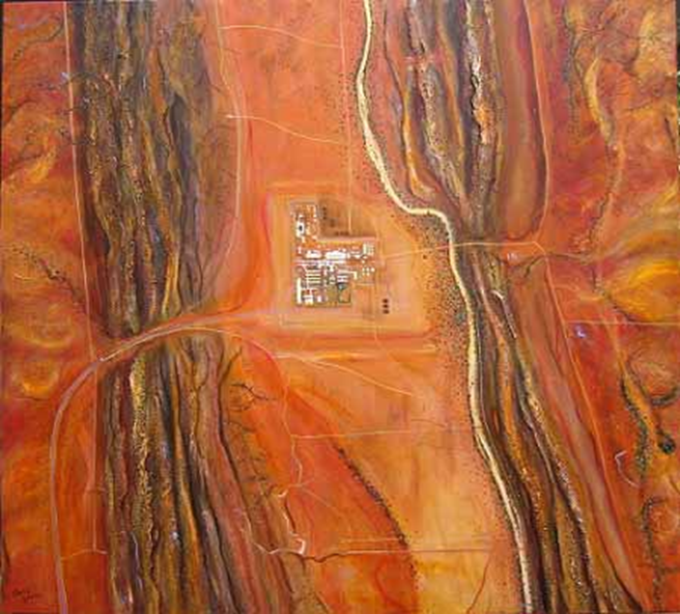
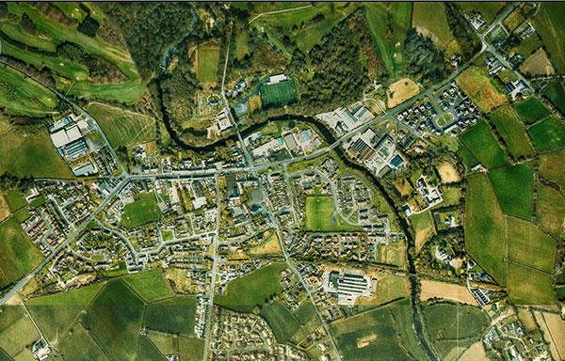
We live in a world where man made cities are woven into natural landscapes.
Collect images/photos of aerial landscapes. Try to get a combination of both rural and urban landscapes. From above these become fragmented areas of colour and pattern.

Slide 13
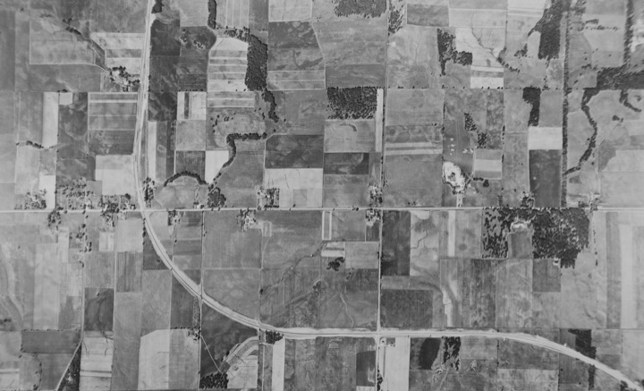
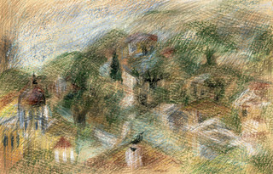
Practical 4: Drawing
Make 3 drawings/ paintings of your aerial landscapes, using a)pencil b)watercolour c)collaged coloured paper

Slide 14
Damien Hirst
Scalpel blades, zip stops, tattoo needles, pins, fish hooks: For his latest project, artist Damien Hirst set aside his palette knife and opted for tools of the flesh. The resulting 17 works, all cityscapes that mimic satellites’ clinical eye, paint a dark and alien picture of the seemingly familiar streets where we live and work.
lack Scalpel Cityscapes, Hirst says, are a commentary on modern surveillance’s invasive eye and modern warfare’s “surgical” drone strikes, which aim to limit collateral damage. From a distance, the paintings look like photographs; up close, the viewer can pick out materials specific to the city. For Paris, for example, Hirst included champagne caps and wire, condoms, and Eiffel Tower souvenirs
“Every city is a fragmented place,”
Homework: Create a research page on this work by Damien Hirst

Slide 15
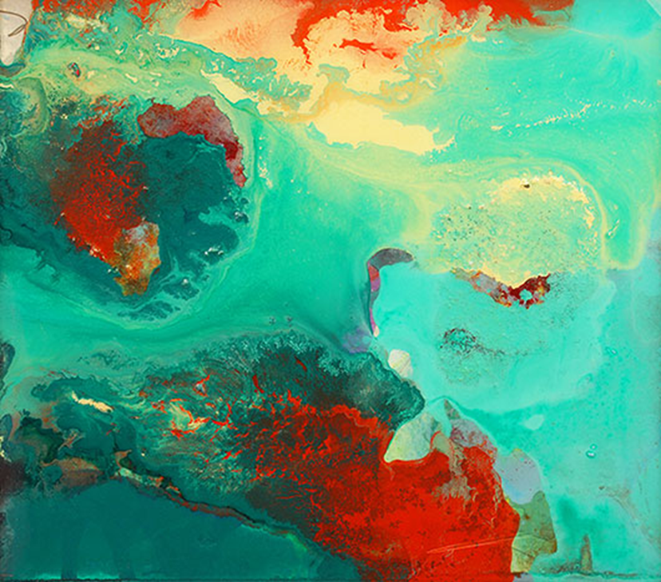
Homework:
Drop Food Dye into water to create different colours on the surface. Drop Paper onto the surface to create a marbled pattern. Try to experiment with colour and shape to reflect one of your aerial landscapes.
Take photos of these experiments

Slide 16
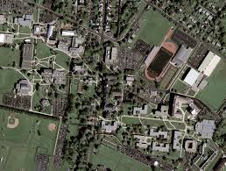
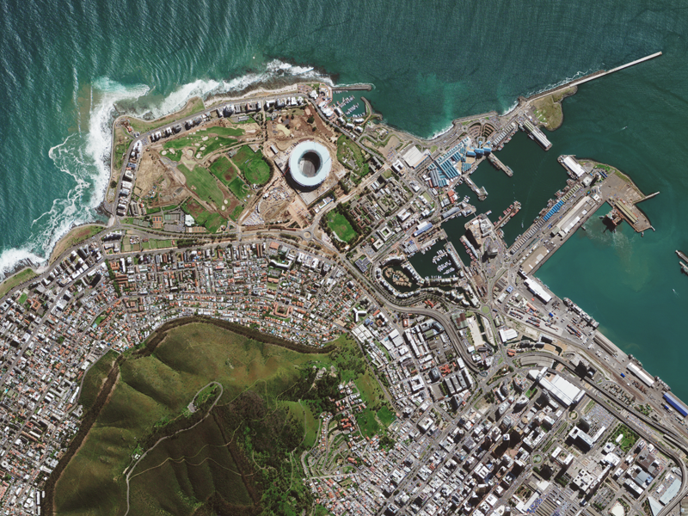
Print off Google maps of where you live. Try to print the satelite version:-

Slide 17
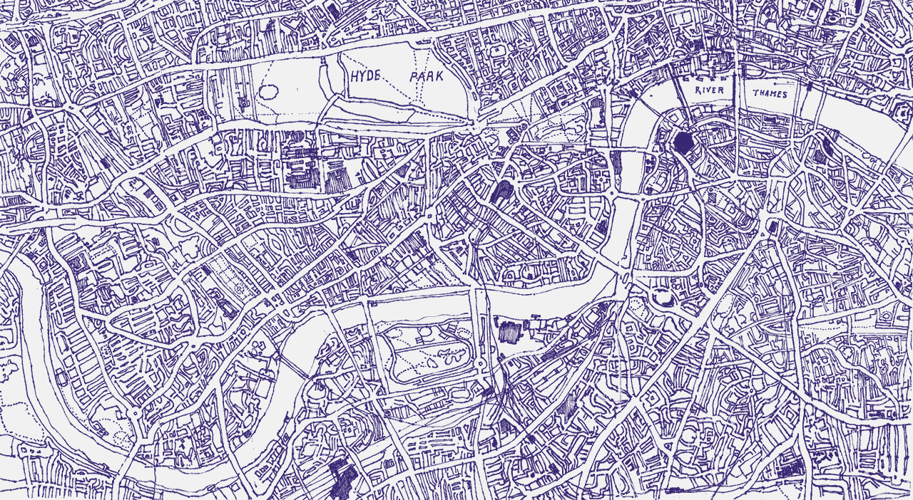
Practical 5 Printmaking
Create a mono-print from your Google maps

Slide 18
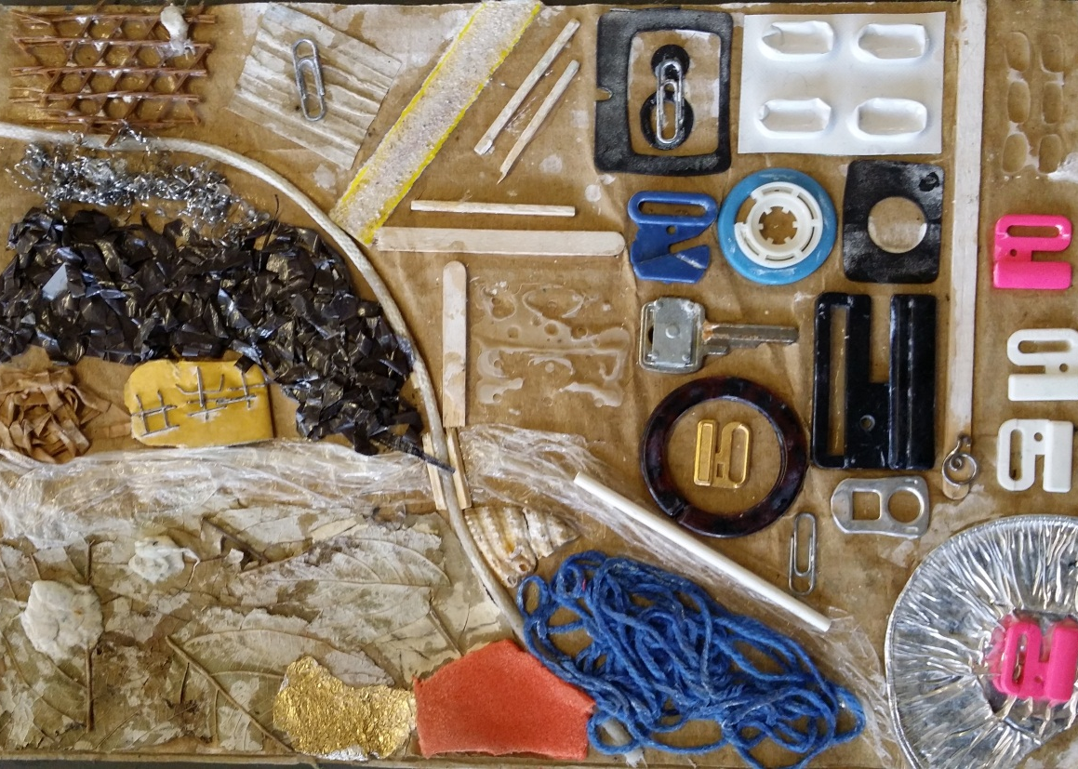
Practical 6 : Creating a Printing Plate
Create a Collagraph print of an aerial landscape of your choice. Use card to place objects /textures onto to create your printing plate. (string, card,ring pulls,matches, washers,tin foil etc)
Explain how you made your plate in your book and photograph it.

Slide 19
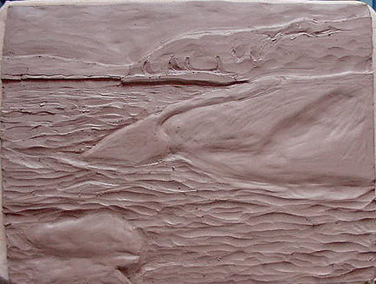
Prcatical 7: Clay Tile
Press your Collagraph print into Clay to create a relief Clay tile of your landscape. Wait for this to dry, then fire, and glaze, using the colours from your images.

Slide 20
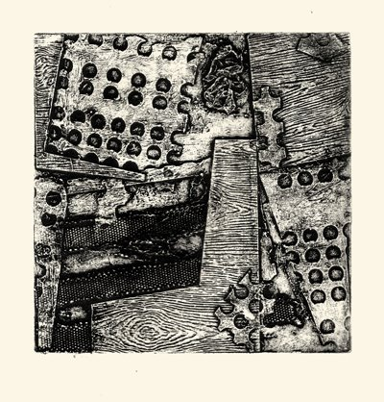
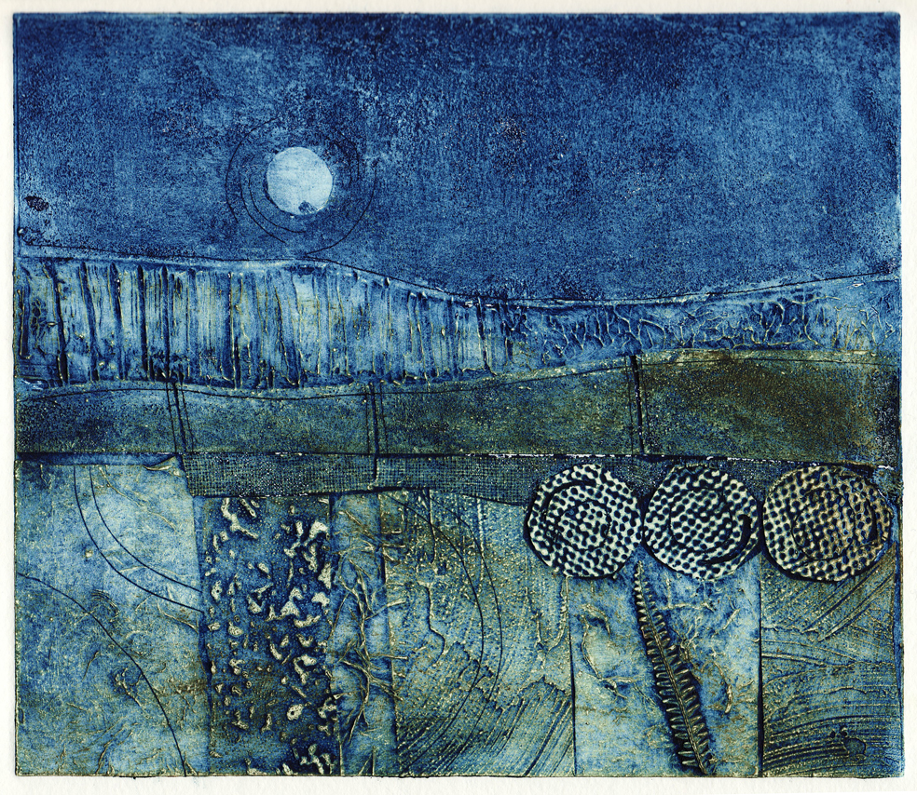
Practical 8 : Collagraph Prints
Make prints from your collagraph plates and experiment with colour, and layering.
Try creating a double print (3D image) by layering one print onto another slightly off-set.

Slide 21
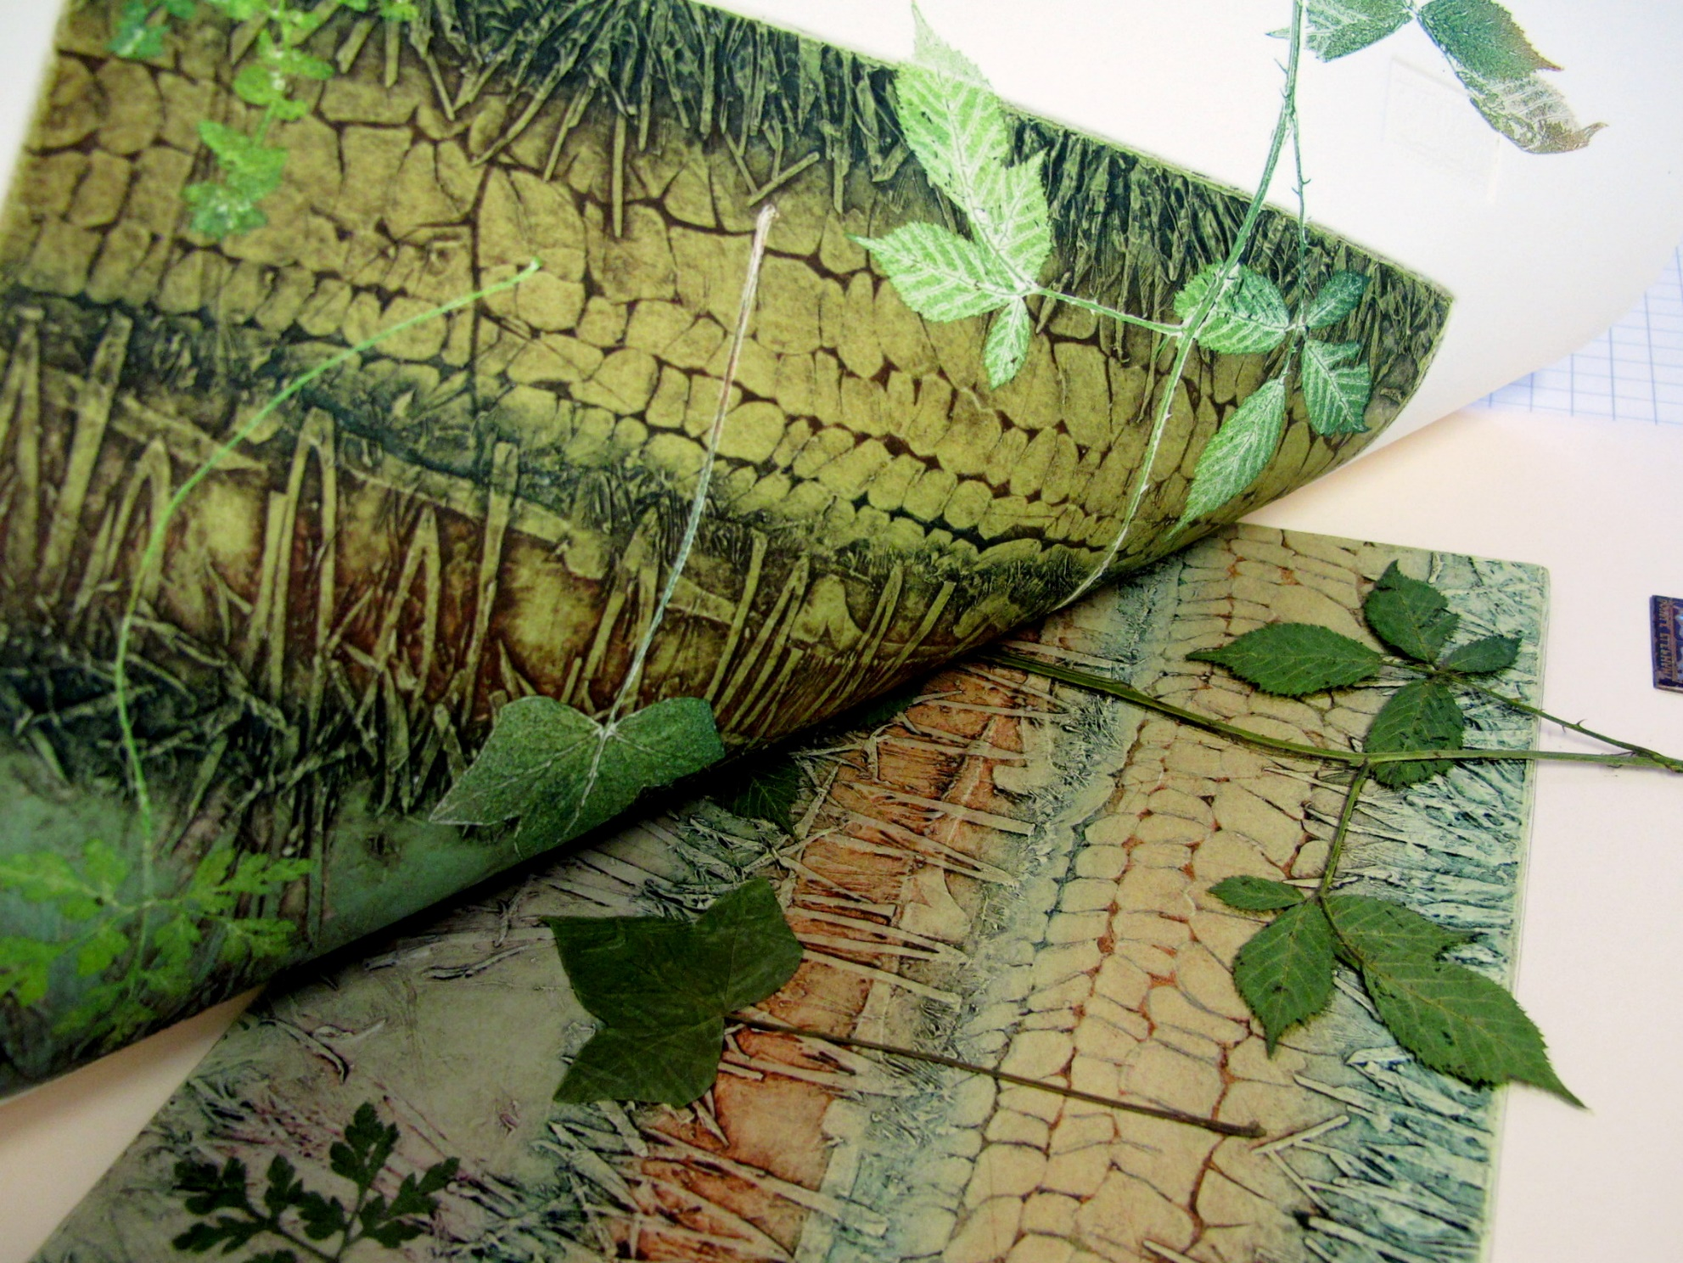

Slide 22
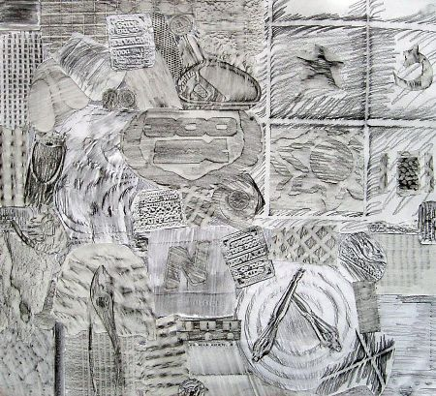
Homework: Create rubbings of different objects textures. Research the rubbings of Max Ernst.

Slide 23
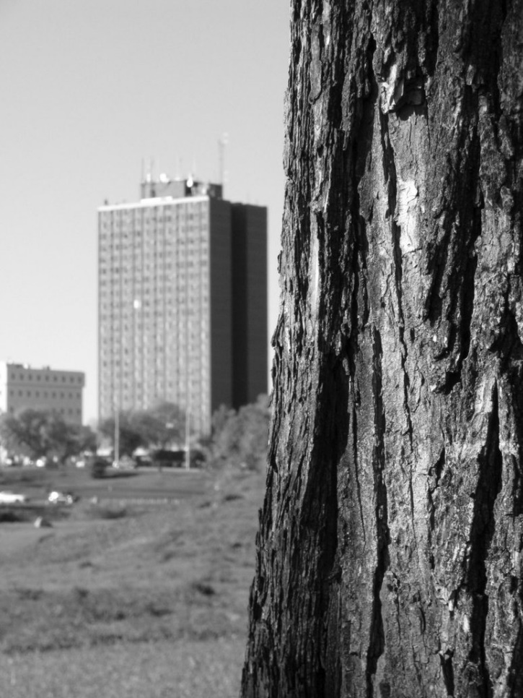
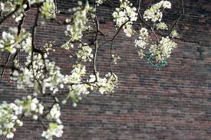
Take photos around London of scenes containing “natural” and man-made things.

Slide 24
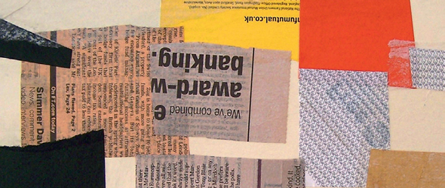
Practical 9: Mixed Media /Experimenting with layering
First create a surface using different pieces of collage.

Slide 25
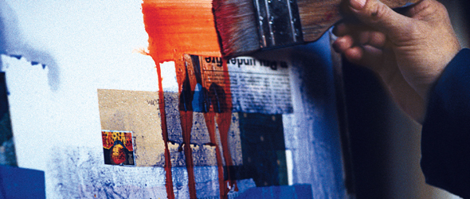
Next, add 2 coloured inks and let the ink run…

Slide 26
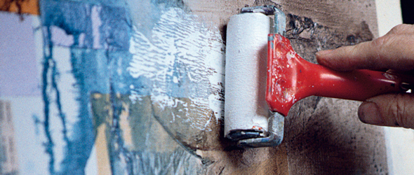
Use a roller with a small amount of ink to roll over the collage to create a mottled effect

Slide 27
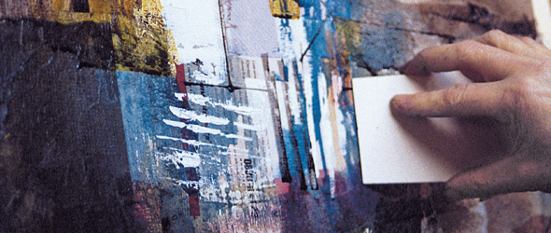
Now look at one of your photos and begin drawing, and painting over the top of your surface

Slide 28
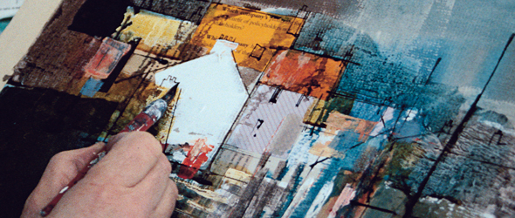
Continue to work from your photographs using the colours in the photo as reference. Use pencil/pen/paint.

Slide 29
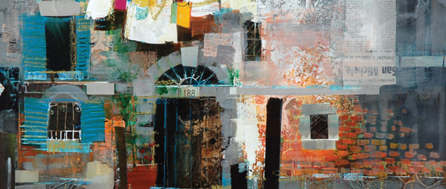
You will then have a mixed media piece with all layers showing through.

Slide 30
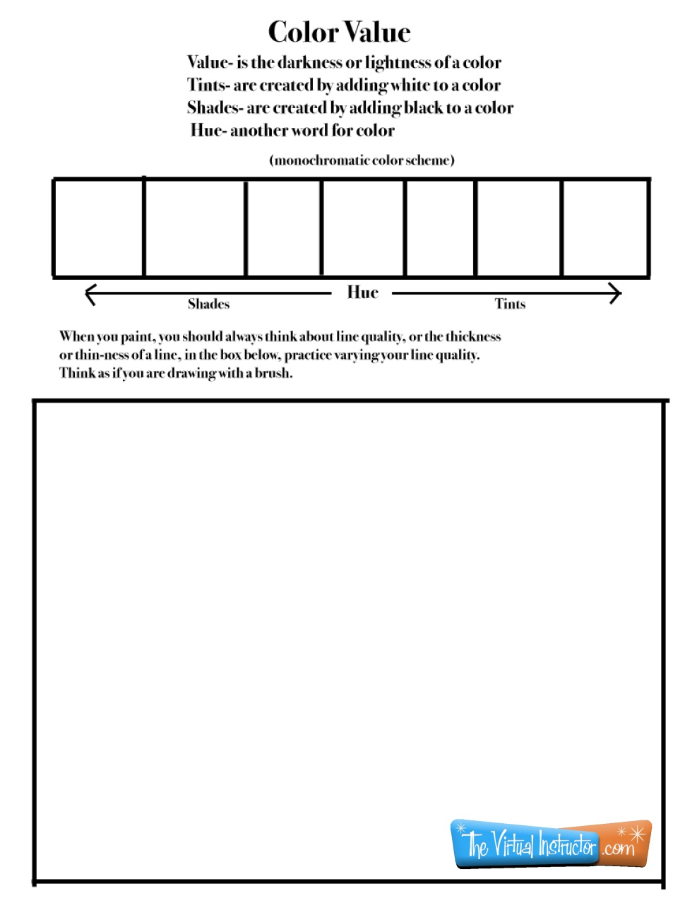
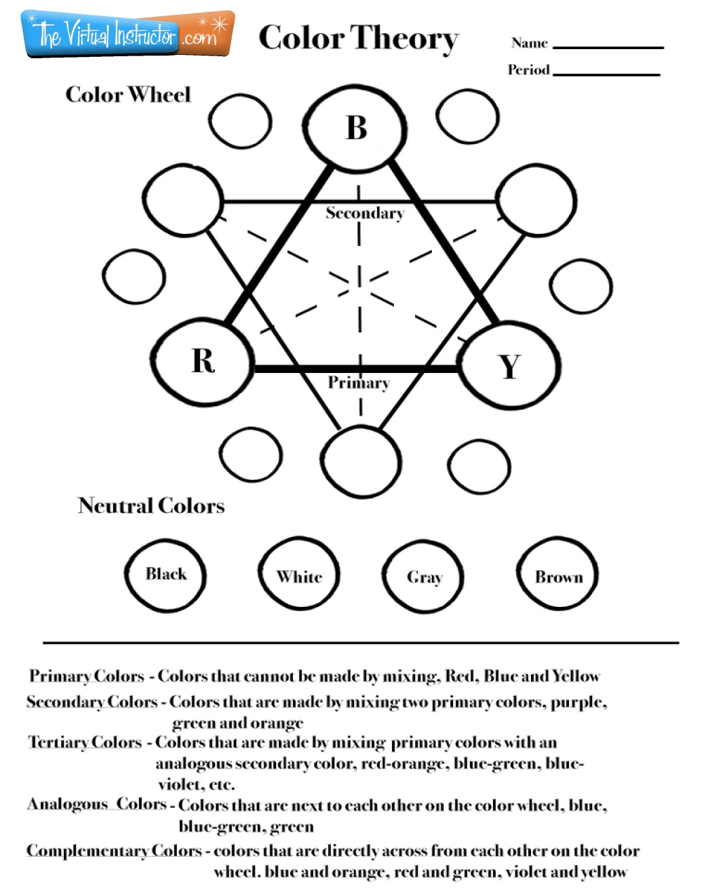
Colour Mixing
Create colour mixing tests in your book.

Slide 31
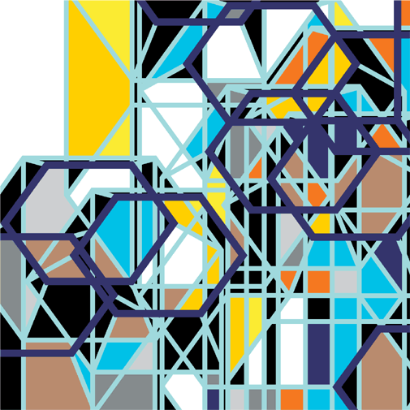
Look at the work of Sarah Morris and create a double page presentation on her.

Slide 32
Ruslan Khais
“For the last four years the landscape has been predominant subject in my art. Shimmer of sun light, coming through the leaves and its ever-changing reflections in the water become the subject of my paintings. My fascination with light has started as an attempt to rethink the legacy of Pointillism, which in our time of the digital media and pixilation, has found a new frame of reference. Emphasizing the well organized chaos of colorful dots, stripes, seemingly mechanical brush marks and alluding to some aspects of digital photography, is resulting the paintings with soft focus were the border between realistic image and abstraction are blurred.”

Slide 33
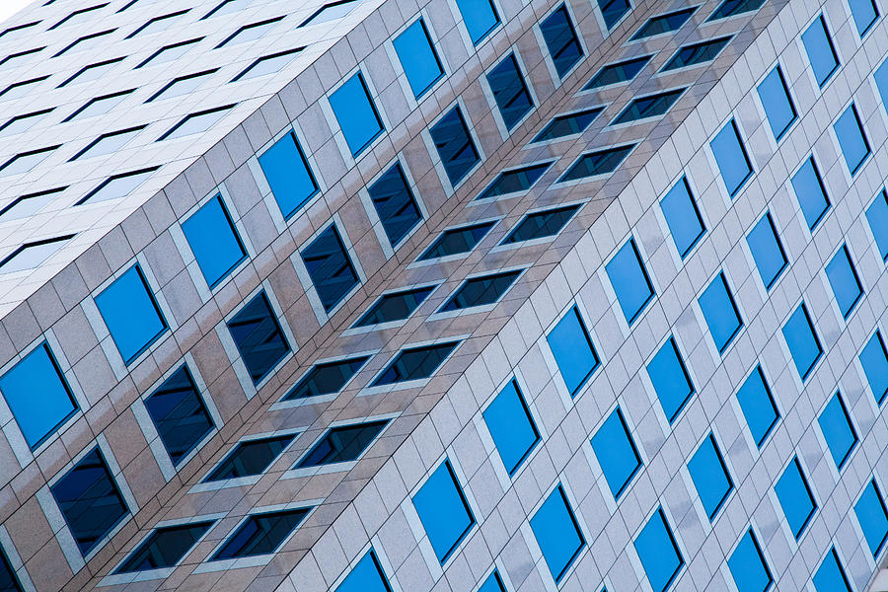
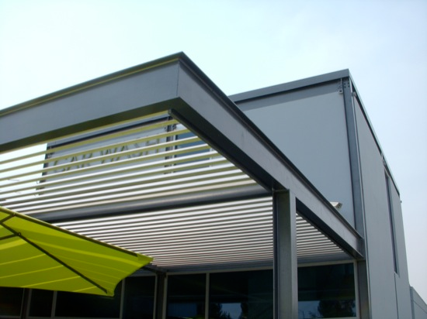
Now take more photographs of sections of man-made buildings around school and around London. This time play with perspectives and angles, some close up, some further away.
Identify 5 colours from your photos that you will use on your final piece.

Slide 34
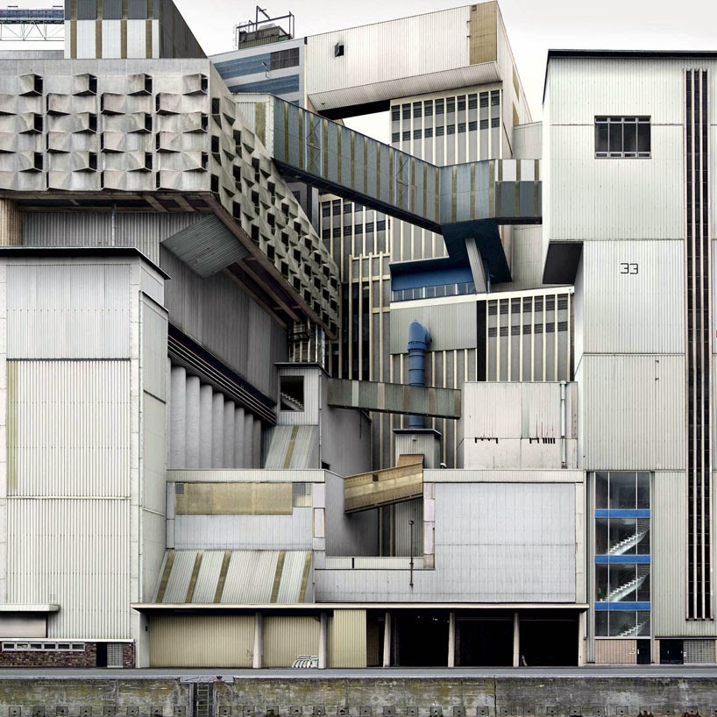
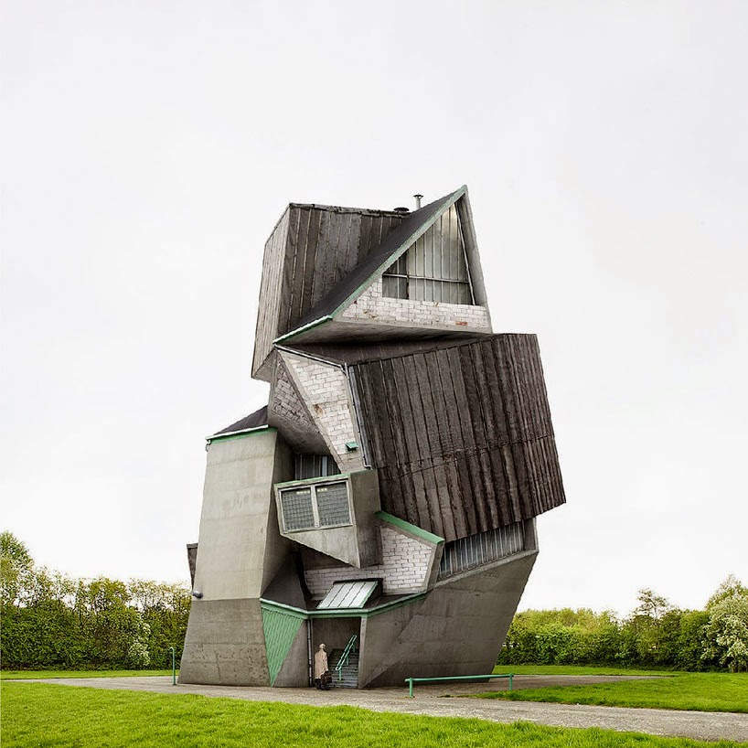
Create collages from your photos to make impossible buildings!

Slide 35
Seth Clark
Research the work by Seth Clark above

Slide 36
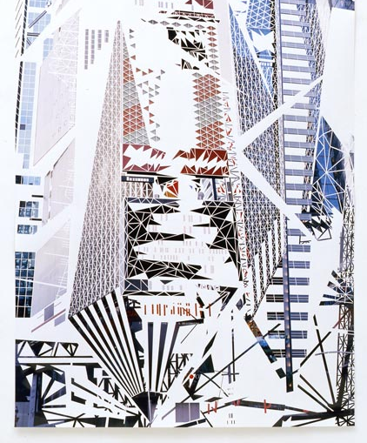
Richard Galphin
Richard Galpin’s complex art works are derived from the artist's own photographs of chaotic cityscapes. Using only a scalpel Galpin intricately scores and peels away the emulsion from the surface of the photograph to produce a radical revision of the urban form. The artist allows himself no collaging, or additions of any kind - each delicate work is a unique piece made entirely by the erasure of photographic information

Slide 37
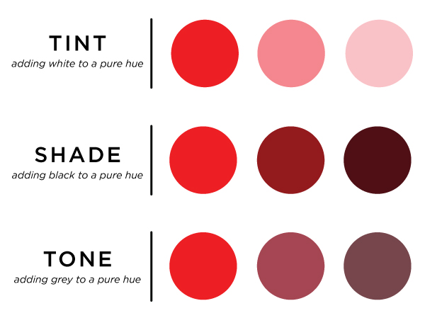
Practical 10: Creating colour/tones from images
Now that you have chosen your 5 main colours from your photos, create different tones of the same colour by adding black/white/grey

Slide 38
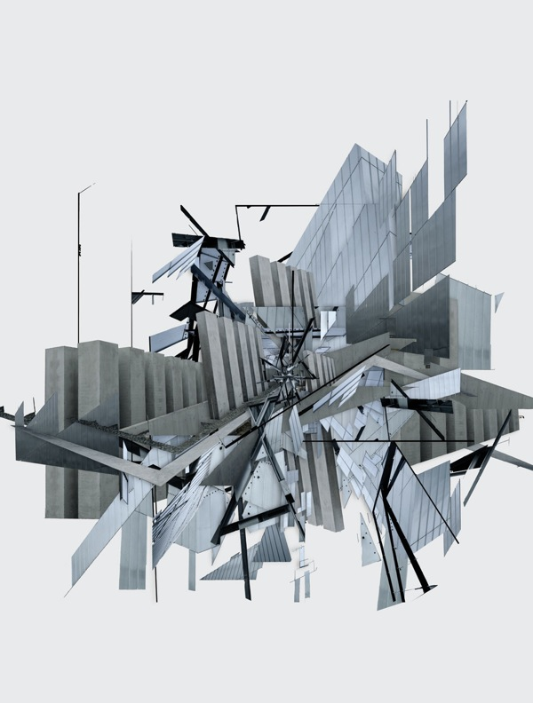
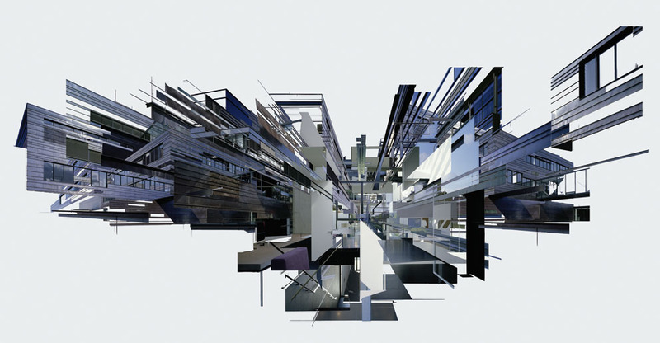
Practical 11: Collage
Create an “exploding” collage from your building photographs. Use sections to create abstract patterns.

Slide 39
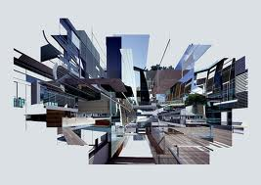
Practical 12: Drawing/ Painting
Make a detailed drawing/painting of a section of your collage. Test out the colours you made previously. This will be a good test for your final piece.

Slide 40
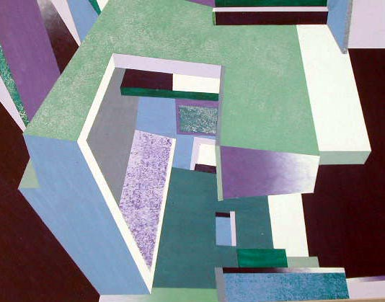
Take another section of your “exploding” city photocollage. Use this to then project onto canvas to create your final painting.

Slide 41
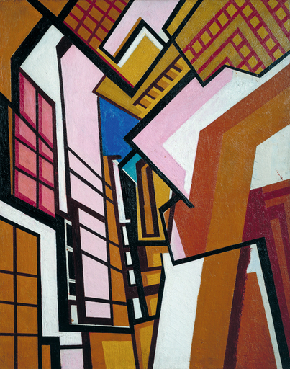
Homework
Research the work of Wyndham Lewis

Slide 42
Final Piece
Project the section of your chosen image.
Using masking tape to create neat edges and paint each section using flat colour.
Use your 5 colour palette and different tones of these colours to fill in the shapes in FLAT colour.
Alternatively use just black and white, and different shades of grey, or just purely warm or cold colours. Speak to your teacher about this!

