Slide 1
From Leaflet
TO
Curatorship 1st Draft
Congratulations you finished your leaflet- WHAT NEXT?
You now need to write the first draft of your Curatorship Task.
WHAT IS THE CURATORSHIP TASK?
IT IS NOT:
An essay that follows an argument through different developments.
A comparative essay.
In fact it is not like any essay you have written for English or History etc.
IT IS:
An exhibition in a book ie:
the press release promoting the show;
the blurb for the separate rooms and work; and the biographies of the artists you choose.

Slide 2
First of all we need to deal with the content.
This is the most common structure…..
Introduction to the whole exhibition
Room 1: Sub heading. Briefly introduce the room- why that particular theme and these artists / photographers. | Artist / Photographer 1 Timeline | Work 1
 |  | Work 2
 |  | Work 3
 | Artist / Photographer 2 Timeline | Work 1
 |  | Work 2
 |  | Work 3
Room 2 Sub heading. Briefly introduce the room- why that particular theme and these artists / photographers. | Artist / Photographer 1 Timeline | Work 1
 |  | Work 2
 |  | Work 3
 | Artist / Photographer 2 Timeline | Work 1
 |  | Work 2
 |  | Work 3
Room 3 Sub heading. Briefly introduce the room- why that particular theme and these artists / photographers. | Artist / Photographer 1 Timeline | Work 1
 |  | Work 2
 |  | Work 3
 | Artist / Photographer 2 Timeline | Work 1
 |  | Work 2
 |  | Work 3
Conclusion
You may have to rethink the artists etc you have chosen previously.
DO NOT be too precious about your artists/photographers in your leaflet or power point if they do not fit with the overarching theme.
AVOID artists or photographers for your curatorship that have limited information. You really need to be able to research who you choose in depth in order to get the best marks. Save the lesser known artists for your practical work.

Slide 3
Use us…….
You need to discuss your leaflet feedback with your teacher. Your leaflet should already be loosely sorted like the structure on the previous slide
Divide the artists you have researched so far into three groups- give each group a subtheme
Your teacher will help you supplement the artists you already have
Determine the theme of your exhibition. (the title can come later)

Slide 4
Research each artist or photographer thoroughly making a note of all your sources somewhere on your computer for future reference.
It is good practice to look at least 8 different sources per artist including books, articles and websites.
Instead of searching on line for just your artist or photographer’s name add ‘interview’ or ‘review’. You will get more insightful critique than a press release or the artist’s own website.

Slide 5
You are now ready for the most exciting part…..choosing three pieces of work for each artist relevant to the overarching theme of the exhibition and the subtheme of the room they are in.
However, the most IMPORTANT part is choosing three significant pieces of information for each artist or photographer. This could be related to the context, intentions, technique, symbolism, recurring metaphors etc.

Slide 6
Why?
Because this is the key to writing the best Curatorship Task AND
gaining the most marks.
Remember, the CT is worth of your final mark!
12%
It is an explicit piece of work and separate to your practical coursework which is why all the work for it should be in a folder NOT your sketchbook (Art) or on a separate weebly page (Photography).

Slide 7
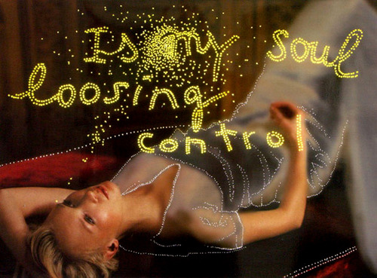
For example:
Daniele Buetti
‘Dreams Result in more Dreams’
2000
Title and date
A broader context, in this case, Buetti’s influences
Apply the broader context to this
specific image.
Bigger Issue | Image specific
It is evident that Buetti’s work is influenced by appropriation art, eliciting questions concerning authenticity and ownership, which are most certainly relevant to the worlds of consumerism and modelling. | ‘Dreams result in more dreams’ is a natural progression from ‘Looking for Love’. Buetti juxtaposes the trivial with the existential, asking philosophical questions through a series of backlit, punched holes in photographs of models from vintage magazines. The bright lights contrast with the washed-out images, and allude to the seemingly omnipotent nature of popular culture.
Then discuss specifics of the image eg. Techniue, composition etc

Slide 8
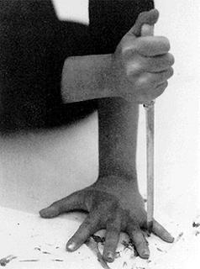
In other words….The discussion for each image you include should begin by discussing one of your significant pieces of information. The image illustrates your point but does not lead the piece of writing. Obviously it appears as a block of text in your final, presented document:
Marina Abramovic, ‘Rhythm 10’, 1973
Deemed the ‘grandmother of performance art’, Marina Abramovic is a New York based Serbian artist. Born to Yugoslav Partisans, Abramovic behaviour was restricted by her mother’s desire to have power over her and her brother’s lives. In this piece Abramovic uses twenty knives and two tape recorders and played the Slavic knife game ‘five finger fillet’. Abramovic swaps her current knife for a new one each time she stabs her hand and, once she makes twenty cuts, she replays the tape and tries to recreate the pattern. This act unifies the past with the present and questions whether replication truly recaptures the something from the past. Abramovic’s mother controlled many aspects of her life, including forcing her to be home before 10pm each night; it is possible that Abramovic used this performance to attempt to reclaim her body through this ritualistic self-mutilation. The intense level of concentration needed for this work demands a stoical detachment from the pain, further considering metaphysical ideas concerning states of existence.

Slide 9
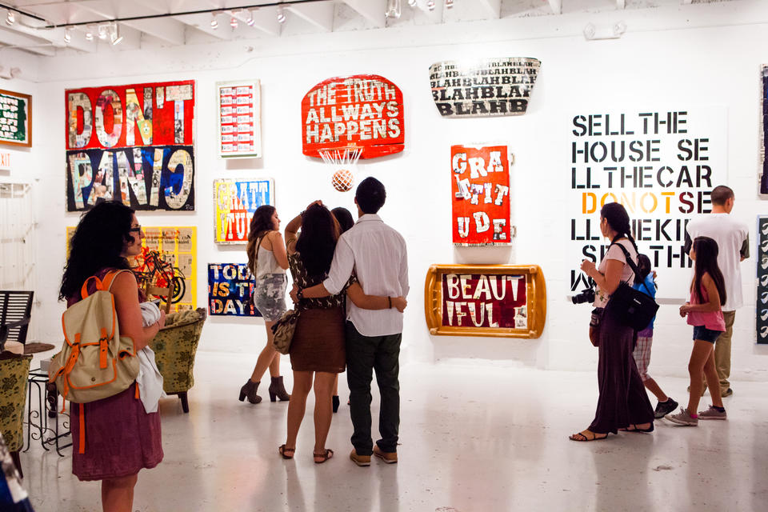
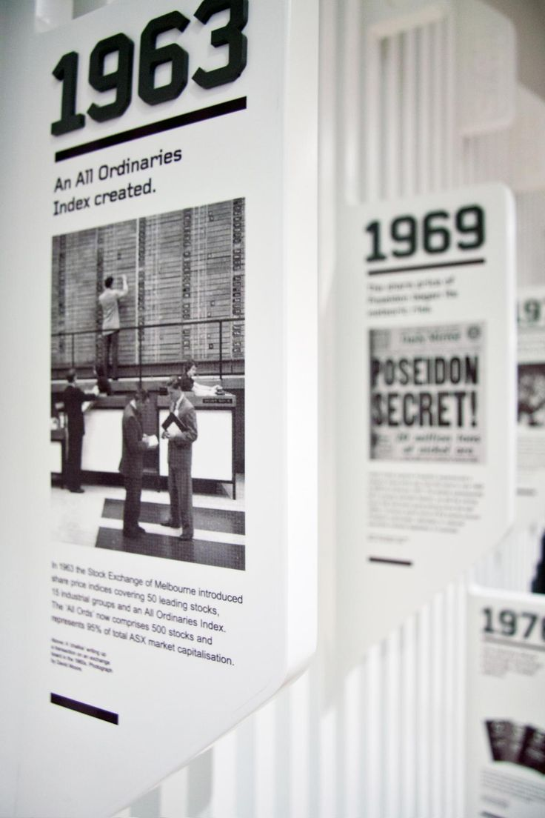
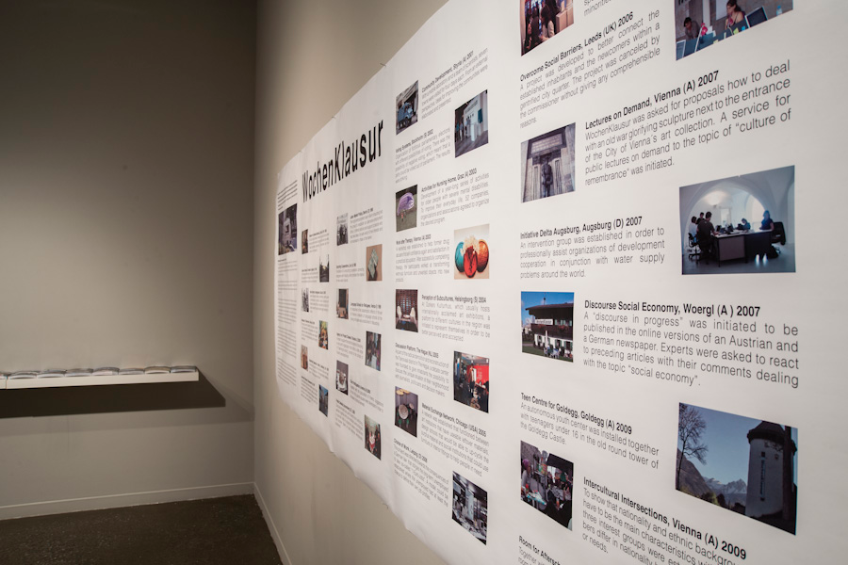
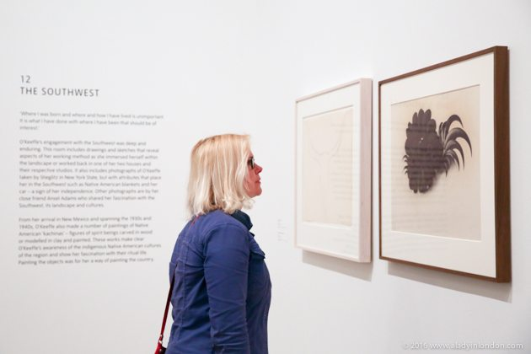
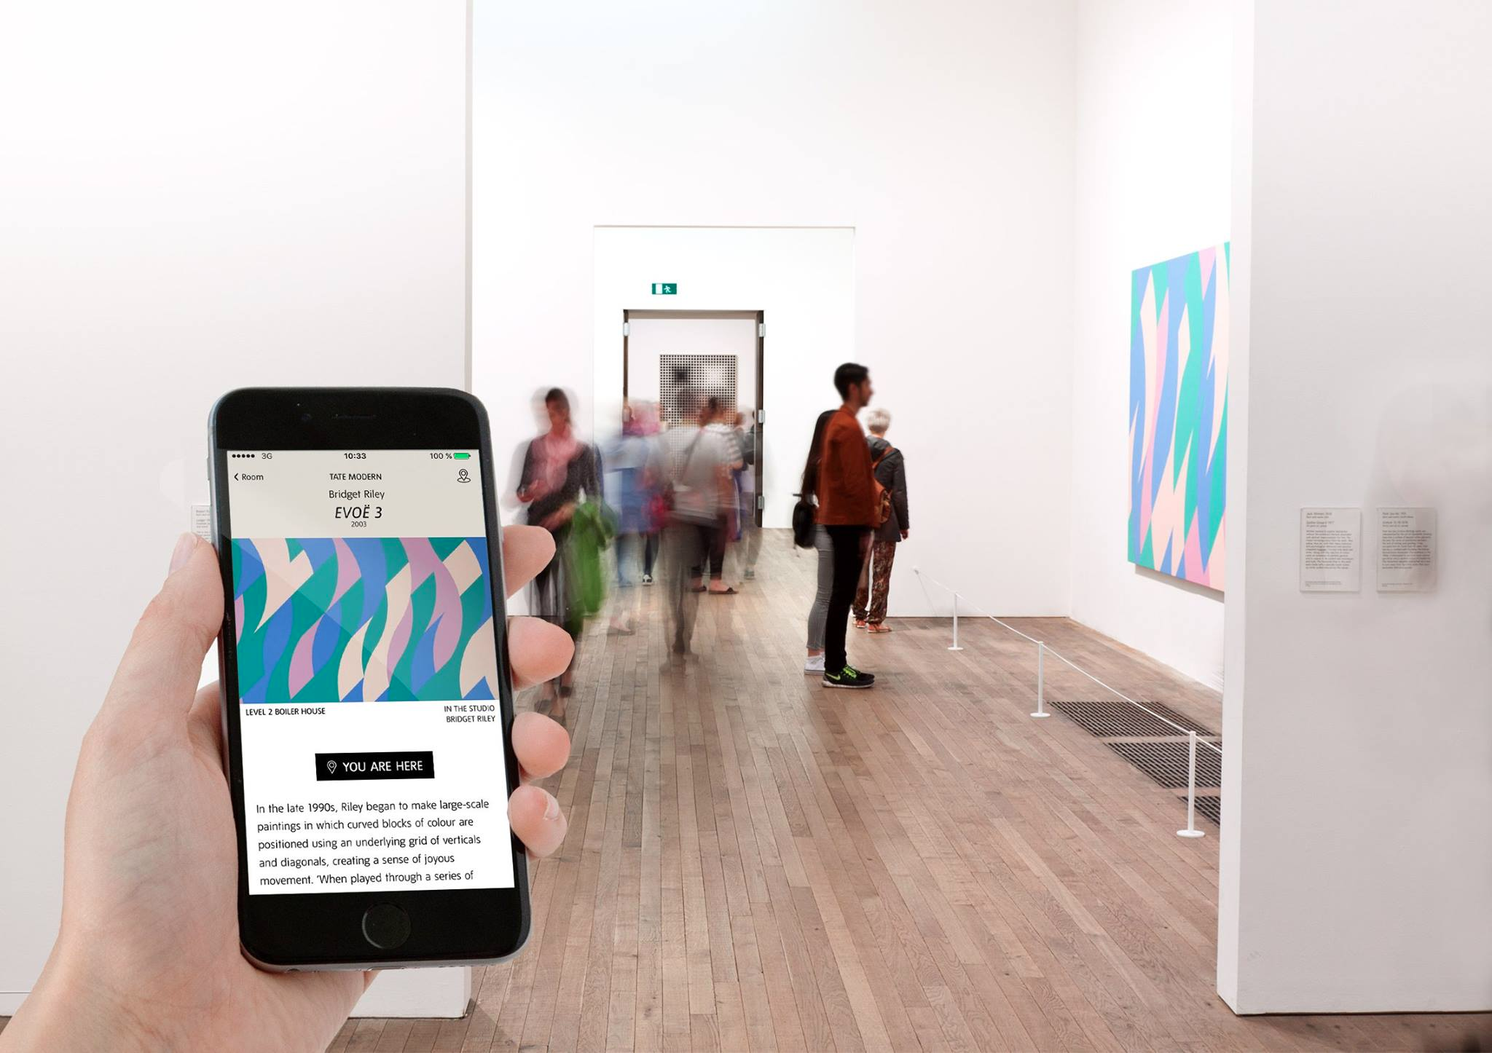
Once you have written the ‘blurb’ for each image you may feel that you can write the overview of the room and then the overview of the whole exhibition. It doesn’t matter as long as all parts have been drafted before you return in September.
Finally, Everything apart from the Conclusion MUST be written in the third person.
Eg.
This exhibition will consider the work of…
NOT
I have chosen these artists because…
You must become the gallery curator!

