Slide 1
GCSE Exam 2018
Fragments Lessons 1-6

Slide 2
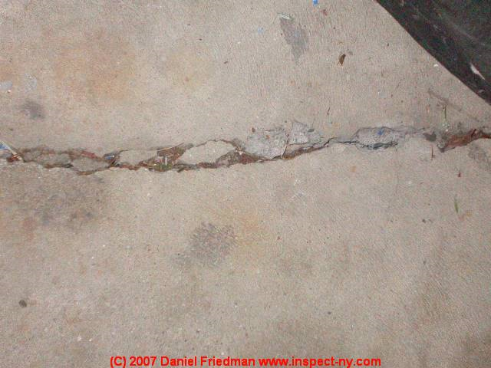
Workshop 1-DAMAGED SURFACES
Go around school (North Wing) looking for any cracks in walls/inperfect damaged surfaces
Make detailed drawings of these cracks and surfaces in your sketchbook. Look at tonal and colour changes.

Slide 3
Jim melchert
Melchert has worked in a variety of media, including drawing, film, and ceramics. The path of his artistic development is conceptual, and his ideas led him to a unique process involving ceramic tiles: breaking them, drawing on them, reassembling them and painting the new constructions with glaze

Slide 4
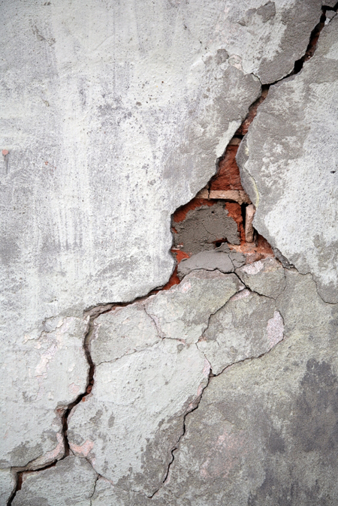
Homework
Take 10 photos of cracks and decayed surfaces up close.
Stick in your book
Make a detailed painting of one of these

Slide 5
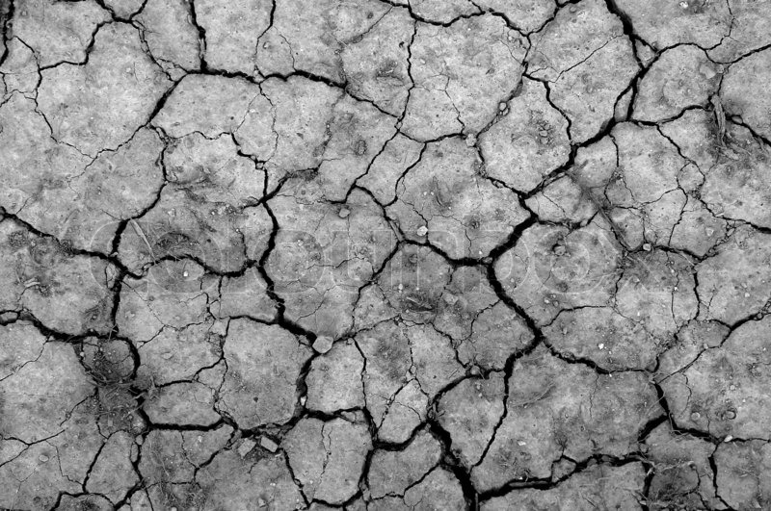
Clay Tile
Make a detailed clay tile based on one of your photos. Try to capture the texture and mark making of the crack/damaged surface.
Once finished leave to dry and fire before glazing

Slide 6
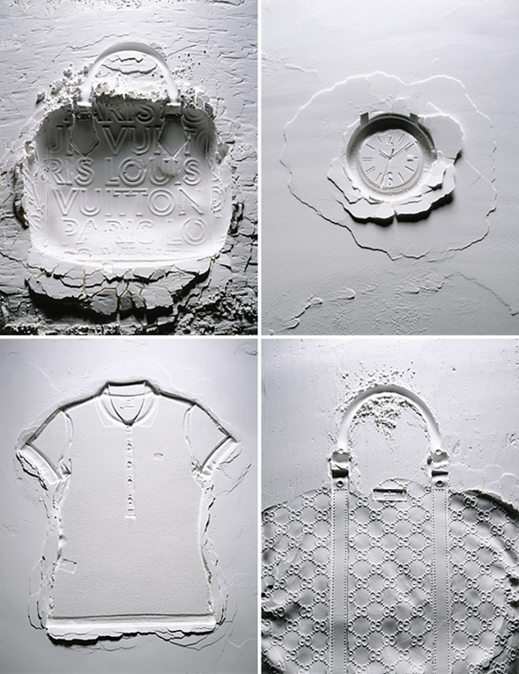
Mitchell feinberg
Such a simple idea. Imagine all the times anyone in the world has ever messed about with making imprints in flour, and in all that time only Mitchell Feinberg, fashion photographer extraordinaire, has actually put it to good use. In a series shot for Muse Magazine, Feinberg drops an array of incredibly expensive things into flour/sand/cornflour/moondust with outstanding results.

Slide 7
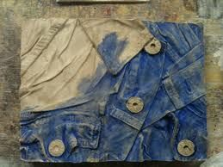
Alternative clay workshop-Impressions in clay
Bring in objects, textures of things from home about you. You may find a patterned wallpaper/fabric, old objects that you could press into a clay tile. Try to bring a minimum of 5 things to press into your tile.

Slide 8
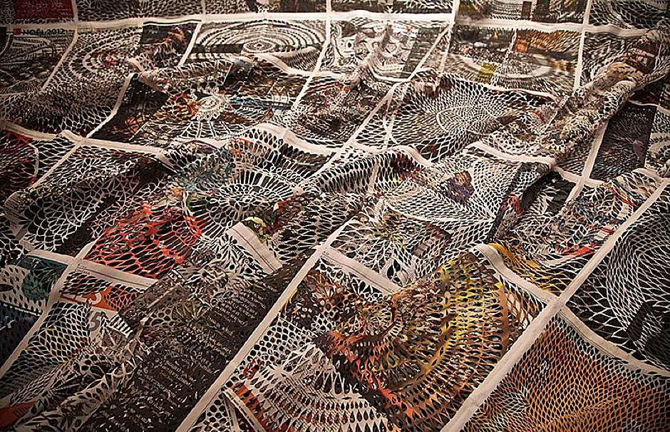
Miriam dion
Myriam Dion is the first to admit that she makes her choice of newspaper each day based on the pictures. For this French-Canadian student is also a papercut artist, whose carefully cut-out newspaper pages have won numerous awards. Dion works freehand using a scalpel to produce these beautiful designs reminiscent of both Arabic latticework and stained-glass windows. She suggests that the transformation from broadsheet to objet d'art is "to find a new use for print media in the process of its disappearance", and the delicate quality of her work may well be a subtle mirroring of the fragile state of print journalism

Slide 9
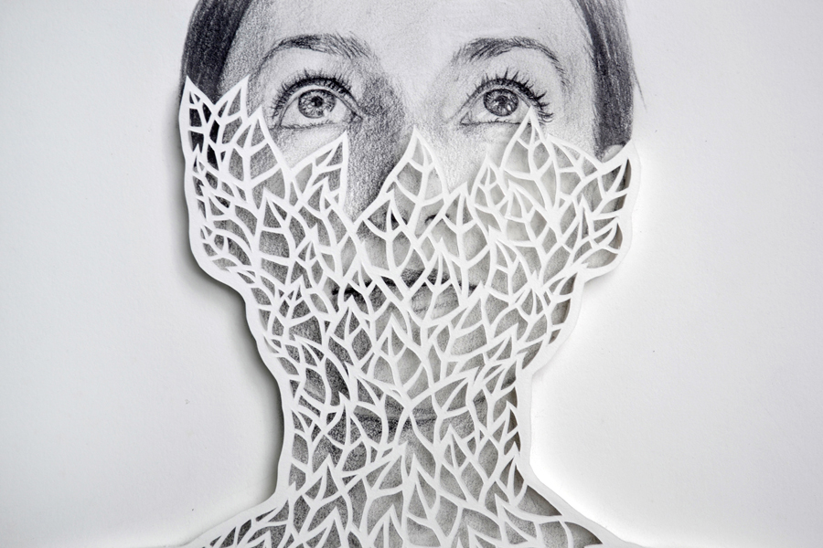
Workshop 2-Paper cutting
Create a Miriam Dion style paper cut into your magazine/newspaper cover
Next make paper cuts into the portrait of yourself. Try to make the cuts different from the newspaper. You could leave some of your photo still visible if you like
Overlay both images on a page in your book
Use clear varnish/ Pva on top.

Slide 10
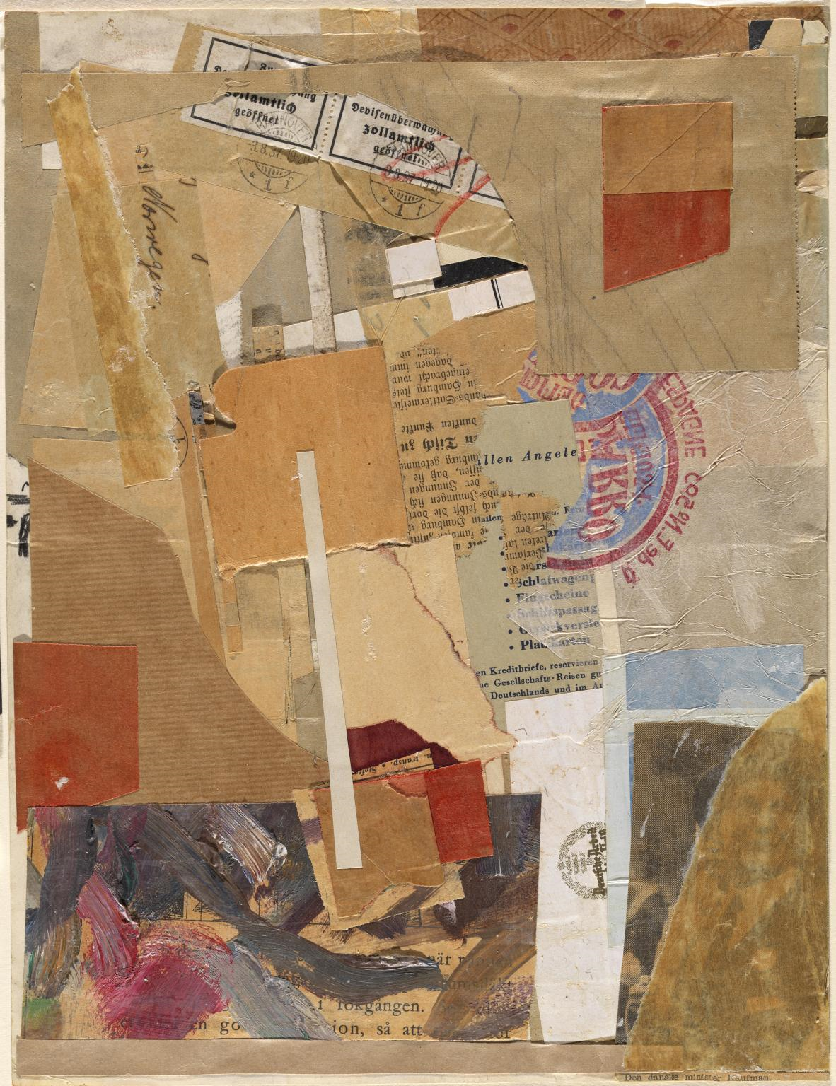
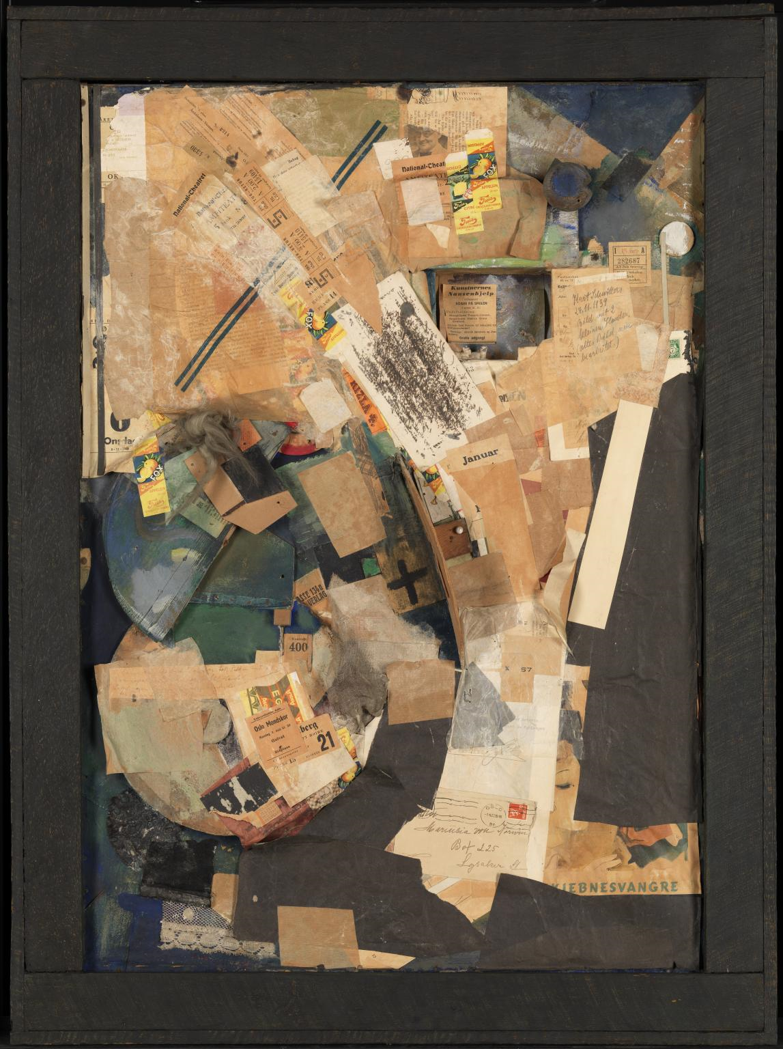
KURT schwitters
Schwitters started this assemblage of discarded rubbish and printed ephemera in Germany in 1920. Seventeen years later he brought it with him to Norway, having escaped from Nazi Germany. There he added Norwegian material: theatre tickets, receipts, newspaper cuttings, scraps of lace, and a box with two china dogs. The different layers of collage reflect the artist’s journey into exile

Slide 11
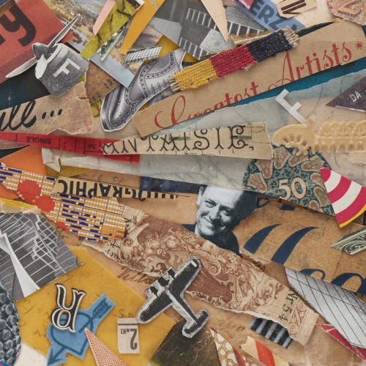
Dogsanddice.co.uk
“Creating a collage like this involves obsessively wandering – lost in scraps & cuttings, making decisions, creating connections, wrongs – rights, tiny personal compositional signatures or jokes, mulling over, stopping – or not, and that secret sensation of something coming to the end of it’s journey right in front of your eyes.”

Slide 12
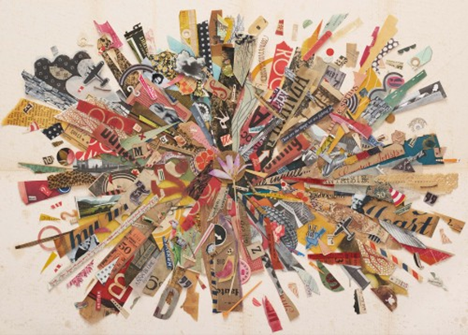
homework
Over the next week keep everything that you would normally throw away!...food packets/receipts, magazines, any packaging that would normally go into a waste paper basket.
Once you have enough collected materials create an abstract pattern or design from all the parts. Try to make the outcome intricate!
Next make a full page drawing/painting of a section of your collage.

Slide 13
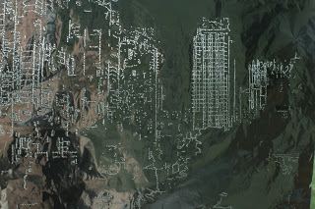
Holly naylor
I began pin-pricking old postcards I had found in Kazimierz market in Krakow and started to pin-prick according to tonality within the images. I however quickly progressed to the film photographs I had taken of light blurs by the Quayside in Newcastle in January before I had arrived in Krakow. I became interested in the layering of drawings, and how I considered my film photographic pieces as drawings in themselves, and so to pin-prick over the photograph was to draw over an existing drawing. The pin-pricks look as if I have almost graffitied or scribbled over the photographic drawing, with the background lighting illuminating/ highlighting certain details of the drawing tonally as if you would with the intensity of pencil tonality

Slide 14
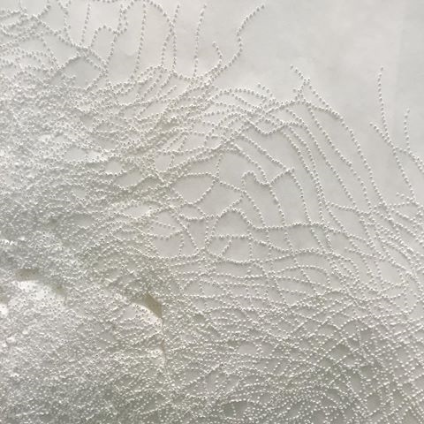
Workshop 3-pin pricking
Bring in an old family photo (photocopied)
Tape this down to another sheet of white cartridge paper
Pin prick through the image (both sheets)
When finished stick the cartridge paper image into your book
Lay the photo over a blank page in your book, and tape down. Use ink to paint over the photo so the ink goes through the holes on to the paper.
Afterwards bleach into the ink (on the photo) to reveal parts of the image.
You should now have 3 versions of the same image-1 white raised pin prick image, 2 the ink dot image, and 3 the bleached photo. Document all in your book.

Slide 15
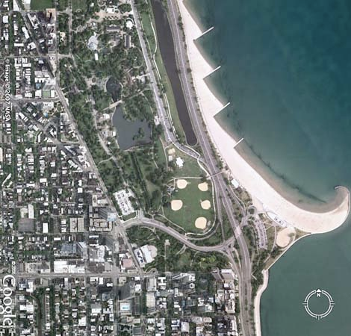
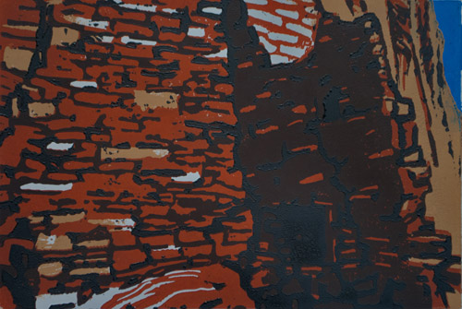
Workshop 4-Aerial Landscape Lino prints
Collect “google maps” (using Google Earth) of the are you live in.
Make detailed line drawings from these and then trace onto Lino.
Cut your lino and make a 3 colour print from these.
Experiment with layering the print to create a 3d image.

Slide 16
homework
Research one of the following artists….

Slide 17
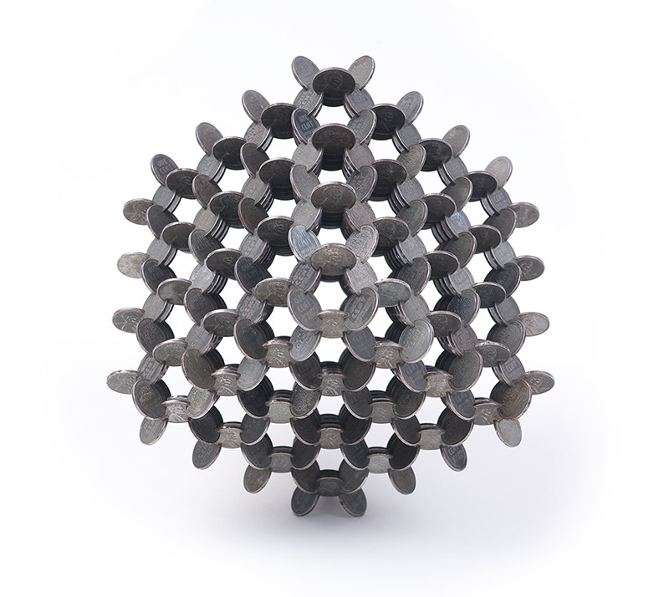
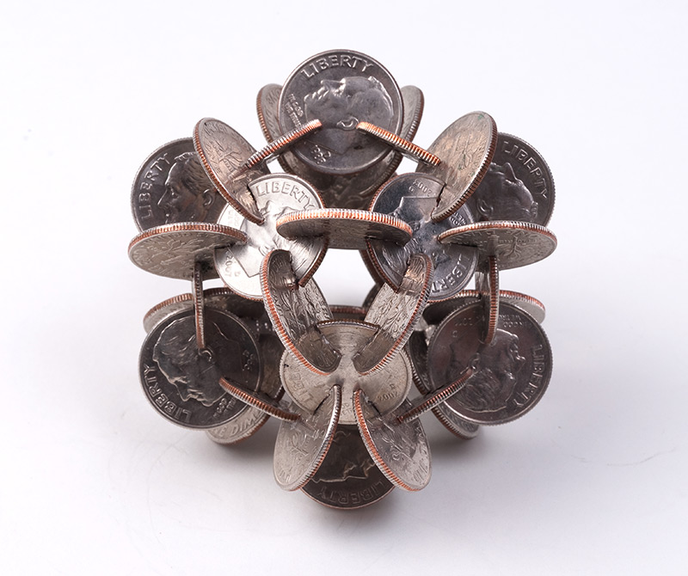
Robert Wechsler
Artist Robert Wechsler was comissioned by the The New Yorker to create a series of coin sculptures for their October 14th money-themed edition. Wechsler used a jeweler’s saw to cut precise notches in coins from various currencies and then joined them together in several geometric forms

Slide 18
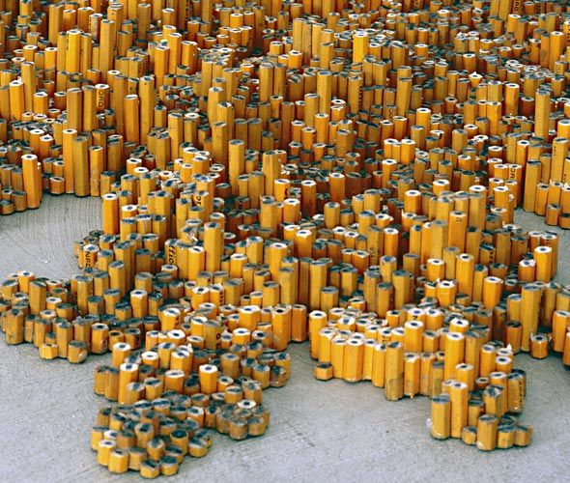
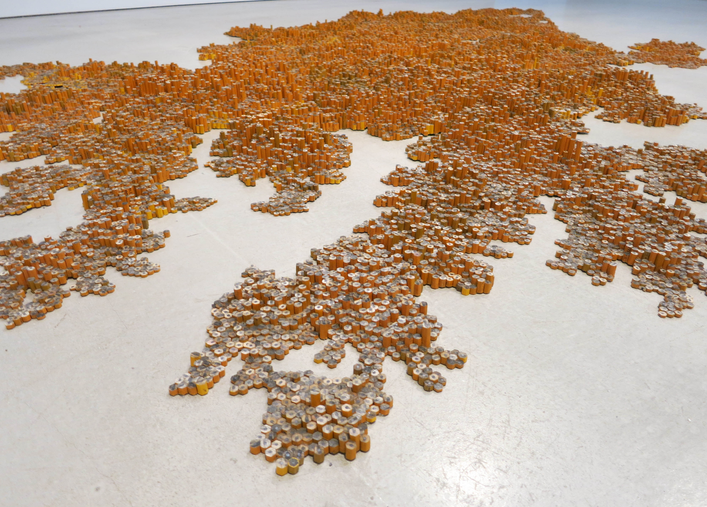
Tara donovan
Brooklyn-based American artist Tara Donovan creates site-specific installations that can make you question the commonest of materials. She uses a variety of everyday objects to create whimsical and intriguing pieces of artwork that look anything but common.

Slide 19
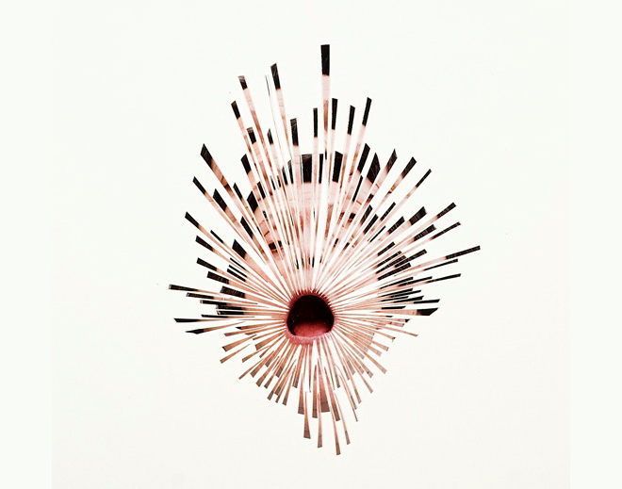
Justine Khamara
Khamara's practice to date has sought to disrupt photography's smooth, two-dimensional surfaces by building sculptures and collages entirely out of photographs. A flat image, usually figurative, is transformed either by slicing directly into the photographic skin and pulling features into three dimensional form, or by taking multiple shots of a single subject which are then collaged.

Slide 20
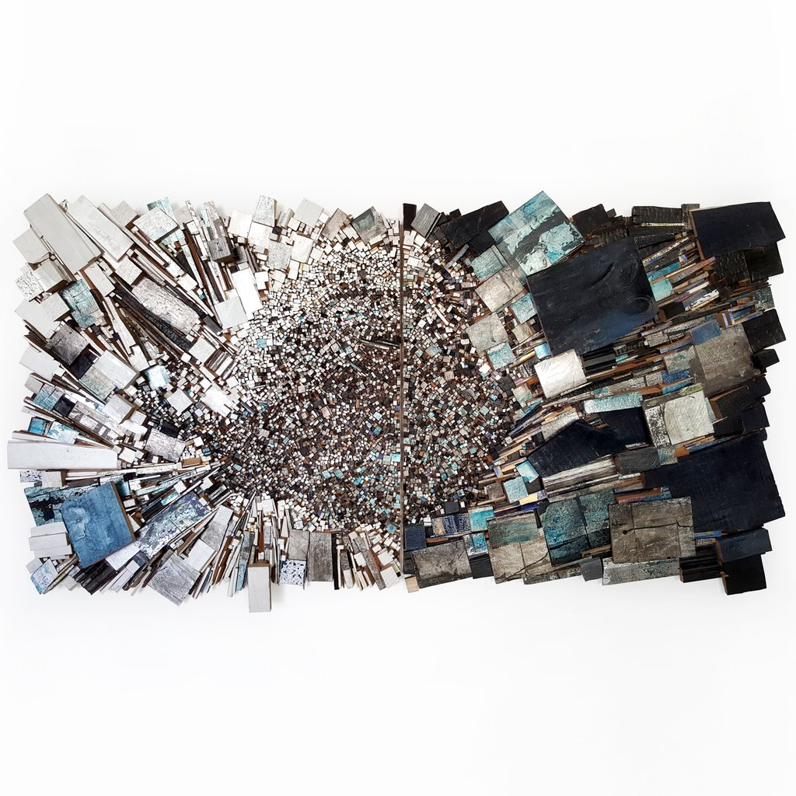
Louise McRae
Louise McRae’s sculptural, wall-based assemblages bring discarded building materials and the debris of her rural environment into new frames of reference. McRae’s practice involves painting upon scrap timber which she then splits into shards and reassembles into matrixes of varying shapes and formats.

Slide 22
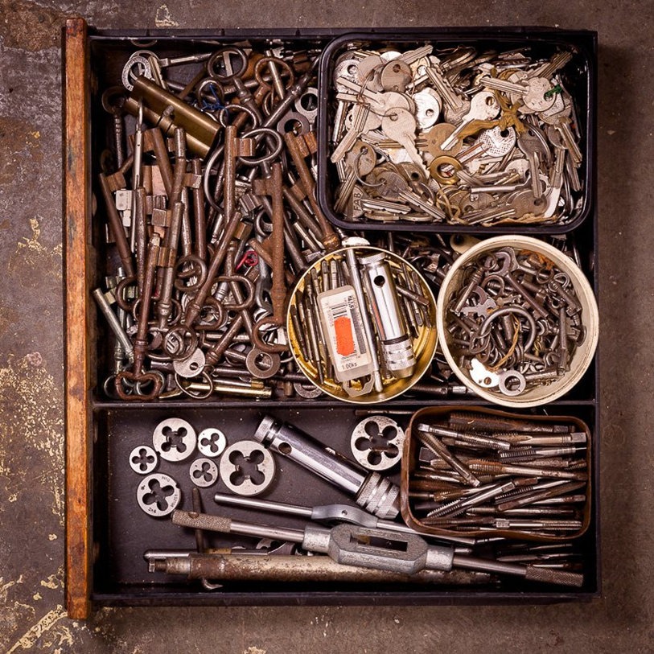
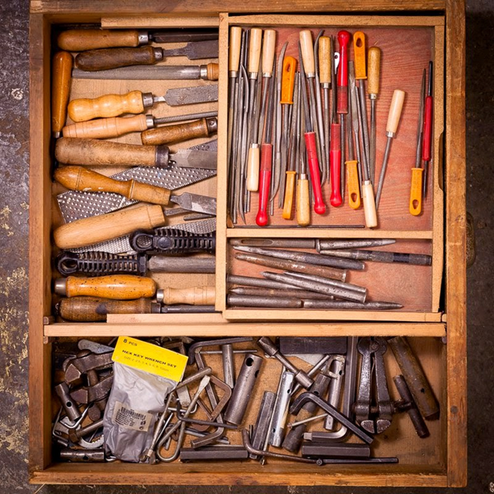
Tom Teodosijev
Teodosijev, a photographer, has used still life photography and the contents of storage drawers to try and record something of his father. He says "Can you capture the soul of a beloved one"

Slide 23
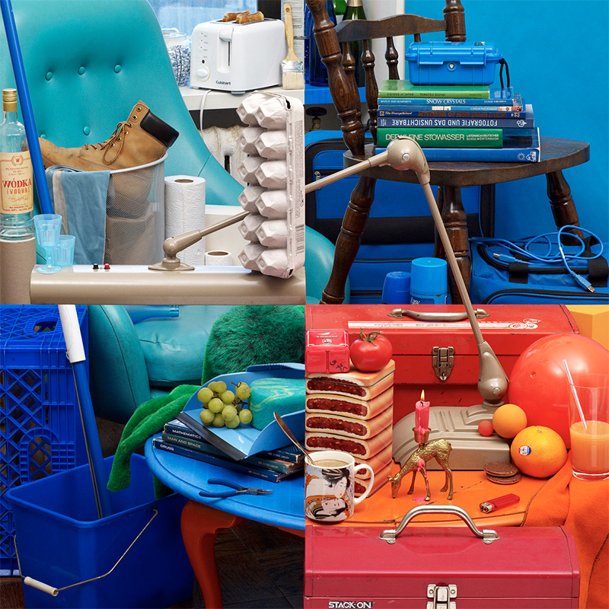
Bela borsodi
Although this image by Bela Borsodi appears to be four separate images, it’s actually a single photograph, with all of the objects perfectly aligned to create an optical illusion. The shot was used as cover art for an album titled Terrain by VLP. See it all come together in the video above…

Slide 24
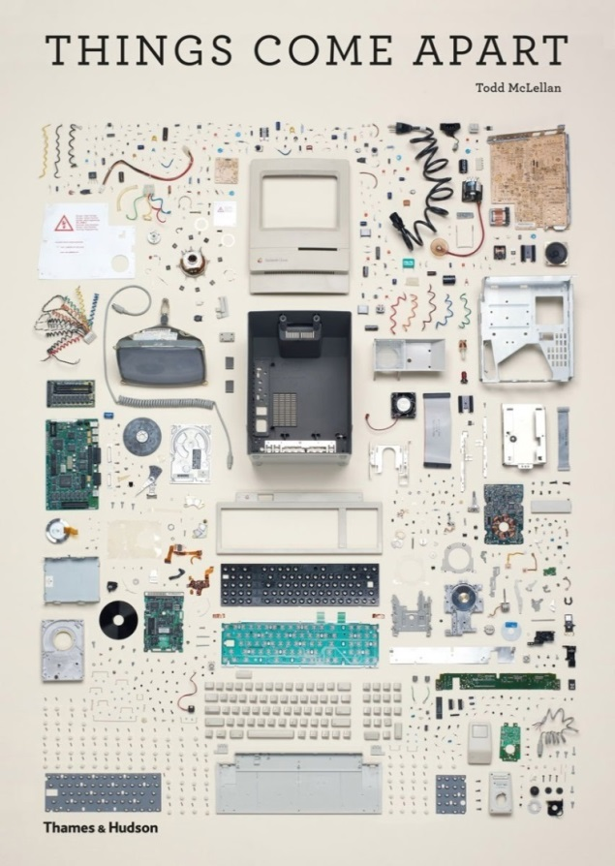
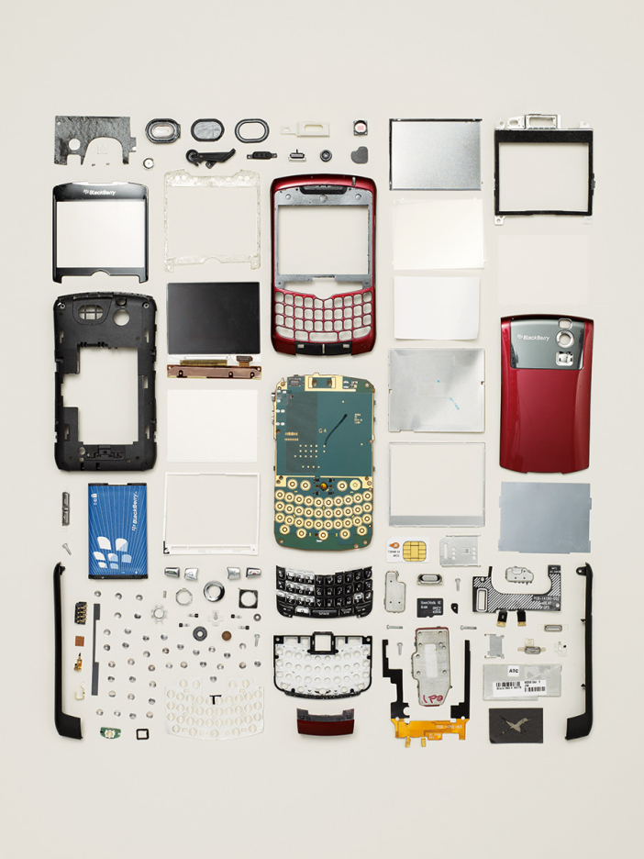
Tom mclellan
In Things Come Apart, McLellan exposes the inner working of 50 objects and 21,959 individual components as he reflects on the permanence of vintage machines built several decades ago—sturdy gadgets meant to be broken and repaired—versus today’s manufacturing trend of limited use followed by quick obsolescence.

Slide 25
Celia levy
Swedish artist Cecilia Levy creates cups, saucers, bowls, plates and saucers out of paper, turning delicate 2D materials into layered 3D sculptures. Although she often uses books from the beginning of the last century, her choices are not narrow as she has also utilized Spiderman comics for an entire series.
To create each work, she takes apart the books, magazines, and comics, tearing the pages and pasting small pieces of them back together. Levy explains her works are, “eggshell thin, yet remarkably steady. The story lives on, but in a different shape.”

Slide 26
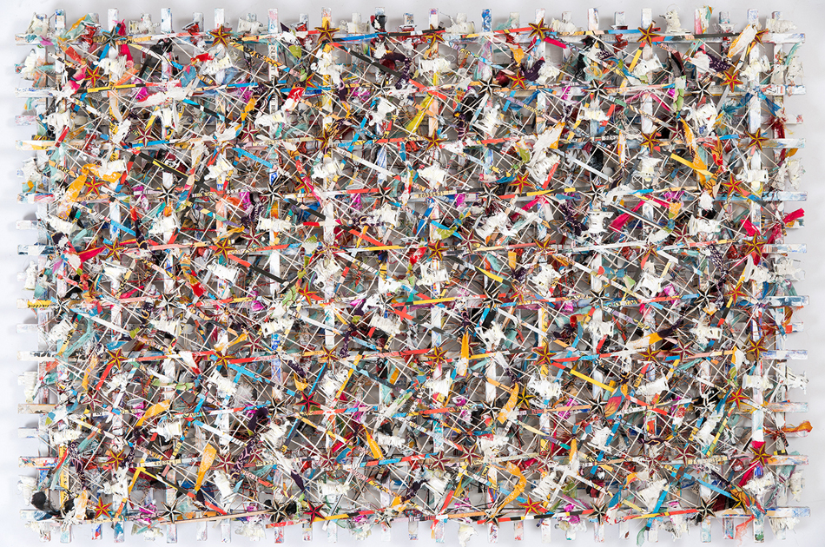
Michael brennand-wood
Michael Brennand-Wood describes himself as ‘an artist with a sustained interest in textiles’. During his 40 odd years as a practicing artist he’s held numerous exhibitions and has also worked as a lecturer (at Goldsmiths College, London), curator and arts consultant. He makes elaborate, eye-catching wall-hung pieces that are part sculpture, part textile. Covered in an intriguing variety of materials ranging from conventional textiles to flags, CDs and badges, the pieces have elaborate visual patterns which mask more profound meanings

Slide 27
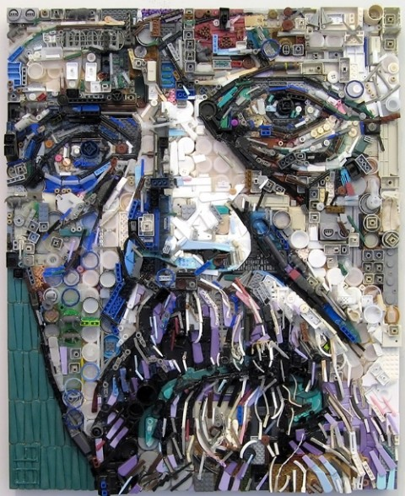
Zac freeman
Zac Freeman started creating assemblage artworks of this type in 1999. All artworks are made entirely out of collected junk, found objects, and general trash. By glueing the bits of junk to a wooden substrate, Zac is able to form an image, usually faces, which only can be seen at a distance

Slide 28
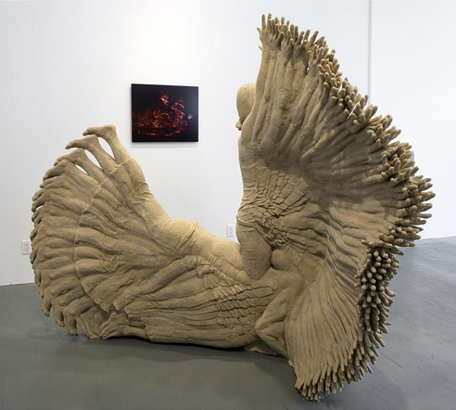
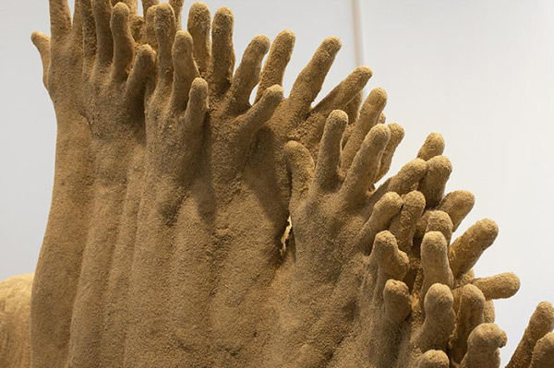
Katie Grinnan
Similar to a camera capturing multiple exposures in a single image, artist Katie Grinnan created this sculptural time-lapse of her body moving through a daily yoga routine using sand, plastic, and enamel. The end result is representative of both time and form as each split second is layered onto the last creating what is both a singular figure and many

Slide 29
Extra resources

