Slide 1
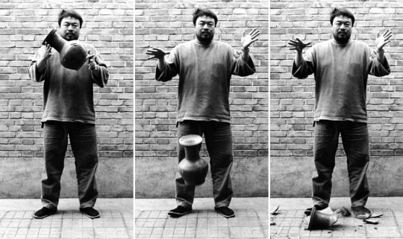
Deconstruct an ideal
Learning Outcomes:
Create an accurate painting of a patterned cup / piece of crockery.
Break the object, document and reconstruct, putting pieces back together and producing a different outcome
Learning Objectives:
Consider how the function and meaning of objects can change when it’s appearance is altered.

Slide 2
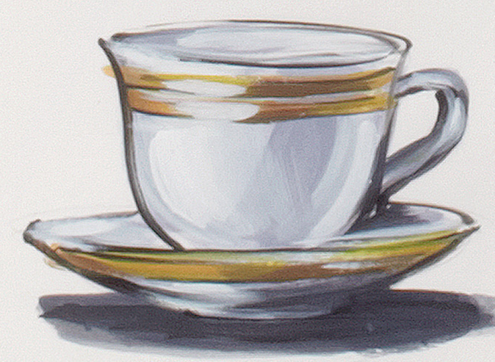
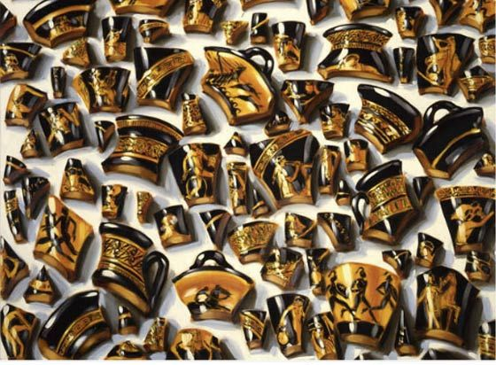
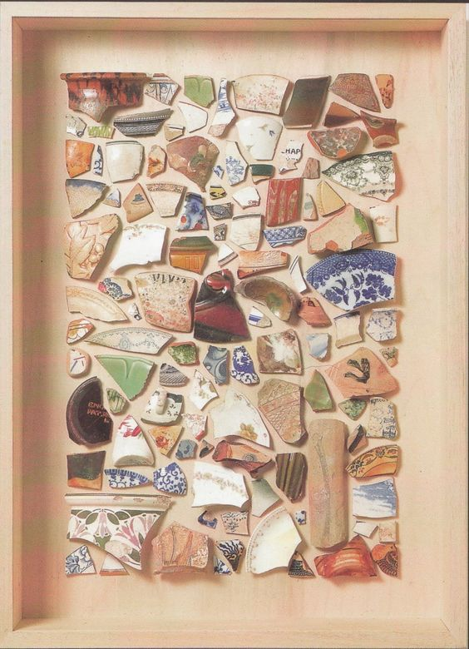
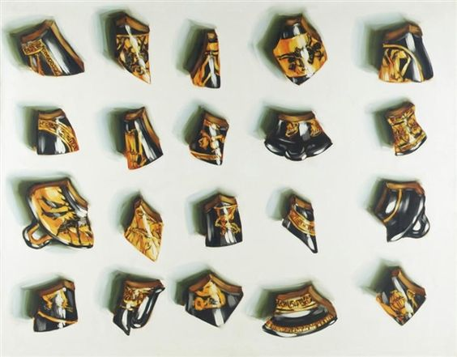
Create a painting of your tea cup
Put your cup into a bag and break it
Now make another painting / drawing of the broken cup
Lisa Milroy
Mark Dion

Slide 3
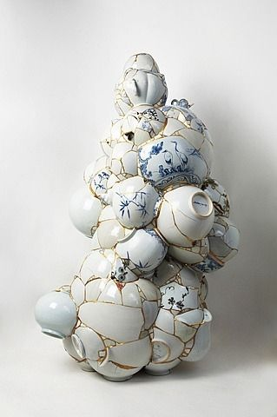
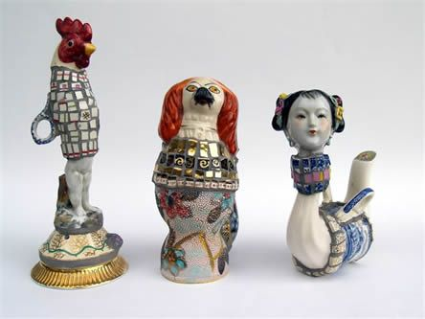
Glue the pieces of your cup back together to create a sculpture. Collaborate with others in the class if you wish.
Cleo Mussi
A potential way to extend this idea later in the project…?
Yee Soo Kyung

Slide 4
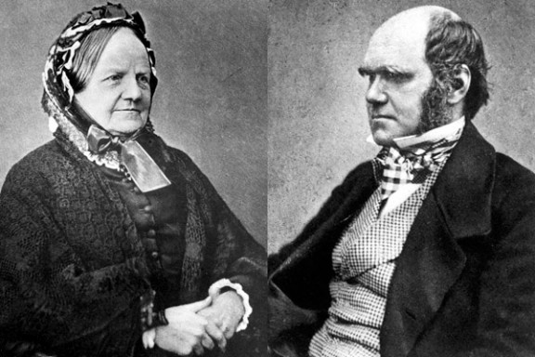
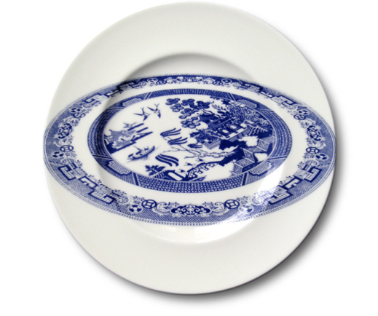
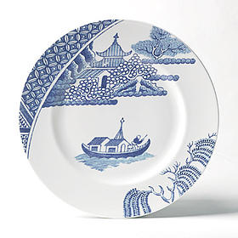
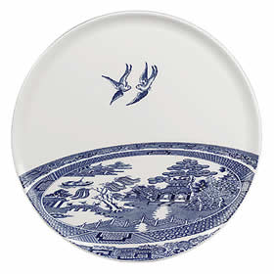
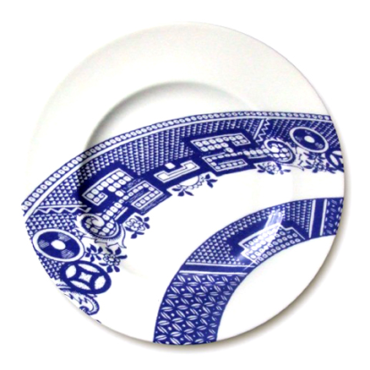
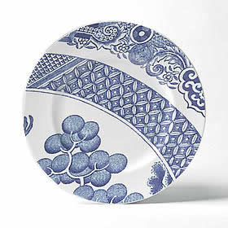
Wedgwood is an old English Ceramics company and for a long time seen as the perfect embodiment of English values. The blue and white willow pattern was brought to England via China. Overtime some features of the pattern where changed and adapted to better suit English tastes and production techniques. Since about 1780 the patter has been a staple of the English ceramic industry. It has fallen in and out of fashion over the years but now enjoys a comeback.
Charles Darwin married Emma Wedgwood. The daughter of Mr and Ms Wedgwood. His first cousin. Is there a way of linking this fact into the tapestry of Wedgwood? They had 10 children, 3 died in early childhood. Flaws, Ideals, Perfection or Compromises? How could Darwin be drawn into this line of investigation?

Slide 5
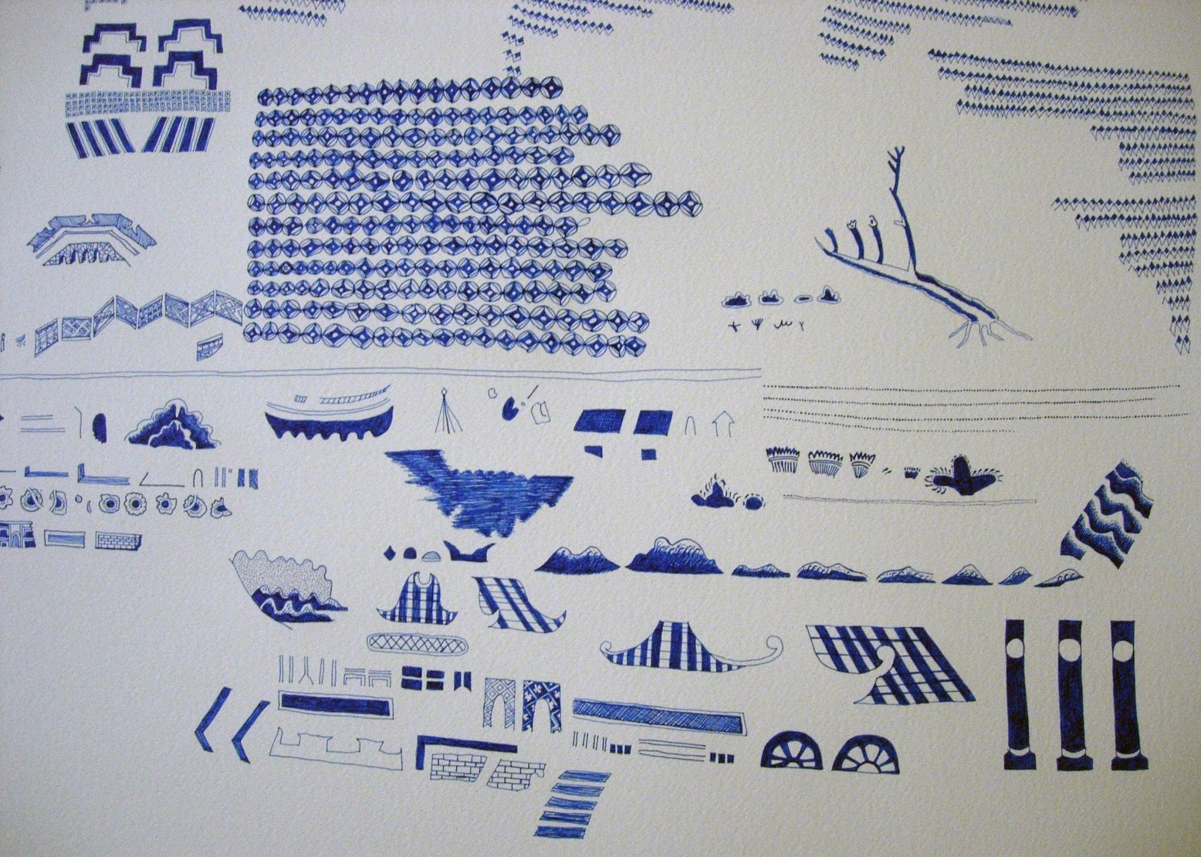
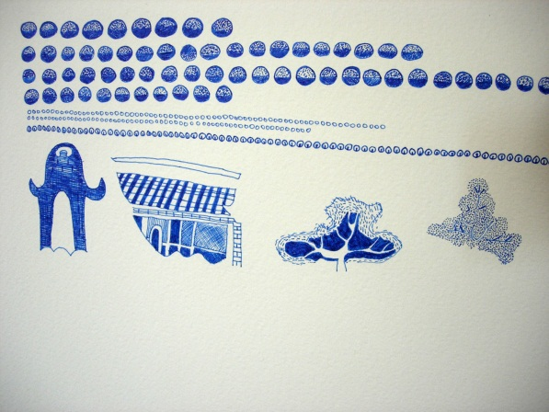
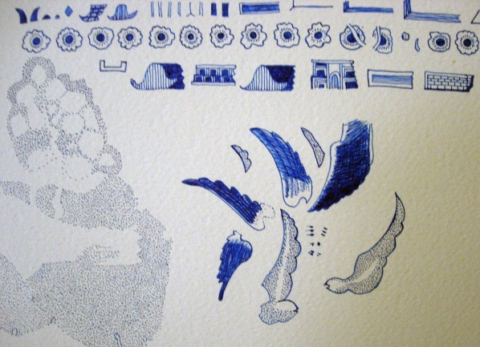
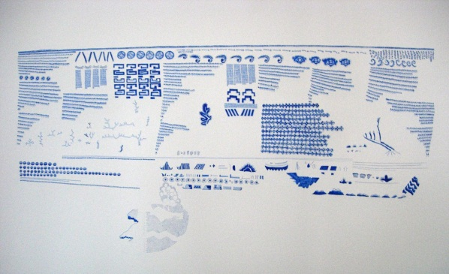
This is a drawing by Heather Deedman. In this drawing Deedman has taken apart the classic Wedgwood Willow pattern and laid it out in a non narrative order. She has compromised the original context of the pattern in order to talk about something else.

Slide 6
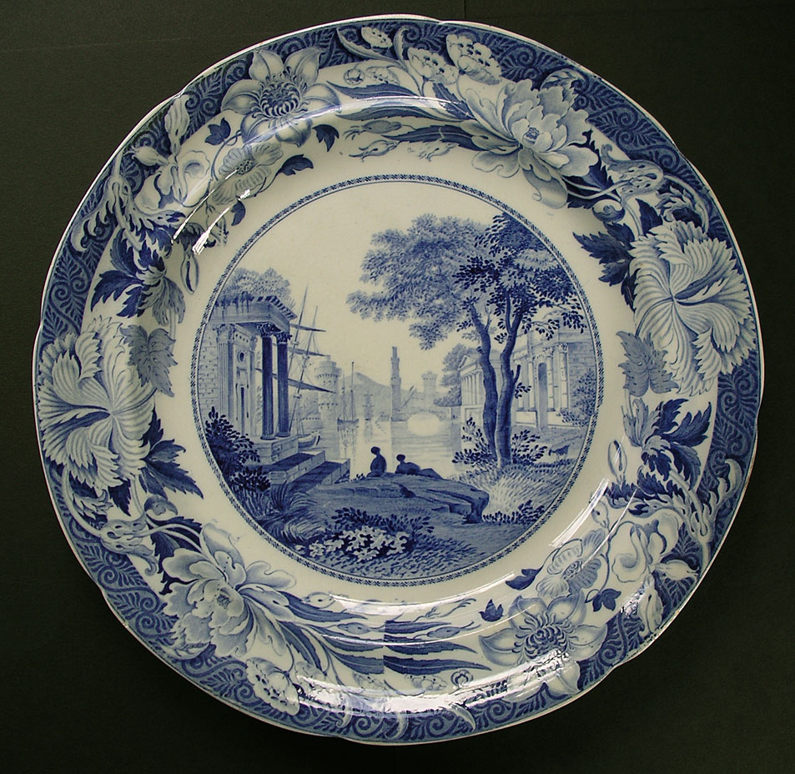
Extension / Alternative….
Look at the Wedgwood pattern and deconstruct it.
Take parts of the pattern and rearrange them to tell a different story. Think about how in this task you are recreating a very well known images. How surprising can you make your ‘remix’ of the image?

Slide 7
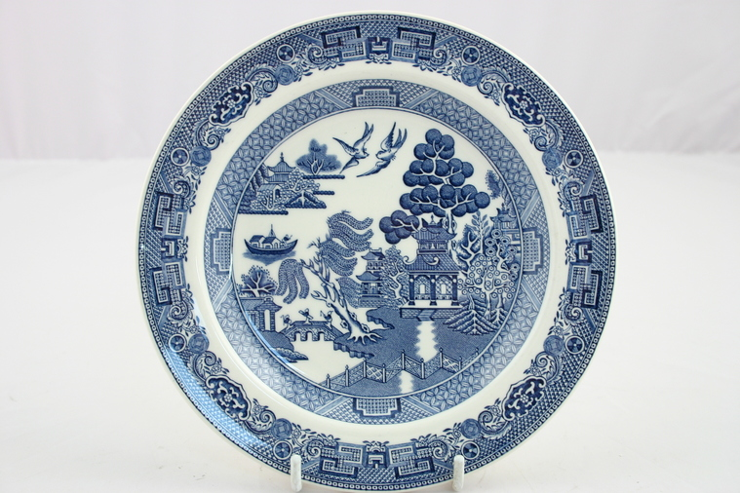

Slide 8
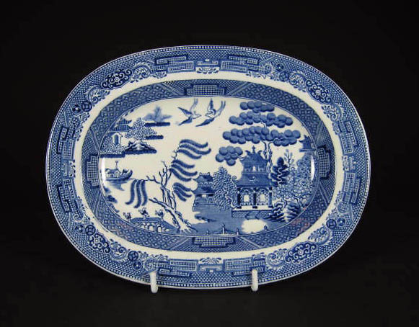

Slide 9
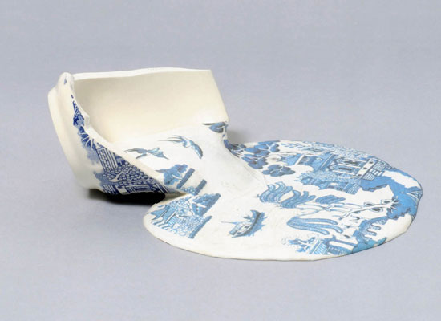
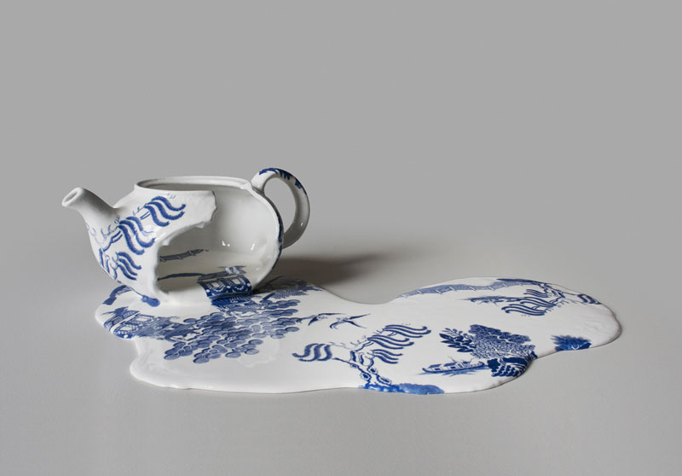
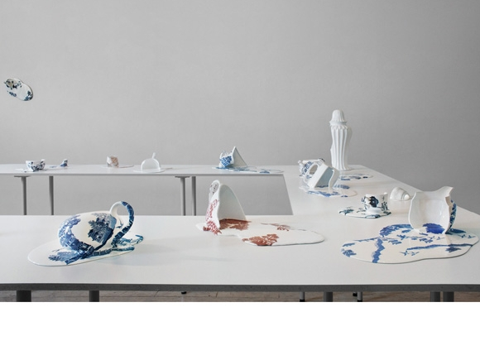
Livia Marin
Nomad Patterns
A mixture of the theme. Taking a perfect object and then damaging it. Putting pieces back together and producing a different outcome .

Slide 10
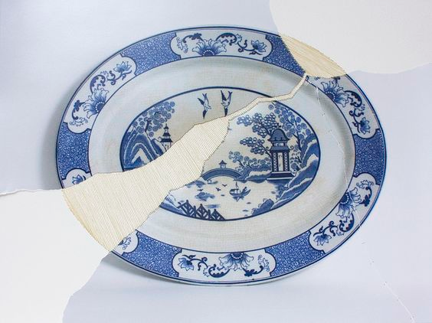
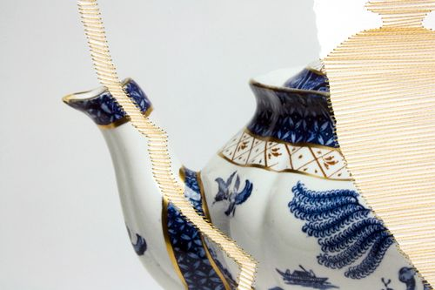
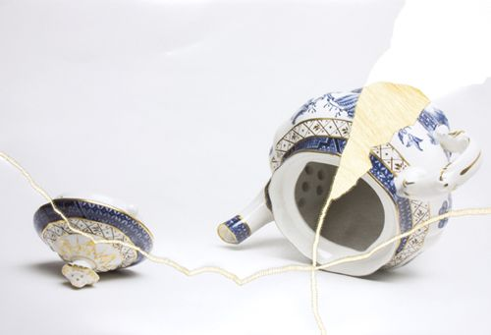
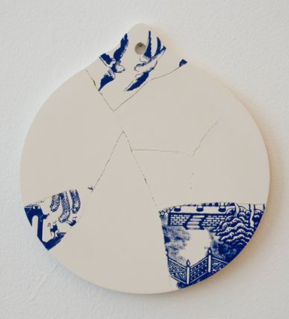
Livia Marin….Broken Things

