Slide 1
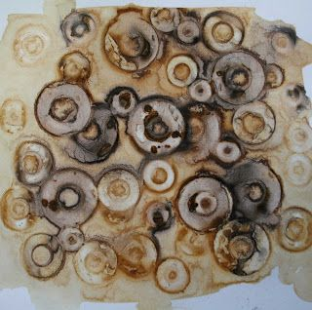
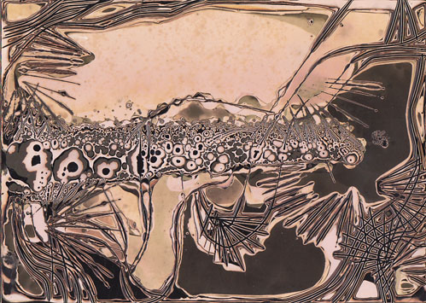
Imperfect processes
Learning Outcomes:
Use rusting and chemigram techniques to create experimental and abstract pieces.
Learning Objectives:
Explore materials and processes that are unpredictable.
Use emerging understanding to refine control and react appropriately to outcomes.
Rust CHEMIGRAM

Slide 2
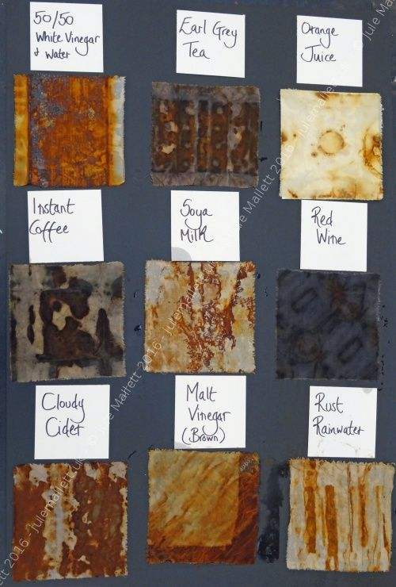
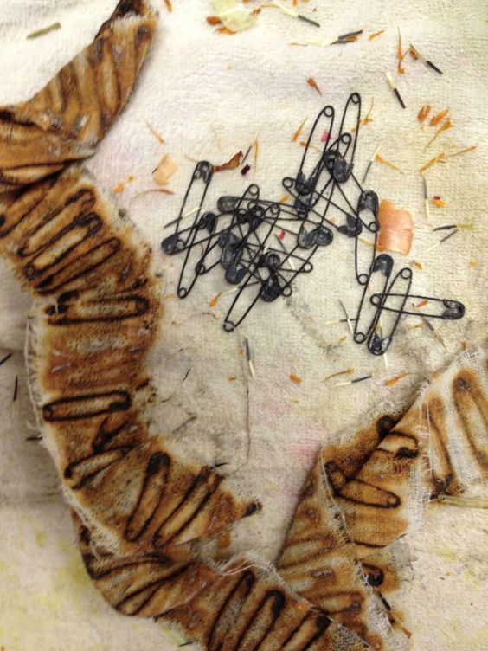
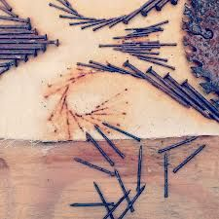
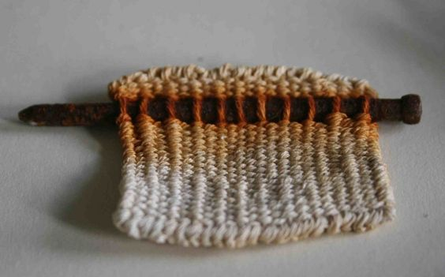
RUSTING: INSTRUCTIONS
Rusting, a well known example of corrosion, is the breakdown of the metal iron. The reactants of this chemical reaction are iron, water, and oxygen, and the product is hydrated iron oxide, better known as rust.
Artists have harnessed this reaction to create marks and effects to incorporate in their artwork.
Stretch the pieces of paper onto the card provided using water and gumstrip.
Treat each piece in a different way eg.
Different liquid
Different concentration of the liquid
Different amount of liquid
Layering metal objects
Saturating the objects at the end of the process
Leave for a week…

Slide 3
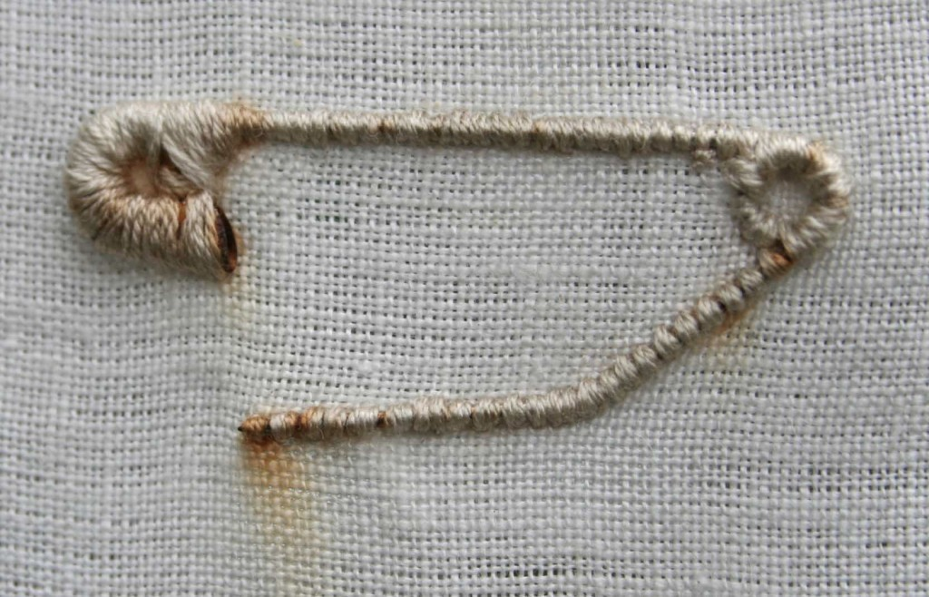
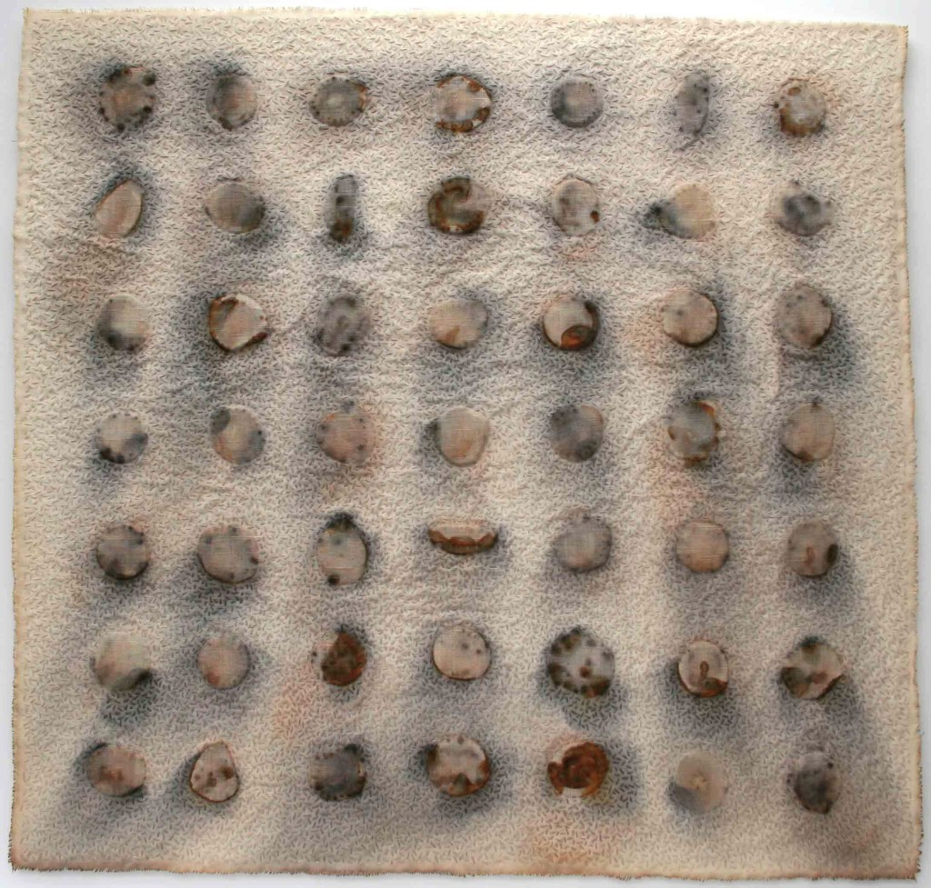
ALICE FOX
Rust Diaries is a series of works exploring the potential marks and stains made by found rusty metal. These objects form a record of activity, collected on an almost daily basis. Small found objects collected whilst walking are stitched around and over; trapping, covering and embedding them with stitch or layers of cloth. The resulting pieces are then exposed, either to the elements outside over a period of time, or to the chemical action of tea. The resulting stains on the surrounding cloth and stitch develops over time and with no further intervention. This is slow mark-making, which explores the potential of the everyday discarded object.

Slide 4
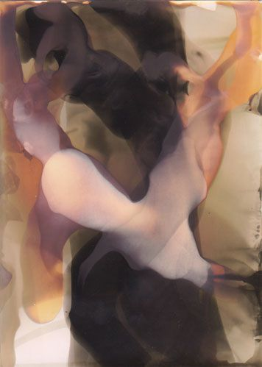
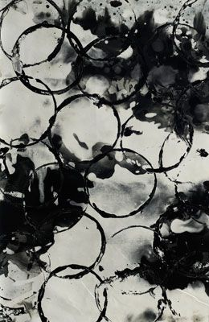
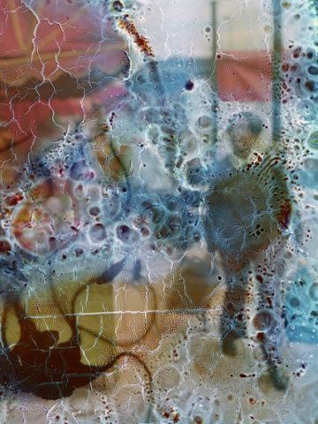
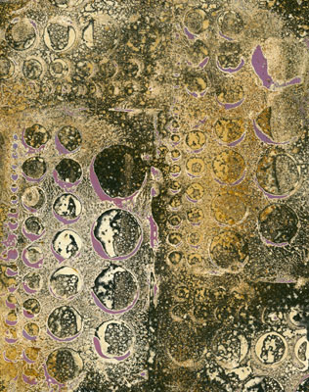
CHEMIGRAM
The chemigram process was discovered by Pierre Cordier on November 10, 1956.
Cordier discovered that a resist can hold back the chemical effects of developer and fixer on black and white photo paper for a time.
Paper put into developer that has been exposed to normal room light for varying periods of time will turn black, except where a resist blocks the chemical reaction. The parts of the paper protected by the resist will continue to change colour from extended exposure to room light.
Paper put into fixer turns white, except where a resist blocks the chemical reaction. The parts of the paper protected by the resist continue to change color from the room light exposure, and suddenly there is the possibility of black, white, and colors in-between on normally monochrome paper.

Slide 5
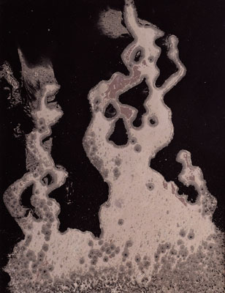
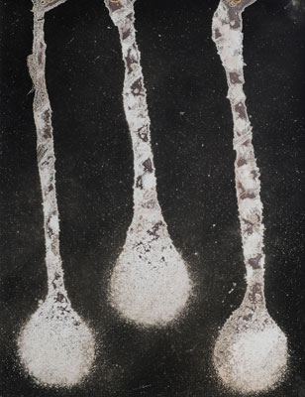
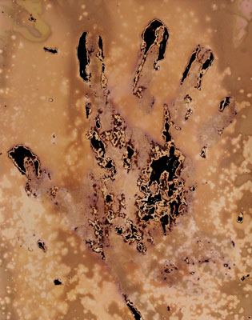
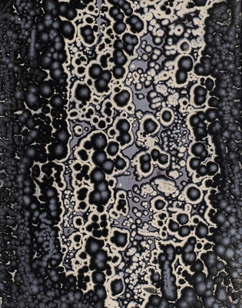
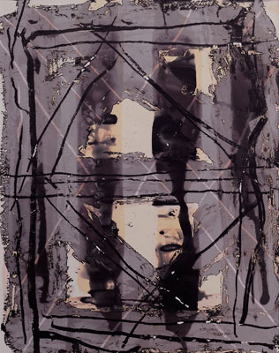
CHEMIGRAM: INSTRUCTIONS
For a Chemigram workshop you'll need:
Photographic paper- good news is that it works on exposed paper too
Four trays of DEVELOPER, WATER, FIX and WATER
To create the resist you can use:
masking tape ( makes interesting marks)
sugary drink such as Lucozade, squash etc
vegetable oil the longer you can leave them on the better
nivea
salt, sugar granules
instant coffee
honey
1. Choose one of the resists to draw onto the photographic paper (this can be done in the light). You can scratch into it, move it around with your fingers or other objects to create different marks.
By James Homme using spray cooking oil.
By James Homme using butter and houmous.
By Meghan Powell using butter and coffee..
By Clare Parsons. Coconut oil, dripped olive oil, cooking oil.
By Cara Thuringer using lotion.

Slide 6
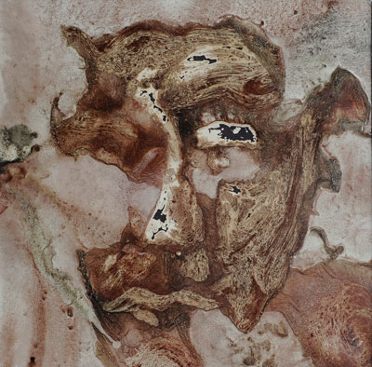
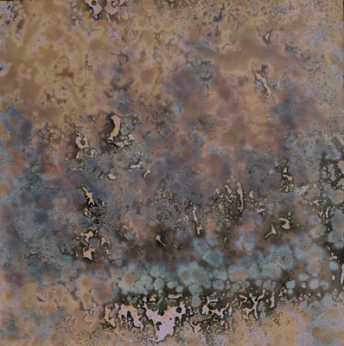
2. Put the paper with the resist in either the developer (to get a black background) or the fixer (to get a white background). Meanwhile the paper will be affected by the natural light in the room—brown, yellow, mauve, blue, pink—that’s OK. Don’t touch the resist just yet.
3. Whenever the paper looks finished developing or fixing, move it to the water wash. Rinse well enough, still not touching the surface and marring the resist, and then put it in the opposite tray of fixer or developer, respectively.
(If the water wash is not used, there will be contamination between the developer and the fixer which can produce chemical fog and dichroic silver, another option to consider.)
4. The resist will start its dissolution process, some resists sooner than later. Wherever the resist starts to dissolve, the underneath area will either turn lighter (fixer) or darker (developer), and with each back and forth, concentric areas of dark and light will begin to form like tree rings. Depending on the resist, the rings can have hard edges, mottled edges, or soft edges.
5. When the chemigram is ‘done’, get as much of the resist off as possible, and then do a final fix for five minutes, rinse for five minutes and dry.
By Clare Parsons. “Face” is butter resist
Chemigram by Scotland Steele done with vegetable oil.

