Slide 1
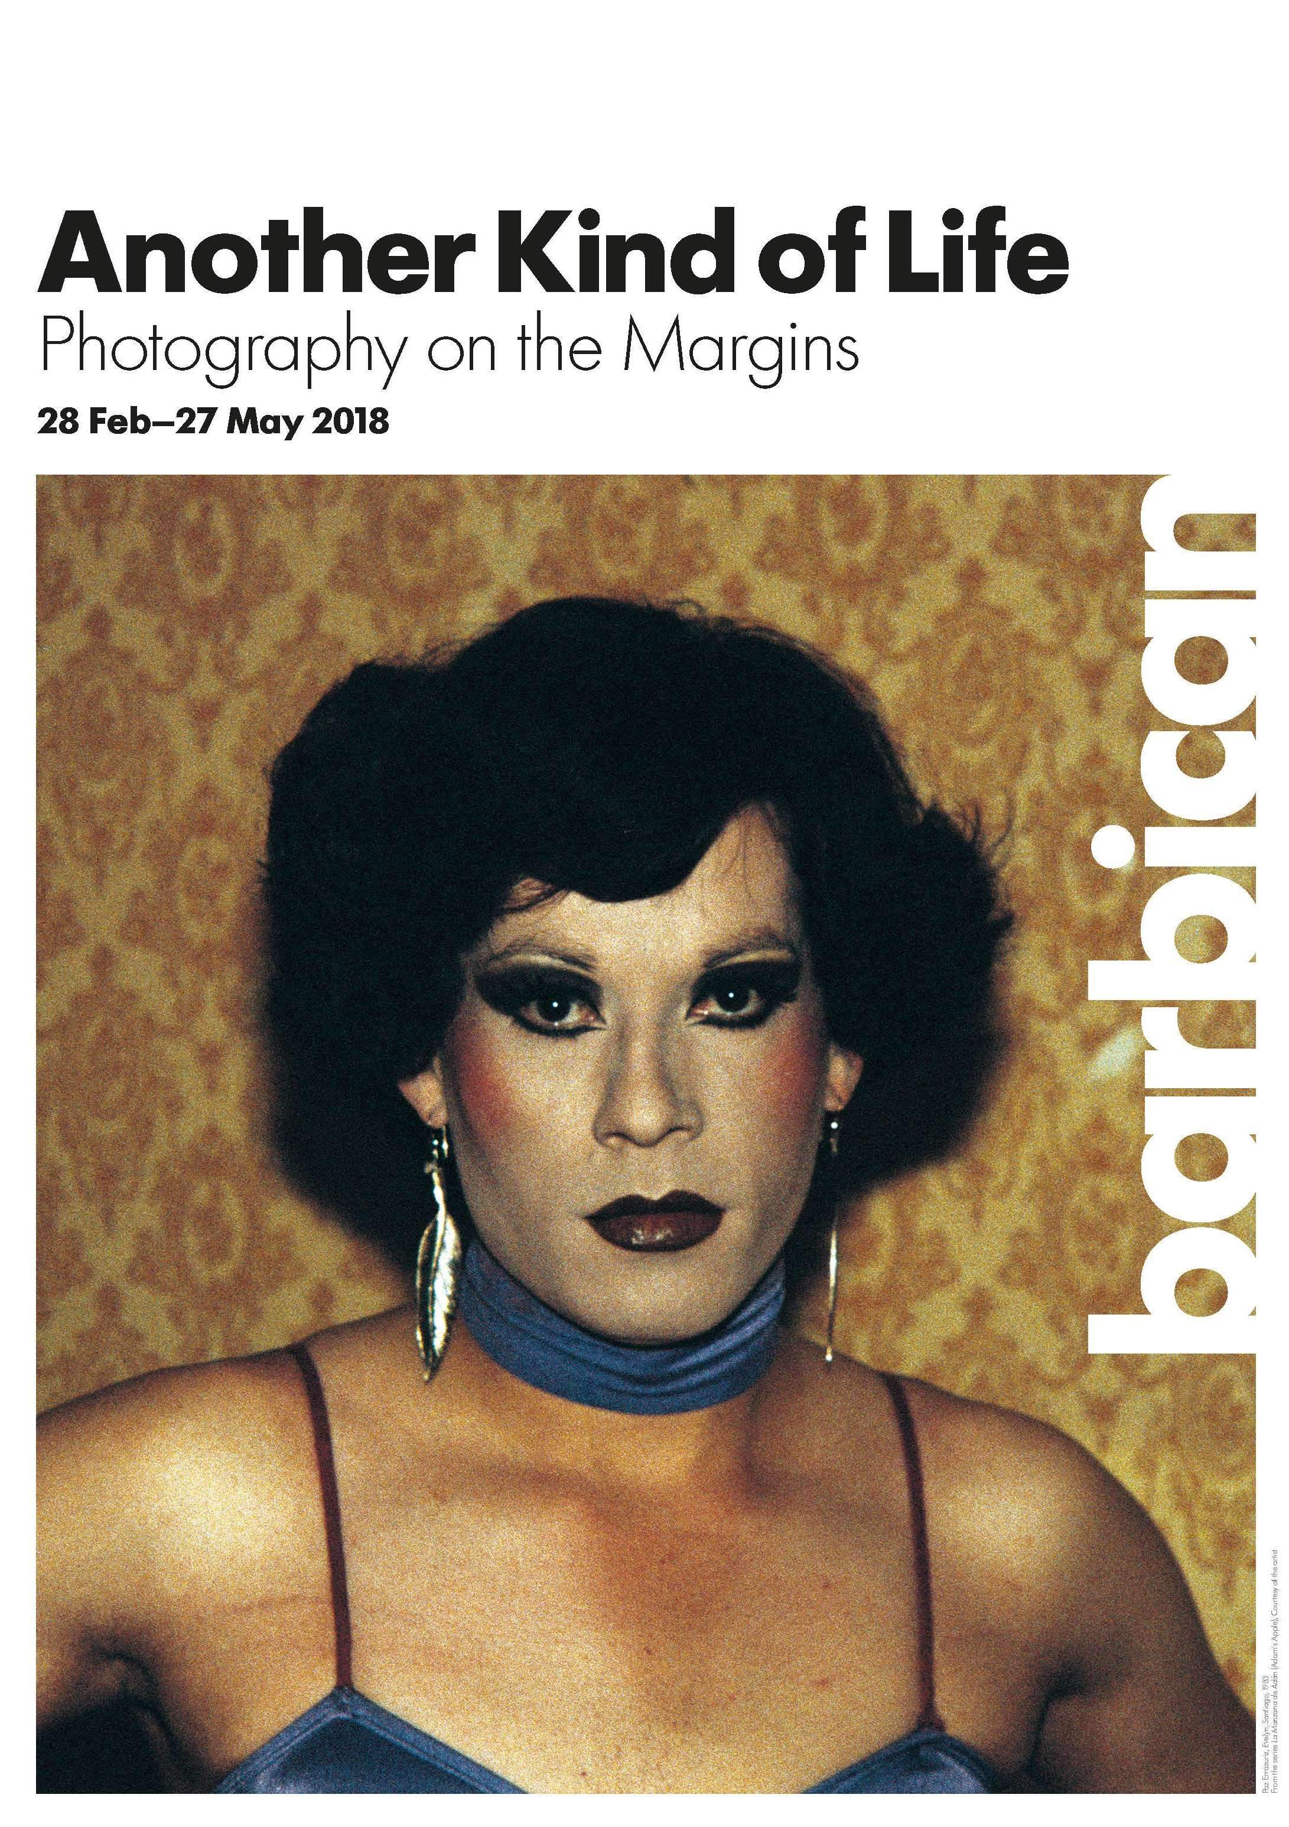
What was the point?
https://www.youtube.com/watch?v=2GnDkRkdod0

Slide 2
AO1 | Develop ideas through sustained and focused investigations informed by contextual and other sources, demonstrating analytical and critical understanding
Examiner’s like an exhibition visit!
EXCEPTIONAL ABILITY (16-18 marks) | inspired, unique, authoritative, challenging, synthesis of ideas, fully informed, questioning, sophisticated, fluent

Slide 3
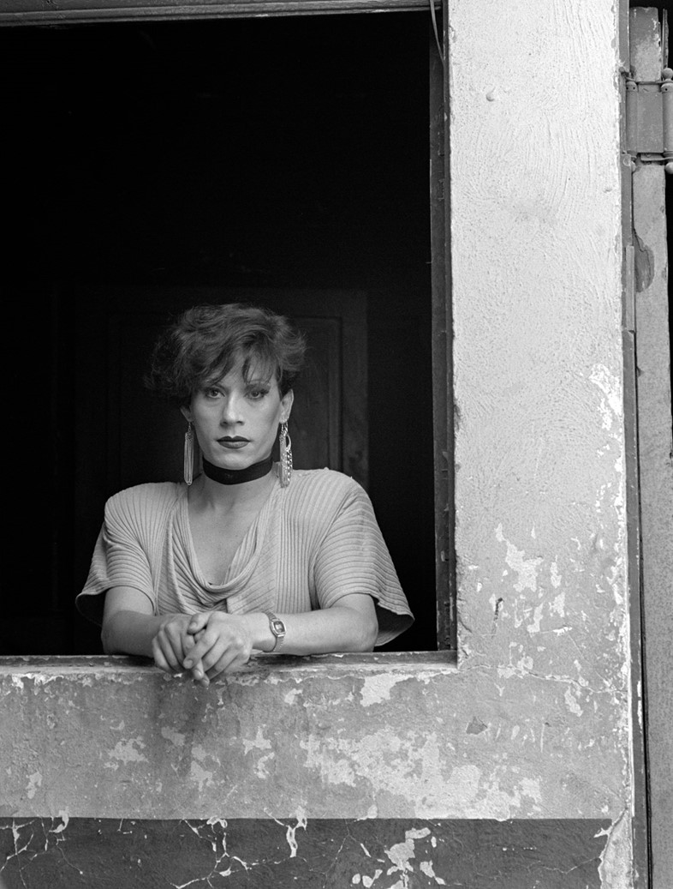
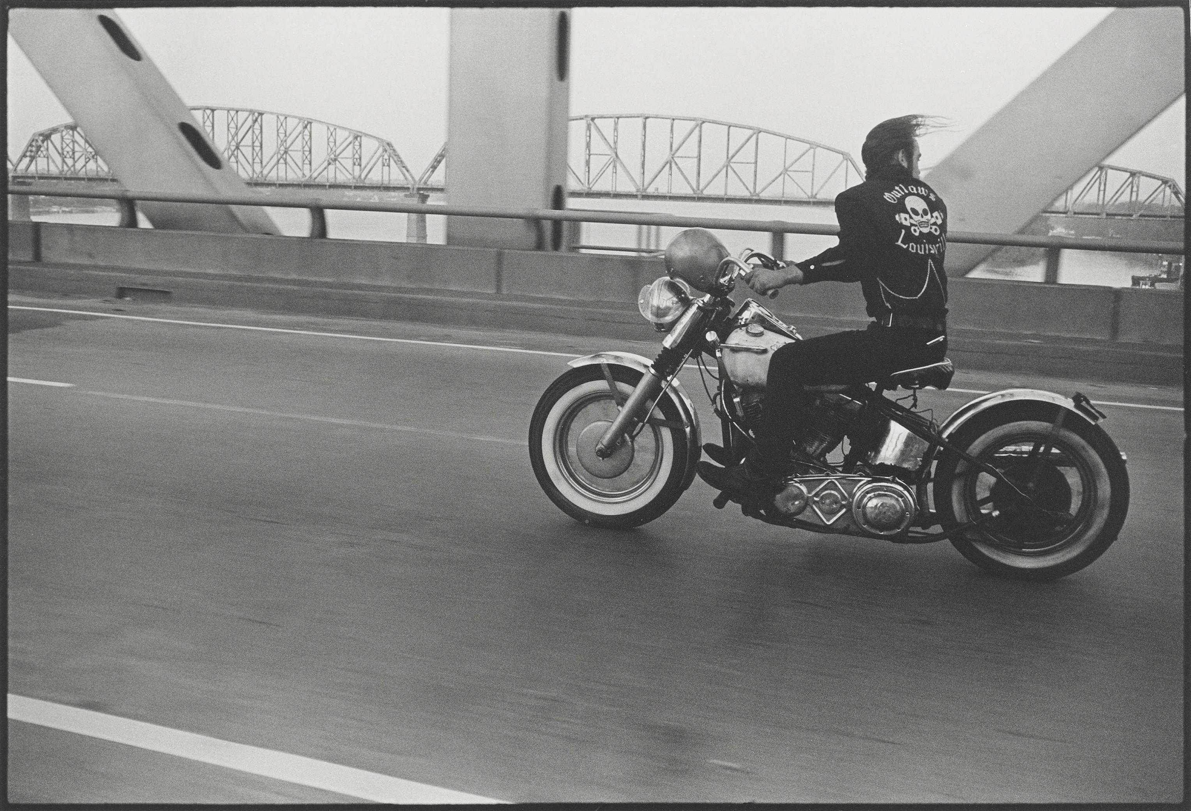
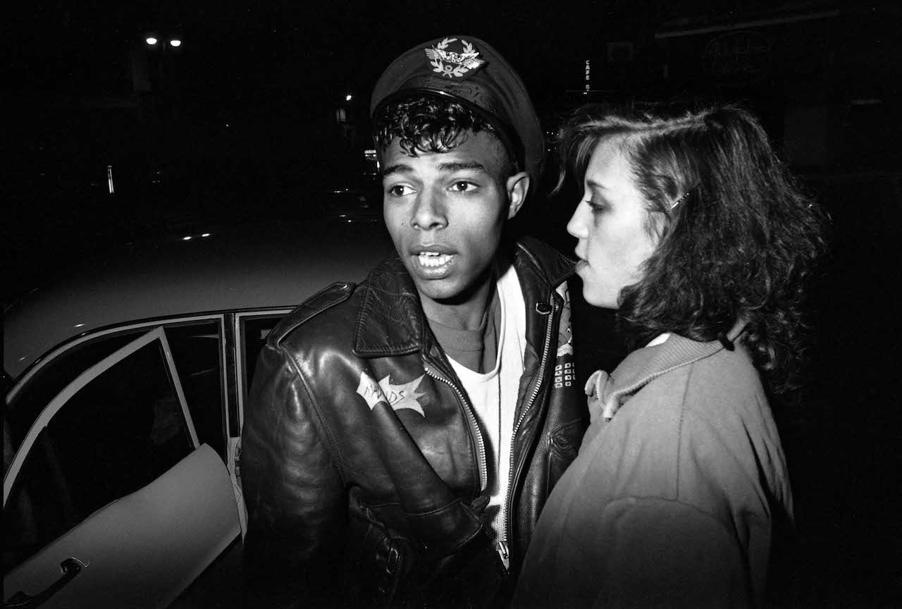
You have to write it up….
1. What was the exhibition about?
“It was our means of showing that we were there and fighting back.” Paz Errazuriza
Danny Lyon said: “I want to get close to people, not just physically close, emotionally close- all of it”
“I immerse myself fully with them, accepted, rejected or caught in the crossfire.” Philippe Chancel
Following the lives of those on the fringes of society
Collaborating with their subjects to construct their identities

Slide 4
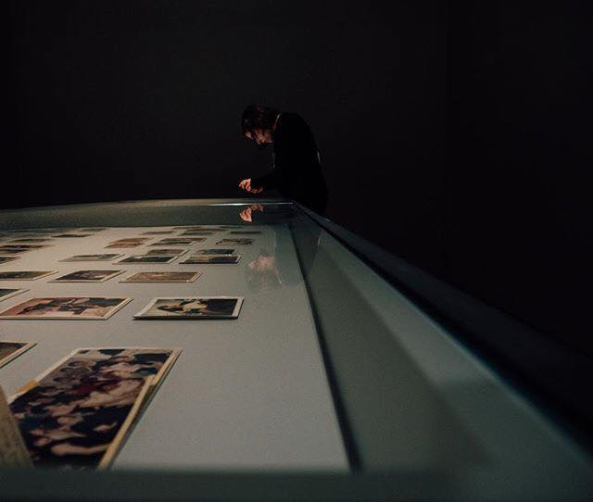
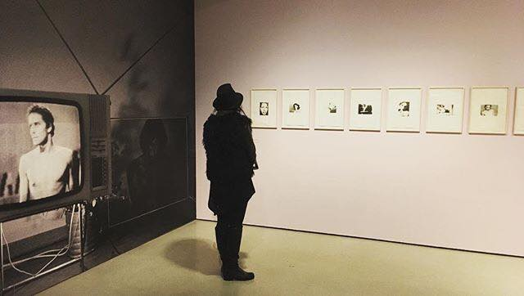
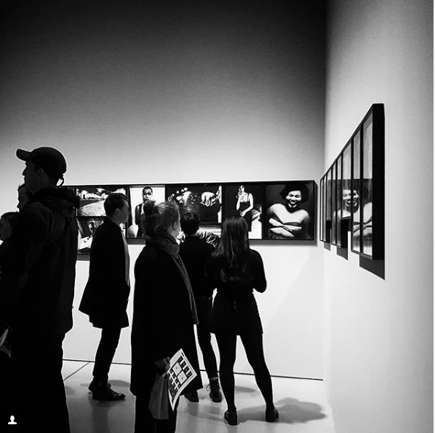
2. Overview of the curatorship…
How were the photographers organised?
How were the photographs presented?
How were you led around the exhibition?
What devices were used to add interest?

Slide 5
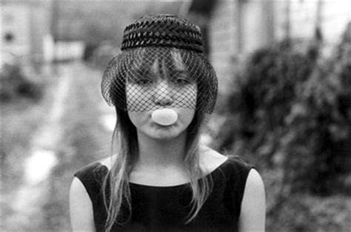
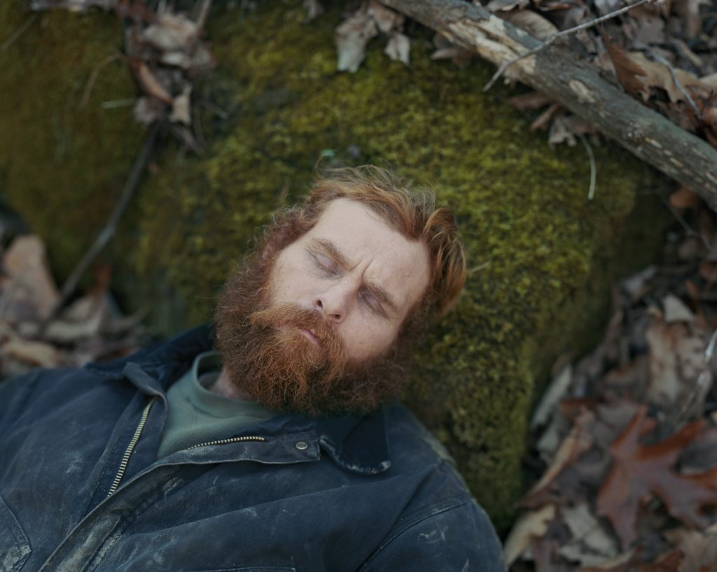
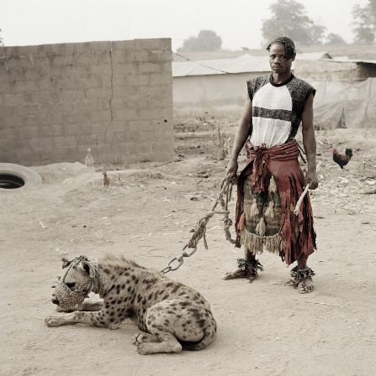
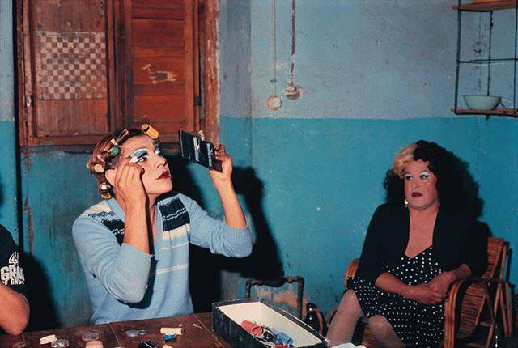
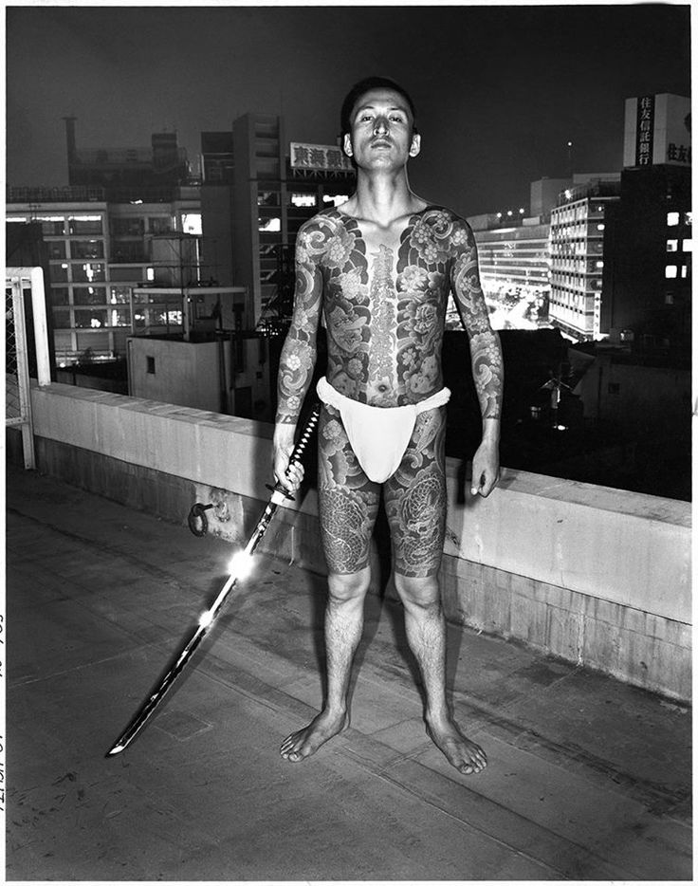
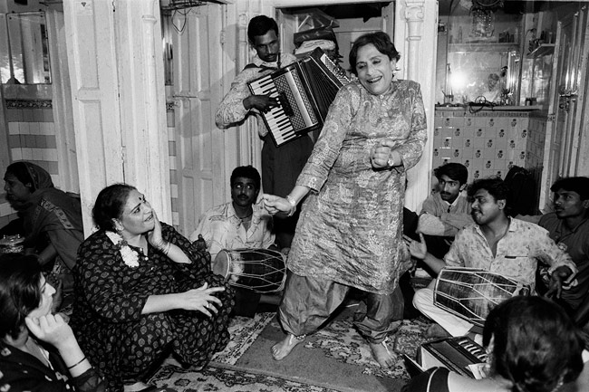
3. What were the highlights?
Name 3…..

Slide 6
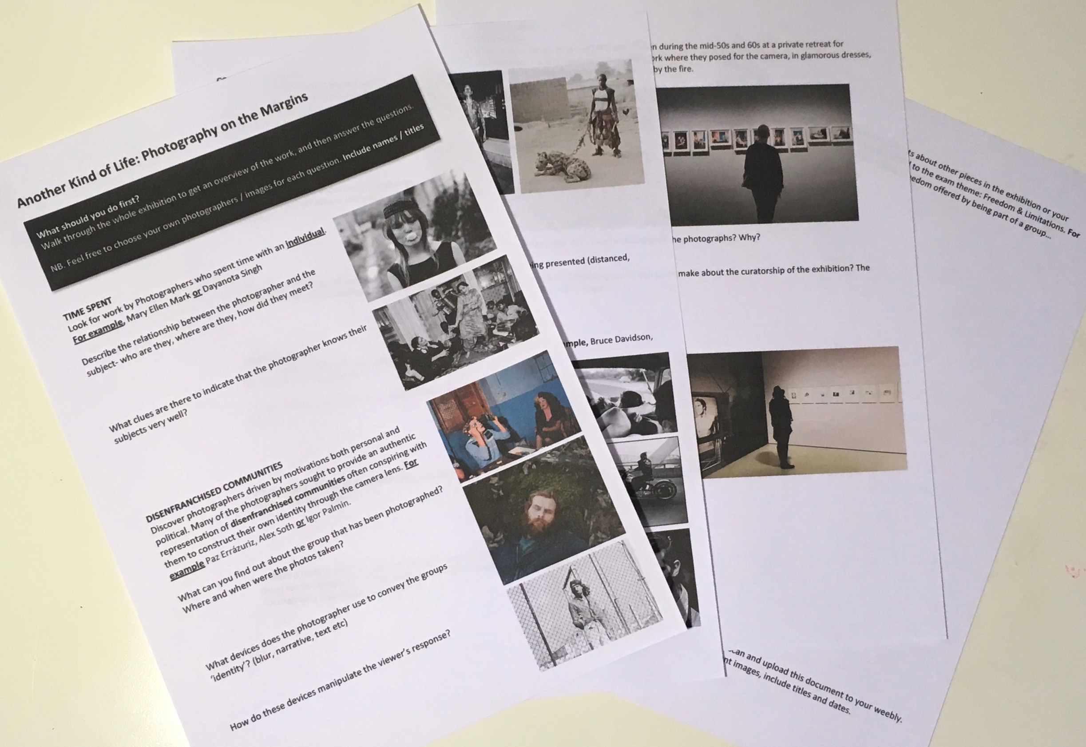
4. Go into depth…
Use your worksheet to discuss one photographer or series in more details.
Use the questions to help structure your analysis.
In your own words

Slide 7
5. Conclusion
How does the exhibition link to the theme, Freedom and Limitations?
freedom of speech, limits posed by society, freedom from reality, freedom within identifying as a group, being an individual, dictating how you want to be presented to the wider world, choice of media, presentation
Did you like the exhibition? How do the experts end a review?
Another Kind of Life’ is a celebration above all of how people find support in one another when the rest of the world has turned them away. (THE GUARDIAN)
‘Another Kind of Life’ is one hell of a transformative experience. (TIMEOUT)

Slide 8
AO2 | Explore and select appropriate resources, media, materials, techniques and processes, reviewing and refining ideas as work develops
EXCEPTIONAL ABILITY (16-18 marks) | genuine discovery, adventurous, accepting of the unexpected, dexterous, fluent skills, erudite, intuitive, daring

Slide 9
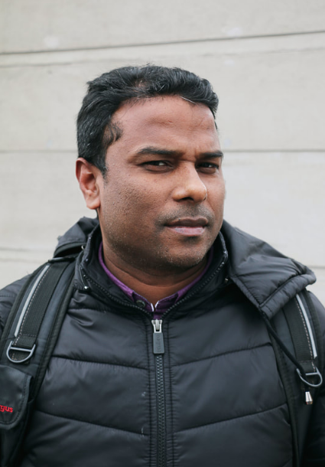
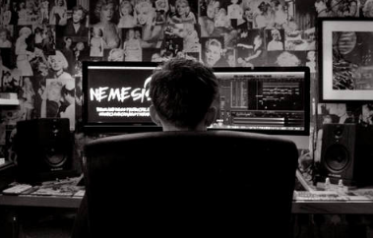
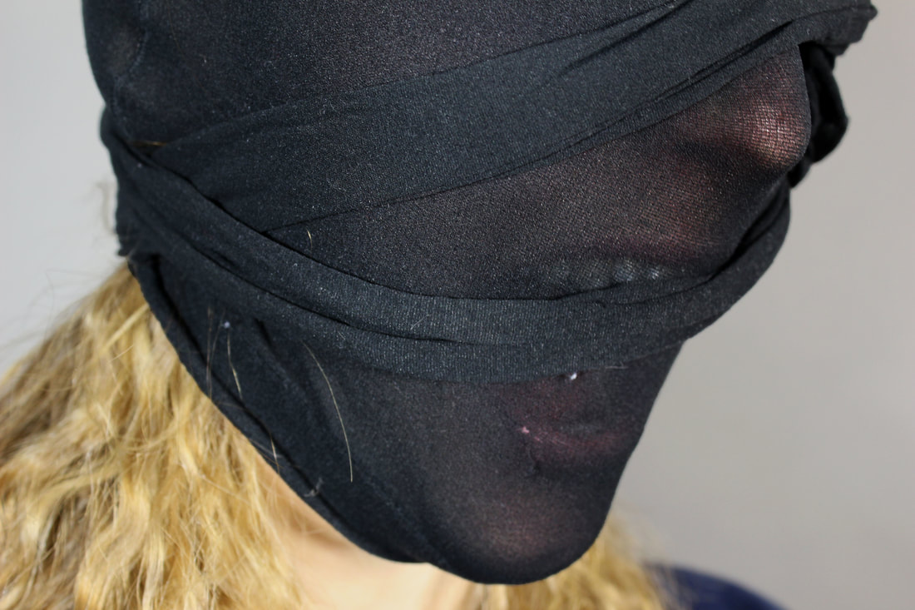

Slide 10
