Slide 1
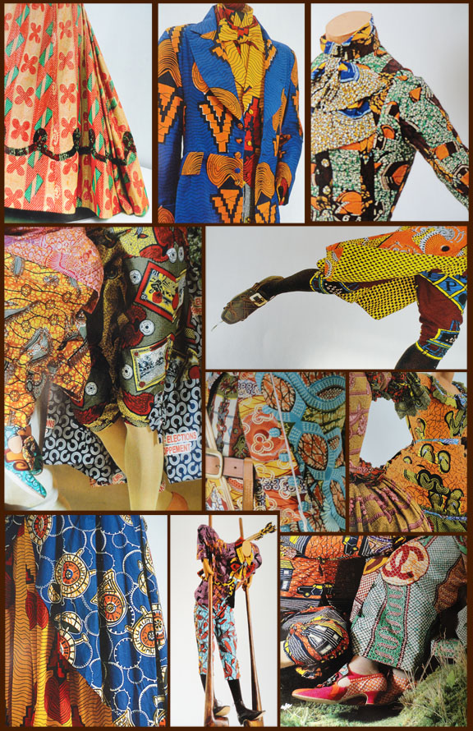
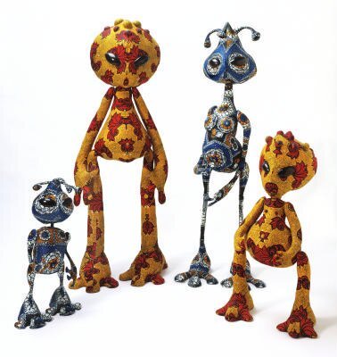
Year 7 cover
Either draw a colour version of the four aliens
Or draw one of the patterns on the right.
Make sure your drawing fills the page.

