Slide 1
The History of Photography
The Early Years

Slide 2
The photograph was the ultimate response to a social and cultural appetite for a more accurate and real- looking representation of reality, a need that had its origins in the Renaissance.
- Naomi Rosenblum, A World History of Photography

Slide 3
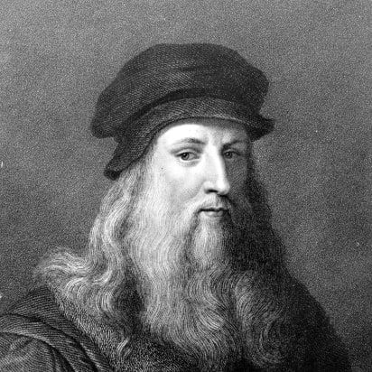
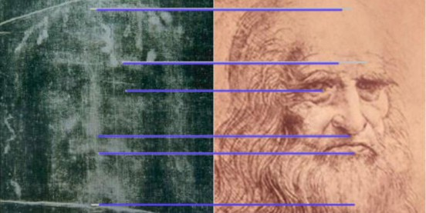
The Search for Realism
During the Renaissance (16th Century), artists became increasingly interested in exploring and representing the reality of nature.
Leonardo Da Vinci was particularly well known for his anatomical drawings and took a great in interest in contemporary advances in science.
Conspiracy theorists argue that the head on the Turin Shroud is actually the image of Da Vinci himself. Professor of Photography, Nicholas Allen used a Camera Obscura with basic lens and a plaster cast of recreated a near identical image. The cloth was stretched and covered with silver salts and fixed with urine.

Slide 4
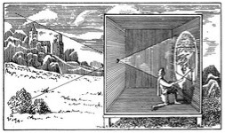
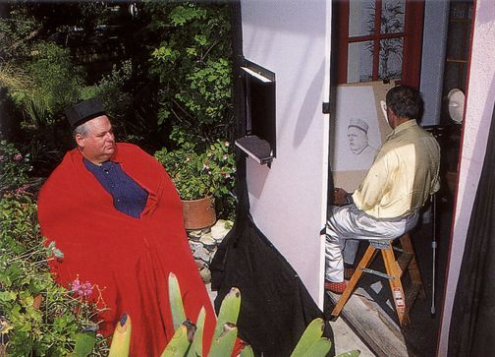
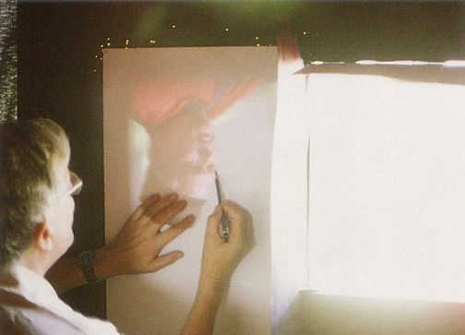
In order to achieve such realism, artists developed various instruments to assist them in their quest for the perfect perspective.
One such instrument used was the camera obscura, a dark room/space in which an inverted image was projected onto a surface. Camera Obscura

Slide 5
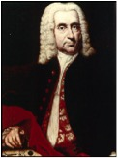
Capturing Shadows
in 1727 Johann Heinrich Schulze found that a slurry of chalk and nitric acid into which some silver had been dissolved was darkened by sunlight
Though Schulze's work did not provide a means of permanently preserving an image, it did provide a foundation for later efforts toward that end.

Slide 6
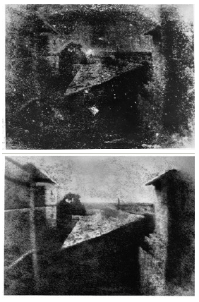
The 19th Century
As the industrial revolution transformed society in the 1800s with mass-production leading the way forward, scientists endeavored to reproduce reality in a fixed format.
In 1827, the scientist Joseph Niépce was successful in fixing the first projected image of his view from his window in Le Gras, South France.
Unable to draw well, Niépce first placed engravings onto engraving stones or glass plates coated with a light-sensitive varnish of his own composition.
He then created the first known
photograph (on metal) in 1826 – he called these heliographs
Joseph Nicéphore Niépce View from His Window at Le Gras 1827

Slide 7
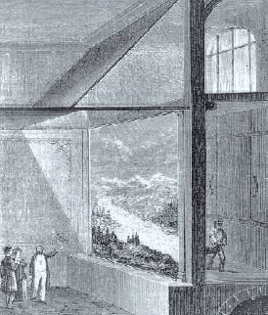
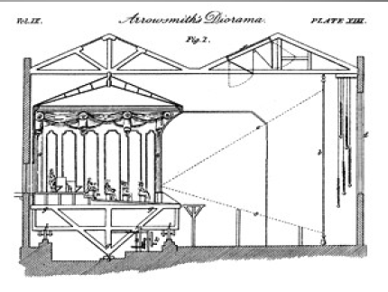
Louis Jacques Daguerre
Louis Daguerre worked with Niépce in his quest to fix the projected image. Daguerre was a painter of stage sets and illusionistic scenery for The Diorama, a popular visual entertainment in Paris.

Slide 8
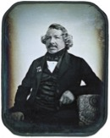
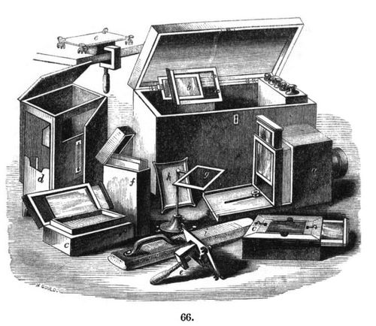
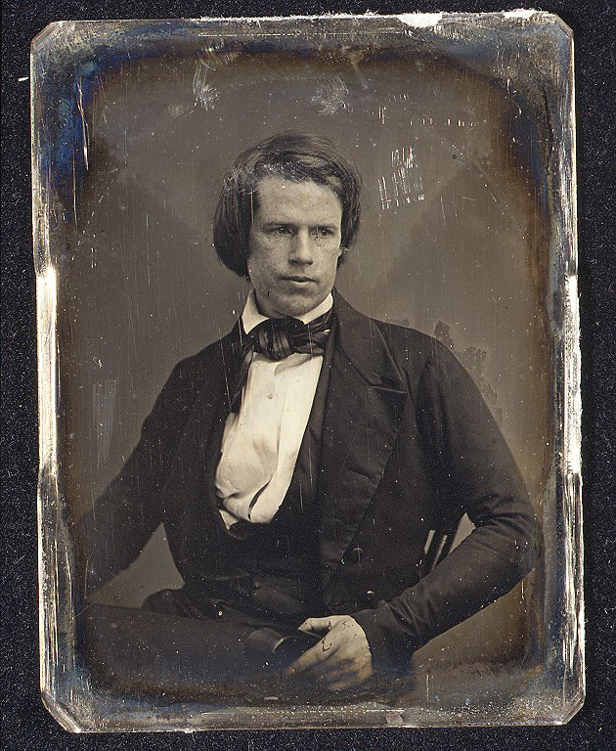
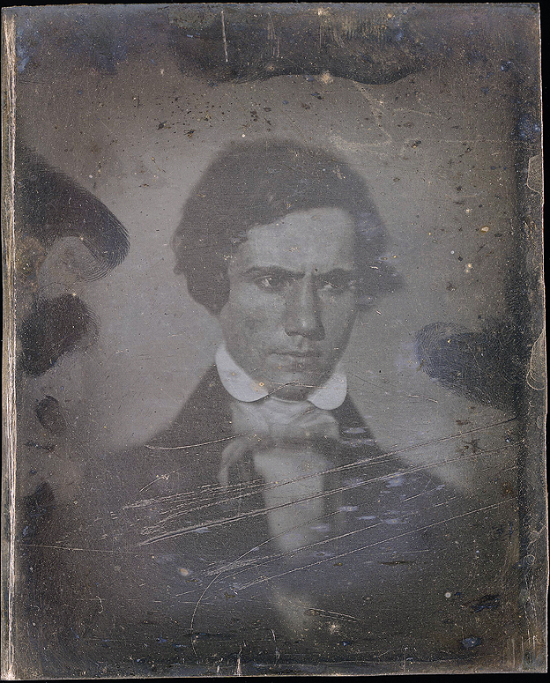
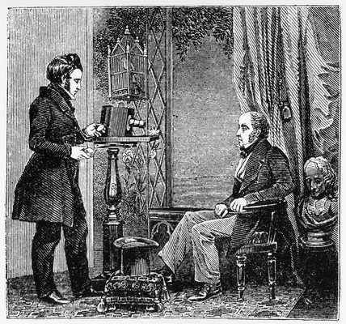
The Daguerreotype
In January 1839, Daguerre officially announced the invention of the Daguerreotype, a type of photograph which was laterally reversed and monochromatic printed onto a metal plate.

Slide 9
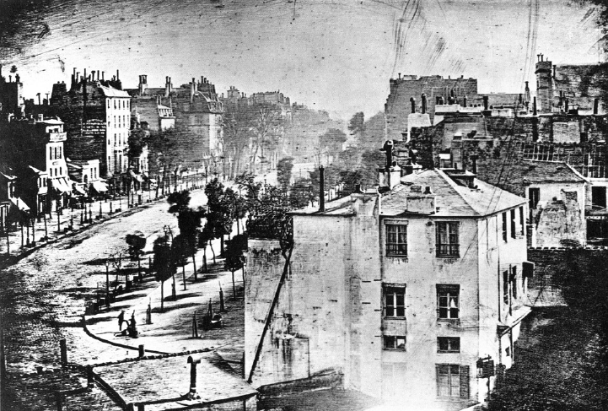
Louis Daguerre, Boulevard du Temple, 1838
Notes:
However there were problems with the daguerreotype.
It required long exposures and this meant that any
movement resulted in blur
It was also a one off image that was extremely delicate the
mirror surface could be easily scratched and this led to them
becoming an object of attention just as much as it was an
image of information

Slide 10
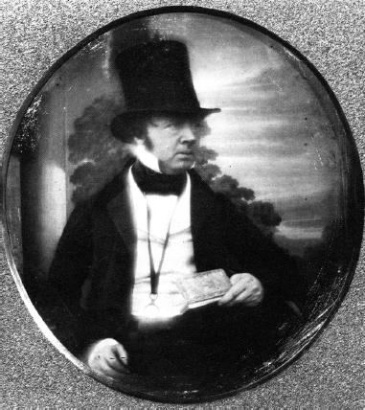
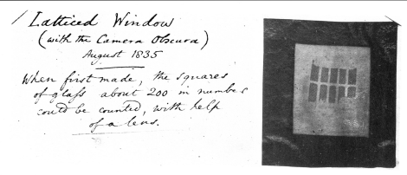
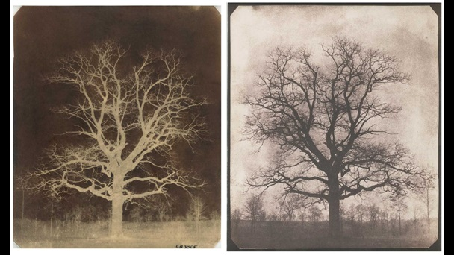
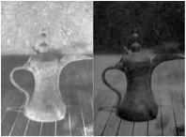
The Calotype
Around the same time as the invention of the Daguerreotype, an English scientist called William Henry Fox Talbot developed another type of photograph called the Calotype.
The Calotype had one distinct advantage over the Daguerreotype: it could be reproduced as a negative as opposed to being a single, non-replicable image.
William Henry Fox Talbot
Latticed Window at Lacock Abbey
1835

Slide 11
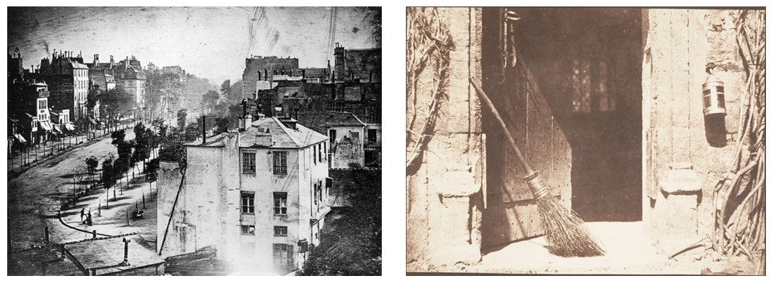
A Question of Quality
In terms of mass production, Talbot’s Calotype was far superior. However, it lacked the sharpness and overall quality to a Daguerreotype and this made it less popular in the early years, especially since many European countries and America had adopted Daguerre’s process.
However, the Calotype was improved over time and advances in paper technology led to better processing. Therefore, the Calotype soon became the most popular type of
photography that is still used today.

Slide 12
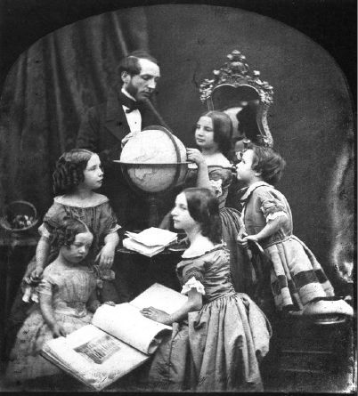
Themes
In the early years, many
photographers were concerned
with documentation and
continued to focus on
traditional fine art themes such
as portraiture and landscape.
Over time this changed as
photographers started to assert
their own identity, separate to
that of contemporary artists.
Antoine François Claudet, The Geography Lesson
1850

Slide 13
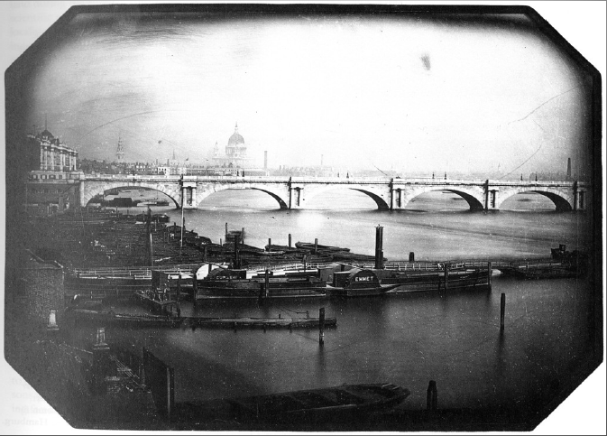
Jean Baptiste Louis Gros, Bridge and Boats on the Thames, 1851

Slide 14
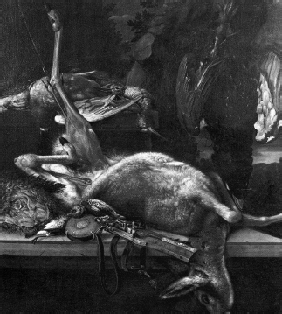
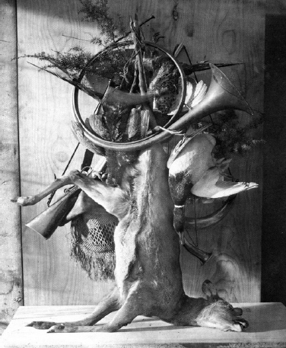
Valentin Gottfried
Hunt Picture (Oil on canvas)
Late 17th Century
Adolphe Braun
Still Life with Deer and Wildfowl
1865

