Slide 1
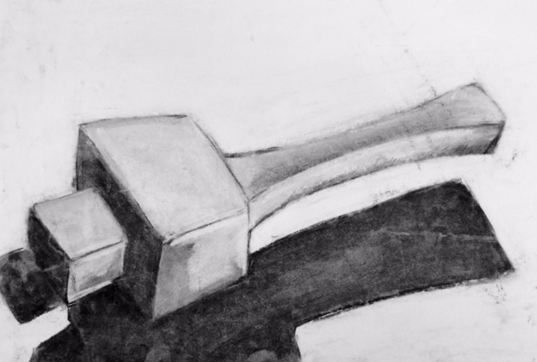
Lesson 6: Charcoal and chalk tonal study

Slide 3
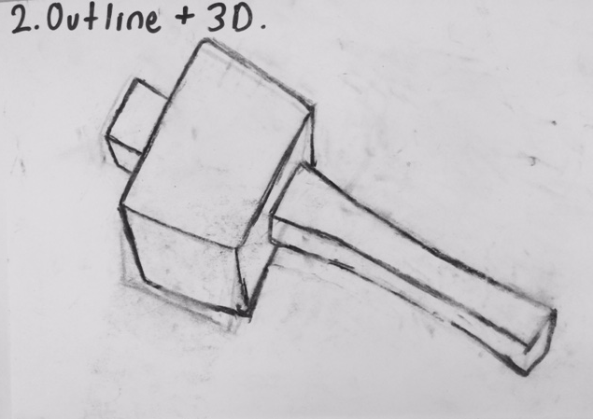

Slide 4
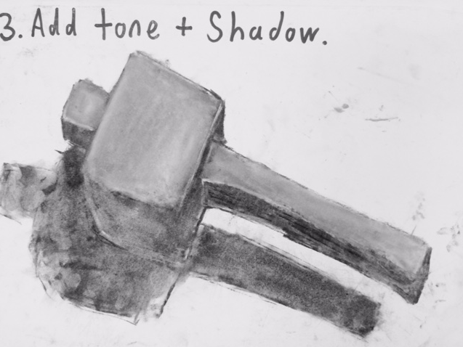

Slide 5
* Example

