Slide 1
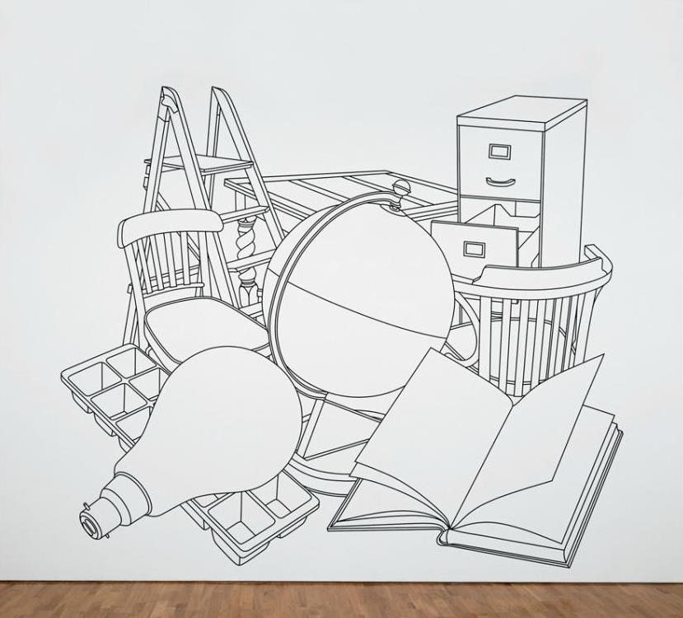
Lesson 5: Michael Craig-Martin

Slide 2
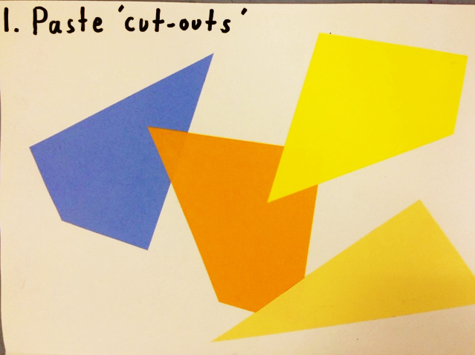

Slide 3
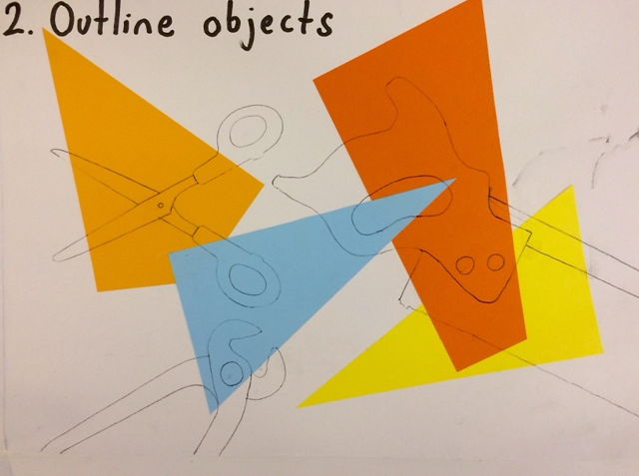

Slide 4
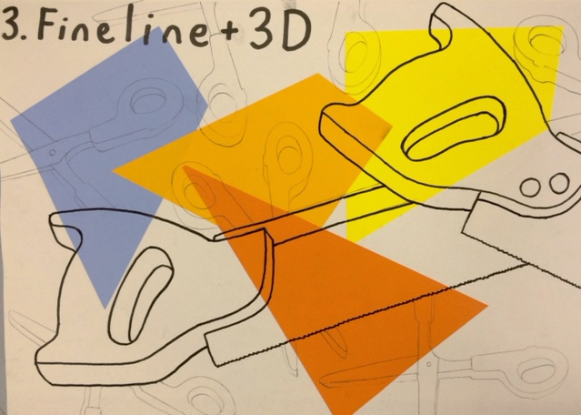

Slide 5
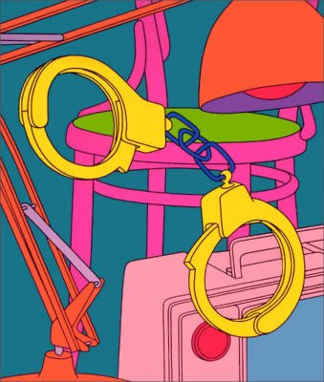
NOW: Analyse this Art work…
GROUP ACTIVITY
What is the medium?
What is it?
Describe the tones.
Describe the shapes?
Who is the artist?
Subject matter?
NOW: On the piece of paper you must all write at least ONE key word to describe the art work

Slide 6
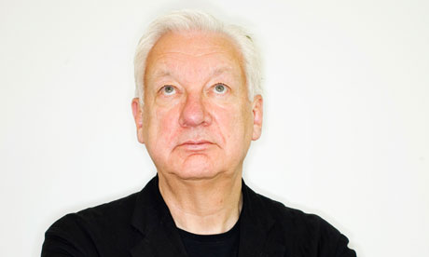
Michael Craig-Martin born 1941, Ireland
Michael Craig-Martin, CBE RA, is a contemporary conceptual artist and painter.
He is noted for fostering the Young British Artists, many of whom he taught, and for his conceptual artwork, An Oak Tree.
He is Emeritus Professor of Fine Art at Goldsmiths

Slide 7
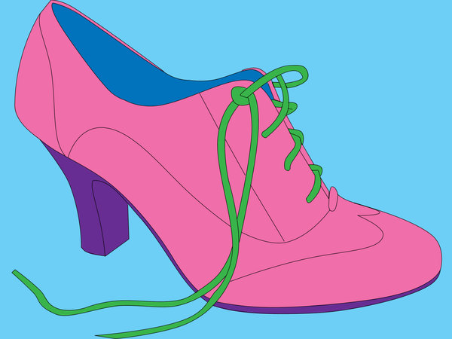

Slide 8
