Slide 1
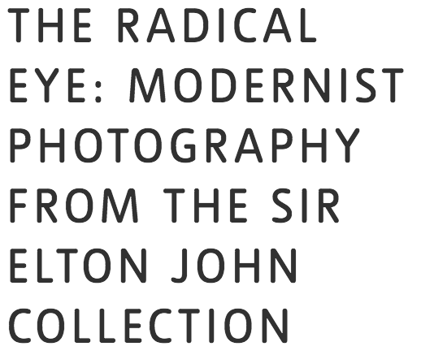
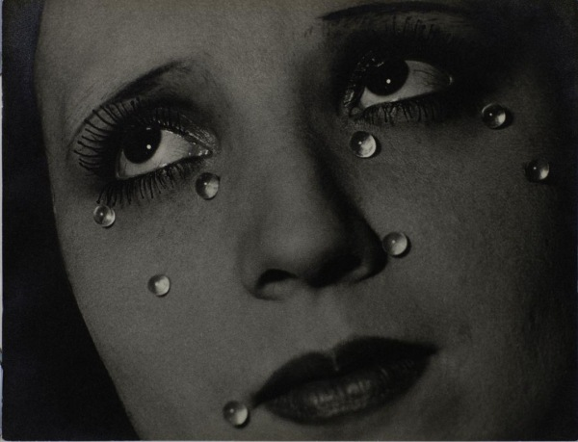
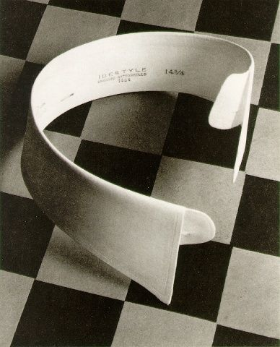
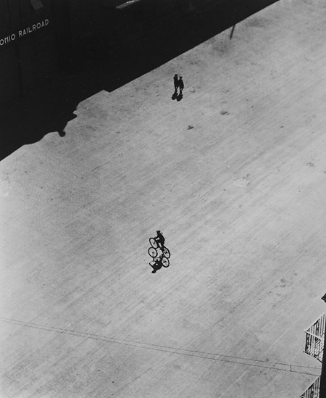
There are tasks for each room however, spend the first five minutes walking through the whole exhibition to get an overview before you begin. You can work on the rooms in any order.
AVOID CROWDING AROUND THE SAME IMAGE.
ROOM 1: THE RADICAL EYE
The beginning of modernism. Artists in the modernist period explored what the camera could do that the human eye alone could not, and how this could be harnessed to present a new modern perspective on the world.
What can be found in the composition?
What is the main focal point drawing your attention?
Title:
Date:
Photographer:
Why has the attention been drawn to one person?
Why has the specific location been chosen?
Title:
Date:
Photographer:

Slide 2
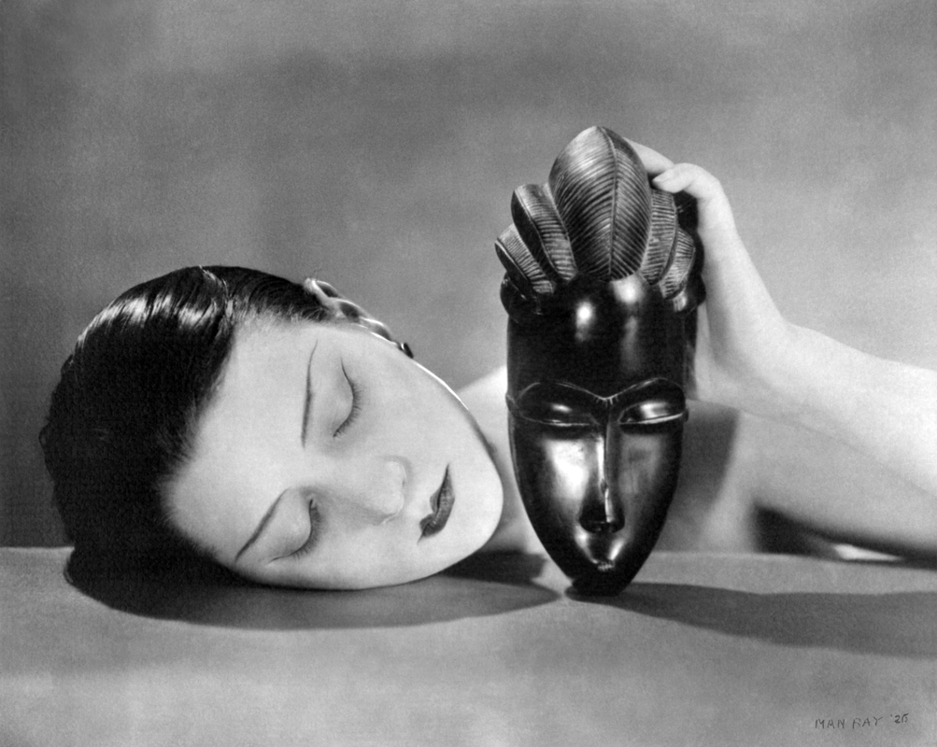
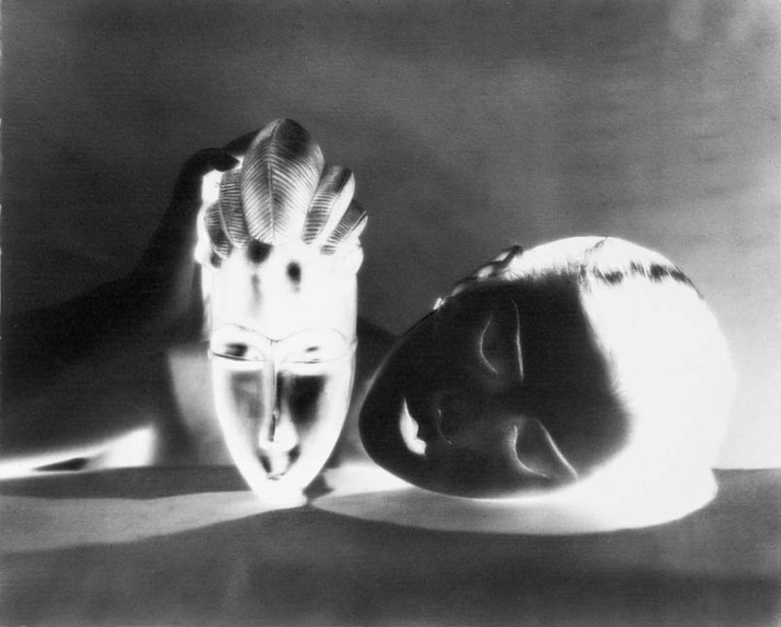
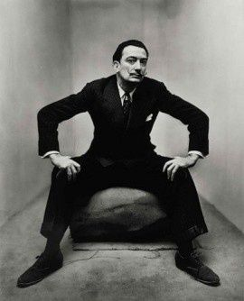
ROOM 1 continued
Man Ray’s pairing of positive and negative images alludes to the technical process of the image’s creation. The title, ‘Black and White’, 1926, also refers to the elements in the composition: the face of a woman and a West African ceremonial mask carved from ebony. This formal juxtaposition alludes to cultural associations of ‘black’ and ‘white’.
How has the image been manipulated?
How has the symmetry been used?
ROOM 2: PORTRAITS
Modernist portraiture harnessed photography’s capacity to
render an accurate likeness in clear, sharp focus and detail. But
at the same time, artists and sitters pushed the conventions of
portraiture with innovations in pose, composition and cropping.
Look at all of Penn’s ‘Corner Portraits’. How would you describe the different poses? Write down 5 descriptions. Make sure you name the person in the portrait for each one.
Eg. Dali: attempts to fill the corner
1
2
3
4
5

Slide 3
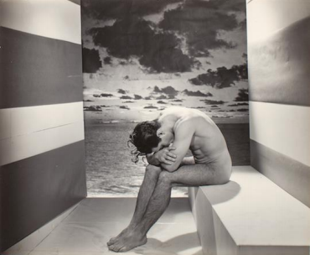
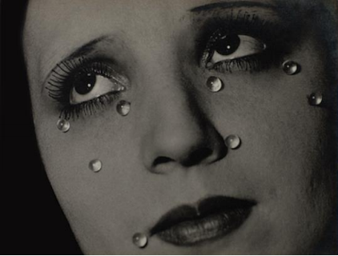
ROOM 3: PORTRAITS / BODIES
Experimental approaches to shooting, cropping and framing
could transform the human body into something unfamiliar.
Photographers started to focus on individual parts of the body,
their unconventional crops drawing attention to shape and
form, accentuating curves and angles.
What is the model thinking? Do you think he is happy, sad, tired after a swim?
How does the composition lead our eye?
Title:
Date:
Photographer:
Describe the image as if you are explaining it to someone on the phone. Think about her gaze and the tears and what they might mean. Compare real and fake.
Title:
Date:
Photographer:
Now read this:
Glass Tears, has come to be known as one of Man Ray’s most iconic images. This work was taken when Man Ray was splitting up with his partner, fellow artist and photographer, Lee Miller.
How does this change your interpretation of the image?
(By the way, the woman in the photograph is not Lee Miller)

Slide 4
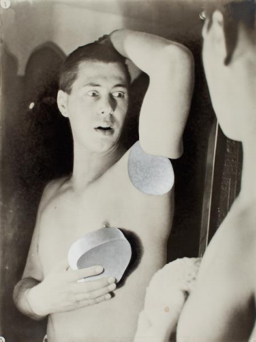
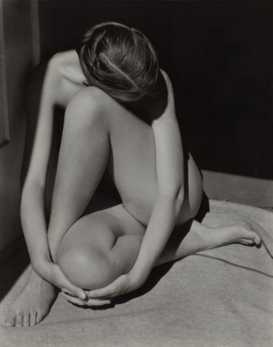
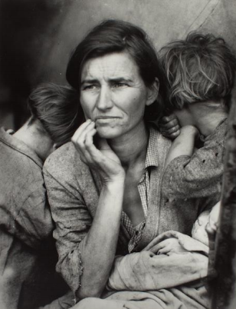
ROOM 4: EXPERIMENTS
This was not a period of discovery but of rediscovery. Artists
were rewriting the preceding century’s rules of photographic
technique, harnessing ‘mistakes’ such as distortions and double exposures, or physically manipulating the printed image, cutting, marking and recombining photographs.
What is the main focal point drawing your attention?
Look closely at the print and read the accompanying text. How do you think it was made? What processes did Bayer use?
Title:
Date:
Photographer:
What types of shapes can be spotted in the image?
How has the photographer used lighting and contrast?
Title:
Date:
Photographer:
ROOM 5: DOCUMENTS
During the 1930s, photographers refined the formula for what
we now know as social documentary. The development of new technology – particularly the portable camera and roll film – allowed photographers to capture spontaneous moments unfolding in the everyday world.
Title:
Date:
Photographer:

Slide 5
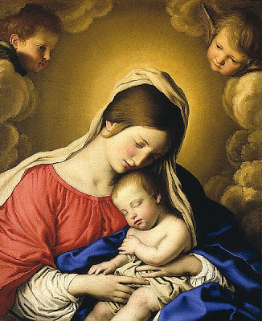
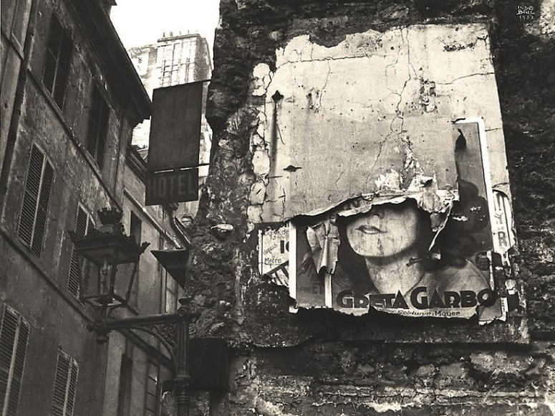
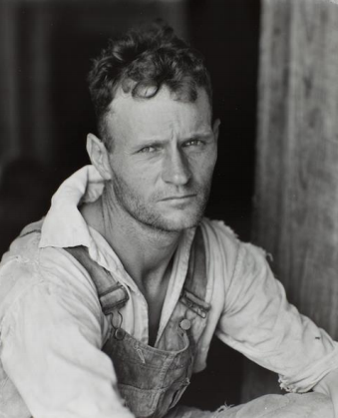
Lange took five exposures, each time moving closer to the migrant mother, and this enabled her to crop the image in a very precise way, the resulting image is very well framed and looks almost like it’s set up.
Does the composition of ‘Migrant Mother’ remind you of any other imagery of a woman and baby? Here’s a clue
Who are the angels?
How does this change our interpretation of the image? Does it seem more important? Does it represent something greater? Do you think it was set up?
How has the photographer positioned their viewpoint?
What comment does his image make on the American Dream?
Title:
Date:
Photographer:
Walker Evans was part of a group of photographers that were commissioned by the FSA, the Farm Security Administration, to document the plight of very poor and impoverished workers during the Depression in the US.
What is the main focal point drawing your attention?
How has the photographer used composition and contrast to direct our gaze?
Title:
Date:
Photographer:

Slide 6
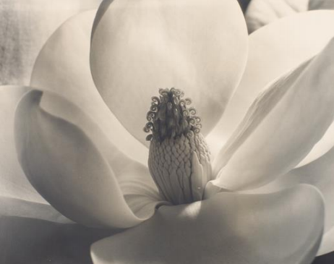
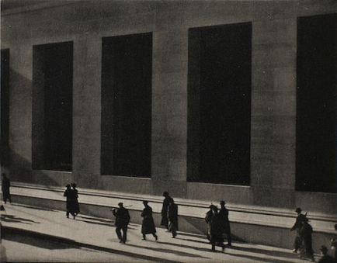
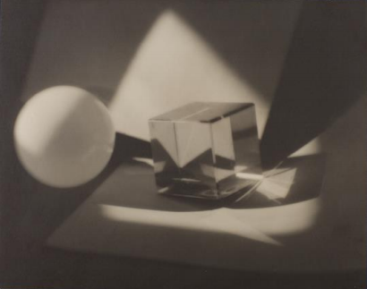
ROOM 6: OBJECTS, PERSPECTIVES, ABSTRACTIONS
This final room shows the still life genre re-imagined by photographers who used the technical capabilities of the camera to reveal the beauty of everyday things. Objects captured at unconventional angles or extreme close-up become strange, even
unrecognisable.
What can be found in the composition?
What is the main focal point drawing your attention?
Title:
Date:
Photographer:
How has the photographer positioned their viewpoint?
How has the photographer used light, shadow and angles to capture the essence of a modern city.
Title:
Date:
Photographer:
How has the photographer positioned the direction of lights?
How has the image been manipulated?
Title:
Date:
Photographer:

Slide 7
OTHER IMAGES
Record any other photographs that interest you here. Don’t forget the title, photographer etc.
Try to draw a small sketch in he frames.
Title:
Date:
Photographer:
Title:
Date:
Photographer:
Title:
Date:
Photographer:

Slide 8
ANY THOUGHTS
Do you have any other thoughts, questions, reactions to the exhibition?
Scan or photograph the pages of this work book and upload them to your weebly.

