Slide 1
Life Drawing 2: Hand, Eye Co-ordination Line & Contour Drawing

Slide 2
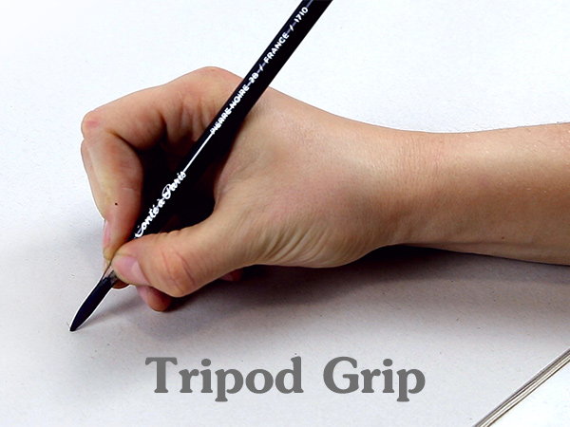
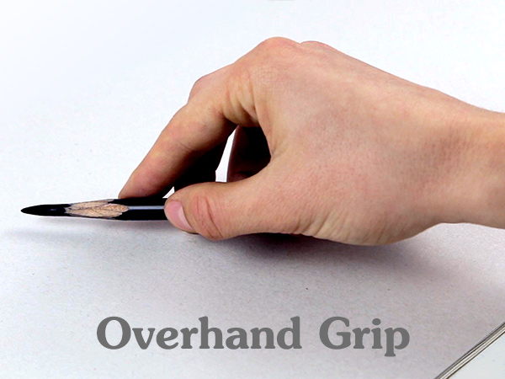
Over hand grip
Change the way you hold your drawing media
This allows for far greater movement and expression within your drawing but can take a bit of getting used to.

Slide 3
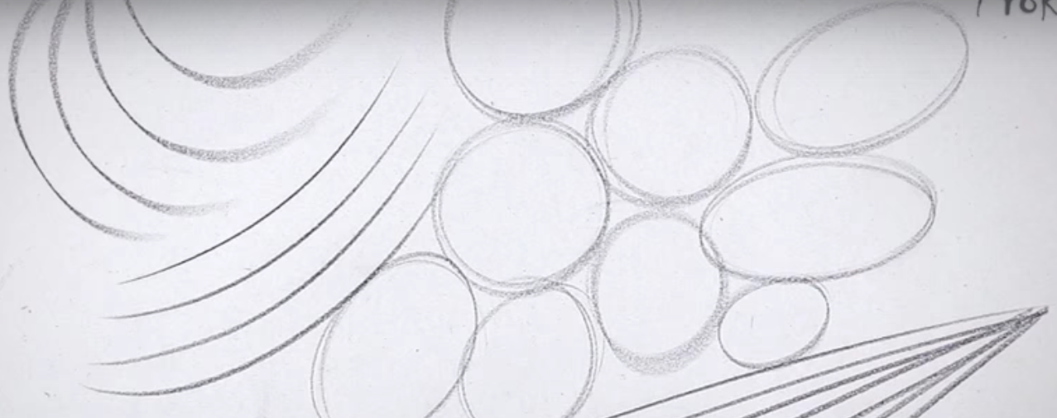
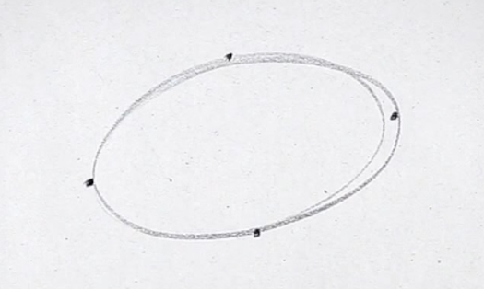
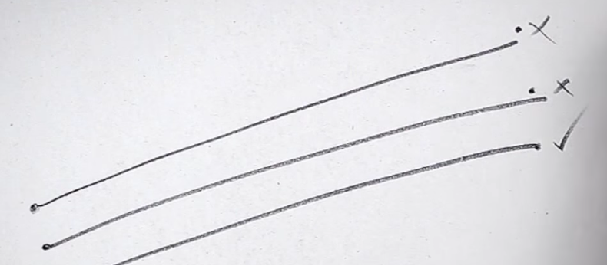
Let’s Practice: graphite / charcoal
Fill a sheet of newsprint with curves, circles and straight lines.
Draw four dots and join them with an ellipse.
‘Ghost’ the lines first by practicing the circular motion over the paper before committing to drawing your line.
Draw two dots and join them with a quick stroke of your drawing media.
This improves your hand eye co-ordination

Slide 4
Warm up…Continuous Line
3 x 5 minute drawings on one sheet
Drawing 1-
Only allow movement from your fingers and wrist.
Drawing 2-
You can now move from your elbow and shoulder. Step back from your drawing to be able to do this.
Drawing 3:
Now move your whole body. Bend your knees as you draw lower down the page rather than leaning over.

Slide 5
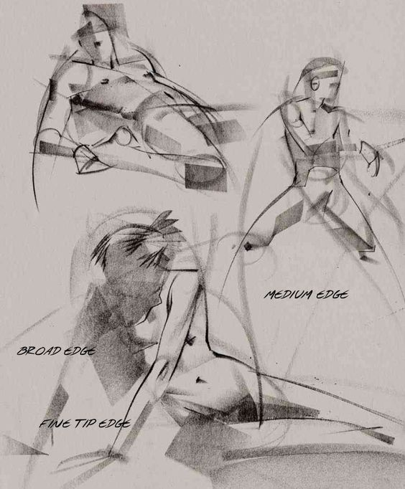
Posture Lines
15 mins
Posture Lines describe and record the angles across the body.
Use the side of your media and gestural marks to show the direction of the limbs and the position of the body.
Then, use the edge of your media to add detail.

Slide 6
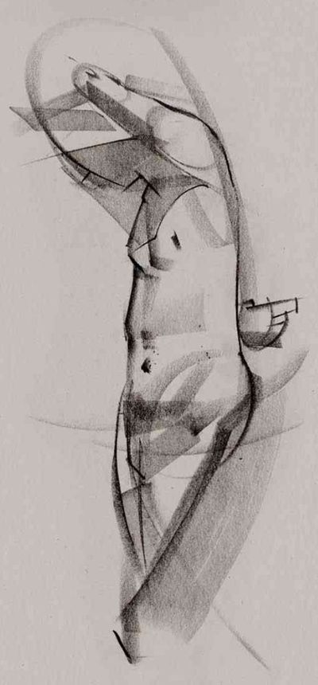
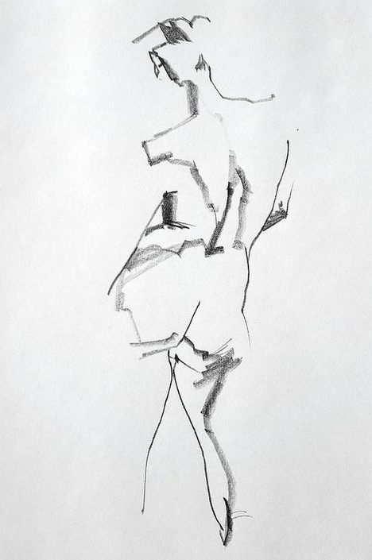
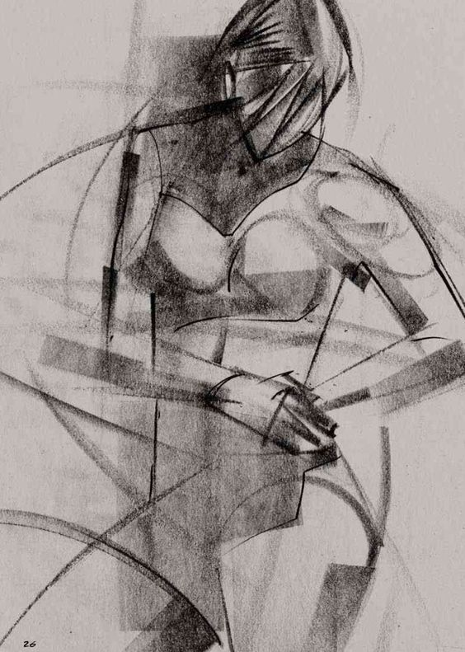
Let’s do that again…
15 mins
Drawing a centre line on your page and locating where this is on your model will help you.

Slide 7
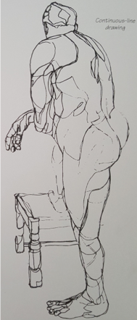
Contour Lines
Contour lines describe the form of the figure, the mass.
15 mins
Use the Continuous Line method to map the body.
Remember:
Look at the figure 99% of the time.
The line you draw on the paper mirrors wherever your eye travels over the figure.

Slide 8
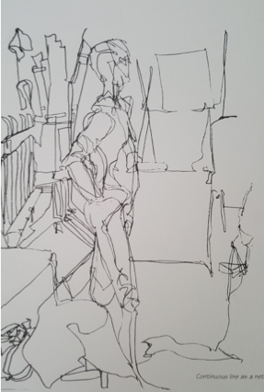
Continuous Line Drawing
30 mins
This time allow your continuous line to extend beyond the figure and include the objects in the room.
Tip:
Apply different pressures to allow for different qualities of line and tone.

Slide 9
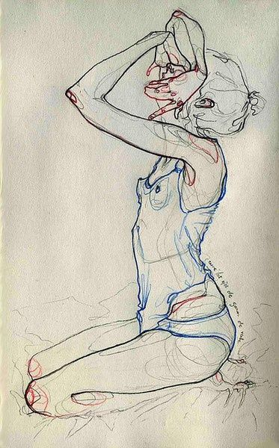
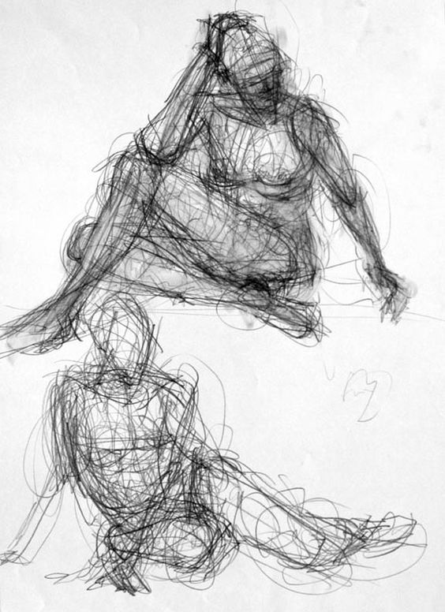
Here the Contour Lines have been ‘ghosted’ before the artist has emphasised the outline. The faint contour lines give the body mass.
Combine, gesture drawing, contour and posture lines to create a dense ‘net’.

