Slide 1
Life Drawing 4: Tone

Slide 2
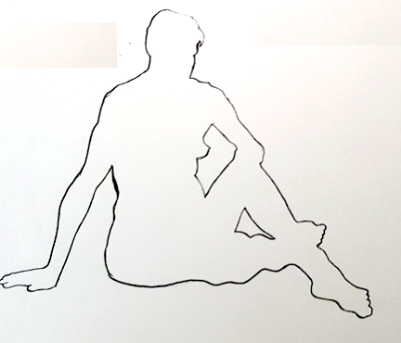
Warm up:
Silhouette Drawing
10 mins
Continuous line
Use the acetate grids to help you.

Slide 3
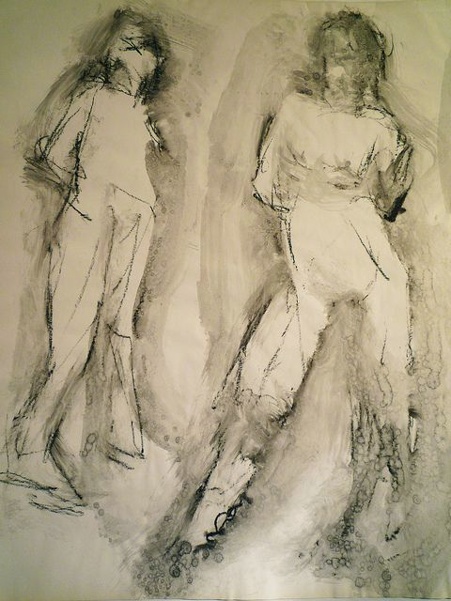
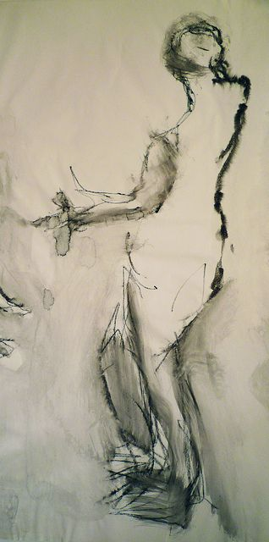
Let’s do that again…
15 mins
This time think about the quality of line and what happens outside the figure- the negative space.

Slide 4
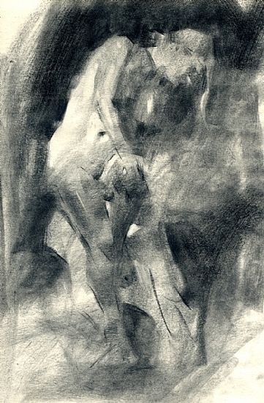
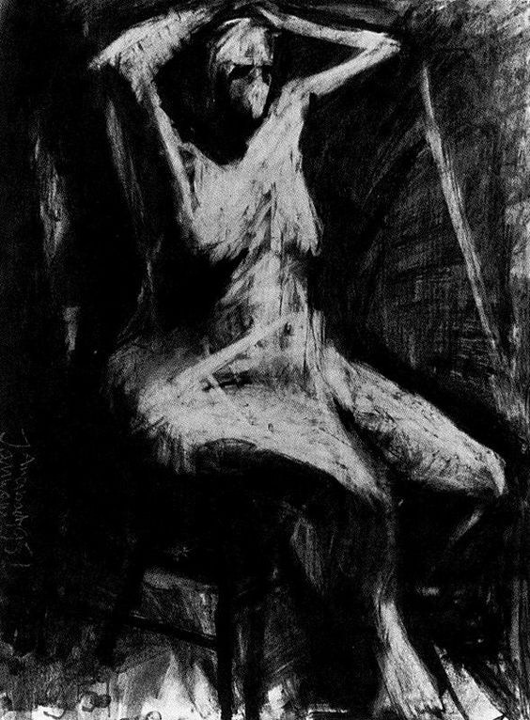
40 minute
Cover your paper in charcoal. Use the putty rubber to remove the charcoal to create different tones.

Slide 5
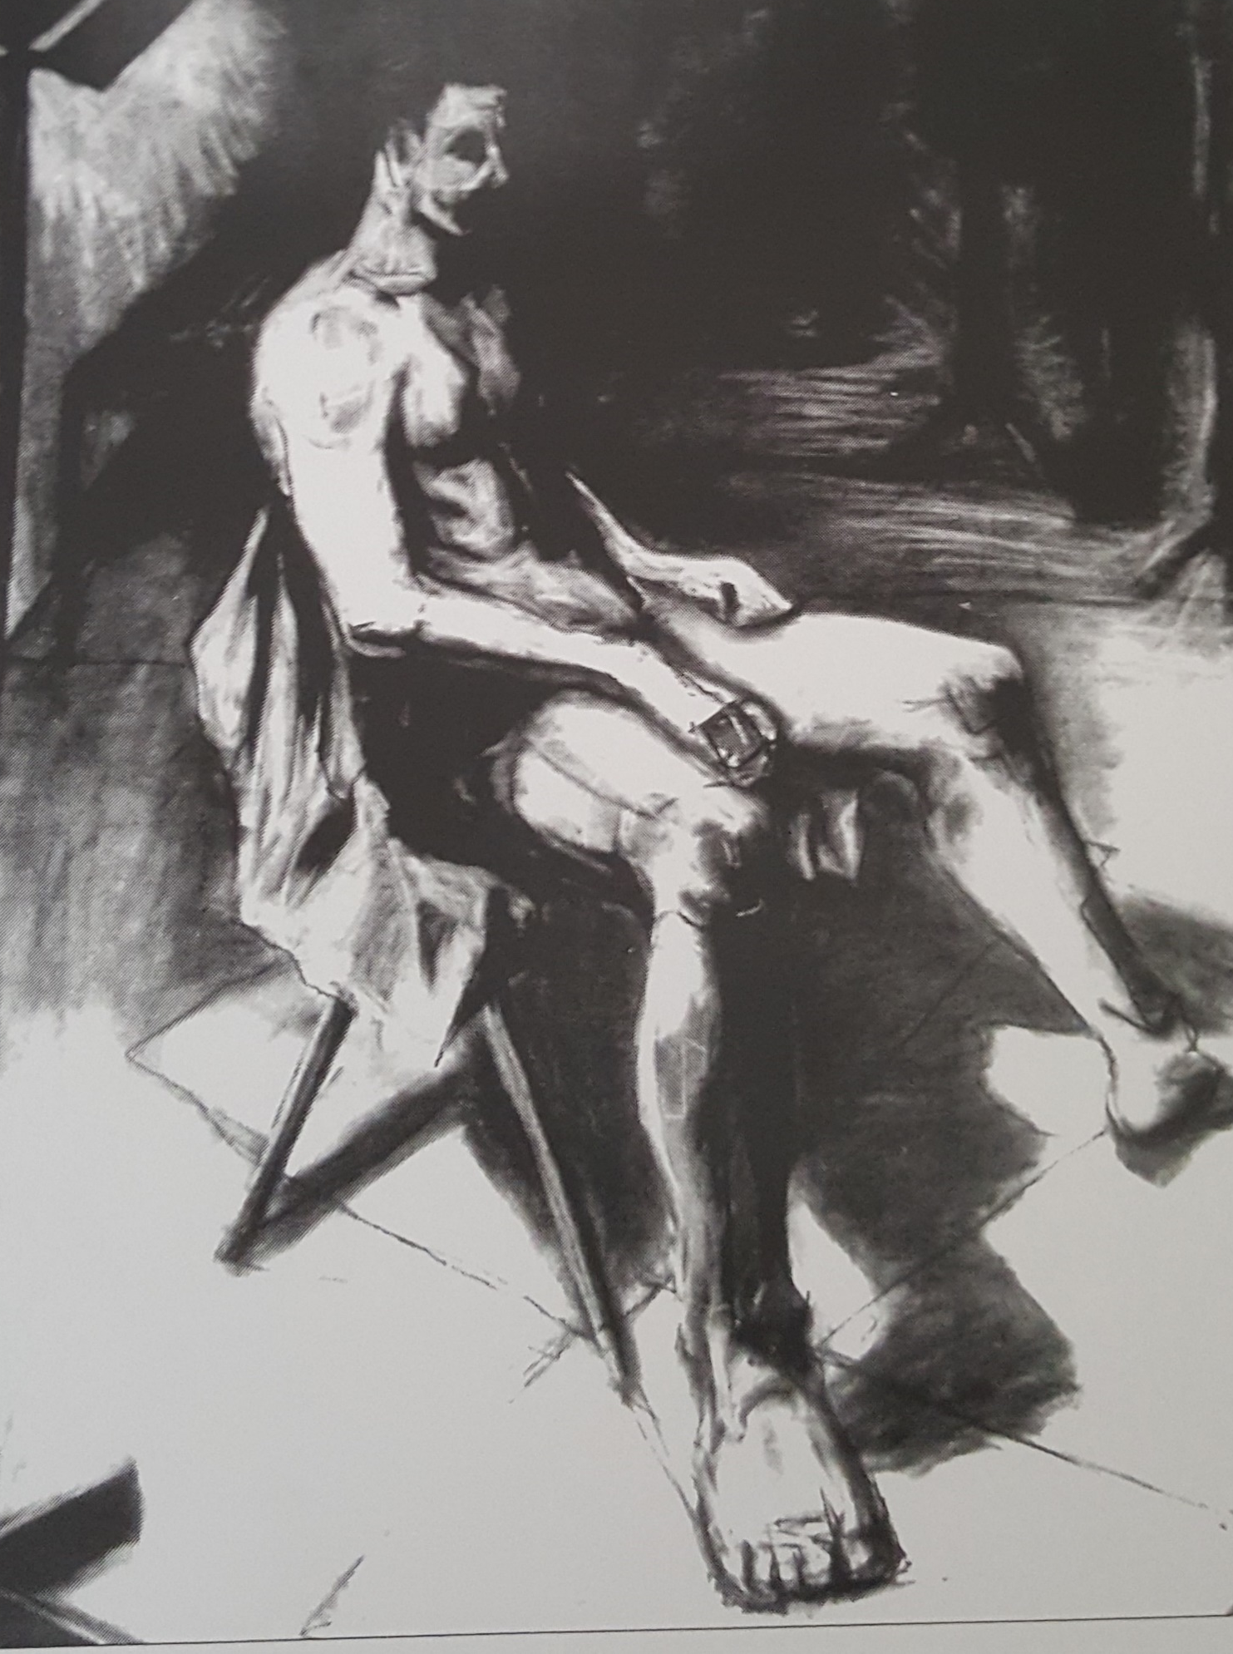
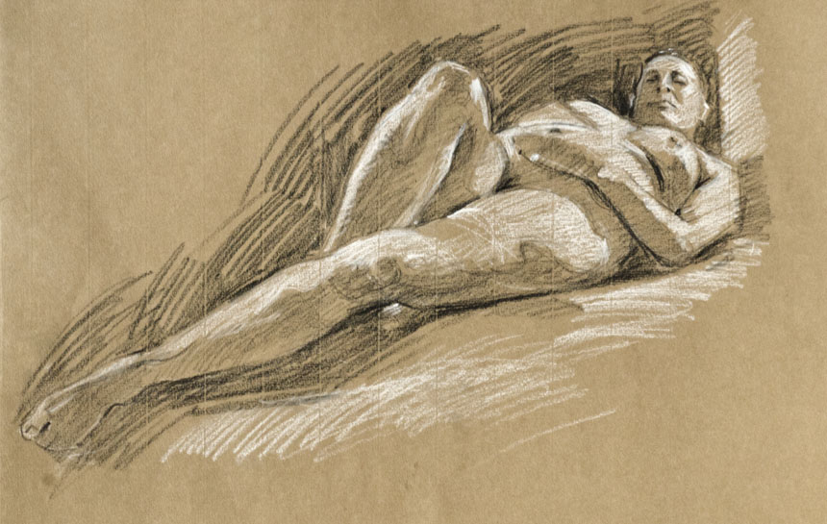
45 minute drawing
Use your understanding of measuring to mark out the figure but no outlines allowed.
Begin by blocking the lightest areas of tone, then the shapes of mid tone finishing with the darkest tones.
Only then should you add detail.

Slide 6
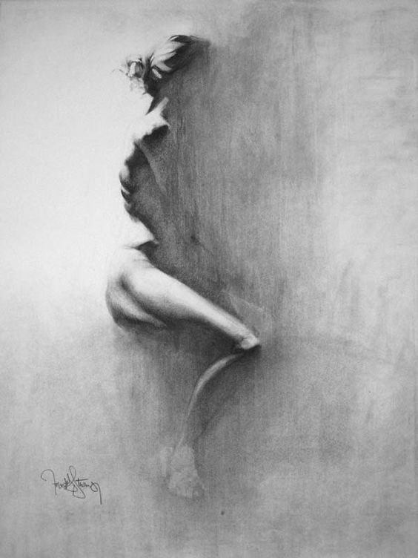
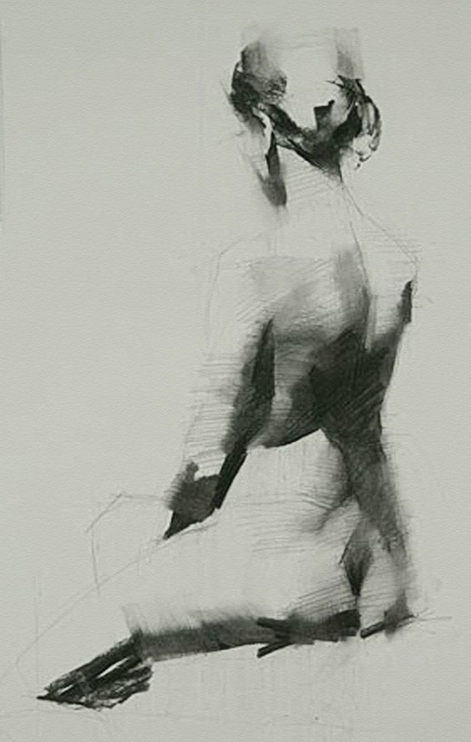
A couple of beautiful tonal drawings…..

