Slide 1
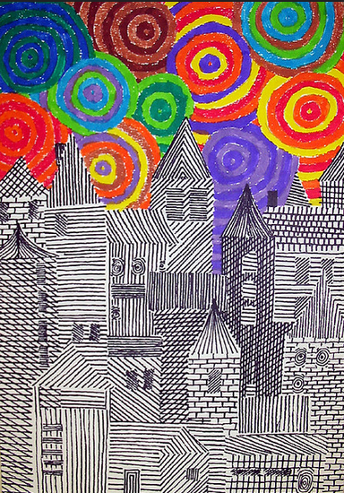
Cover lesson 2
Students should design a town of buildings inspired by the work of Hundertwasser.
The buildings should be shaded in with biro, pencil or black pen.
The sky must be filled with bright, Hundertwasser patterns.
Equipment: pencils, pens and colour crayons and rulers.
Materials: paper for those who do not have their sketchbooks.

